Slide 1

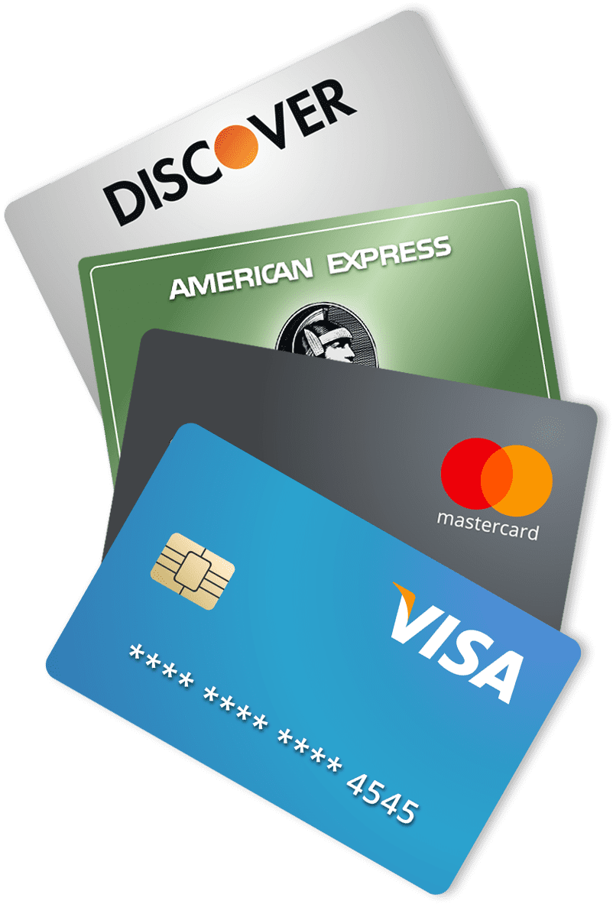
Card-Validator, Finance
Kushagra Shukla
IET LUCKNOW, B Tech CS III Year

Slide 2
Validation of Credit Card numbers
A web tool to validate the cc number to avoid fraudulent activities and unnecessary penetrations.
Category: Finance
This tool try to illustrate the following concepts in general.
Using fraud detection systems for finances
Build secure systems by using stronger encryption algorithms for online payments / transactions

Slide 3
Luhn Algorithim
Credit card numbers are generated according to certain rules. It gives merchants a way to verify the validity of a card number before accepting the customer's payment.
This sequence is decided by a famous algorithm known as Luhn’s algorithim. The four steps to validate a cc number is as shown:
Starting from the rightmost digit, double the value of every second digit.
If doubling of a number results in a two digit number i.e greater than 9 (e.g., 6 × 2 = 12), then add the digits of the product
Now take the sum of all the digits.
If the total modulo 10 is equal to 0 (if the total ends in zero) then the number is valid according to the Luhn formula; else it is not valid.

Slide 4

Impact
A web tool to validate the cc number to avoid fraudulent activities and unnecessary penetrations.
It is important to keep in mind that whenever fraudulent cards are used, the merchant loses if too many fraudulent transactions occur, you may incur higher processing fees, expensive chargebacks, or even losing your merchant account and your ability to do business.
We can mitigate these risks with the help of this tool !!

Slide 5

Technology Stack
HTML
CSS
Java script
Algorithm Implementation

Slide 6
Innovation
This tool is quite amazing and the frontend is designed in an innovative way such that while the user is entering the cc number, the tool will quickly recognize the card type and will glow up with green shade if the card is valid else glow up with red shade.
It can be helpful to merchants to avoid unnecessary transaction by users to keep there server robust and efficient all the time.
It can be used by website owner to stop penetrations activities and any such hacks that may slow down the server.

Slide 7
Feasibility
This tool is quite flexible and easy to use for end users, moreover e-merchants can also use this by establishing a web-crawling or scraping script to validate the credit card number.
It is light weight tool without any extra or heavy dependencies
The tool don’t collect any personal data or credit number hence one can freely enter to test/validate the card.

Slide 8
Challenges
This tool can be extended with further supports that may control fraudulent activities in finance.
We can optimize this tool to validate cc number which are greater than 16 digits.
Robust and better frontend design.
Support for backend and

Slide 9
Refrences
https://www.creditcardinsider.com/learn/anatomy-of-a-credit-card/#credit-card-number
https://en.wikipedia.org/wiki/Luhn_algorithm
https://www.geeksforgeeks.org/luhn-algorithm/

Slide 10
THANK-YOU
^_^
Check out cc-validator

