Slide 1
From Articial Narrow Intelligence to Artificial Super Intelligence

Slide 2
Topics
ANI vs. AGI vs. ASI
Timeline
Paths to superintelligence
Friendly AI
Intelligence explosion
Decisive strategic advantage
Sources

Slide 3
ANI vs. AGI vs. ASI
What is?
Artificial Narrow Intelligence
games, virtual assistants, smart cars, purchase forecasts, …
Artificial General Intelligence
Human level intelligence
Artificial Super Intelligence
Notes:
ANI
Weak AI
Defined as specific type AI that is better at a human in a narrow described task.
AGI
Strong AI
Human level intelligence
Applicable to more than one situation or context.
The ability to solve problems, learn, and take effective, human like action, in a variety of environments
ASI
An intellect that is much smarter than the best human brains in practically every field incl. Scientific creativity, general wisdom and social skills.
Still hypotetical.

Slide 4
Timeline
James Barrat
When?
10% chance AGI before 2028
50% chance AGI before 2050
90% chance AGI before the end of the century
Notes:
Professionals in AI-related fields
- engineering
- robotics
- neuroscience

Slide 5

Friendly AI
Eliezer Yudkowski
An AI that has a positive rather, than a negative impact on mankind.
Not knowing how to build a friendly AI is not deadly, of itself. …It’s the mistaken belief than an AI will be friendly which implies an obvious path to global catastrophe.
Calling telephone analogy
Notes:
Eliezer Yudkowski creator of term
The Friendly AI is the kind that will preserve humanity an our values forever.
Friendliness should be designed in from the start, but designers should recognize both that their own designs may be flawed, and that the robot will learn and evolve over time. Challenge is one of mechanism design—to define a mechanism for evolving AI systems under a system of checks and balances, and to give the systems utility functions that will remain friendly in the face of such changes.
We’re building a machine that’ll excel in problem solving, learning, adaptive behavior, and commonsense knowledge. We’ll think it’s humanlike. But that will be a tragic mistake.
If programmers are less than overwhelmingly competent about how they construct the AI then Eliezer expects to get something very alien.
Just like dialing nin-tenths of my phone number correctly does not connect you to someone who is 90% similar to me. If you are trying to construct the whole AI system and you get is 90% rigth, the result is not 90% good, it’s 100% bad.
Blissfull AI makers
The AI should be neither hostile nor ambivalent toward humans, forever, no matter what its goals are or how many self-improving iterations it goes trough.

Slide 6
Paths to superintelligence
AI
Whole brain emulation
Biological cognition
Brain-computer interfaces
Networks and organizations
Notes:
The existence of multiple paths increases the probability that the destination can be reached by at leat one of them

Slide 7
AI
Turing Test
Trial and error
We know that blind evolutionary processes can produce human-level general intelligence, since they have already done so at least once
Seed AI capable of improving own architecture
Recursive self improvement
Need not much resemble human mind
Notes:
AI:
Turing Test:
Learning as a means to bootstrapping a simpler system to human-level intelligence.
Seed AI that is capable of improving its own architecture:
In first stages improvements can be made by:
Trial and error
Information acquisition
Assistence from the programmers
At later stages, the seed AI should be able to understand its own workings sufficiently to engineer new algorithms and computational structures to bootstrap its cognitive performance.
This artificial intelligence need not much resemble a human mind.

Slide 8
Whole brain emulation
Intelligent software by scanning en closely modeling the computational structure of biological brain
Scanning
Translation
Simulation
Notes:
Intelligent software produced by scanning and closely modeling the computational structure of a biological brain.
Scanning:
High-throughput microscopy with sufficient resolution and detection of relevant properties.
Translation:
Automated image analysis to turn raw scanning data into an interpreted three-dimensional model of relevant neurocomputational elements
Simulation:
Hardware powerful enough to implement the resultant computational structures.
Relies less on theoretical insight and more on technological capability than artificial intelligence

Slide 9
Biological Cognition
(Selective breeding)
Biotechnology will allow much more direct control of human genetics and neurobiology
Embryo selection
Human reproductive cloning
Notes:
Enhance the functioning of biological brains.
In principle it can be achieved without technology, but trough selective breeding. Would be confronted by political and moral hurdles.
Biotechnology will allow much more direct control of human genetics and neurobiology.
Embryo selection
Selection of embryos or gametes before implantation.
The range of traits that can be selected from will expand greatly
A strong driver of progress in behavioral genetics is the rpaidly falling cost of genotyping and gene sequencing.
Iterated embryo selection does not require a deep understanding of the causal pathways by which genes, in complicated interplay with environments, produce phenotypes:
It only needs (lots of) data on the genetic correlates of the traits of interest.
Your child vs others. You don’t want to fall behind.
Human reproductive cloning:
Replicate genome of exceptionally talented people

Slide 10



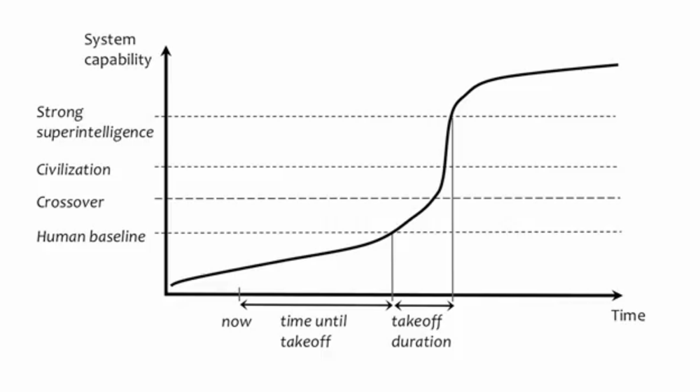
Intelligence explosion
What is it?
Why is it important?
I.J Good ~ Alan Turing
Notes:
Moore’s law says that transistors in a chip double at least every two years, so there is no limit
Crossover:

Slide 11
Slow takeoff
Long temporal interval (decades, centuries)
Opportunities for political processes to adapt
Better solutions would gradually become visible
Notes:
New people can get trained
Campains of people or groups that feel mishandled by this new technology

Slide 12
Fast takeoff
Short temporal interval (minutes, hours, days)
Nobody need even notice anything unusual before the game is already lost.
Humanity’s fate depends on preparations previously put in place.

Slide 13
Moderate takeoff
Intermediary temporal interval (months, years)
Some chance for humans to respond, but not much time to
Analyze situation
Test different approaches
Solve complicated coordination problems

Slide 14
Decisive strategic advantage
One or many ASI’s?
Might an intelligence explosion propel one project so far ahead of all others as to make it able to dictate the future?
Cyclists analogy
Notes:
If the takeoff is fast – then it is unlikely that two independent projects would be taking off. The first project will have completed its takeoff before any other project would have started its own.
If takeoff is slow – plausibly multiple projects. Multiple projects undergoing takeoffs concurrently, no time at which any project was far ahead of the others to give it an overwhelming lead.
Moderate – in between
A frontrunner might find it difficult to gain and maintain a large lead if followers can easily copy the frontrunner’s ideas and innovations. Imitation creates a headwind that disadvantages the leader and benefits laggards.
Just as with cyclist who falls too far behind the competition is no longer shielder from the wind by the cyclists ahead, so a technology follower who lags sufficiently behind the cutting edge might find it hard to assimilate the advances being made at the frontier. The gap in understanding and capability might have grown too large.
It appears that lags in the range of a few months to a few years are typical of strategically significant technology projects.
It is possible that different projects takeoff in tandem, but how many projects emerge on the yonder side sufficiently tightly clustered in capability that none of them has a strategic advantage?
If a frontrunner attains strong superintelligence three months before the following one that gets to the crossoverpoint. It has a strategic advantage an can parlay its lead into permanent control by disabling the rest.

Slide 15
Utopia vs dystopia
Our final invention vs. The Singularity is near
Notes:
A singular period in time (around 2045) after which the pace of technological change wil irreversibly transform human life. The singularity will jump-start a new era in mankind’s history in which most of our problems, such as hunger, disease, even mortality will be solved.
Based more innovations around nanotechnology than AI.
Perhaps tech thinkers have considered AI’s downside but believe it’s too unlikely to worry about. Or they get it, but think they can’t do anything to change it.
Kurzweil argues that the actual danges of AI cannot be seen from here. In other words, if you are living in the horse-and-buggy age, it’s impossible to anticipate how to steer an automobile over icy roads. We’ll figure it out when we get there..

Slide 16
Sources
Superintelligence – Nick Bostrom
Our Final Invention – James Barrat
The Singularity Is Near – Ray Kurzweil
Notes:
A singular period in time (around 2045) after which the pace of technological change wil irreversibly transform human life. The singularity will jump-start a new era in mankind’s history in which most of our problems, such as hunger, disease, even mortality will be solved.
Based more innovations around nanotechnology than AI.

Slide 17
“The AI does not hate you, nor does it love you, but you are made out of atoms which it can use for something else.” ~ Elizer Yudkowsky, MIRI
Questions?

