Slide 1


Azure Data Explorer
Kusto Emulator
#365DaysofADX
aka.ms/ADX.365
Day 25/365

Slide 2
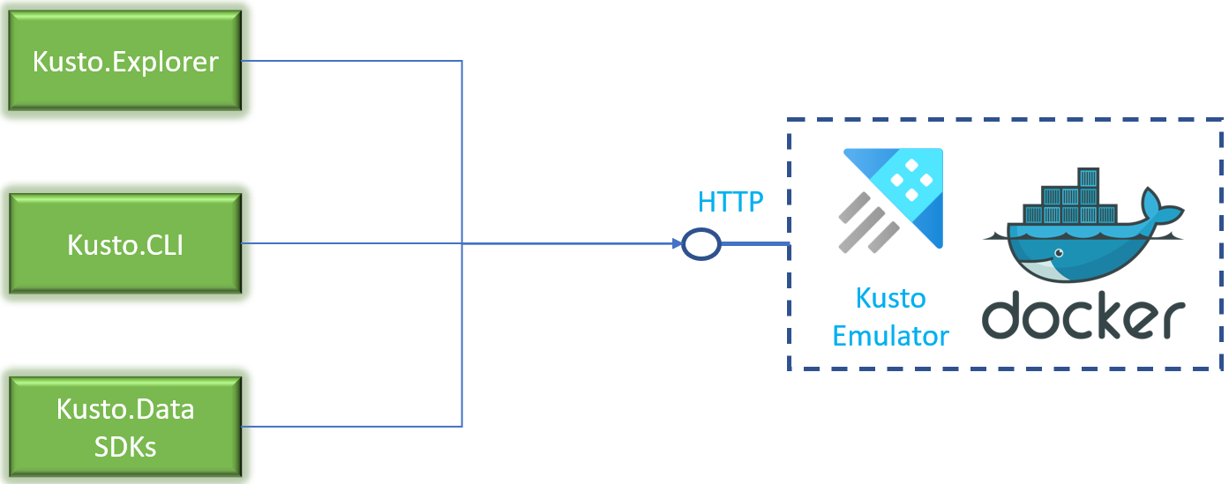
Azure Data Explorer
Kusto Emulator
The Kusto emulator is a local environment that encapsulates the Kusto Query Engine.
You can use the environment to facilitate local development and automated testing.
Since the environment runs locally, it doesn't require provisioning Azure services or incurring any cost.
Free offering under the Microsoft Software License Terms.
#365DaysofADX
aka.ms/ADX.365
Day 25/365

Slide 3
Kusto Detective Agency
Azure Data Explorer

