Slide 1

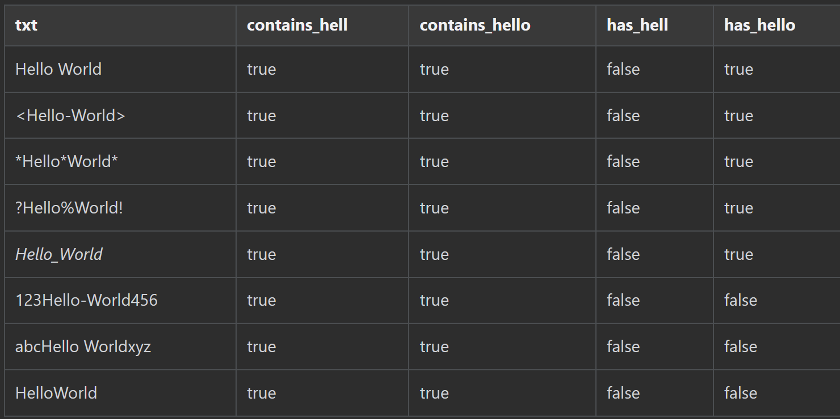
Azure Data Explorer
Contains vs Has Operator
Contains searches for characters rather than terms of three or more characters. The query scans the values in the column.
Has searches for indexed terms, where a term is three or more characters else it scans the values in the column.
Contains will always return true if the searched string exists within the searched text.
Has result depends on the surrounding of the searched string within the searched text.
Has uses index for terms and therefore can be more performant compared to data scan.
#365DaysofADX
aka.ms/ADX.365
Day 23/365

