Slide 1





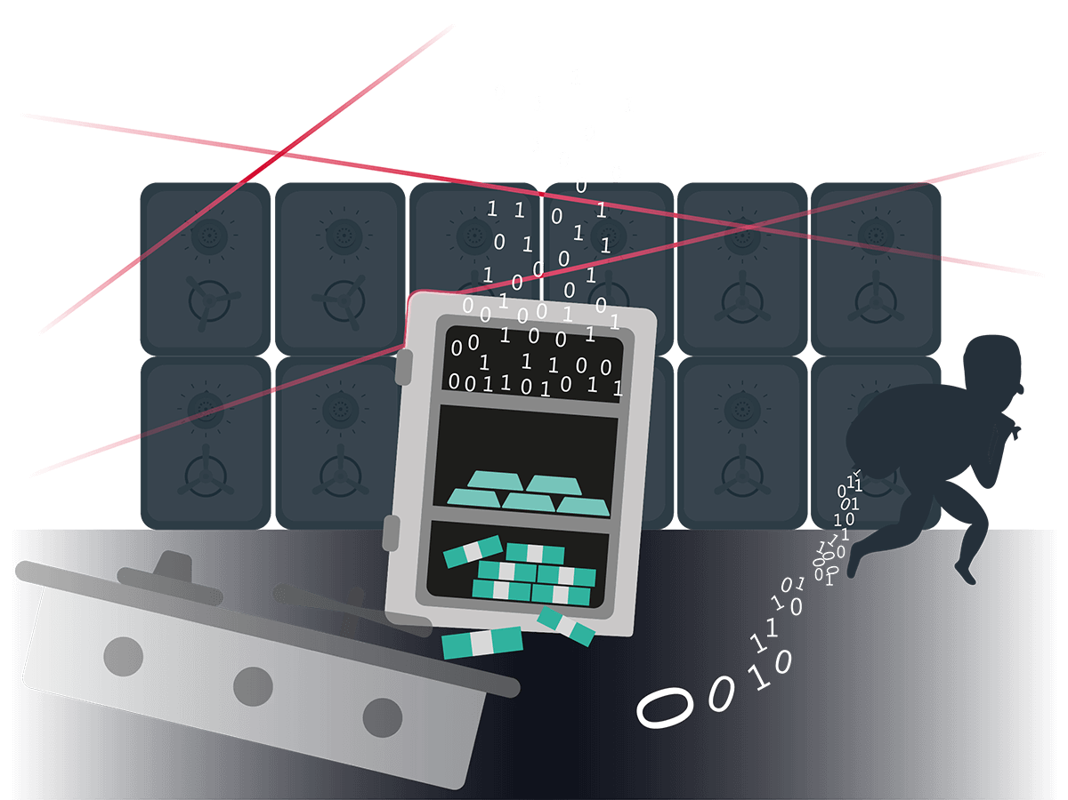
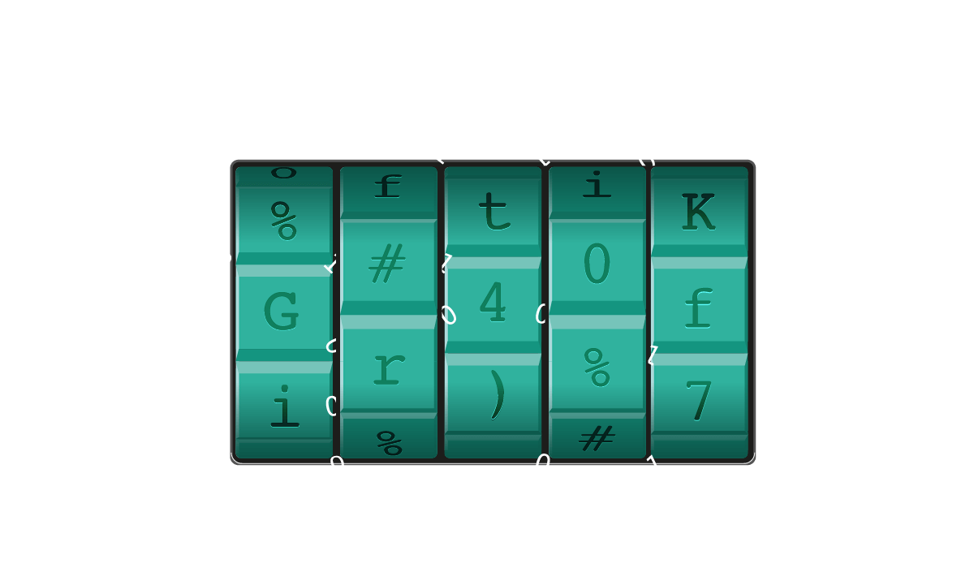
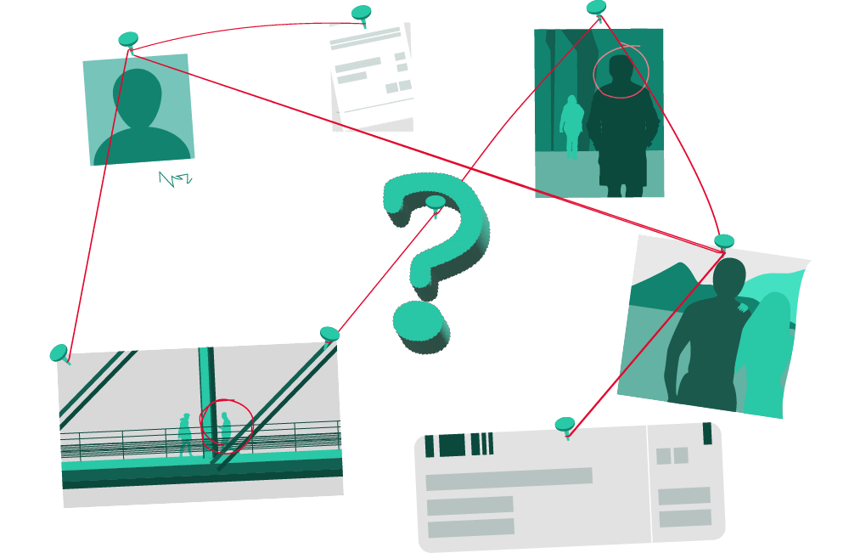
Azure Data Explorer
Kusto Detective Agency
Gamified way of Learning ADX and KQL.
Set of five challenges to solve using KQL.
Challenges as cases that need investigation.
Win Credly badges for solving each case.
#365DaysofADX
aka.ms/ADX.365
Day 24/365

Slide 2
Azure Data Explorer
Kusto Detective Agency
Gamified way of Learning ADX and KQL.
Set of five challenges to solve using KQL.
Challenges as cases that need investigation.
Win Credly badges for solving each case.
Want to become a detective,
And learn KQL at the same time?
#365DaysofADX
aka.ms/ADX.365
Day 24/365

Slide 3
Azure Data Explorer
Kusto Detective Agency
Gamified way of Learning ADX and KQL.
Set of five challenges to solve using KQL.
Challenges as cases that need investigation.
Win Credly badges for solving each case.
Join Kusto Detective Agency at
detective.kusto.io
#365DaysofADX
aka.ms/ADX.365
Day 24/365

Slide 4






Azure Data Explorer
Kusto Detective Agency
Gamified way of Learning ADX and KQL.
Set of five challenges to solve using KQL.
Challenges as cases that need investigation.
Win Credly badges for solving each case.
#365DaysofADX
aka.ms/ADX.365
Day 24/365

Slide 5
Azure Data Explorer
Kusto Detective Agency
Gamified way of Learning ADX and KQL.
Set of five challenges to solve using KQL.
Challenges as cases that need investigation.
Win Credly badges for solving each case.
Win badges on completion of each Detective Case.
#365DaysofADX
aka.ms/ADX.365
Day 24/365

Slide 6
Kusto Detective Agency
Azure Data Explorer

