Slide 1

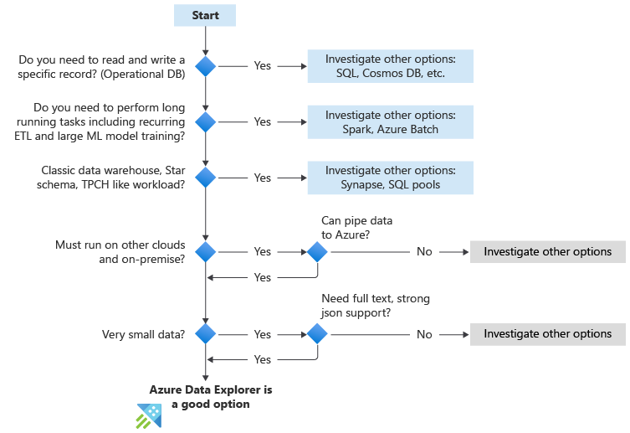
Azure Data Explorer
14/365
#365daysofADX [aka.ms/ADX.365]
When to use Azure Data Explorer?
The below flowchart summarizes the key questions to ask when you're considering using Azure Data Explorer.

