Slide 1
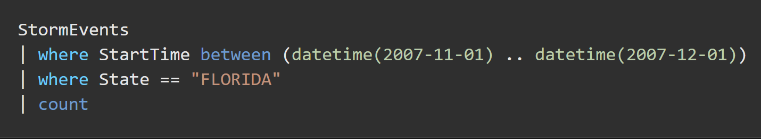
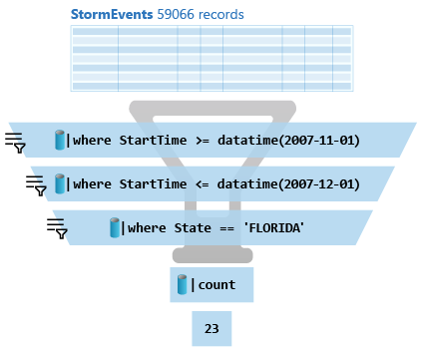

15/365
What is a Tabular Statement?
Azure Data Explorer
#365DaysofADX
aka.ms/ADX.365

