Slide 1

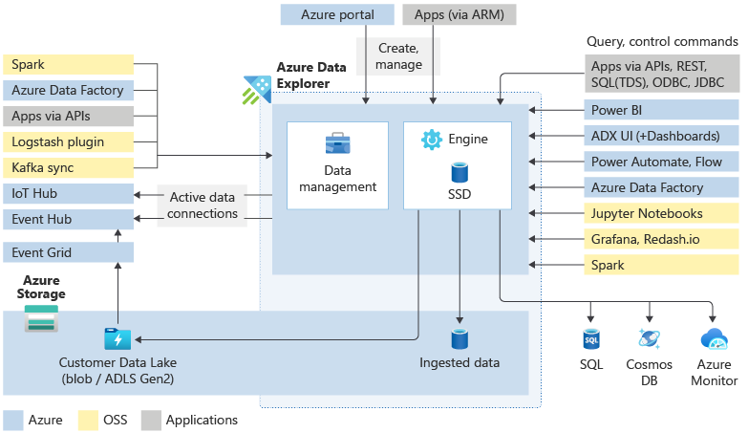
Azure Data Explorer
12/365
#365daysofADX [aka.ms/ADX.365]
Ecosystem: Major Components
An ADX common workflow includes data ingestion, Storage + Retrieval using Kusto Query Language, and data visualization. ADX integrates with a large suite of Azure, OSS and Applications via connectors and SDKs.

