Slide 1

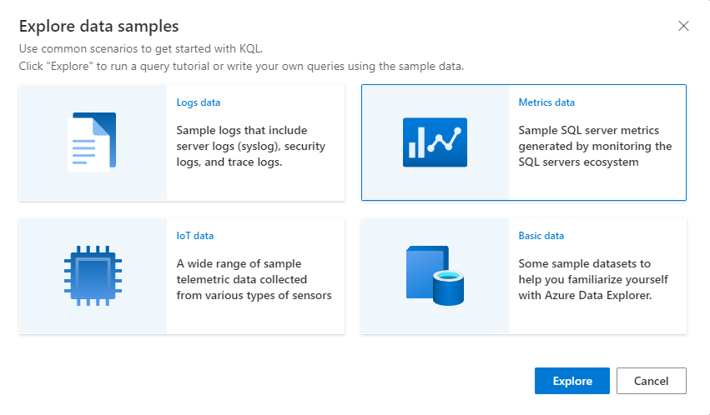
Azure Data Explorer
11/365
#365daysofADX [aka.ms/ADX.365]
Sample Gallery (Help Cluster)
Provides an easy way to experience Azure Data Explorer and learn about Kusto Query Language (KQL) commands, queries, and built-in dashboards using sample data in a free, publicly available help cluster.

