Slide 1

Bestseller Books data Analysis
Analyzing the Various Features on Best seller books
By
Kusuma sareddy

Slide 2
Introduction:
In this project, we conducted a comprehensive data analysis on book-related information sourced from the Bookswagon website. The process began with collecting raw data, which was then cleaned and manipulated to ensure accuracy and consistency. After preparing the dataset, we performed various analyses to uncover trends in book genres, ratings, pricing, and publication years. Through visualization techniques, we highlighted key insights, such as the most popular genres, price distributions, and the relationship between ratings and prices. The project ultimately demonstrates the value of data-driven insights in understanding patterns in the online book market.
Problem statements:
To analyze Bestseller books-related data, identifying patterns and trends in genres, ratings, prices, and publication years.
Top selling books based on maximum rating and high cost.
Examine how the number of pages and the cost of books influence their status as bestsellers.

Slide 3
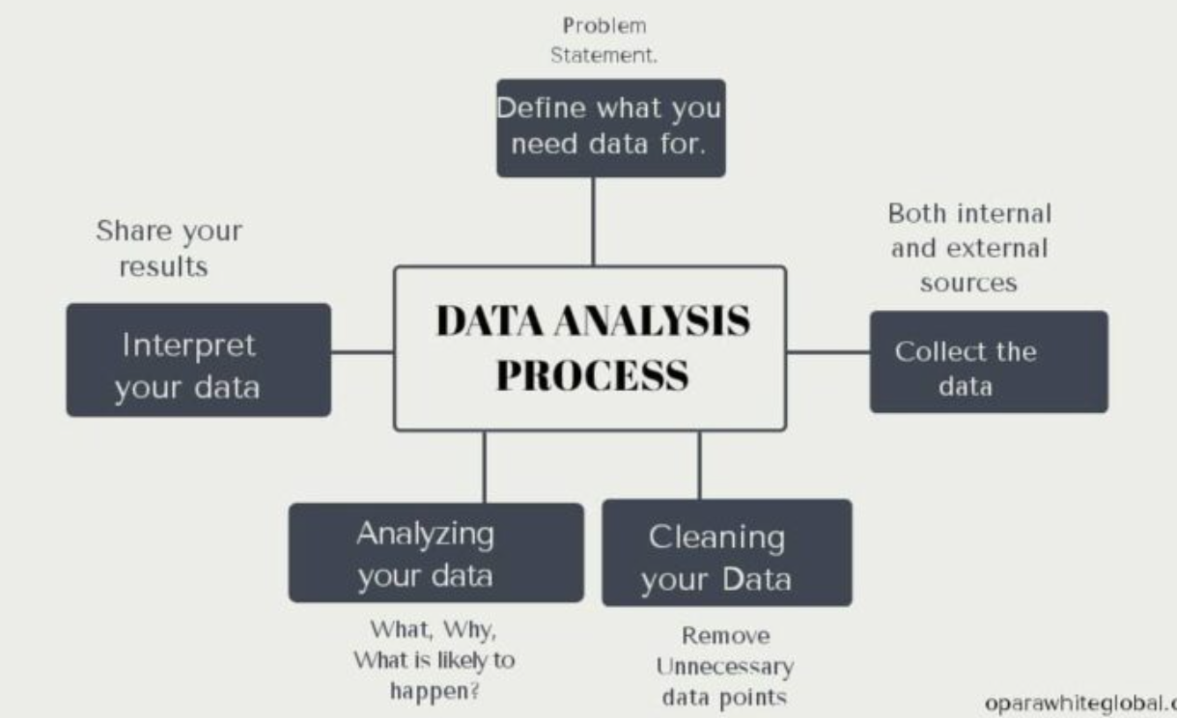
Contents
Introduction
Problem statement
Data Collection
Libraries used
Data cleaning
Data analysis
Data Visualization
Conclusion

Slide 4
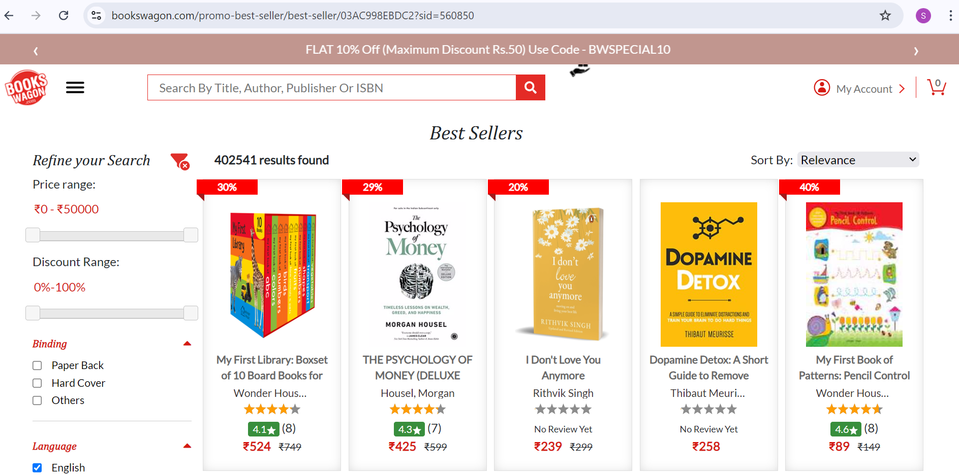
Website used for scrapping the data
Url: https://www.bookswagon.com/best-seller

Slide 5

Tools (Libraries) used:
Python
Numpy
Pandas
re (regular expression)
BeautifulSoup
Selenium
Matplotlib
Seaborn

Slide 6
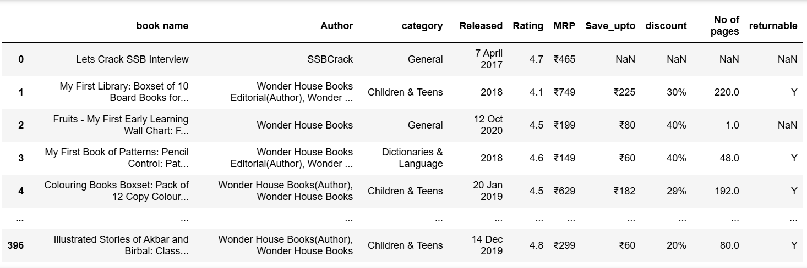
Raw data from the website

Slide 7
Data Cleaning and Data Manipulation Steps:
Identify Missing Values
Handle Missing Values
Correct Data Types
Standardize Values
Identify and Handle Outliers
Identify Duplicates values

Slide 8
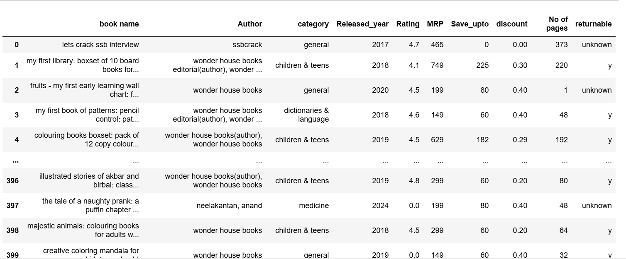
Cleaned data

Slide 9
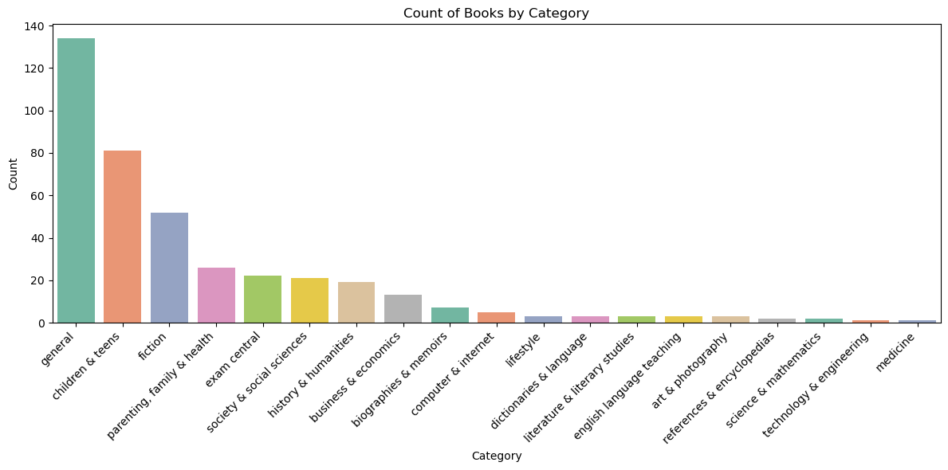
Book Categories: A Visual Overview
There are 19 distinct book categories represented in the dataset.
Notably, the majority of bestselling books belong to the general category, highlighting its popularity among readers.

Slide 10
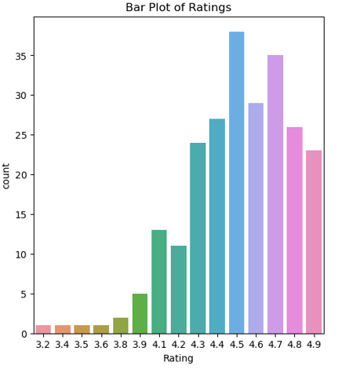
Books Grouped by Rating: Bar Chart Analysis
The highest rating recorded is 4.9, which was given by 23 members.
The most frequently awarded rating is 4.5, with 38 members rating at this level.

Slide 11
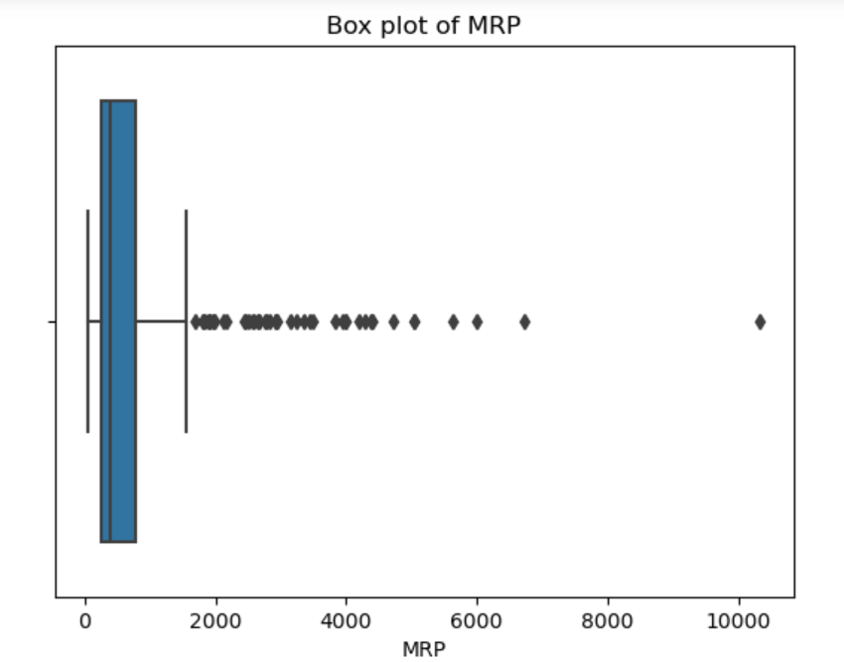
Analysis on MRP
Outliers >2000
Highest cost book in bestsellers is encyclopedia general science (e)(paperback)

Slide 12
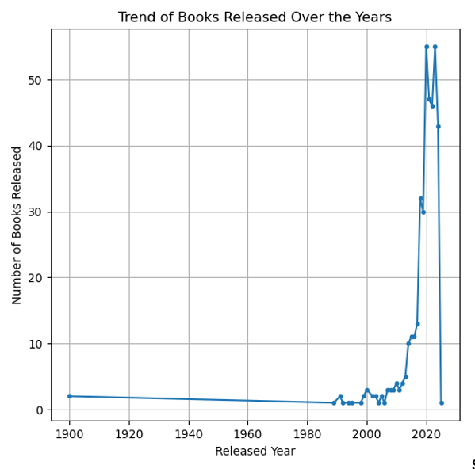
Analysing Book Released by Year
Most books were released in the years 2020 and 2023.

Slide 13
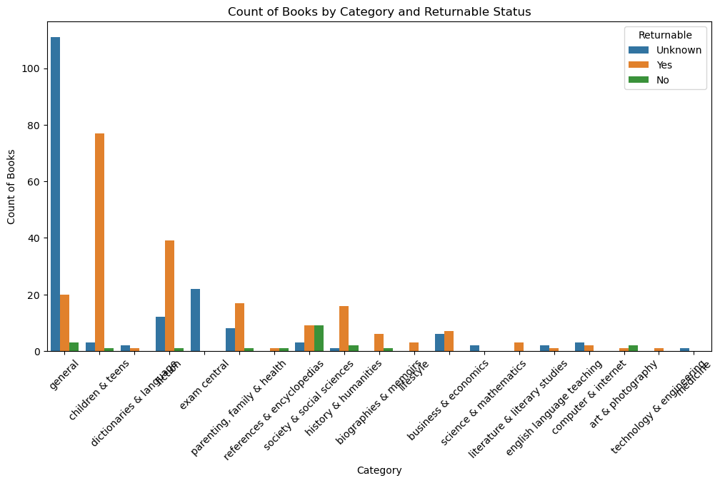
Books in the Children and Teens categories have a higher count of returnable items.
In the General category, a significant number of books have an unknown returnable status.

Slide 14
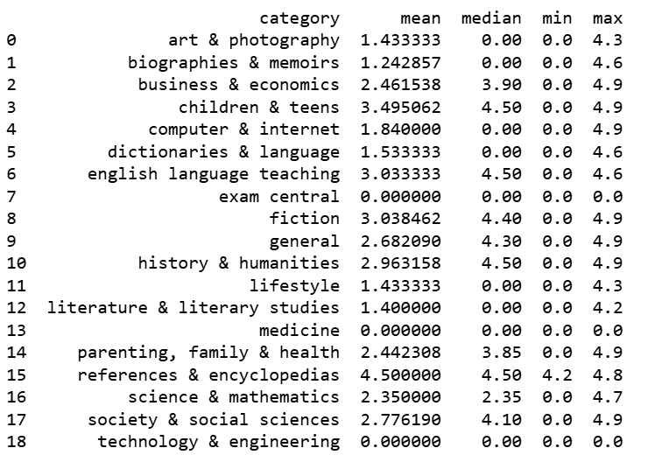
Category and Rating Analysis

Slide 15
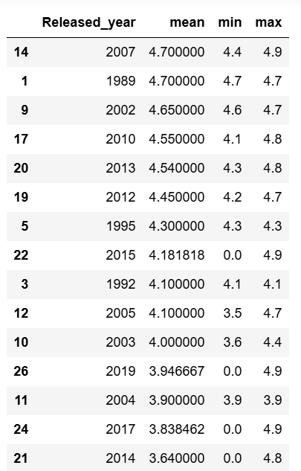
Released Year and Ratings Analysis
In 2007, we observed the highest average rating based on the analysis conducted.

Slide 16
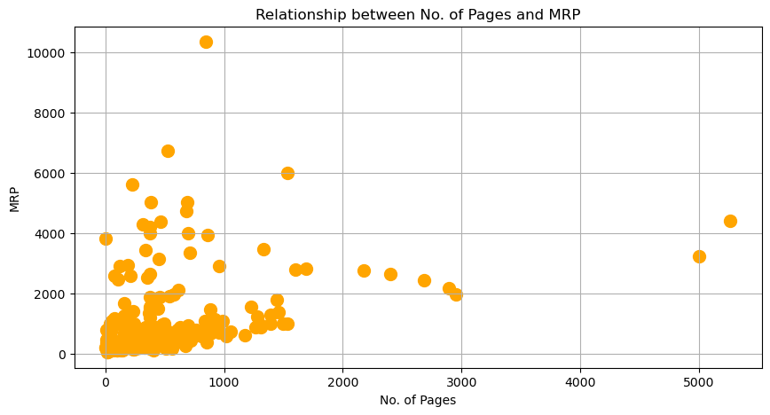

Slide 17
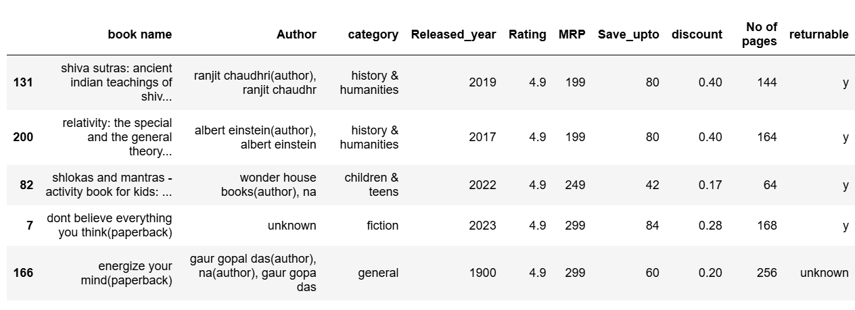
Top selling books based on maximum rating and high cost

Slide 18
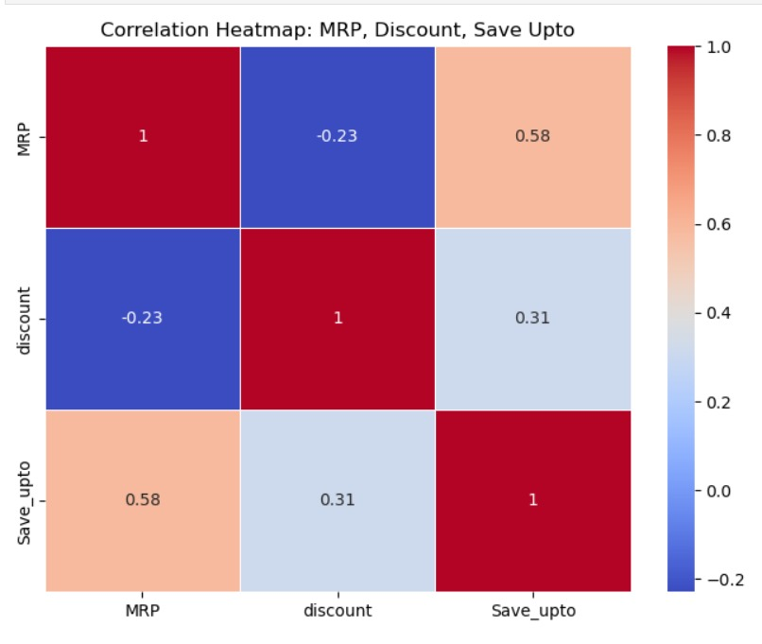
When the cost increases, both the discount and Save Up To amounts decrease.
As the discount increases, the Save Up To value also increases.

Slide 19
Conclusion
Most books were released in the years 2020 and 2023.
Most bookselling categories are General and children and teens.
No of pages increase then cost of the book is also increases.
highest mean rating in the year of 2007 and highest mean rating for category references and encyclopedias.
Books in the Children and Teens categories have a higher count of returnable items.
Discounts and Save Up To amounts can significantly affect the MRP.
When the cost decreases, both the discount and Save Up To amounts increases.

Slide 20

THANK YOU

