Slide 1
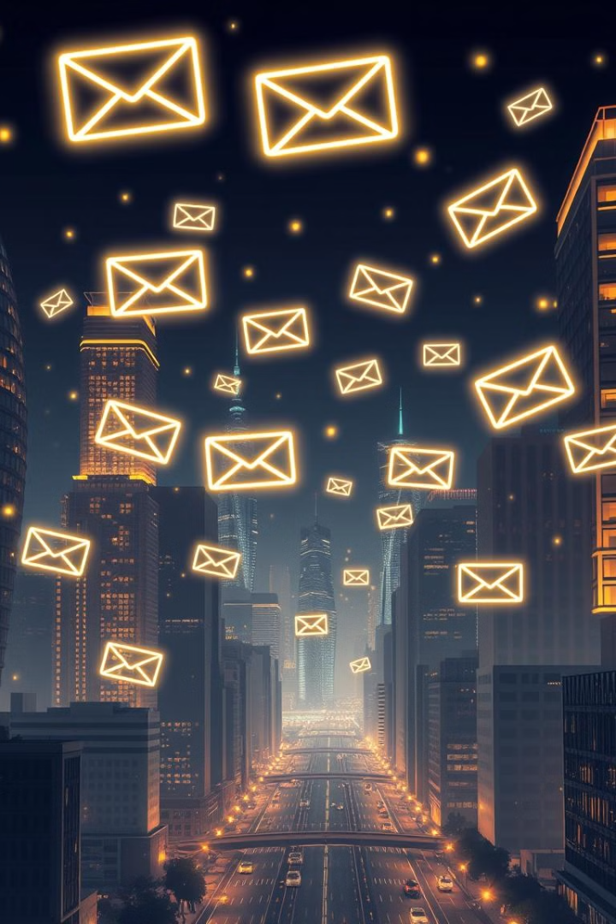
AI Personalized Email Generator
Discover how to revolutionize your email marketing. Learn to create personalized emails at scale. Boost engagement and drive conversions with AI.SSS

Slide 2
What is an AI Personalized Email Generator?
Definition
Function
An AI Personalized Email Generator uses artificial intelligence.
It analyzes data. This includes past interactions and preferences.
It crafts tailored emails. These emails resonate with individual recipients.
It generates unique content. This increases open rates and clicks.

Slide 3

Benefits of using an AI Email Generator
1
Increased Engagement
2
Improved Conversion Rates
Personalized emails capture attention. They foster stronger connections.
Tailored content drives action. This results in higher sales.
3
Time Savings
Automate email creation. Focus on strategy and analysis.

Slide 4
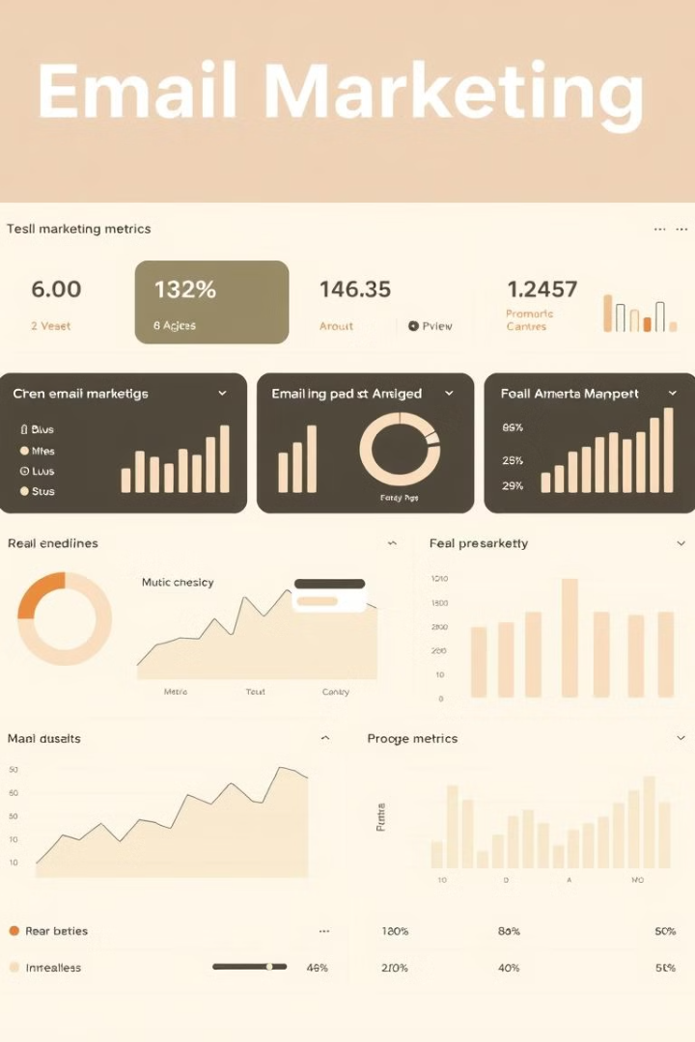



Key Features of an AI Email Generator
Segmentation
Content Creation
Analytics
Group contacts based on criteria. Send relevant messages.
Track performance. Refine your email campaigns.
Generate email copy. Adjust tone and style.

Slide 5





How does an AI Email Generator work?
Data Input
Feed the AI with customer data. Include preferences and behavior.
Analysis
The AI analyzes the data. It identifies patterns and insights.
Generation
The AI creates personalized emails. It tailors the content to each recipient.
Delivery
Send emails at optimal times. Maximize engagement.

Slide 6
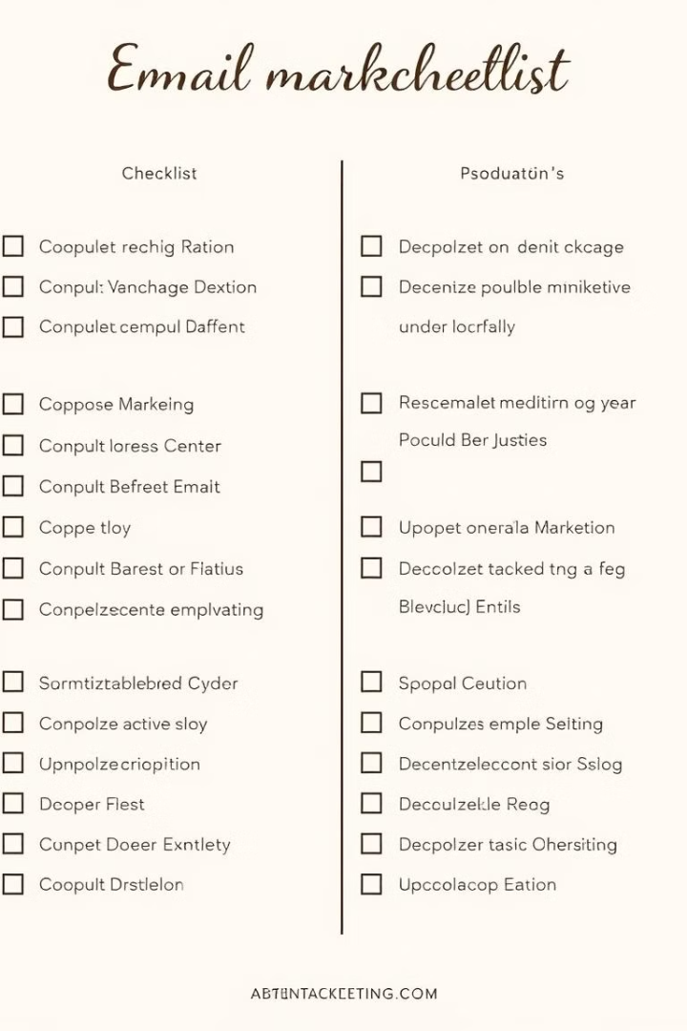
Best Practices for using an AI Email Generator
Define Goals
Quality Data
Set clear objectives. What do you want to achieve?
Ensure accurate data. AI needs good input.
Test and Refine
Continuously test emails. Improve based on results.

Slide 7




Personalizing emails with AI
Subject Lines
1
Body Content
2
4
Call to action
3
Offers
Use AI to tailor different aspects of your emails. Start with subject lines. Adapt body content and offers. Personalize the call to action.

Slide 8



The future of AI-powered email generation
1
Enhanced Personalization
2
Predictive Analytics
3
Automation
AI will deeply personalize emails. It will anticipate customer needs. The future of email is automated and intelligent.

