Slide 1

MALLAREDDY COLLEGE OF ENGINEERING

Slide 2
Alzheimer Disease Prediction using
Machine Learning Algorithms

Slide 3
OBJECTIVE:
To developed and implement a Machine learning approaches that characterizes the features of the Alzheimer , and proposes a Alzheimer processing model, from the machine learning perspective using Naive Bayes Classification and Random forest.

Slide 4
ABSTRACT:
Alzheimer disease is the one amongst neurodegenerative disorders. Though the symptoms are benign initially, they become more severe over time. Alzheimer's disease is a prevalent sort of dementia. This disease is challenging one because there is no treatment for the disease. Diagnosis of the disease is done but that too at the later stage only. Thus if the disease is predicted earlier, the progression or the symptoms of the disease can be slow down. This paper uses machine learning algorithms to predict the Alzheimer disease using psychological parameters like age, number of visit, MMSE and education.

Slide 5
INTRODUCTION:
Alzheimer disease is caused by both genetic and environmental factors, those affects the brain of a person over time. The genetic changes guarantee a person will develop this disease.
This disease breaks the brain tissue over time. It occurs to people over age 65. However people live with this disease for about 9 years and about 1 among 8 people of age 65 and over have this disease.

Slide 6
INTRODUCTION:
MMSE (Mini Mental State Examination) score is the main parameter used for prediction of the disease. This score reduces periodically if the person is affected. Those people having MCI have a serious risk of growing dementia. When the fundamental MCI results in a loss of memory, the situation expects to develop to dementia due to this kind of disease.
There is no treatment to cure Alzheimer's disease. In advanced stages of the disease, complications like dehydration, malnutrition or infection occurs which leads to death. The diagnosis at MCI stage will help the person to focus on healthy approach of life, and good planning to take care of memory loss.

Slide 7
Tools used:
HARDWARE
1GB RAM
80 GB Hard Disk
Intel Processor
LAN
SOFTWARE
Windows OS
Python GUI or Anaconda Navigator
OPERATING SYSTEM
Windows 7 Ultimate 32 bit / Windows XP

Slide 8
Our process is easy
Block diagram:
Data set
Data pre-processing
Feature extraction
Result
Data classification
Naive Bayes
classifier
Test data

Slide 9
Existing System:
In this existing method is we used SVM Algorithm for predict that Alzheimer details. SVM algorithm makes only clustering process and it will segregate the person who are all suffering from Alzheimer. SVM Algorithm is slow process for classify all the given details. In that main disadvantage is time efficiency. Patient’s Alzheimer details start with large-volume, heterogeneous, autonomous sources with distributed and decentralized control, and seek to explore complex and evolving relationships among data.

Slide 10
Limitations/ Disadvantages:
It will take more time to calculate our dataset which we having our Alzheimer dataset.
Discover patterns using traditional data mining tools may not used for predictions.
They concluded that drug treatment for patients in the young age group can be delayed whereas; patients in the old age group should be prescribed drug treatment immediately.
Prediction and classification of various type of Alzheimer using classification algorithm was carried out in Alzheimer dataset

Slide 11
Proposed System:
The raw data set is given as input to the system. The unstructured voluminous input data can be obtained from various Electronic Health Record (EHR) / Patient Health Record (PHR), Clinical systems and external sources (government sources, laboratories, pharmacies, insurance companies etc.). Algorithms are Naive bayes classification, SVM algorithm, Decision tree, Random forest are used to predict the results accurately. To explore Big Data, proposed system analyzed several challenges at the data, model, and system levels. To support Big Data mining, high-performance computing platforms are required, which impose systematic designs to unleash the full power of the Big Data.

Slide 12
Proposed System:
At the data level, the autonomous information sources and the variety of the data collection environments, often result in data with complicated conditions, such as missing/uncertain values. In other situations, privacy concerns, noise, and errors can be introduced into the data, to produce altered data copies.

Slide 13
Advantages:
Fastest path to business value from raw big data .
Machine learning models to detect the Alzheimer early.
Discover patterns using machine learning algorithm that identify the best mode of treatment for Alzheimer across different age.
Novel, high value business insights driving growth and profitability
Leverage existing skills and investments, minimal time, cost and effort spent
These technical challenges are common across a large variety of application domains, and therefore not cost-effective to address in the context of one domain alone.

Slide 14
MODULES:
Data Collection
Data Preprocessing
Data Visualization
Classification

Slide 15
DATA PRE-PROCESSING:
Organize your selected data by formatting, cleaning and sampling from it.
Three common data pre-processing steps are:
Formatting
Cleaning
Sampling

Slide 16
FEATURE EXTRATION:
Next thing is to do Feature extraction is an attribute reduction process. Unlike feature selection, which ranks the existing attributes according to their predictive significance, feature extraction actually transforms the attributes. The transformed attributes, or features, are linear combinations of the original attributes.
Finally, our models are trained using Classifier algorithm. We use classify module on Natural Language Toolkit library on Python. We use the labelled dataset gathered. The rest of our labelled data will be used to evaluate the models. Some machine learning algorithms were used to classify pre-processed data. The chosen classifiers were Random-forest. These algorithms are very popular in text classification tasks.

Slide 17
EVALUATION MODEL:
Model evaluation is an integral part of the model development process. It helps to find the best model that represents our data and how well the chosen model will work in the future. Evaluating model performance with the data used for training is not acceptable in data science because it can easily generate overoptimistic and over fitted models.
Performance of each classification model is estimated base on its averaged. The result will be in the visualized form. Representation of classified data in the form of graphs
Accuracy , precision , recall , f1-measure , and roc curve

Slide 18
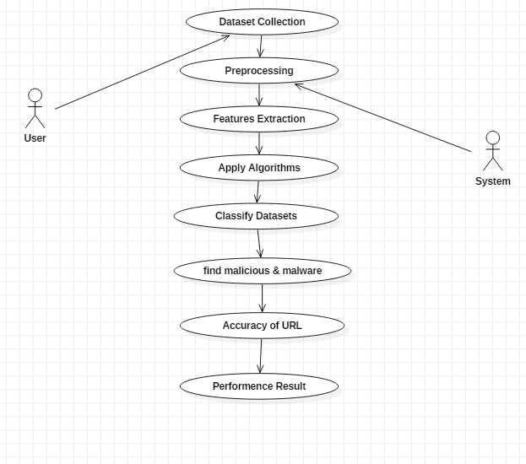
UML DIAGRAM:

Slide 19
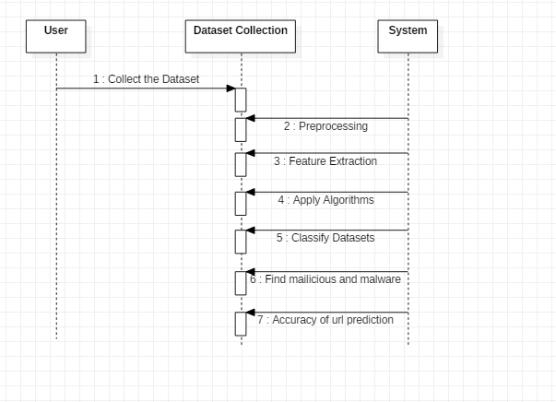
SEQUENCE DIAGRAM:

Slide 20
ANACONDA NAVIGATOR:
Anaconda navigator is a desktop graphical user interface (GUI) included in anaconda distribution that allows you to launch applications and easily manage conda packages, environments and channels without using command-line commands. Navigator can search for packages on anaconda cloud or in a local anaconda repository. It is available for windows, mac OS and Linux. Fastest path to business value from raw big data .

Slide 21
APPLICATIONS ARE AVAILABLE BY DEFAULT IN NAVIGATOR:
Jupyter Lab
Jupyter Notebook
QT Console
Spyder
VS Code
Glueviz

Slide 22
PYTHON’S STANDARD LIBRARY:
Pandas
Numpy
Sklearn
Seaborn
Matplot

Slide 23
ALGORITHMS APPLIED:
SVM
Random forests
Decision Tree
Naive Bayes

Slide 24
SVM (SUPPORT VECTOR MACHINE):
Support-vector machine constructs a hyperplane or set of hyperplanes in a high or infinite-dimensional space, which can be used for classification, regression, or other tasks like outliers detection. Intuitively, a good separation is achieved by the hyperplane that has the largest distance to the nearest training-data point of any class (so-called functional margin), since in general the larger the margin, the lower the generalization error of the classifier.

Slide 25
RANDOM FOREST:
Random forest is a type of supervised machine learning algorithm based on ensemble learning. Ensemble learning is a type of learning where you join different types of algorithms or same algorithm multiple times to form a more powerful prediction model.

Slide 26
DECISION TREE:
Decision Tree is a Supervised learning technique that can be used for both classification and Regression problems, but mostly it is preferred for solving Classification problems. It is a tree-structured classifier, where internal nodes represent the features of a dataset, branches represent the decision rules and each leaf node represents the outcome.
In a Decision tree, there are two nodes, which are the Decision Node and Leaf Node. Decision nodes are used to make any decision and have multiple branches, whereas Leaf nodes are the output of those decisions and do not contain any further branches.
A decision tree simply asks a question, and based on the answer (Yes/No), it further split the tree into subtrees.

Slide 27
NAIVE BAYES:
Naive Bayes algorithm is a supervised learning algorithm, which is based on Bayes theorem and used for solving classification problems.
It is mainly used in text classification that includes a high-dimensional training dataset.
Naive Bayes Classifier is one of the simple and most effective Classification algorithms which helps in building the fast machine learning models that can make quick predictions.
It is a probabilistic classifier, which means it predicts on the basis of the probability of an object.

Slide 28
CONCLUSION:
Machine learning approach to predict the Alzheimer disease using machine learning algorithms is successfully implemented and gives greater prediction accuracy results. The model predicts the disease in the patient and also distinguishes between the cognitive impairment.
The future work can be done by combining both brain MRI scans and the psychological parameters to predict the disease with higher accuracy using machine learning algorithms. When they are combined, the disease could be predicted with a higher accuracy in the earlier stage itself.

Slide 29
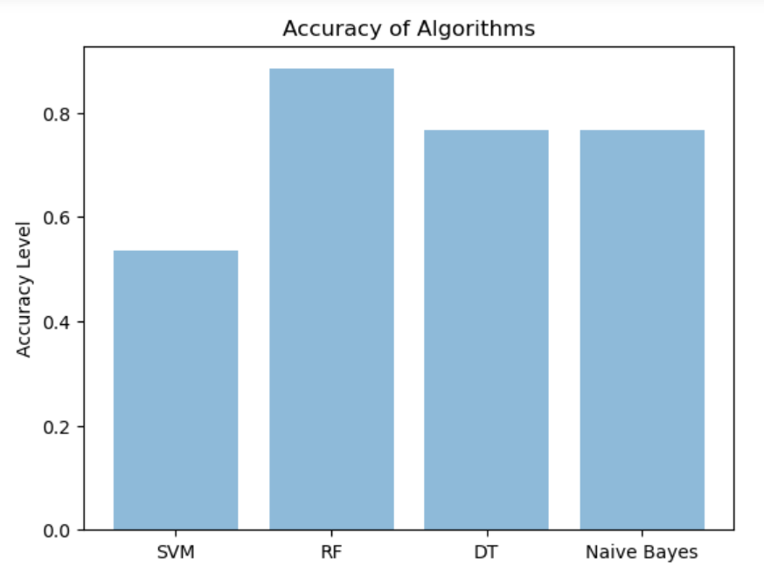
ACCURACY COMPARISION:

Slide 30
Thankyou!

