Slide 1

Shri Vishnu engineering college for women::Bhimavaram (Autonomous)
Sign Language Detection
IV B.Tech II Sem Major Project Presentation
In
Computer Science and Engineering
By
1.Kovvuri Sushma - 18B01A0574
2.Gadidesi Chandrika - 18B01A0590
3.Pappula Kusuma Latha - 18B01A05A9
4.Sanka Sri Naga Vardhini Vyshnavi - 18B01A05B7
5.Kasani Rupa Sri - 19B05A0508
Under the guidance of
Dr. P. Kiran Sree
(Head Of Department – CSE)
REVIEW NO: 02
Date: 07-05-2022
Department of Computer Science and Engineering Slide No:01

Slide 2
CONTENTS
PROBLEM STATEMENT
PROBLEMS IN EXISITNG SYSTEM
PROPOSED SYSTEM
SYSTEM DESIGN
FUNCTIONALITIES
IMPLEMENTATION OF MODULES
RESULTS & ANALYSIS
ATTAINMENT OF OBJECTIVES
Department of Computer Science and Engineering Slide No:2

Slide 3
PROBLEM STATEMENT
According to WHO, the world is having around 15-20% of the deaf and dumb population. Some of the major problems faced by a person who are unable to speak is they cannot express their emotion as freely in this world. This is the main motive to develop this project so that deaf and dumb people can have a comfortable conversation with normal people.
Sign Language detection is a Proposed system based on ML that translates the gesture shown by the user to text based on ASL. The text is again converted to speech, so that the user can see the text and hear it at the same time.
Department of Computer Science and Engineering Slide No:3

Slide 4
Problems in Existing System
The Existing Solutions for Detecting Sign Language is a Hardware solution that uses a sensor based approach.This approach collects the data of gestures performed by using different sensors. In case of hand gesture recognition different types of sensors were used and placed on the hand, when the hand performs any gesture, the data is recorded and is then further analyzed. The major disadvantage is that complex gestures cannot be performed using this method and the sensors are very expensive to afford.
The Existing software models can only able to detect numbers from one to ten but not the hand gestures that are used by deaf and dumb people to express something in real life and alphabets.
Department of Computer Science and Engineering Slide No:04

Slide 5
Proposed System
Our system will be helpful for communicating deaf and hard hearing people with normal people
In our sign language detection system the given sign languages can be converted into particular text
And the particular text can also be converted into speech
Department of Computer Science and Engineering Slide No:05

Slide 6
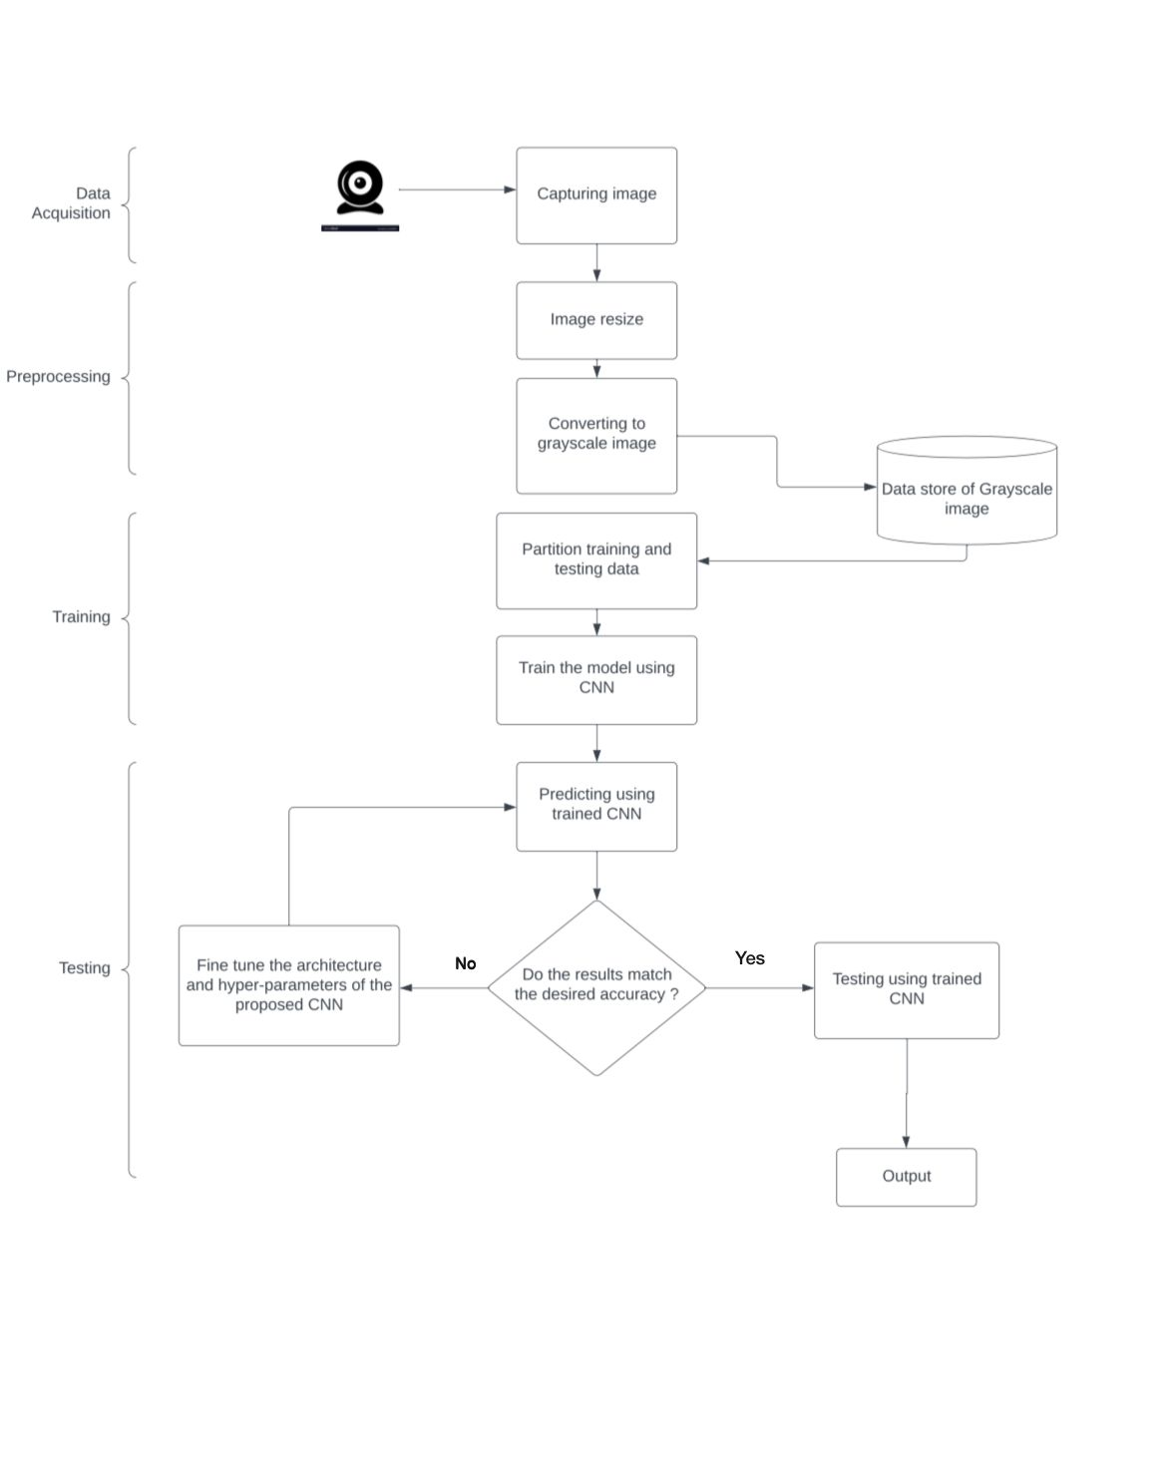
SYSTEM DESIGN
Department of Computer Science and Engineering Slide No:6

Slide 7
TECHNOLOGIES USED
Python 3.6.
Keras – CNN model.
Real-time computer vision using OpenCV.
Industrial standard GUI application (PyQT5), Tkinter.
gTTS – for text to speech.
Department of Computer Science and Engineering Slide No:7

Slide 8
FUNCTIONALITIES
Collects the data​set
Perform Pre-processing
- Resizing the images into same size
- Converting images into black and white image
Build the Model
Train the Model
Test the Model​
Test on Real time (live streaming)
Converting to speech​
Department of Computer Science and Engineering Slide No:8

Slide 9
IMPLEMENTATION OF MODULES
(MODULE-1) Data collection and Pre-processing: This module involves collection of dataset and pre-processing of the dataset.
(MODULE – 2) Build the proposed Model: In this module, We have developed a Machine Learning model using convolutional neural network(CNN) which runs effectively on extensive databases of sign language.
Department of Computer Science and Engineering Slide No:9

Slide 10
IMPLEMENTATION OF MODULES
(MODULE – 3) Training and experimentation on datasets: In this module, the proposed model was trained with the training dataset and tested with the testing dataset.
(MODULE – 4) Live Streaming: In this Live streaming module, the user can turn on their webcam and the corresponding gestures will be converted into text and the predicted text will be displayed.
(MODULE – 5) Speech Conversion: In this module, the predicted text will be converted to text so that the user can hear the predicted result at the same time.
Department of Computer Science and Engineering Slide No:10

Slide 11
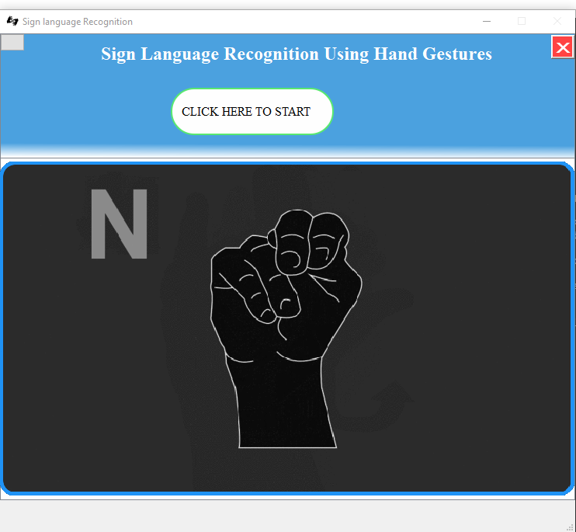
RESULTS & ANALYSIS
Department of Computer Science and Engineering Slide No:11

Slide 12
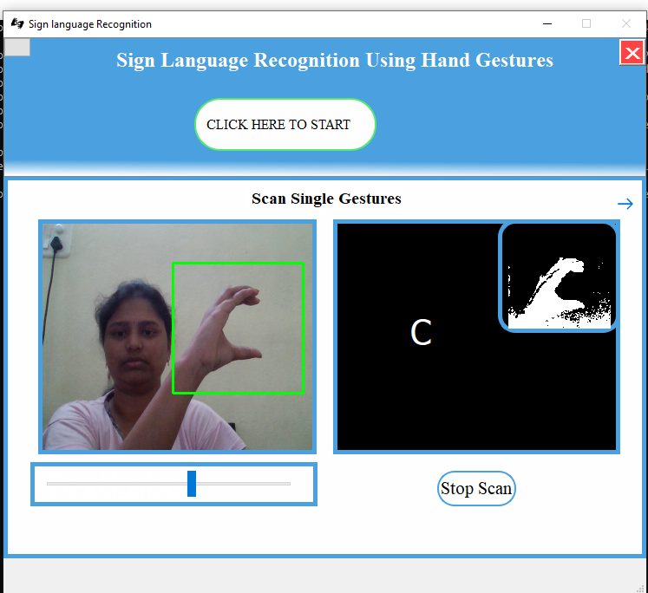
RESULTS & ANALYSIS
Department of Computer Science and Engineering Slide No:12

Slide 13
ATTAINMENT OF OBJECTIVES
At the initial stage of development , we have planned these tasks:
i. Conversion of gestures to text
ii . Develop UI for Application using Tkinter
iii. Converting text to speech in live streaming
Now we have developed an UI for translation of gesture to speech in live stream. But, during the initial stages we have planned to include all the gestures like numbers and general usage words like hello, yes…. But due to overlapping of numbers with alphabets we haven’t included numbers and words because of not availability of dataset.
Department of Computer Science and Engineering Slide No:13

Slide 14
LIMITATIONS
Can detect only American Sign Gestures.
Our application can be applicable only for alphabets.
The model works well only in good lighting conditions.
Plain background is needed for the model to detect with accuracy.
Department of Computer Science and Engineering Slide No:14

Slide 15
FUTURE SCOPE
• Integration to search engines and texting application.
We can extend this application by adding words.
• Detection of motion video sequence instead of images.
Department of Computer Science and Engineering Slide No:15

Slide 16
THANK YOU

