Slide 1
“My AI Vision Project”
Built by Navara Kusuma

Slide 2
“What My AI Does”
“My AI guesses pictures like cats and airplanes using the CIFAR-10 dataset. I built two models: a CNN and MobileNetV2.”

Slide 3
“How I Made It”
“Used Python and TensorFlow in Google Colab. Trained my AI with 50,000 pictures. Made charts to show progress.”

Slide 4
“My AI’s Results”
“First AI accuracy:69.33% (replace with your number from Step 11). Smarter AI accuracy:31.78% (replace with your number from Step 17).”

Slide 5
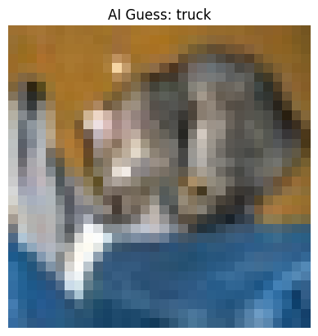
“See It Work!”
“My AI guessed a picture!”

