Slide 1
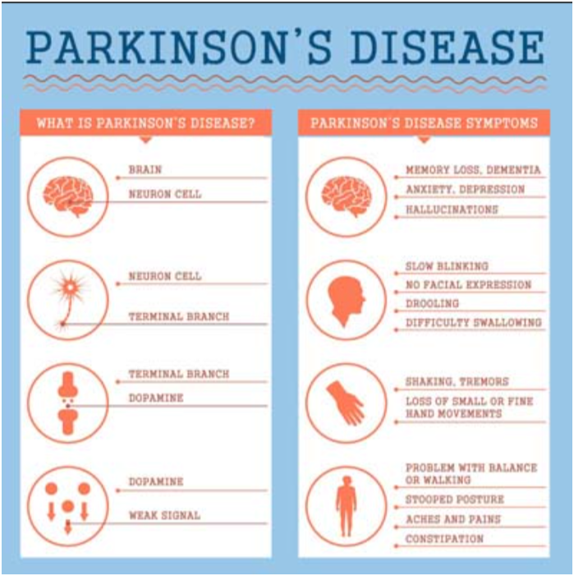
PARKINSON’S DISEASE PREDICTION IN AI
Problem Statement:
Parkinson's Disease Analysis Using Artificial Intelligence
Algorithm:
Extract protein sequences and structure data from PDB. Predict secondary with AlphaFold; generate 3D models with MODELLER.
Use AI to identify aggregation-prone regions in sequences. Refine models using PyRosetta for stability.
Dataset:
Title: Protein Data Bank(PDB)
Source: RCSB Protein Data Bank
Expected Output:
➔Identify misfolding and aggregation
Patterns using AI
➔Predict binding sites for therapeutic
Molecules
➔Enhance understanding of Parkinson’s
Disease mechanisms
Team Members:
Sajja Kusumitha – 2320030302
Salta Prayukthika – 2320030153
Pocharam Navya Sree Navya – 2320030266

