Slide 1
Project title: Elect Viz Election Data Visualization for Media
Name : Kusum Kumar Reddy
Study :B.Tech(CSE-3rd year)

Slide 2
OBJECTIVE OF THE PROJECT
The key objectives of this project are: Perform data cleaning and integration. Build a structured data model for analysis.
Develop multiple dashboards:
• Election analysis Dashboard
• Historical Trends Dashboard
• Real-Time Research Dashboard
• Turnout & Demographic Analysis Dashboard
• Party & Candidate Performance Tracker

Slide 3
Data Integration and Data Modelling
Combined multiple election datasets such as candidate details, constituency information, party data, and vote results.
Matched records using common fields like State, Constituency Name, Candidate Name, and Party.
Cleaned the dataset by:
Removing duplicate entries
Handling missing values
Standardizing party and state names
Converted columns into correct formats (numeric votes, percentages, text fields).
Created a final integrated dataset containing key attributes:
Candidate Name
Party
State
Constituency
Votes Received
Vote Share (%)
Vote Margin
Winner Status
Notes:
Combined multiple election datasets such as candidate details, constituency information, party data, and vote results.
Matched records using common fields like State, Constituency Name, Candidate Name, and Party.
Cleaned the dataset by:
Removing duplicate entries
Handling missing values
Standardizing party and state names
Converted columns into correct formats (numeric votes, percentages, text fields).
Created a final integrated dataset containing key attributes:
Candidate Name
Party
State
Constituency
Votes Received
Vote Share (%)
Vote Margin
Winner Status

Slide 4
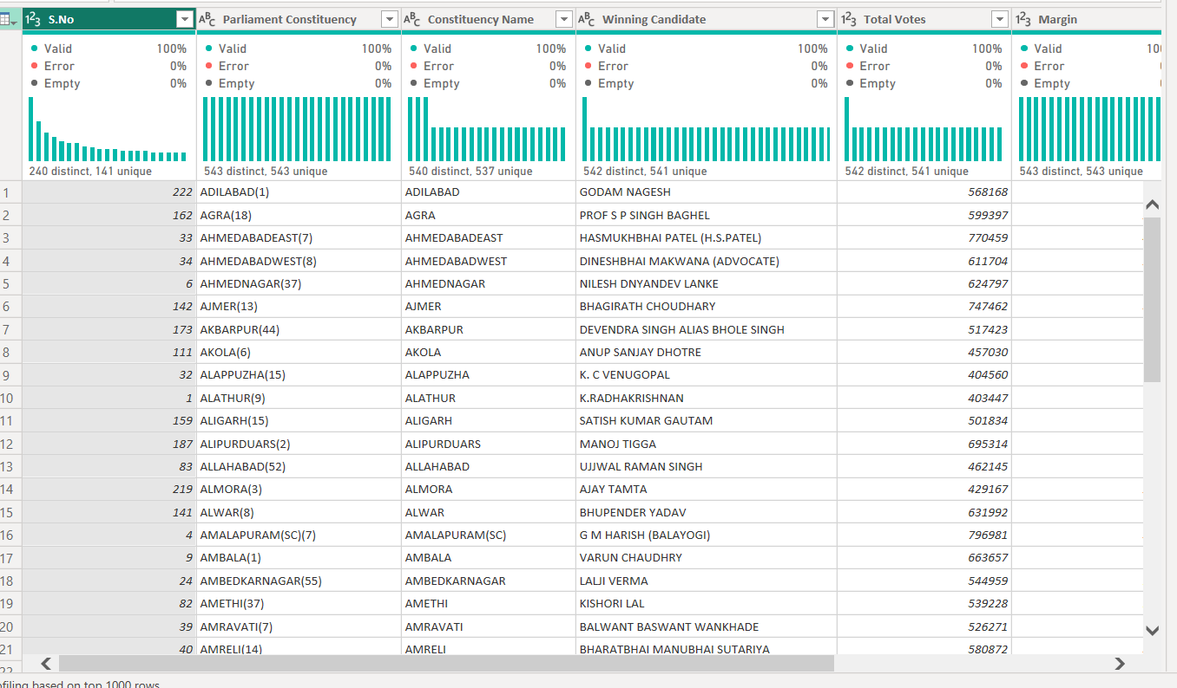

Slide 5
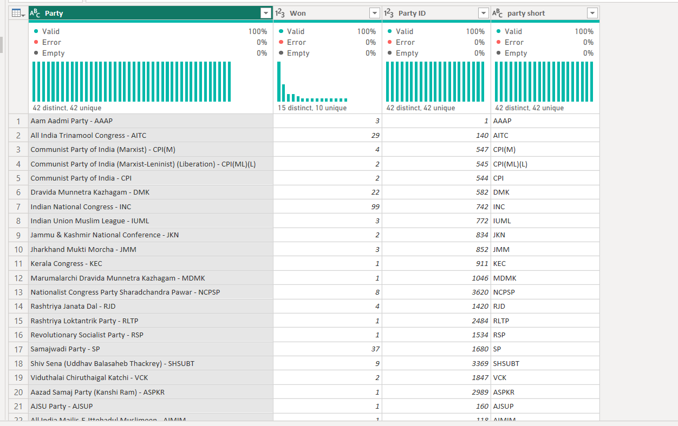

Slide 6
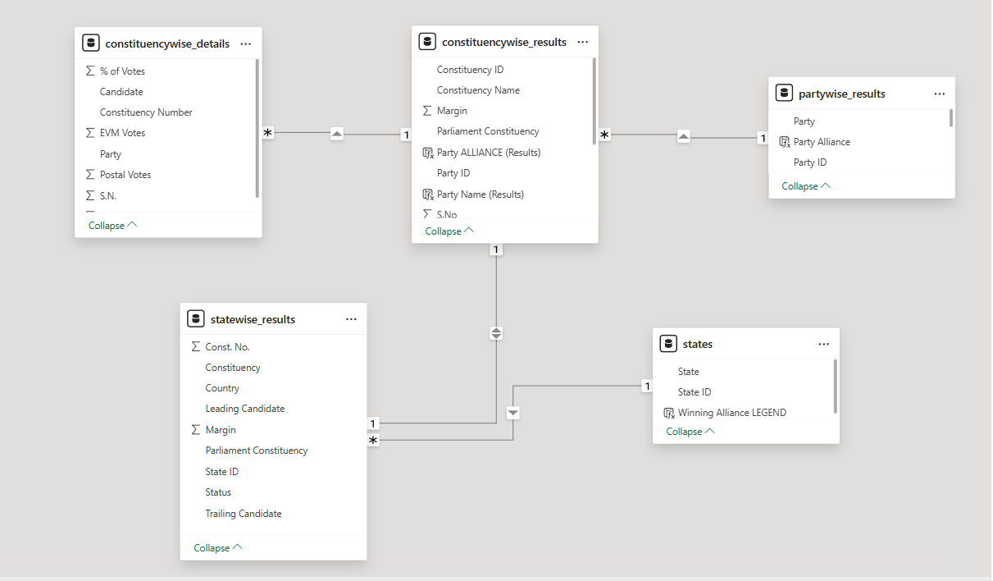

Slide 7
Organized the dataset into structured tables for easier analysis.
Identified main entities in the election data:
State
Constituency
Party
Candidate
Election Results
Established relationships between tables:
One State → Many Constituencies
One Party → Many Candidates
One Constituency → Many Candidates
Election Results connect candidates with vote counts
Created a relational structure to support analysis and visualization in tools like Power BI/Tableau.
This model enables insights such as:
Seats won by party
State-wise election results
Vote share comparison
Candidate performance analysis
Notes:
Organized the dataset into structured tables for easier analysis.
Identified main entities in the election data:
State
Constituency
Party
Candidate
Election Results
Established relationships between tables:
One State → Many Constituencies
One Party → Many Candidates
One Constituency → Many Candidates
Election Results connect candidates with vote counts
Created a relational structure to support analysis and visualization in tools like Power BI/Tableau.
This model enables insights such as:
Seats won by party
State-wise election results
Vote share comparison
Candidate performance analysis

Slide 8
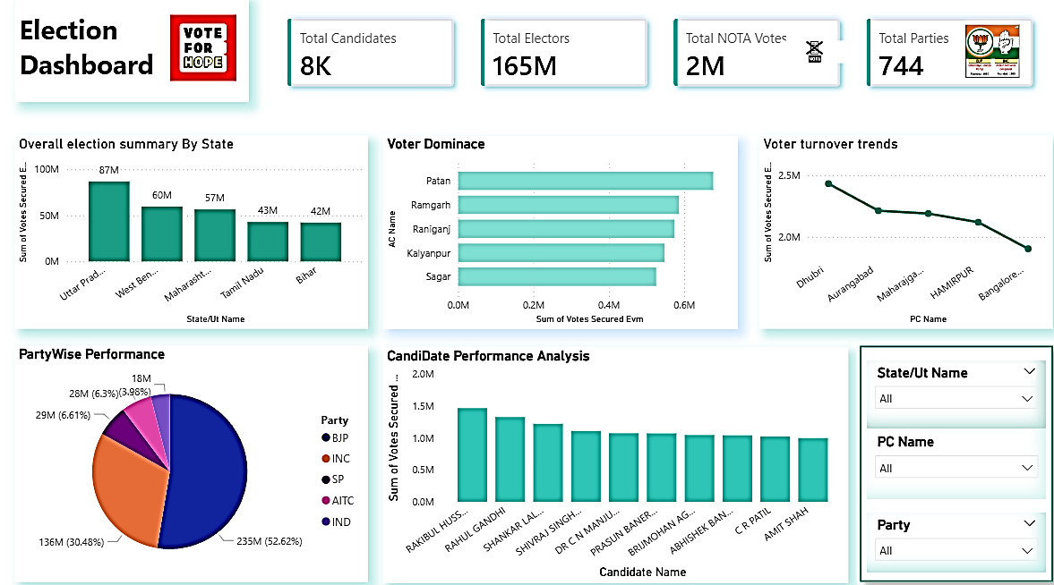
Historical Trends Dashboard
Notes:
Historical Trends Dashboard

Slide 9
1. Comparative Seat Count (2024 vs. 2019)
This is the most prominent feature, showing the "Gain/Loss" for each party.
Performance Tracking: A side-by-side bar or pie chart showing how many seats the NDA, INDIA Alliance, and Others won compared to their 2019 standing.
Majority Mark: A visual indicator of the 272-seat threshold.
2. Vote Share Swing
The dashboard displays the percentage of the total popular vote each party received.
Swing Analysis: It calculates the "Swing" (e.g., if a party got 37% in 2019 and 36% in 2024, it shows a -1% swing).
Vote-to-Seat Ratio: A comparison showing how efficiently a party converted its total votes into actual seats.
3. Voter Turnout Trends
Historical Comparison: A line graph showing turnout percentages from 1951 to 2024.
Gender Breakdown: Specific data on female vs. male turnout, highlighting the record 312 million women who voted in 2024.
Postal Ballots vs. EVMs: A breakdown of how people voted.
4. Geographic Distribution (Heat Maps)
State-wise Performance: Interactive maps where you can click on a state (like Uttar Pradesh or Maharashtra) to see the shift in dominance.
New Territory: Highlighting "First-time" wins (e.g., BJP’s first seat in Kerala).

Slide 10
5. Candidate & Constituency Logistics
Winning Margins: A list of the highest and lowest victory margins (e.g., the 10-lakh+ margin in Dhubri, Assam).
Demographics: The number of winning women candidates (74 in 2024) compared to previous years.
NOTA Trends: The percentage of voters choosing "None of the Above" across different cycles.
Notes:
5. Candidate & Constituency Logistics
Winning Margins: A list of the highest and lowest victory margins (e.g., the 10-lakh+ margin in Dhubri, Assam).
Demographics: The number of winning women candidates (74 in 2024) compared to previous years.
NOTA Trends: The percentage of voters choosing "None of the Above" across different cycles.

Slide 11
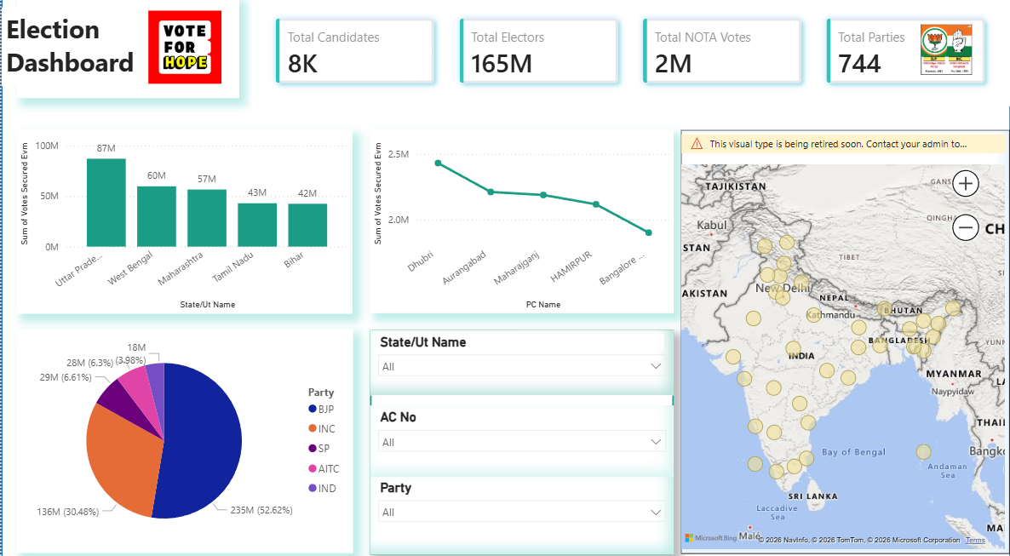
Realtime results Dashboard

Slide 12
The dashboard uses several charts to analyze voter behavior and party performance:
Overall Election Summary by State: A bar chart showing the sum of votes secured across major states. Uttar Pradesh leads significantly with 87M votes, followed by West Bengal (60M) and Maharashtra (57M).
Party Wise Performance: A pie chart illustrating the distribution of votes among major parties. The BJP holds the largest share with 235M votes (52.62%), followed by the INC with 136M votes (30.48%).
Voter Turnover Trends: A line graph tracking votes across specific Parliamentary Constituencies (PC). It shows a downward trend from Dhubri (the highest) toward Bangalore.
Candidate Performance Analysis: A bar chart ranking individual candidates by votes secured. Notable names like Rakibul Hussain, Rahul Gandhi, and Shivraj Singh Chouhan are featured among the top performers.
Voter Dominance: A horizontal bar chart identifying specific Assembly Constituencies (AC) with high vote totals, including Patan, Ramgarh, and Raniganj.
Geospatial Mapping: One view includes a map of India with bubble indicators representing vote concentrations or constituency locations across the country.

Slide 13
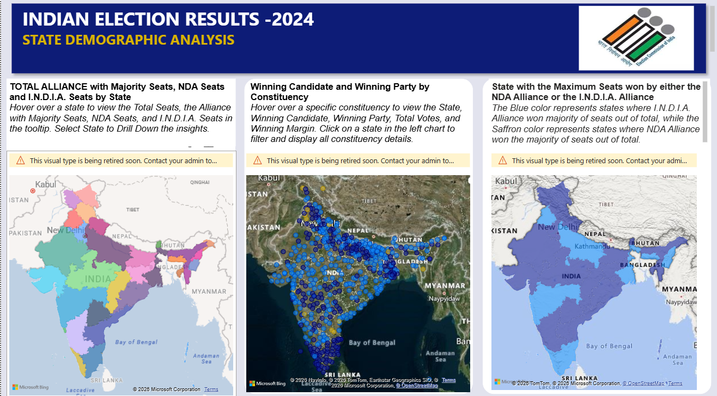
Demographic Analysis
Notes:
Demographic Analysis

Slide 14
The "Saffron" Areas (NDA): These represent the areas where the BJP-led alliance maintained or gained control. They had a clean sweep in states like Madhya Pradesh, Gujarat, and Delhi, and made massive gains in Odisha.
The "Blue" Areas (I.N.D.I.A.): The opposition alliance performed much stronger than exit polls predicted. They won a significant number of seats in Uttar Pradesh (the most populous state), Maharashtra, and West Bengal, which prevented the BJP from reaching a solo majority.
Coalition Government: Because the BJP won 240 seats (short of the 272 needed for a majority), they formed the government with the help of allies like the TDP (Andhra Pradesh) and JD(U) (Bihar).
Interesting Context
The 2024 election was historic for several reasons:
Narendra Modi became the first Prime Minister since Jawaharlal Nehru to win three consecutive terms.
It marked the return of a strong Opposition Leader in Parliament (Rahul Gandhi) for the first time in a decade.
Digital infographics like the one in your image were widely used to show the "North-South" divide and the "Rural-Urban" voting patterns.

Slide 15
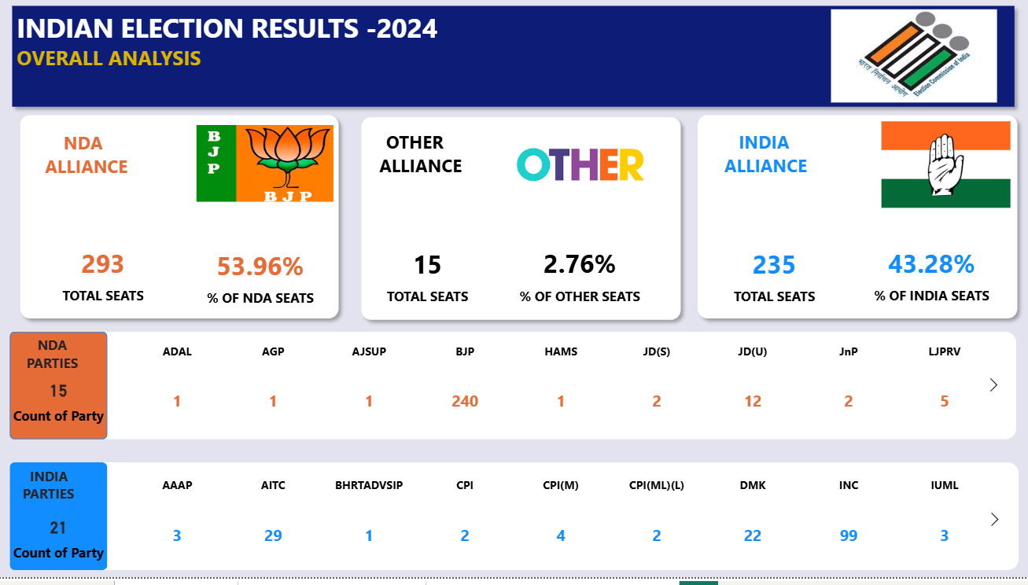
party and candidate performance trackers

Slide 16
Alliance | Total Seats Won | Lead Party (Seats Won) | Key Outcomes
NDA (Orange/Saffron) | 293 | BJP (240) | Secured a majority but the BJP lost its solo majority for the first time in 10 years.
I.N.D.I.A. (Blue/Green) | 234 | INC (99) | Performed significantly better than exit polls predicted, gaining over 100 seats compared to 2019.
Others (Grey) | 16 | Various (e.g., YSRCP, BJD) | Independent and non-aligned regional parties.

Slide 17
NDA Dominance (Saffron): The alliance maintained strong holds in states like Madhya Pradesh (clean sweep of 29/29), Gujarat (25/26), and Odisha.
I.N.D.I.A. Gains (Blue): The opposition made massive gains in the "Hindi heartland," particularly in Uttar Pradesh, where the Samajwadi Party (SP) and Congress combined for 43 seats, leaving the BJP with only 33. They also dominated in Tamil Nadu and Maharashtra.
Key Allies: Because the BJP fell short of the 272-seat majority mark, the support of regional allies like the Telugu Desam Party (TDP) in Andhra Pradesh and Janata Dal (United) in Bihar became crucial for forming the government.
Notes:
NDA Dominance (Saffron): The alliance maintained strong holds in states like Madhya Pradesh (clean sweep of 29/29), Gujarat (25/26), and Odisha.
I.N.D.I.A. Gains (Blue): The opposition made massive gains in the "Hindi heartland," particularly in Uttar Pradesh, where the Samajwadi Party (SP) and Congress combined for 43 seats, leaving the BJP with only 33. They also dominated in Tamil Nadu and Maharashtra.
Key Allies: Because the BJP fell short of the 272-seat majority mark, the support of regional allies like the Telugu Desam Party (TDP) in Andhra Pradesh and Janata Dal (United) in Bihar became crucial for forming the government.

Slide 18
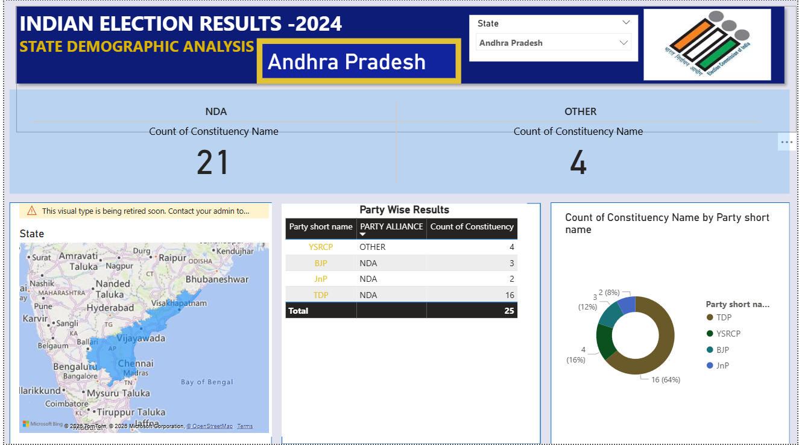

Slide 19
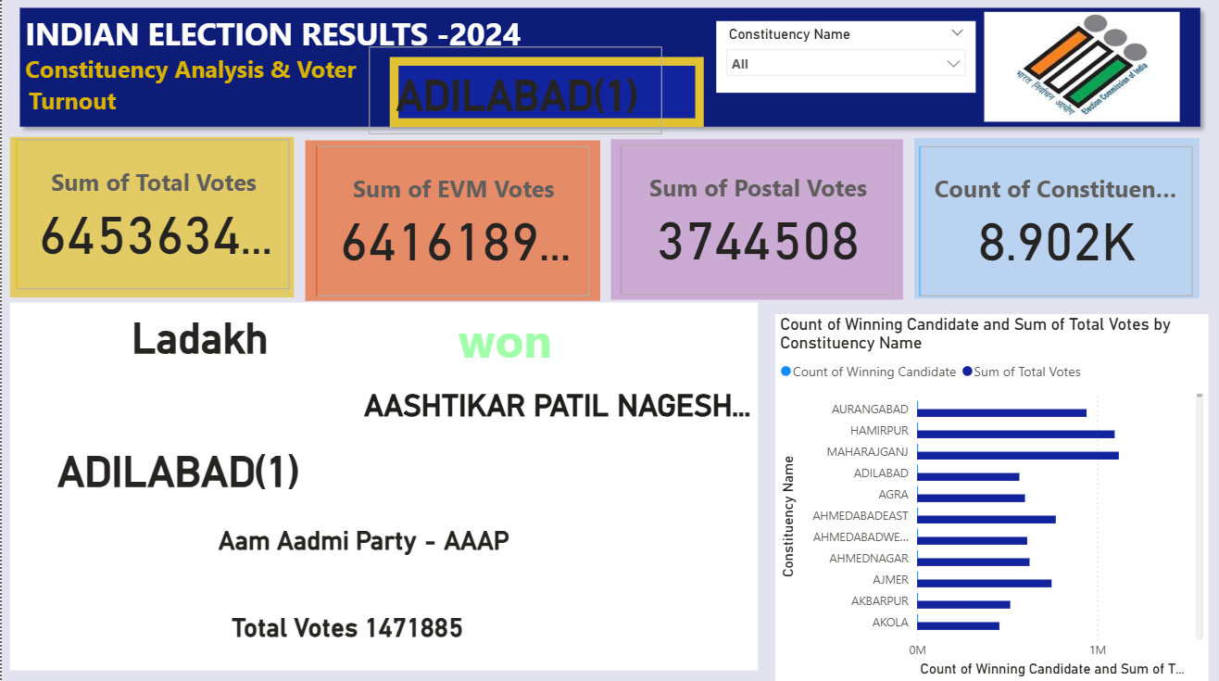

Slide 20
Thank You

