Slide 1
ADaM AI: PoC on how to interact with CDISC Library API using Natural language
Saikrishnareddy Yengannagari
Bristol Myers Squibb
PHUSE SDE 2025

Slide 2
Introduction: The Challenge
CDISC Library API: Authoritative source for standards metadata (ADaM, SDTM, etc.).
Access Methods: Website navigation or direct API calls.
Problem: Direct API interaction requires technical skill (formulating calls, parsing JSON), creating a barrier for many clinical programmers/managers seeking quick info.
Question: Can we use Natural Language Processing (NLP) for easier access?

Slide 3
Proposed Solution: ADaM AI
Goal: Enable natural language queries for ADaM variable info (metadata, codelists).
Core Idea: Use AI as an interface layer, not a data generator.
Workflow:
User asks question in plain English.
AI extracts key parameters (e.g., variable name).
Backend script calls CDISC Library API for actual data.
AI formats the factual API response into a natural language answer.

Slide 4
Method: Stage 1 - SAS Foundation
Initial Step: Created adamgenius.sas macro.
Functionality:
Takes adamvar (required), adamigversion, adamctversion (optional).
Fetches latest IG/CT versions if not provided (via /mdr/products).
Retrieves ADaM IG structure (/mdr/adam/adamig-...).
Finds variable’s dataset context.
Fetches variable metadata (/mdr/adam/adamig-.../variables/...).
Extracts codelist links & fetches terms (via %GetCDISCCodelist, handles ADaM/SDTM CT).
Output: Prints details to SAS results window.
Purpose: Established baseline functionality using familiar SAS environment.

Slide 5
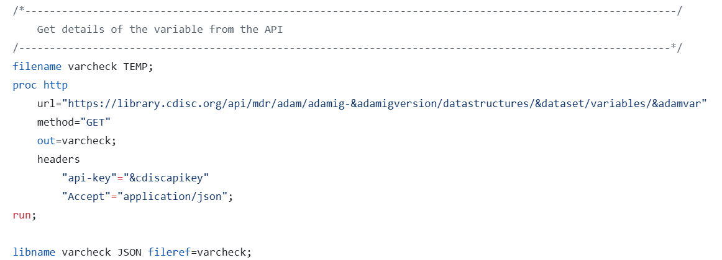
Proc http call to fetch adam variable metadata using SAS

Slide 6
Method: Stage 2 - Python Conversion
Goal: Translate SAS logic to Python (adam_genius.py) for broader integration.
Process: “Vibe Coding”
Used AI code assistant (e.g., GitHub Copilot) due to SAS expertise > Python expertise.
Provided SAS code sections to AI.
Stated intent: Replicate logic in Python using CDISC API.
Iteratively refined & validated AI-generated Python code against SAS output.
Adapted to Python idioms (requests, json, argparse, dotenv).
Outcome: Python script mirroring SAS macro functionality, serving as the core data engine.

Slide 7
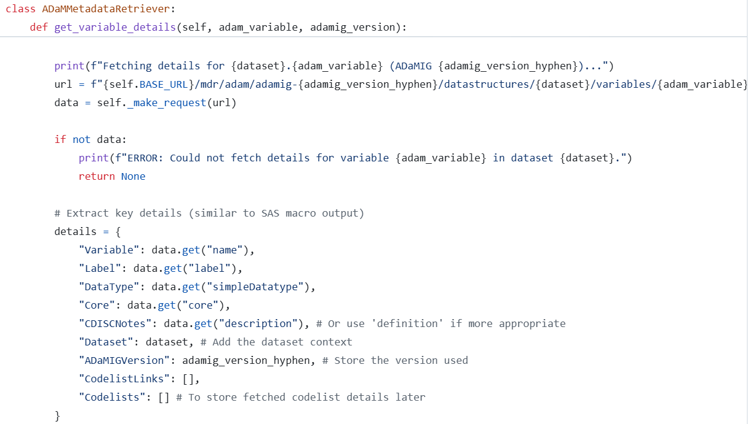
Python version of fetching adam variable metadata

Slide 8
Method: Stage 3 - AI Integration
Goal: Enable natural language input/output using AI (adamai.py).
Tool: OpenAI GPT-4o-mini.
Two-Step AI Process:
Variable Extraction:
AI Prompt: Extract only the ADaM variable name (uppercase) from user query.
Example: “Tell me about subject age” -> AGE
Purpose: Focused task to minimize errors.
Explanation Generation:
Input: Factual metadata from adam_genius.py.
AI Prompt: Explain the provided metadata conversationally.
Purpose: Format reliable data for user-friendliness.

Slide 9
Method: Architecture & Interfaces
Architecture: Layered approach to mitigate AI hallucination.
User Query -> AI (Extract Var) -> Python Script (CDISC API Call) -> Metadata -> AI (Explain) -> User Response
AI handles NLP, Script handles factual data retrieval.
Interfaces:
CLI (adamai.py): For command-line usage.
Web App (streamlit_app.py): User-friendly GUI.
Input query -> Shows extracted var -> Shows raw metadata -> Shows AI explanation.

Slide 10
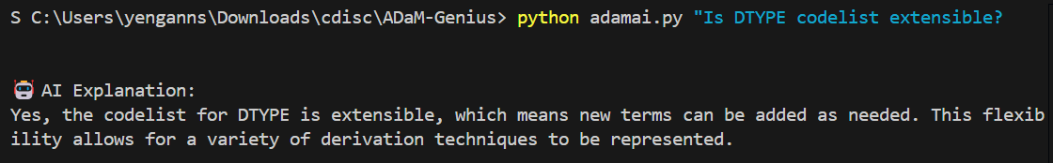
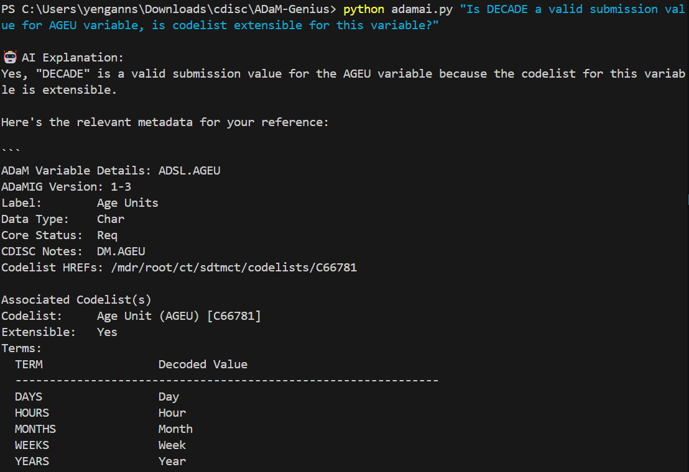
CLI Examples

Slide 11
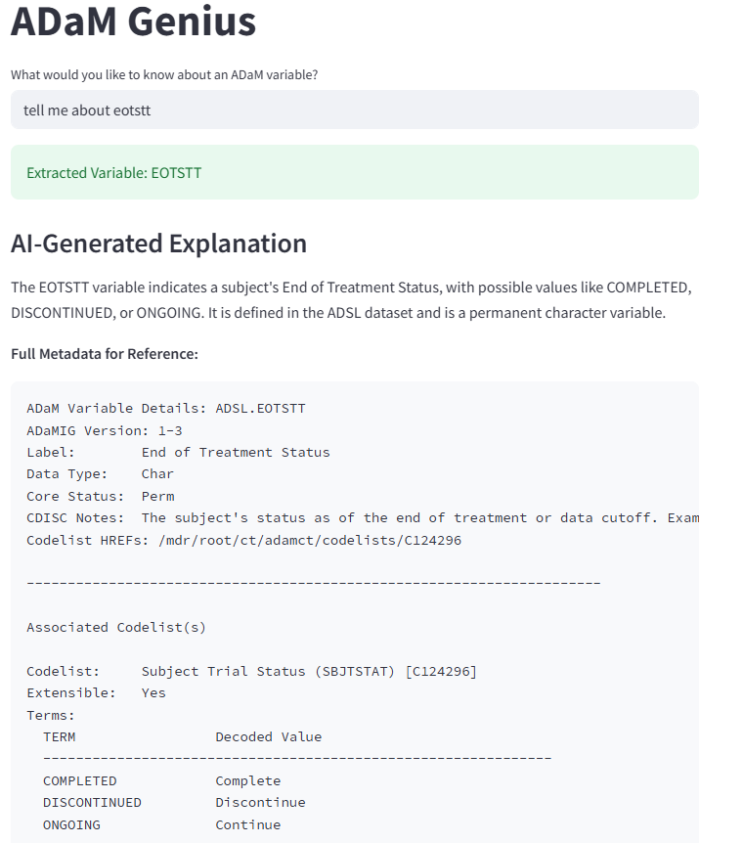
Streamlit webapp example

Slide 12
Results
Functionality: Both CLI and Streamlit app successfully implemented.
Accurate variable extraction from natural language.
Reliable metadata/codelist retrieval via adam_genius.py (using CDISC API).
Clear, conversational explanations generated by AI based on factual data.
Usability: Streamlit app provides easy-to-use GUI.
Hallucination Mitigation: Architecture successfully prevented AI from fabricating metadata; AI only formatted API-sourced data.
Performance: Acceptable for PoC; API calls are main latency source.

Slide 13
Enhancement: ADaMIG Q&A with RAG (adamrag.py)
Problem: The API approach is great for specific metadata/codelists, but can’t answer broader questions about ADaM principles or implementation details found within the ADaMIG document.
Solution: Developed adamrag.py using Retrieval-Augmented Generation (RAG).
How it Works:
Uses LlamaIndex library.
Loads and indexes the ADaMIG PDF document (e.g., v1.3) from a local directory.
Creates a vector store of the document content.
User asks a natural language question via command line.
The script queries the index, retrieves relevant text chunks from the PDF, and uses an LLM to synthesize an answer based only on the retrieved document context.
Benefit: Complements the API tool by enabling queries about the textual content, examples, and guidance within the ADaMIG itself.
Example Query: “What are fundamental principles of adam standard?”

Slide 14
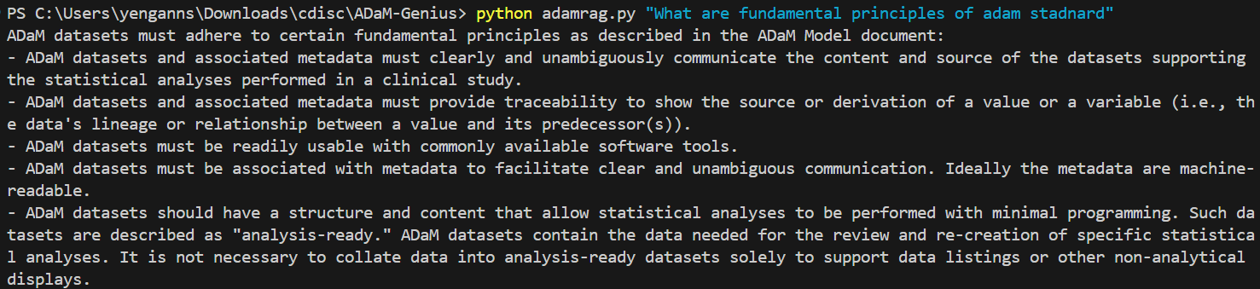
Example RAG query

Slide 15
Discussion & Key Takeaways
AI as Interface: Successfully enhances usability of technical APIs (CDISC Library).
Hallucination Mitigation: Layered architecture (AI for NLP, Script for API data) is crucial for trust in regulated environments.
“Vibe Coding”: Pragmatic use of AI assistants for code translation (SAS -> Python), but requires rigorous validation.
Target Audience Benefit: Lowers barrier for SAS programmers/managers to access ADaM info.
Public GPT: “Adam Genius” Custom GPT demonstrates practical application and accessibility (for Plus users).
Limitations: API dependency, PoC performance, simple query handling.

Slide 16
Conclusion & Future Work
Conclusion: AI can be a powerful, trustworthy interface for technical APIs like CDISC Library when architected correctly (separating NLP from data retrieval).
Value: Improves accessibility and usability for clinical teams.
Future Work:
Expand to other CDISC standards (SDTM, SEND).
Handle more complex queries.
Optimize performance (caching).
Integrate into development/review platforms.

Slide 17

Thank You!

