Slide 1
ASE3 成果報告
粕谷，片岡，小松，松元

Slide 2
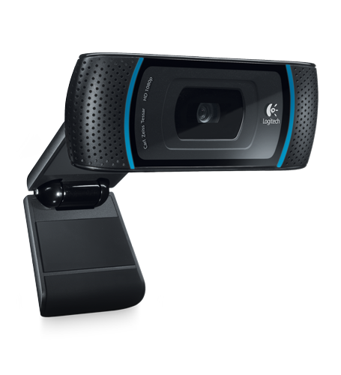
Internal key unlocking system by Face recognition
judge whether visitor was registered by face recognition
Door

Slide 3
初期案
Motion sensor
Door
Motor
Camera
Buzzer
Ring!!
Internal key

Slide 4
初期案
Motion sensor
断念
Door
Motor
Camera
Buzzer
Ring!!
Internal key
サーボモータでは鍵を回せない

Slide 5
How to recognize face?
Library ：Face_recognition
Environment：on remote PC
too late on Raspberry Pi

Slide 6
Send e-mail
judge that the visitor is not registered
→ raise a buzzer & send e-mail with photo
Send e-mail to registered address
Attach the photo (used in face recognition)

Slide 7

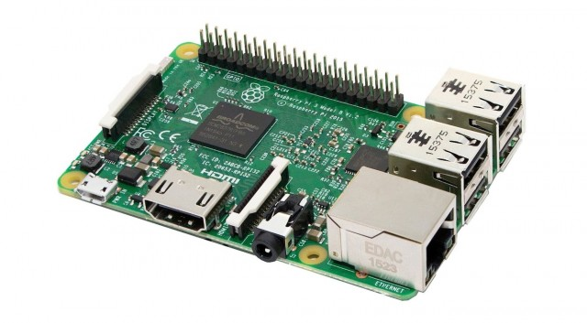
System Overview
Buzzer
Motion sensor
LED
https
Door
Server
Raspberry Pi

Slide 8
System Overview
Buzzer
2.
Take photo.
Motion sensor
LED
https
Door
Server
Raspberry Pi
1.
黄色のLED点灯.

Slide 9
System Overview
Buzzer
3.
顔写真の送信
Motion sensor
LED
https
Door
Server
Raspberry Pi

Slide 10
System Overview
Buzzer
4.
Recognize face & judge
Reply the result
Motion sensor
LED
https
Door
Server
Raspberry Pi
5.
If not registrant,
send e-mail with photo
to registered address

Slide 11
System Overview
Buzzer
Failure confirm,
→ turn on the red LED
& raise a buzzer
Motion sensor
LED
https
Door
Server
Raspberry Pi
Success confirm
→ turn on the green LED

Slide 12
進捗
Buzzer
実装済み
Motion sensor
LED
https
Door
サーバ
Raspberry Pi

Slide 13
進捗
Buzzer
Motion sensor
LED
https
Door
サーバ
Raspberry Pi
未実装

Slide 14
Buzzer
Motion sensor
LED
https
Door
Server
Raspberry Pi

Slide 15

RaspberryPi to Server
Send a POST request with photo.
Node.js
Server
Raspberry Pi

Slide 16

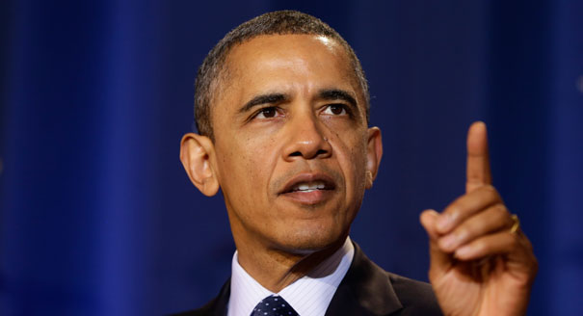
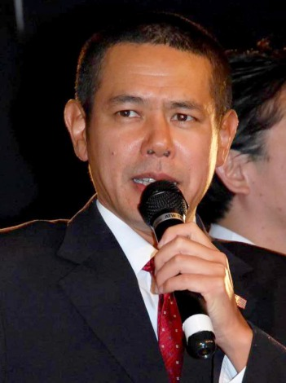
Face recognition on Server
known list
Recognize and compare.
Judge the result.
Node.js
Server

Slide 17
Server to RaspberryPi
Send a POST request with photo.
Node.js
Server
Raspberry Pi

Slide 18
Node.js
server

Slide 19
Buzzer
LED
Motion sensor
Raspberry Pi
Door

Slide 20
Demo

Slide 21
完成度（自己評価）
顔認識
認識精度が悪い
ライブラリが日本人の認識には向かない
RaspberryPiによるセンサ類の制御
問題なし
画像の送受信
問題なし

Slide 22
まとめ
顔認証式防犯システム
今後の課題
顔認証の精度（せめてアジア人も区別できるように）
基盤が丸出し
力の強いモータで鍵を開ける？
認証に時間がかかりすぎる

