Slide 1
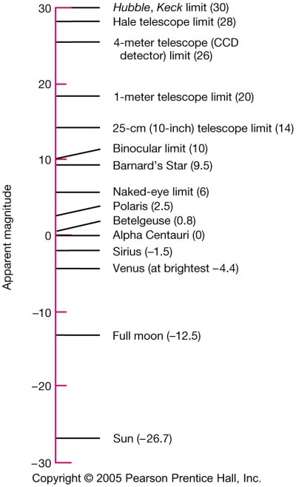
Apparent Magnitude
(useful for describing how bright objects appear from the Earth)
The original magnitude system of Hipparchus had:
magnitude 1 – the brightest stars
magnitude 2
magnitude 3
magnitude 4
magnitude 5
magnitude 6 – the faintest stars
Today, the magnitude system has been extended to include much fainter and brighter objects.

Slide 2
Absolute Magnitude
(useful for describing how intrinsically luminous objects are)
Absolute magnitude is described as the apparent magnitude an object would have at a distance of 10 parsecs.
Imagine moving all of the stars in the sky so that they reside on a sphere of radius 10 parsecs that is centered on the Earth. The apparent magnitude that these stars would have at that time is their absolute magnitude. Thus, it is a theoretical quantity.
Star
d = 10 pc
Earth

Slide 3
Distance Modulus
(a useful quantity for determining distances)
The distance modulus is the difference between apparent magnitude m and absolute magnitude M for an object.
m > M
m < M
Star
d = 10 pc
Earth
m < M → d < 10 pc
m >M → d > 10 pc

Slide 4
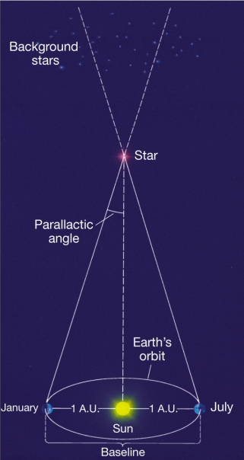
Parallax
(a method for obtaining the distance to nearby objects)
Parallax is the apparent change in position of nearby objects relative to more background objects as the observer changes position. As the earth revolves around the sun, the apparent positions of nearby stars change relative to background objects.
Where d is the distance in parsecs and π is the parallax in arc seconds.

Slide 5
Stellar Velocities
Radial Velocity (v_{r}) is the component of velocity along the line of sight to the star. It is determined from Doppler shifts in spectral lines by:
- positive velocities imply separation is increasing; negative, increasing
2) Tangential velocity (v_{t}) is the component of velocity perpendicular to the line of sight. It is calculated from:
Where μ is the proper motion in arcseconds/year and d is the distance in parsecs. Proper motion can be thought of as motion on the celestial sphere.
3) Space velocity (v_{s}) is a star’s true velocity through space and is calculated from:

Slide 6
Luminosity
(the total energy that a star produces each second)
Luminosity depends on both the radius of a star and its surface temperature. It is the product of …
Flux - the total energy produced each second by each square meter of a blackbody radiator. Given by the Stefan-Boltzmann Law in units of J/s-m² where temperatures in Kelvin.
Area - the total surface area of the star (area of a sphere in m²).
Thus, the Luminosity in units of J/s is given by:

Slide 7
Flux
(the total energy from a star that hits each square meter
of a detector in a second)
Realize that the energy a star produces each second (its luminosity L) is spread out over the surface of a sphere whose radius is the distance to the star.
Thus, the flux we detect is:
Star
d
Earth
Astronomers say the flux
“falls off as one over r squared”

Slide 8
Spectroscopic Parallax
(a technique for distance determination that identifies a star’s place on the HR Diagram using a star’s spectra)
Observe the types of lines in a star’s spectrum to determine its spectral type
– this tells you the column a star is in on the HR Diagram
2) Observe the thickness of lines in a star’s spectrum to determine its luminosity class
– each luminosity class is a curve on the HR Diagram
3) Find the intersection of the spectral type and luminosity class on the HR Diagram and read off the absolute magnitude M
4) Observe the apparent magnitude m
5) Use the distance modulus (m-M) to determine the distance to the star

