Slide 1
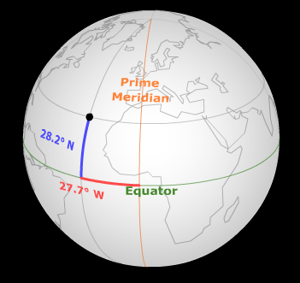
Terrestrial Coordinates
(useful for specifying locations on the surface of the Earth)
Longitude
-- East/West Coordinate
-- 0° at the Prime Meridian (the Great Circle through Greenwich England)
-- increases to either 180°E or 180°W at the International Date Line
Latitude
-- North/South Coordinate
-- 0° at the Equator
-- increases to either 90°N at the North Pole or 90°S at the South Pole
Longitude -

Slide 2
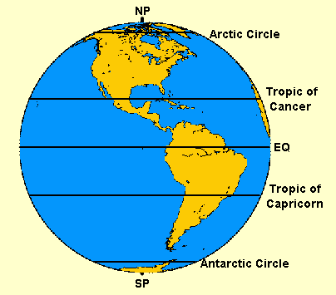
Parallels of
Latitude
Parallel | Latitude
North Pole | 90°N
Arctic Circle | 66.5°N
Tropic of Cancer | 23.5°N
Equator | 0°
Tropic of Capricorn | 23.5°S
Antarctic Circle | 66.5°S
South Pole | 90°S

Slide 3
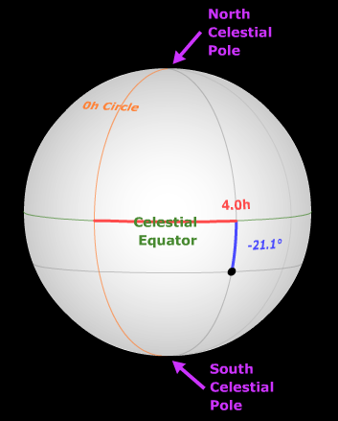
Celestial Equatorial Coordinates
(useful for specifying locations on the Celestial Sphere)
Right Ascension
-- East/West Coordinate
-- 0 hours at the Vernal Equinox (the intersection of the ecliptic and the celestial equator where the sun is moving northward)
-- increases eastward to 23 hours 59 minutes
Declination
-- North/South Coordinate
-- 0° at the Celestial Equator
-- increases to either +90° at the North Celestial Pole or -90° at the South Celestial Pole
Longitude -

Slide 4
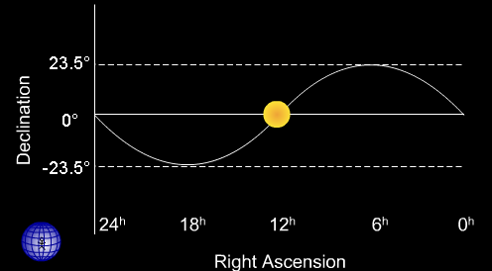
Ecliptic
(the apparent path of the sun)
 | Approximate Date | Right Ascension | Declination | Latitude of Direct Rays
Vernal Equinox | March 21 | 0^{h} | 0° | 0°
Summer Solstice | June 21 | 6^{h} | +23.5° | 23.5°N
Autumnal Equinox | Sept. 21 | 12^{h} | 0° | 0°
Winter Solstice | Dec. 21 | 18^{h} | -23.5° | 23.5°S

Slide 5
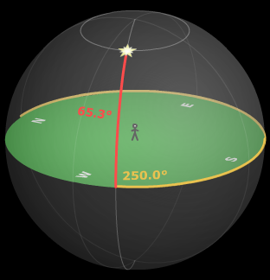
Horizon Coordinates
(useful for specifying locations relative to a particular observer)
Azimuth
-- specifies location on the horizon directly below the object
-- 0° at the north point on the horizon and increasing eastwards (90° at the east point, 180° at the south point, 270° at the west point).
Altitude
-- specifies angular distance above horizon
-- 0° at the horizon
-- increases to either +90° at the zenith or down to -90° at the nadir
Longitude -

Slide 6
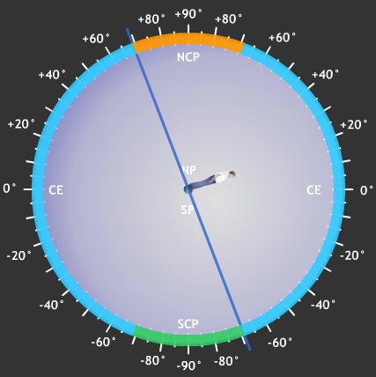
Circumpolar Stars
-- stars which are always above the observer’s horizon
-- from (90 – lat) up to the pole in that hemisphere (+69° to +90°)
Never Rise Stars
-- stars which never come above the observer’s horizon
-- from (90 – lat) up to the pole in that hemisphere (-69° to -90°)
Rise & Set Stars
-- stars which can either rise or set during the night and which change with the seasons
-- from (90 – lat) to (90 – lat) in the other hemisphere (-69° to +69°)
Declination Ranges
(Declinations of stars which can be seen from specific latitudes on the Earth. Most locations have 3 distinct groups of stars.)
Longitude -
Observer at 21°N

Slide 7
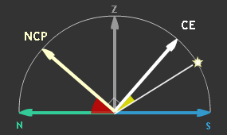
Draw in the pole corresponding to the hemisphere of the observer at an altitude equal to the observer’s latitude. (Ex. An observer in Lincoln, NE (lat. = 41°N) would draw in the NCP at an altitude of 41° above the north point.)
Draw in the Celestial Equator 90° away from the pole. The Meridinal Altitude of the Celestial Equator is 90 minus the observer’s latitude.
Take into account the declination of the object. If the declination is positive move from the celestial equator toward the NCP -- if declination is negative move toward the SCP.
The Meridinal Altitude is then the altitude of object on the observer’s meridian. Meridinal Altitude should be less than 90°.
Meridinal Altitude
(the maximum altitude an object has on a certain date)
The Meridinal Altitude of Sirius (dec. = -17°) from Lincoln, NE (lat. = 41°) is 32°.

