Slide 1
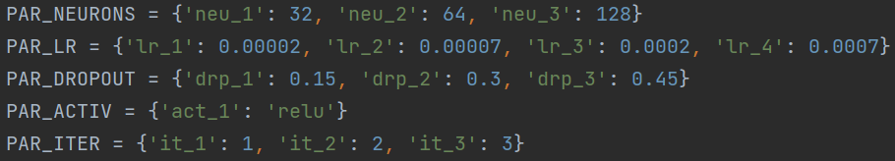
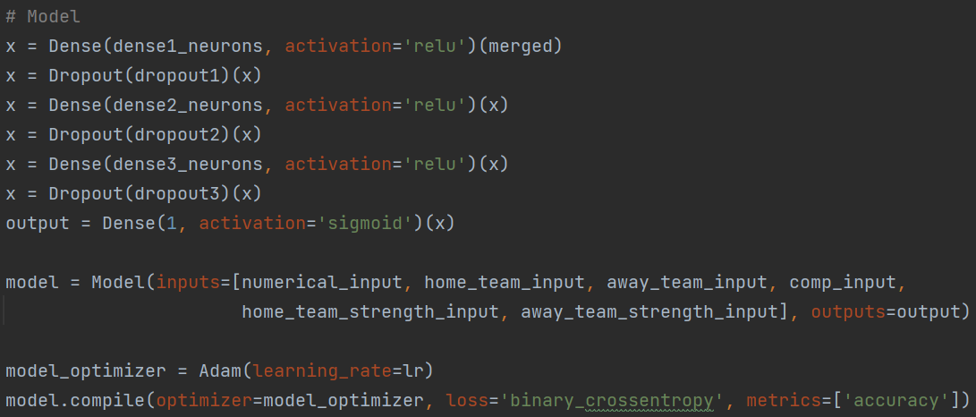

Slide 2
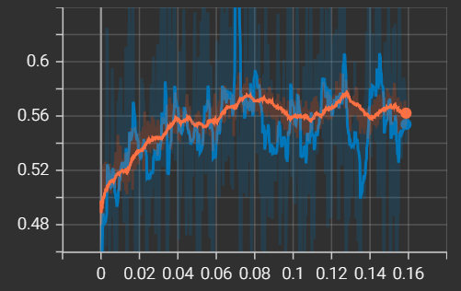
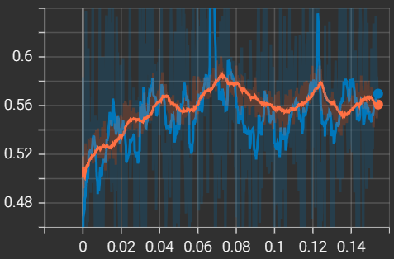
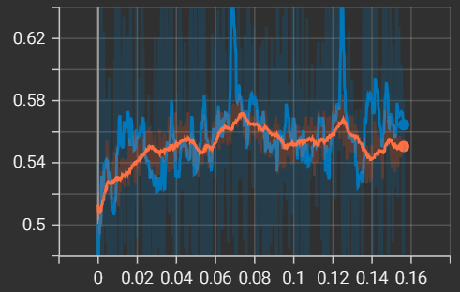
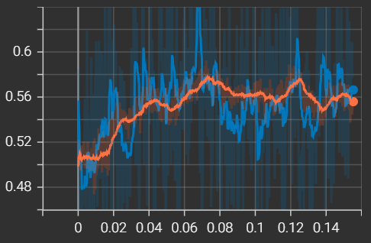
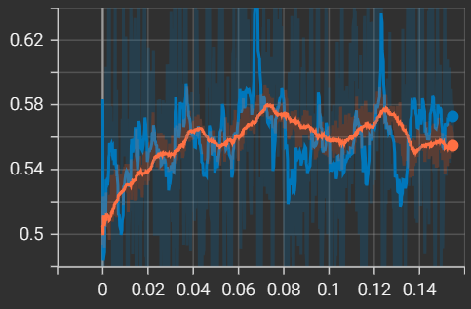
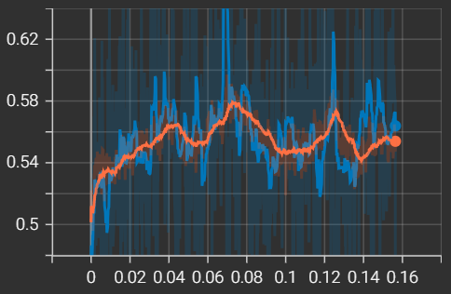
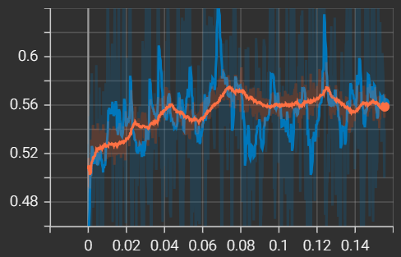
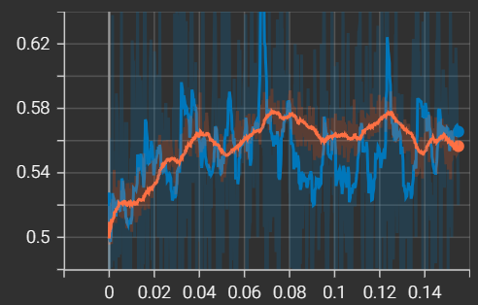
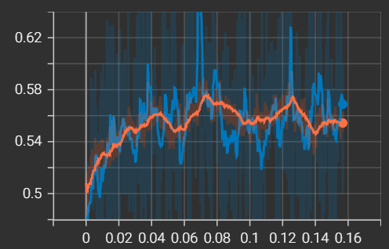
N=1, DR=1, LR=1
N=1, DR=1, LR=2
N=1, DR=1, LR=3
N=1, DR=1, LR=4

Slide 3
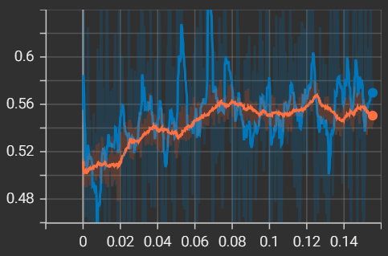
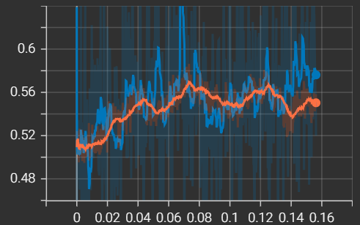
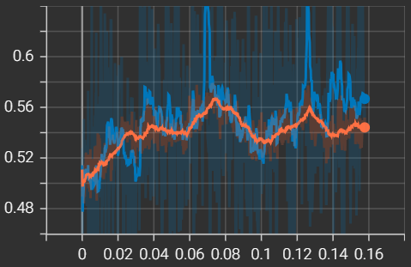
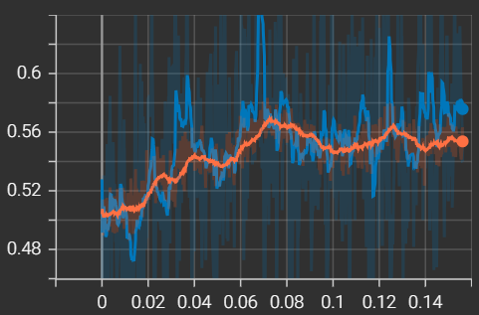
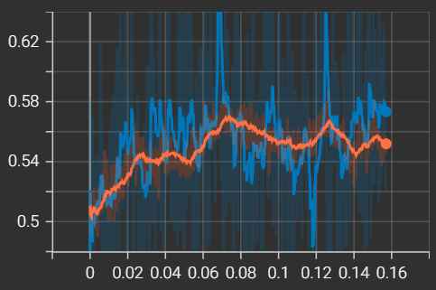
N=1, DR=2, LR=1
N=1, DR=2, LR=2
N=1, DR=2, LR=3
N=1, DR=2, LR=4

Slide 4
N=1, DR=3, LR=1
N=1, DR=3, LR=2
N=1, DR=3, LR=3
N=1, DR=3, LR=4

Slide 5
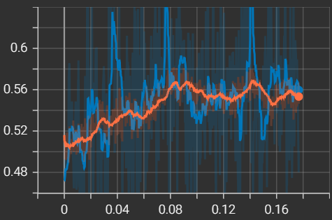
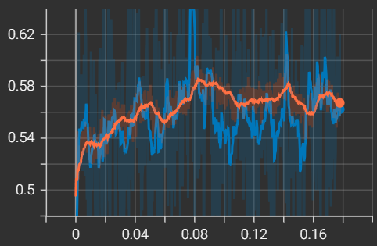
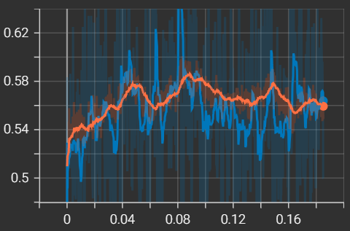
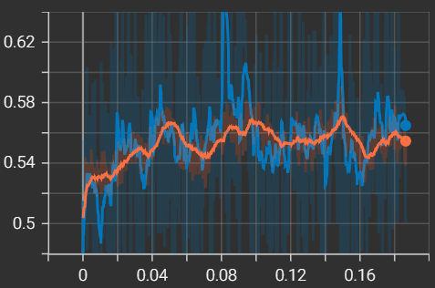
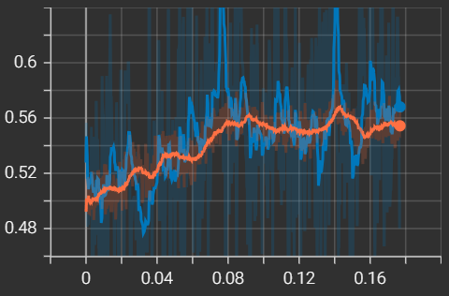
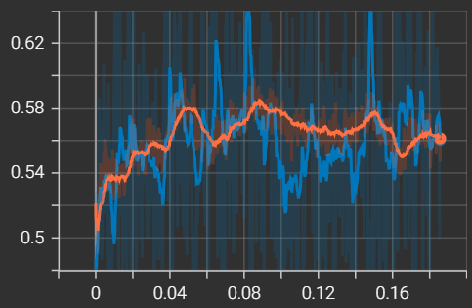
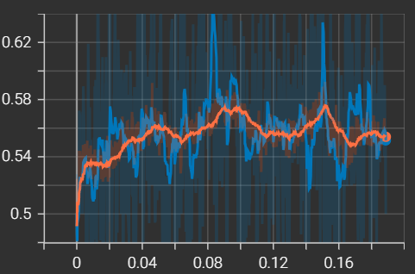
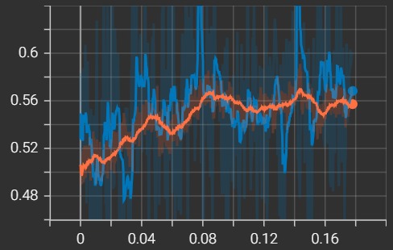
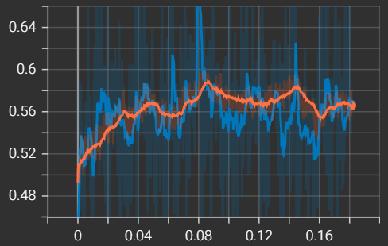
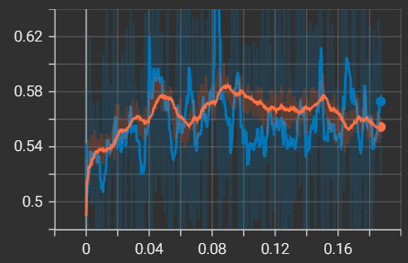
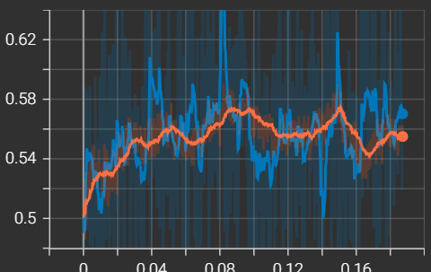
N=2, DR=1, LR=1
N=2, DR=1, LR=2
N=2, DR=1, LR=3
N=2, DR=1, LR=4

Slide 6
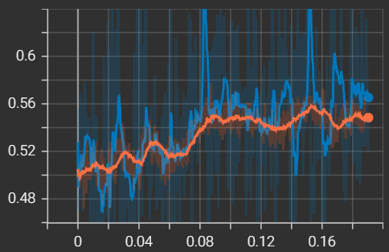
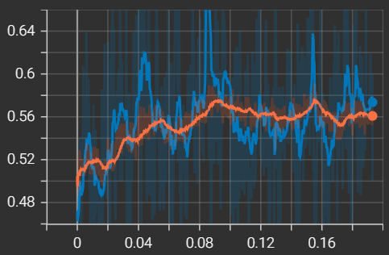
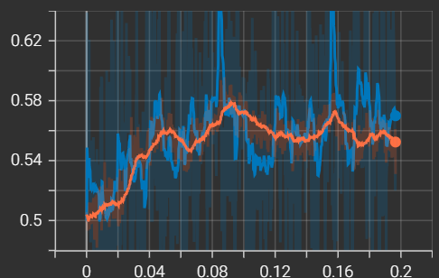
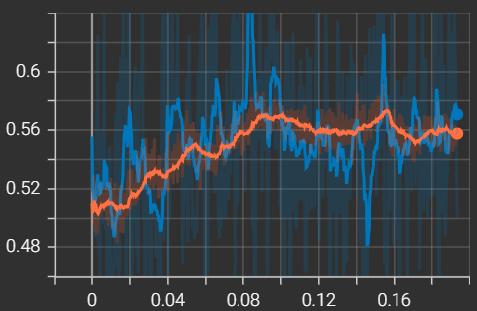
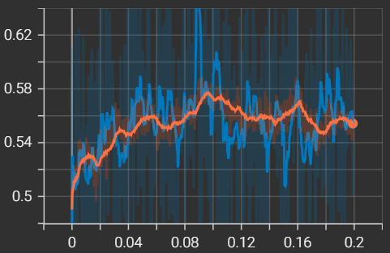
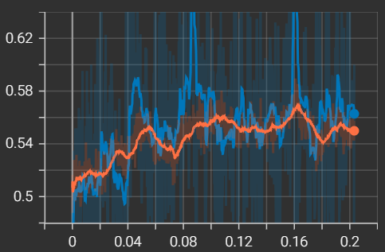
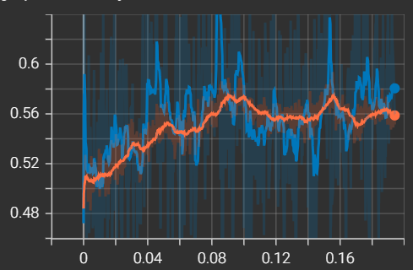
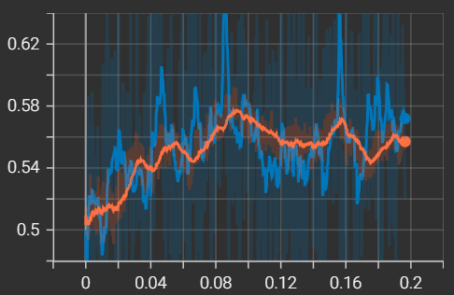
N=2, DR=2, LR=1
N=2, DR=2, LR=2
N=2, DR=2, LR=3
N=2, DR=2, LR=4

Slide 7
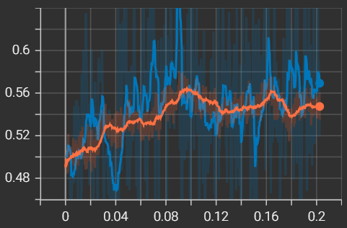
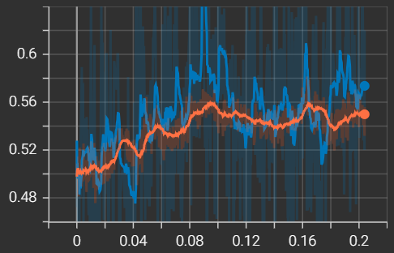
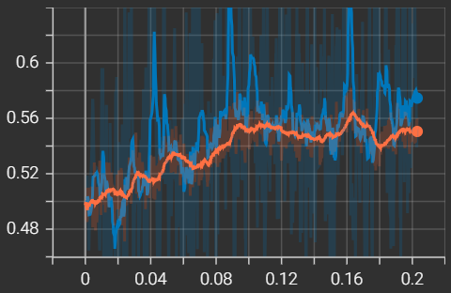
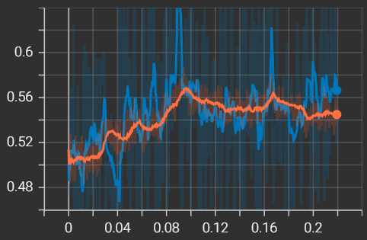
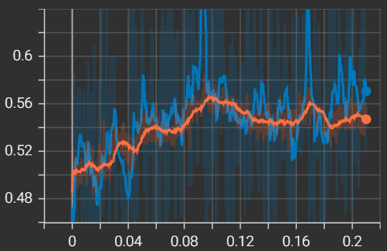
N=2, DR=3, LR=1
N=2, DR=3, LR=2
N=2, DR=3, LR=3
N=2, DR=3, LR=4

Slide 8
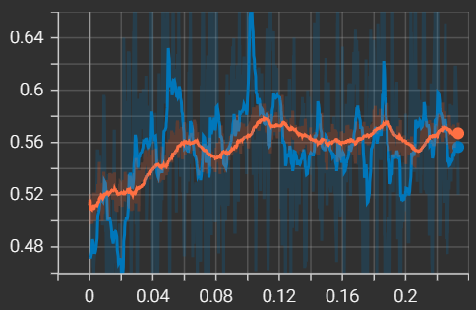
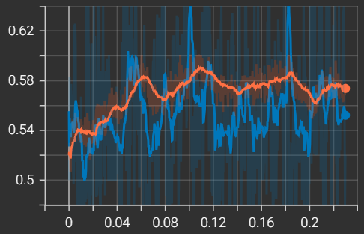
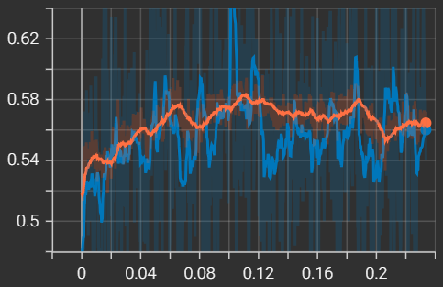
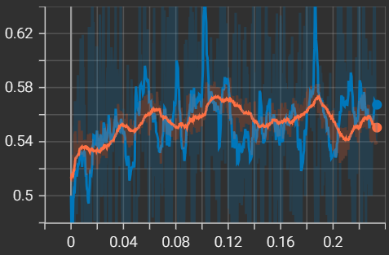
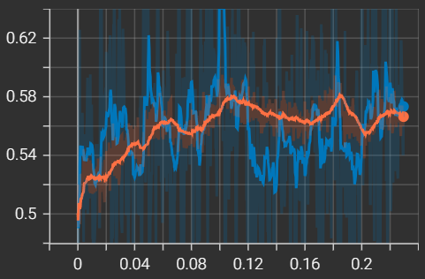
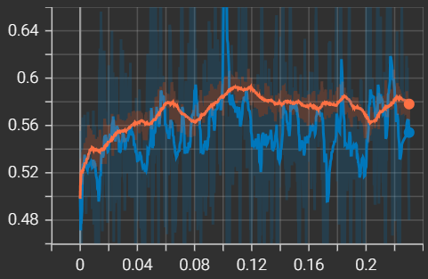
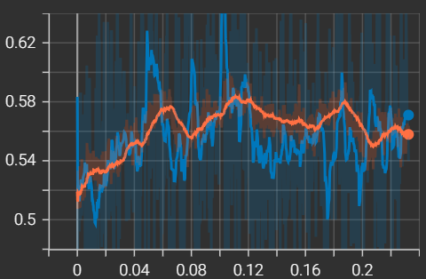
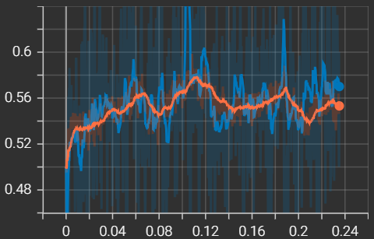
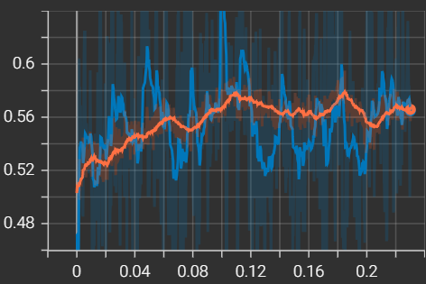
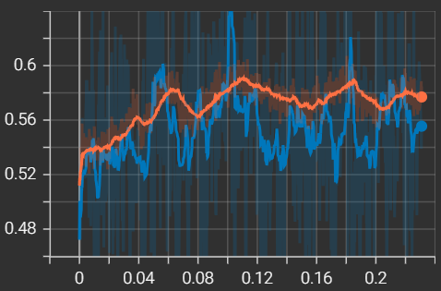


N=3, DR=1, LR=1
N=3, DR=1, LR=2
N=3, DR=1, LR=3
N=3, DR=1, LR=4

Slide 9











N=3, DR=2, LR=1
N=3, DR=2, LR=2
N=3, DR=2, LR=3
N=3, DR=2, LR=4

Slide 10









N=3, DR=3, LR=1
N=3, DR=3, LR=2
N=3, DR=3, LR=3
N=3, DR=3, LR=4

Slide 11

Best model 18.3.

Slide 12




Slide 13
N=1, DR=1m, LR=1, DECAY=1
N=1, DR=1m, LR=1, DECAY=2
N=1, DR=1m, LR=1, DECAY=3

Slide 14






N=1, DR=1m, LR=3, DECAY=1
N=1, DR=1m, LR=3, DECAY=2
N=1, DR=1m, LR=3, DECAY=3

Slide 15



N=1, DR=1m, LR=5, DECAY=1
N=1, DR=1m, LR=5, DECAY=2
N=1, DR=1m, LR=5, DECAY=3

Slide 16
N=1, DR=1p, LR=1, DECAY=1
N=1, DR=1p, LR=1, DECAY=2
N=1, DR=1p, LR=1, DECAY=3

Slide 17






N=1, DR=1p, LR=3, DECAY=1
N=1, DR=1p, LR=3, DECAY=2
N=1, DR=1p, LR=3, DECAY=3

Slide 18
N=1, DR=1p, LR=5, DECAY=1
N=1, DR=1p, LR=5, DECAY=2
N=1, DR=1p, LR=5, DECAY=3

Slide 19



N=2, DR=1m, LR=1, DECAY=1
N=2, DR=1m, LR=1, DECAY=2
N=2, DR=1m, LR=1, DECAY=3

Slide 20





N=2, DR=1m, LR=3, DECAY=1
N=2, DR=1m, LR=3, DECAY=2
N=2, DR=1m, LR=3, DECAY=3

Slide 21


N=2, DR=1m, LR=5, DECAY=1
N=2, DR=1m, LR=5, DECAY=2
N=2, DR=1m, LR=5, DECAY=3

Slide 22

N=2, DR=1p, LR=1, DECAY=1
N=2, DR=1p, LR=1, DECAY=2
N=2, DR=1p, LR=1, DECAY=3

Slide 23






N=2, DR=1p, LR=3, DECAY=1
N=2, DR=1p, LR=3, DECAY=2
N=2, DR=1p, LR=3, DECAY=3

Slide 24

N=2, DR=1p, LR=5, DECAY=1
N=2, DR=1p, LR=5, DECAY=2
N=2, DR=1p, LR=5, DECAY=3

Slide 25




Slide 26






N=1, DR=1m, LR=2
N=1, DR=1m, LR=3m
N=1, DR=1m, LR=3

Slide 27





N=1, DR=1p, LR=2
N=1, DR=1p, LR=3m
N=1, DR=1p, LR=3

Slide 28






N=2, DR=1m, LR=2
N=2, DR=1m, LR=3m
N=2, DR=1m, LR=3

Slide 29






N=2, DR=1p, LR=2
N=2, DR=1p, LR=3m
N=2, DR=1p, LR=3

Slide 30


After checking the permutation feature importance the 0.00008 LR/0.995 LR_DECAY model was still taken as the best one.

Slide 31

Updated model from 27.3.

Slide 32

Updated model from 30.3.

Slide 33

Updated model from 4.4.

Slide 34

Updated model from 7.4.

