Slide 1
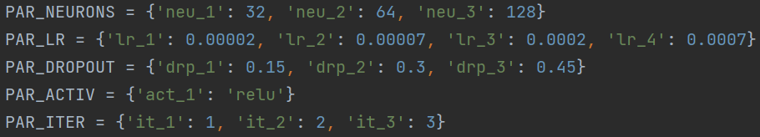
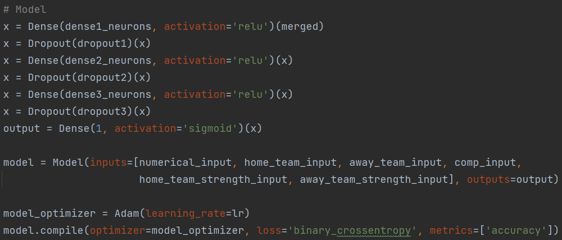

Slide 2
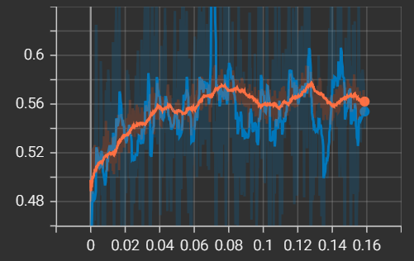
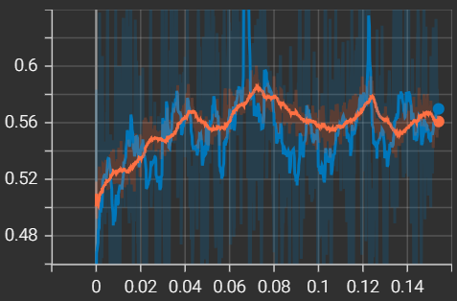
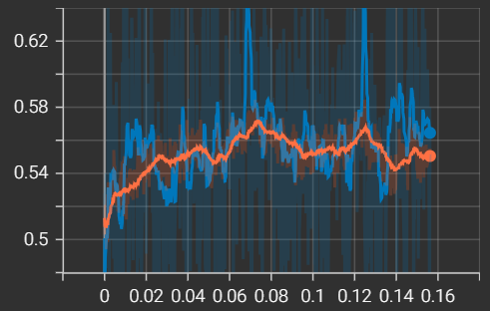
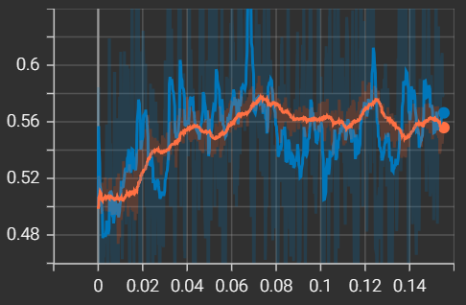
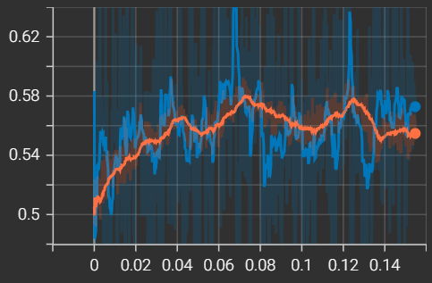
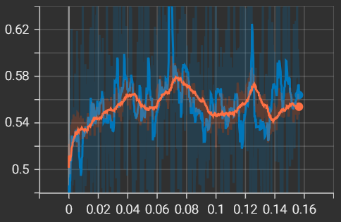
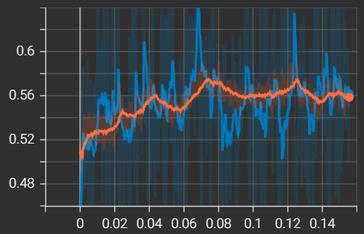
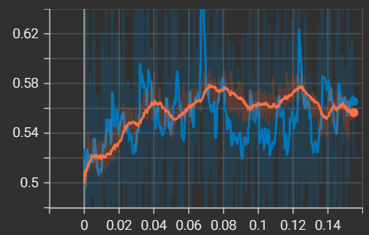
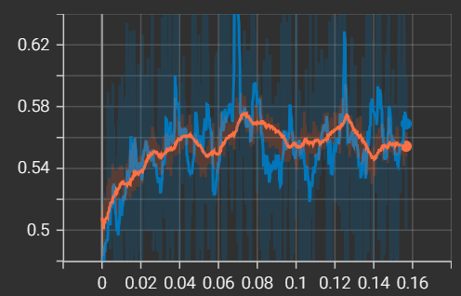
N=1, DR=1, LR=1
N=1, DR=1, LR=2
N=1, DR=1, LR=3
N=1, DR=1, LR=4

Slide 3
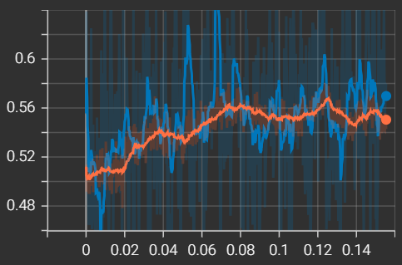
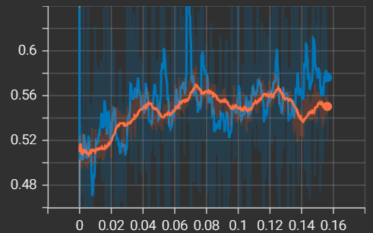
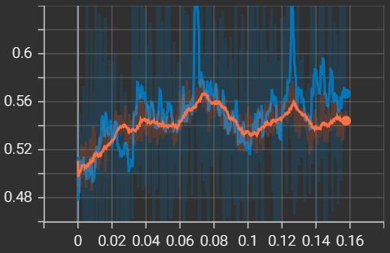
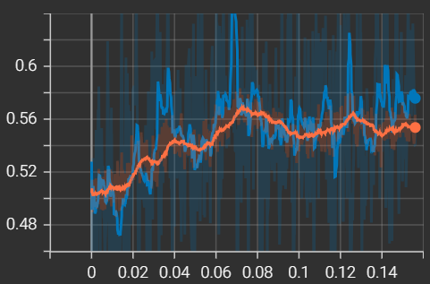
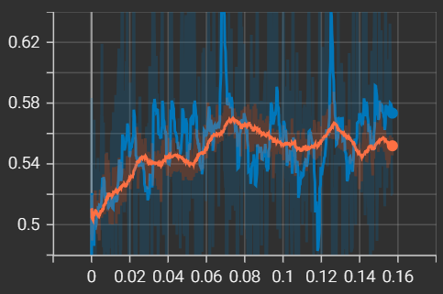
N=1, DR=2, LR=1
N=1, DR=2, LR=2
N=1, DR=2, LR=3
N=1, DR=2, LR=4

Slide 4
N=1, DR=3, LR=1
N=1, DR=3, LR=2
N=1, DR=3, LR=3
N=1, DR=3, LR=4

Slide 5
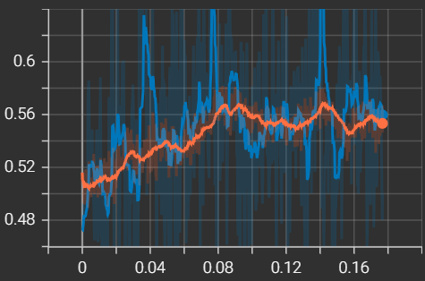
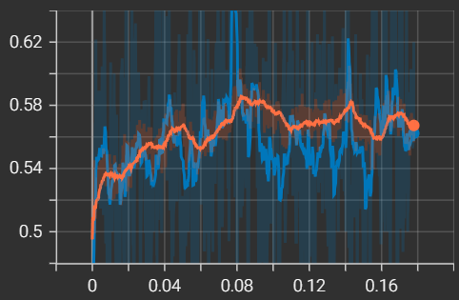
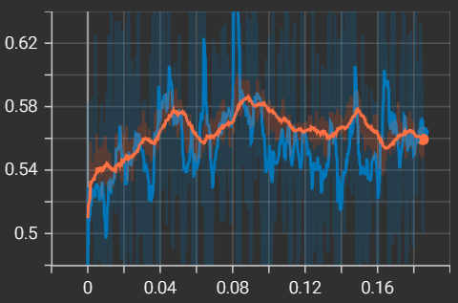
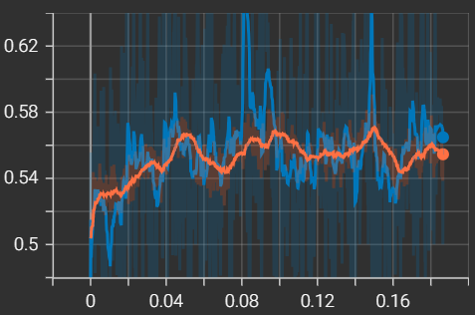
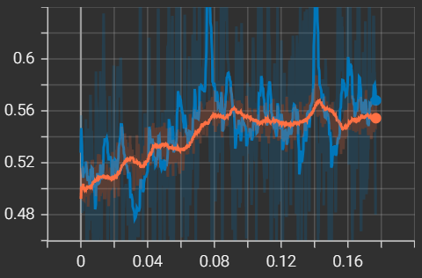
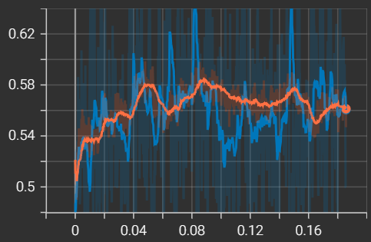
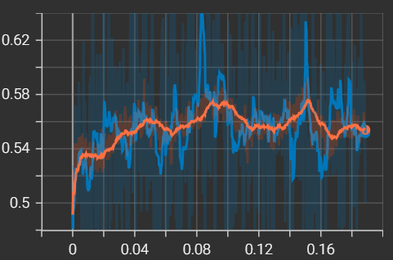
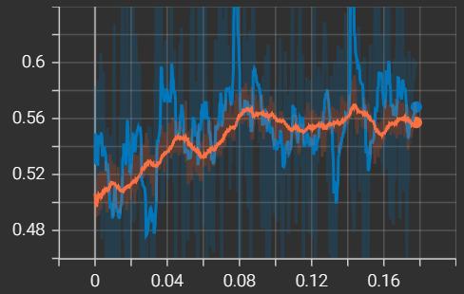
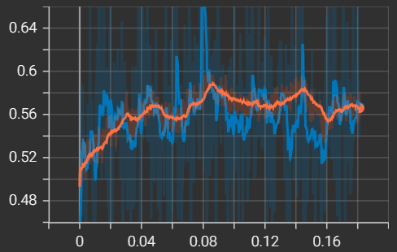
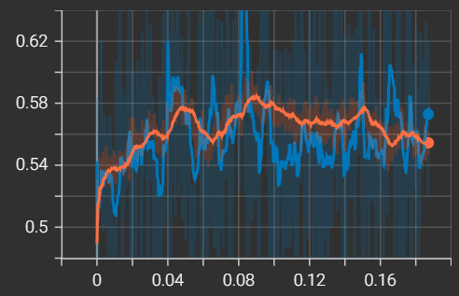
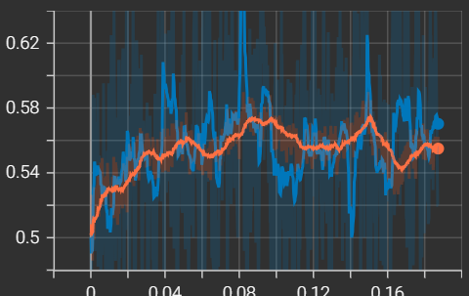
N=2, DR=1, LR=1
N=2, DR=1, LR=2
N=2, DR=1, LR=3
N=2, DR=1, LR=4

Slide 6
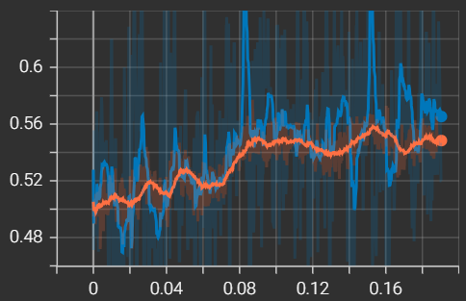
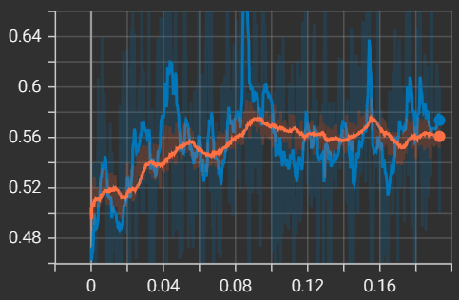
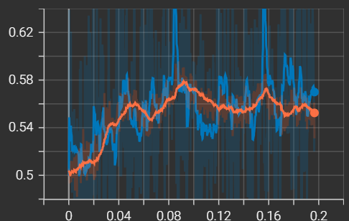
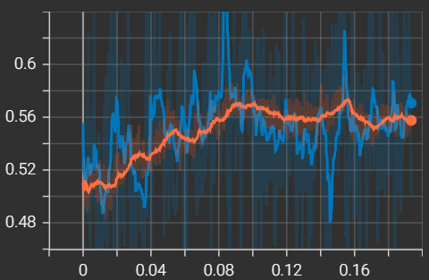
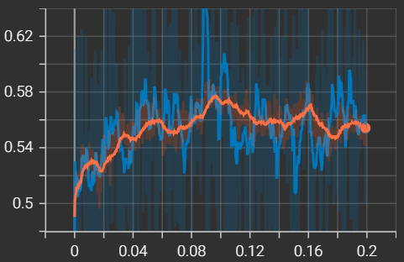
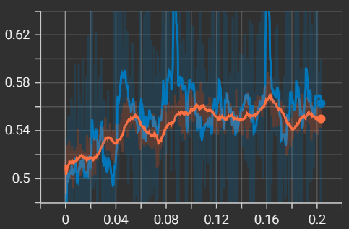
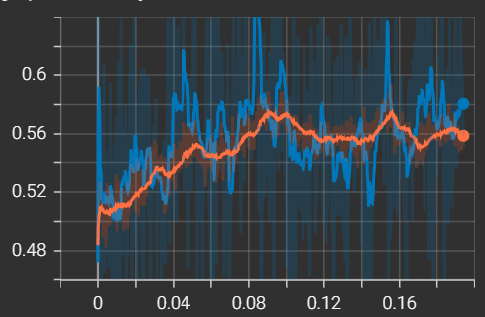
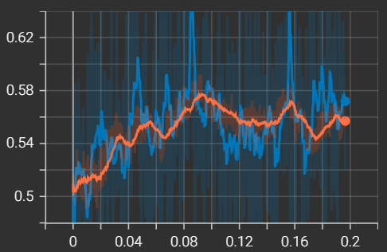
N=2, DR=2, LR=1
N=2, DR=2, LR=2
N=2, DR=2, LR=3
N=2, DR=2, LR=4

Slide 7
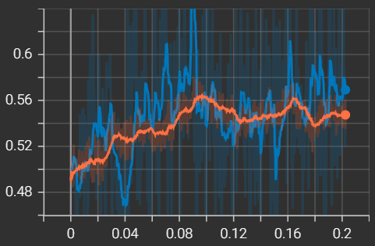
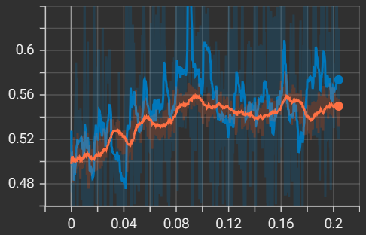
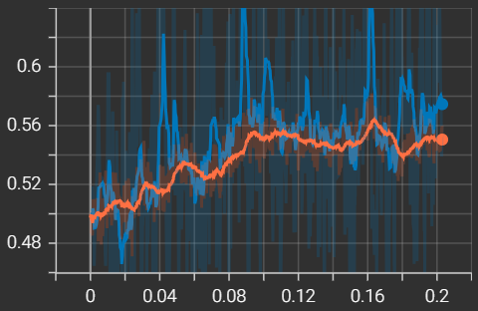
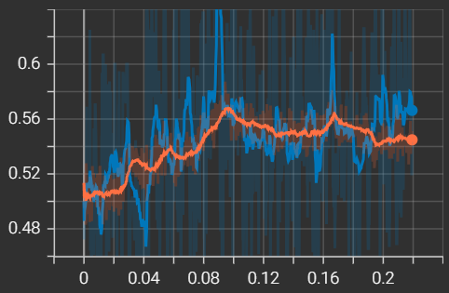
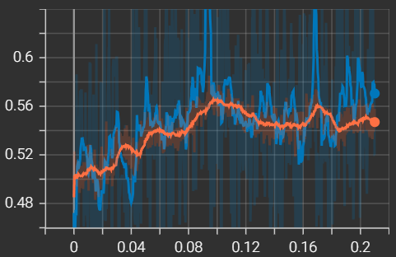
N=2, DR=3, LR=1
N=2, DR=3, LR=2
N=2, DR=3, LR=3
N=2, DR=3, LR=4

Slide 8
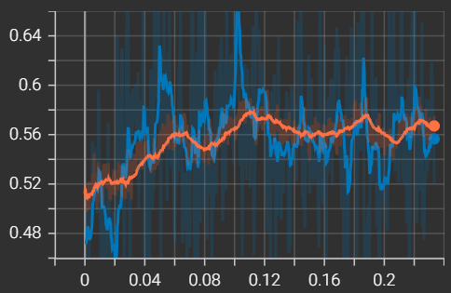
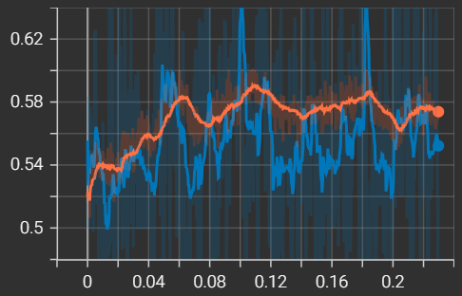
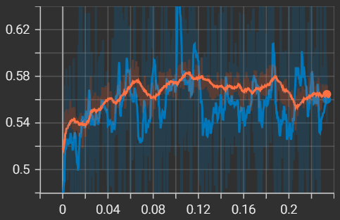
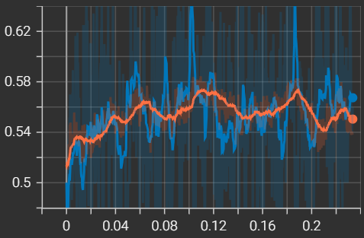
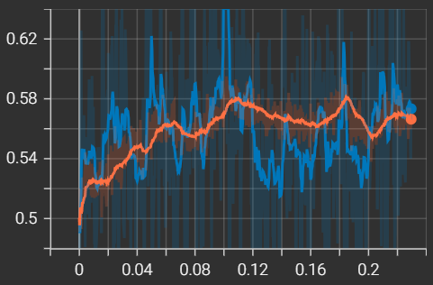
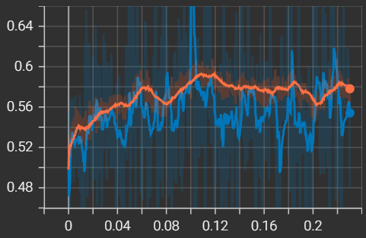
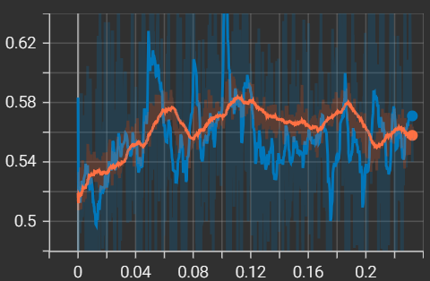
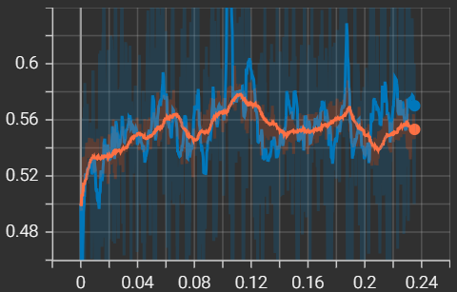
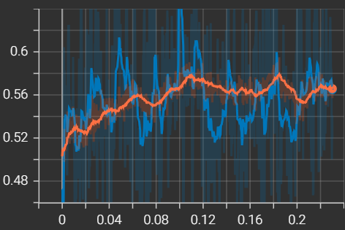
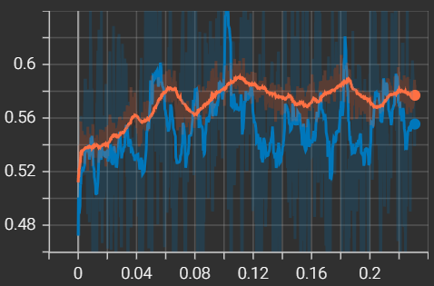


N=3, DR=1, LR=1
N=3, DR=1, LR=2
N=3, DR=1, LR=3
N=3, DR=1, LR=4

Slide 9











N=3, DR=2, LR=1
N=3, DR=2, LR=2
N=3, DR=2, LR=3
N=3, DR=2, LR=4

Slide 10









N=3, DR=3, LR=1
N=3, DR=3, LR=2
N=3, DR=3, LR=3
N=3, DR=3, LR=4

Slide 11

Best model 18.3.

Slide 12




Slide 13
N=1, DR=1m, LR=1, DECAY=1
N=1, DR=1m, LR=1, DECAY=2
N=1, DR=1m, LR=1, DECAY=3

Slide 14






N=1, DR=1m, LR=3, DECAY=1
N=1, DR=1m, LR=3, DECAY=2
N=1, DR=1m, LR=3, DECAY=3

Slide 15



N=1, DR=1m, LR=5, DECAY=1
N=1, DR=1m, LR=5, DECAY=2
N=1, DR=1m, LR=5, DECAY=3

Slide 16
N=1, DR=1p, LR=1, DECAY=1
N=1, DR=1p, LR=1, DECAY=2
N=1, DR=1p, LR=1, DECAY=3

Slide 17






N=1, DR=1p, LR=3, DECAY=1
N=1, DR=1p, LR=3, DECAY=2
N=1, DR=1p, LR=3, DECAY=3

Slide 18
N=1, DR=1p, LR=5, DECAY=1
N=1, DR=1p, LR=5, DECAY=2
N=1, DR=1p, LR=5, DECAY=3

Slide 19



N=2, DR=1m, LR=1, DECAY=1
N=2, DR=1m, LR=1, DECAY=2
N=2, DR=1m, LR=1, DECAY=3

Slide 20





N=2, DR=1m, LR=3, DECAY=1
N=2, DR=1m, LR=3, DECAY=2
N=2, DR=1m, LR=3, DECAY=3

Slide 21


N=2, DR=1m, LR=5, DECAY=1
N=2, DR=1m, LR=5, DECAY=2
N=2, DR=1m, LR=5, DECAY=3

Slide 22

N=2, DR=1p, LR=1, DECAY=1
N=2, DR=1p, LR=1, DECAY=2
N=2, DR=1p, LR=1, DECAY=3

Slide 23






N=2, DR=1p, LR=3, DECAY=1
N=2, DR=1p, LR=3, DECAY=2
N=2, DR=1p, LR=3, DECAY=3

Slide 24

N=2, DR=1p, LR=5, DECAY=1
N=2, DR=1p, LR=5, DECAY=2
N=2, DR=1p, LR=5, DECAY=3

Slide 25




Slide 26






N=1, DR=1m, LR=2
N=1, DR=1m, LR=3m
N=1, DR=1m, LR=3

Slide 27





N=1, DR=1p, LR=2
N=1, DR=1p, LR=3m
N=1, DR=1p, LR=3

Slide 28






N=2, DR=1m, LR=2
N=2, DR=1m, LR=3m
N=2, DR=1m, LR=3

Slide 29






N=2, DR=1p, LR=2
N=2, DR=1p, LR=3m
N=2, DR=1p, LR=3

Slide 30


After checking the permutation feature importance the 0.00008 LR/0.995 LR_DECAY model was still taken as the best one.

Slide 31

Updated model from 27.3.

Slide 32

Updated model from 30.3.

Slide 33

Updated model from 4.4.

Slide 34

Updated model from 7.4.

Slide 35
Updated model from 10.4.
Logs weren’t saved due to low average accuracy

Slide 36

Updated model from 17.4.

Slide 37

Updated model from 20.4.

Slide 38

Updated model from 25.4.

Slide 39
Updated model from 29.4.
Logs weren’t saved due to low average accuracy

Slide 40

Updated model from 4.5.

Slide 41

Updated model from 10.5.

Slide 42

Updated model from 17.5.

Slide 43

Updated model from 22.5.

