Slide 1
Analysıs OF Deep Multilayer Perceptrons for Dimensional Speech Emotion Recognition
Kutay Uğurlu
Notes:
This video presentation is for EE583 PR project.
In this project I have analyzed the paper Deep Multilayer Perceptrons for Dimensional Speech Emotion Recognition , which is published as a proceedings paper in Asia-Pacific Signal and Information Processing Association Annual Summit

Slide 2
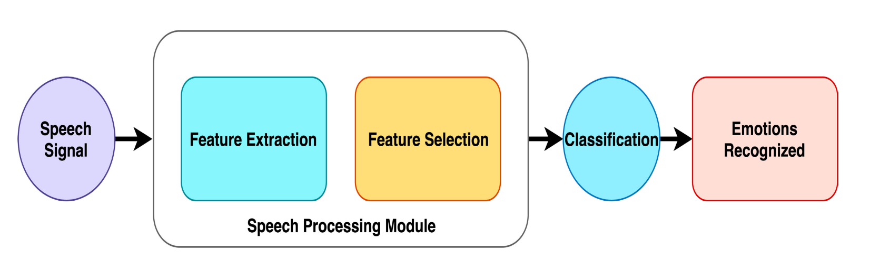
Figure 1. Traditional Speech Emotion Recognition Scheme
Notes:
Traditional scheme where the categorical labels such as joy and anger are utilized for classification. Researchers of this paper, on the other hand, utilize the dimensional emotions and convert this problem into more of a regression one .

Slide 3
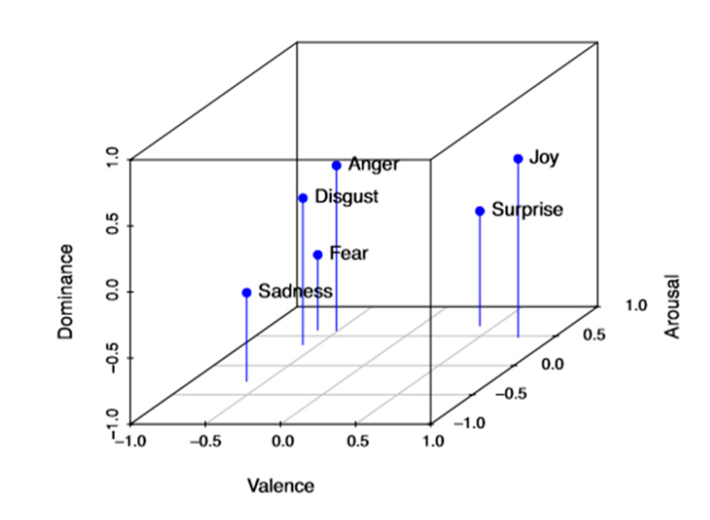
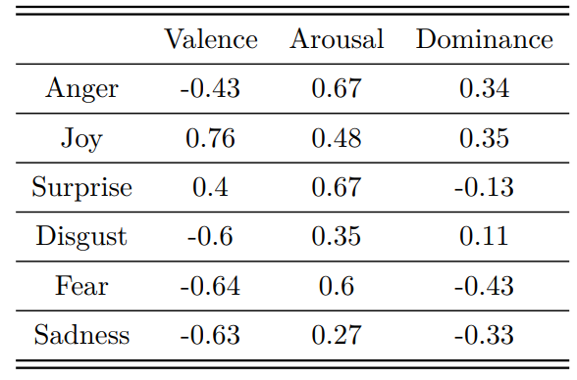
DIMENSIONAL EMOTIONS
Figure 2. Emotions in VAD Space
Notes:
So how did they do that, numerical labels are needed in this regression problem
Russel argued in his 1979 paper that the emotions have representations in 3 dimension, being Valence, Arousal and Dominance.
Valence: the pleasantness
Arousal: The intensity of emotion
Dominance: Degree of control

Slide 4
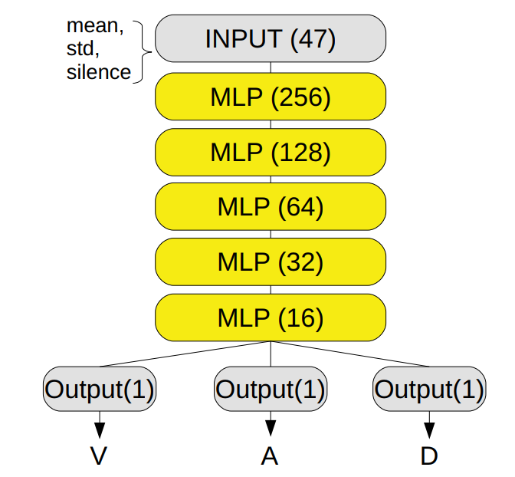
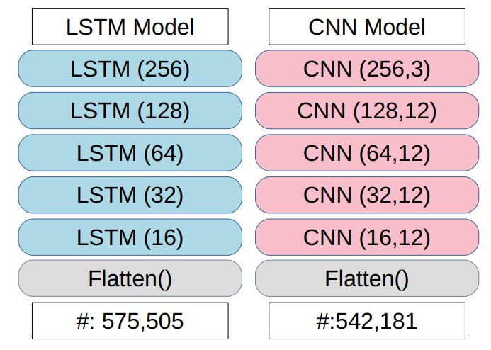
ARCHITECTURES
Layer numbers
Computational units in each layer
Number of trainable parameters
Figure 3. Architectures of the models used in the study
Notes:
Below you see the benchmark models and above you see the proposed architecture

Slide 5
DATASETS
MSP-IMPROV
12 hours of speech data, 10039 utterances
IEMOCAP
18 hours of speech data, 8438 utterances
Notes:
2 databases are utilized in this study. MSP : dyadic interactions staged by 12 actors
Although both datasets include extra data such as video and text, only audio data was utilized.
Labelled by multiple annotators

Slide 6
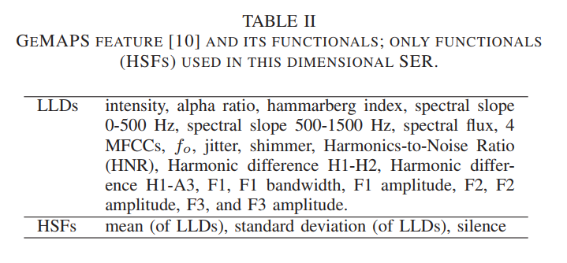


Features
Figure 4. eGeMAPS v01b features utilized in the study
$$th=0.3 ×\sqrt{\sum_{i=1}^{N}{ {x[i]}^{2}}}$$
Silence = $\frac{\#Silent frames}{\#Total frames}$
Notes:
This table shows the GeMAPS features utilized in the study.
There seems to be 20 features but one feature is actually composed of 4 components, here there are 4 MFCCs
These low level descriptors are extracted from the data resulting in nodes dimension of nodes (3409 × 23) along the larger dimension mean and standard deviation are calculated to obtain 46 features. In addition authors defined a new feature
The silence is obtained as the ratio of silent frames by the number of total frames.

Slide 7
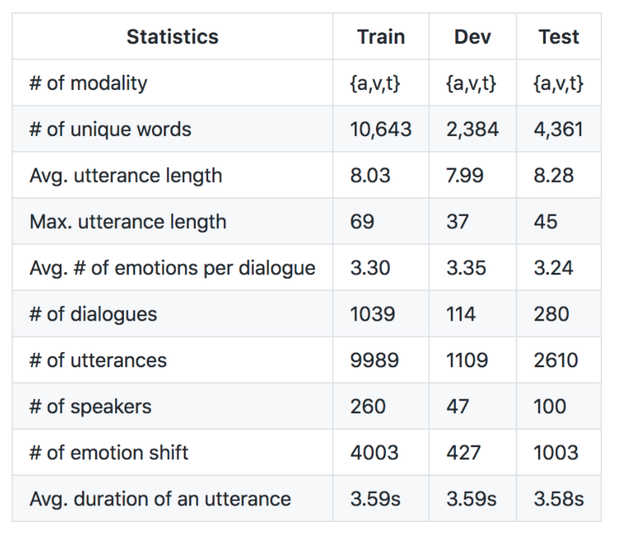
MELD Dataset
Figure 5. MELD Dataset Statistics
Notes:
Utilized only training and test sets
There were categorical labels, converted it to dimensional based on the table that I showed before
There were labels annotated “neutral” in this dataset, after dropping them I am left with approximately 5 thousand samples.
Added 0.01 to reflect the effect of human bias to the labels just one times

Slide 8

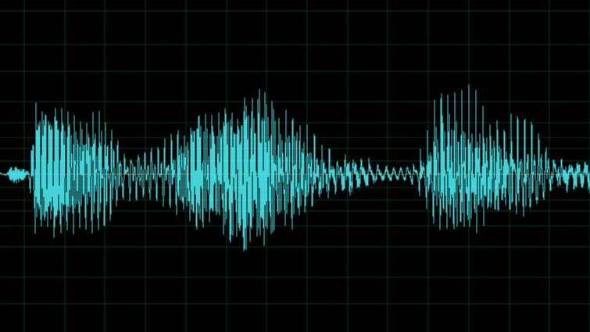
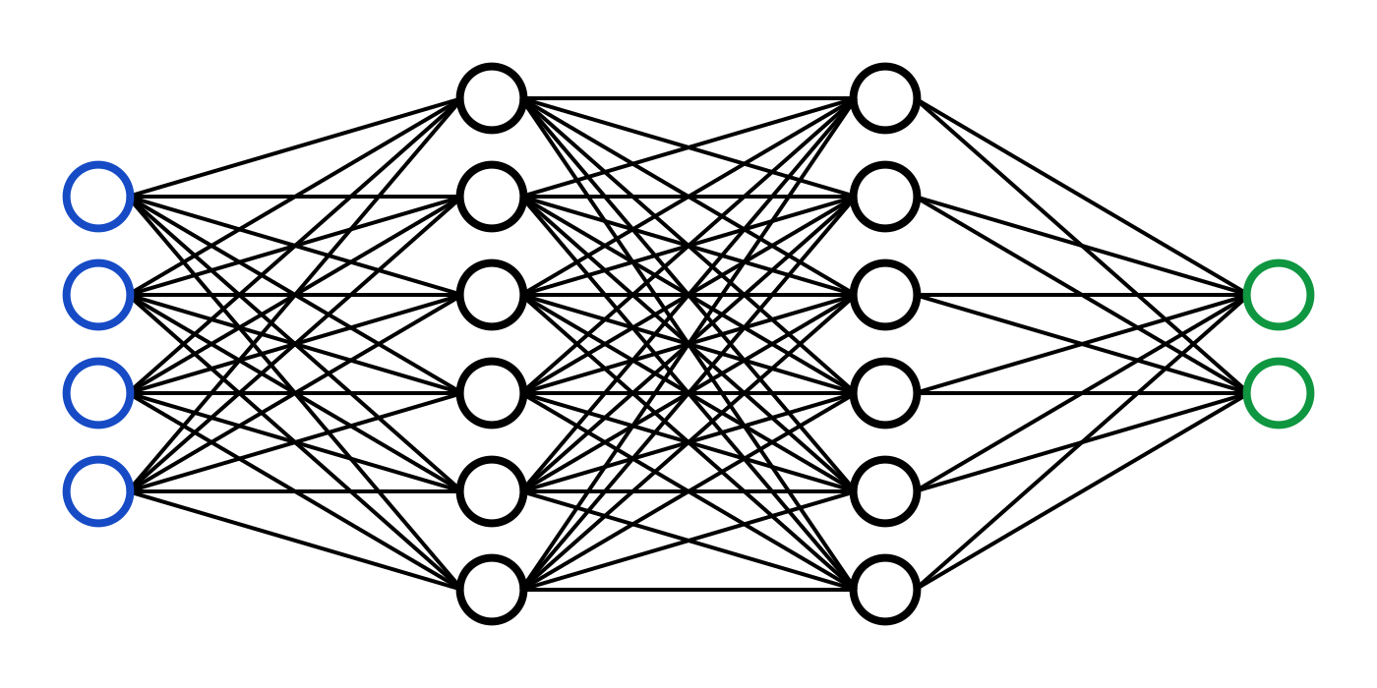
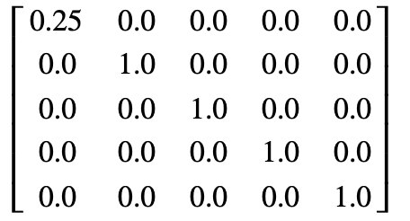
FFMPEG
MP4 to WAV
OPENSMILE
Feature extraction
FEATURE DATA
Data processing
NUMPY

Slide 9
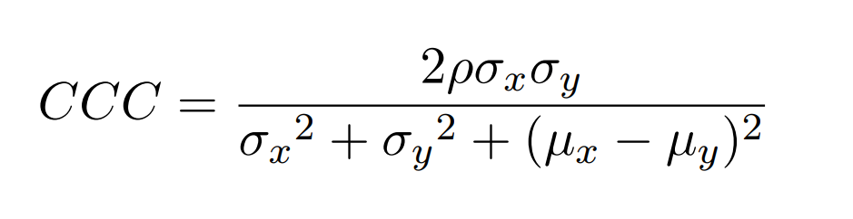

Concordance correlation coefficient & CCC LOSS
Notes:
Pearsons
Loss definition is intuitive
Used MSE loss for MLPs due to scikit implementation of MLPRregressor

Slide 10
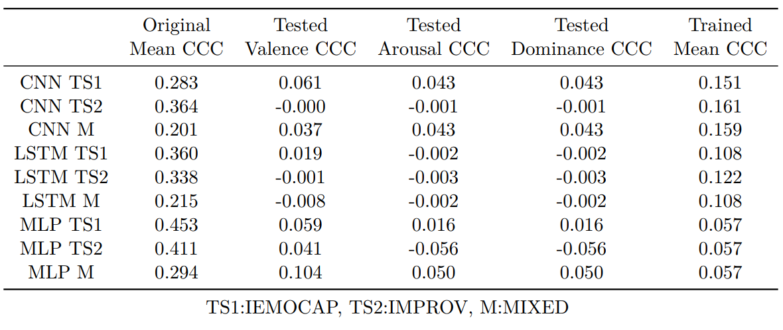
Size of the dataset
Number of training data distributions
Labelling and Human Bias
Architecture
Notes:
Counterintuitive results are caused from a specific case of hyperparameter optimization along with the used datasets

Slide 11
Thanks....

