Slide 3
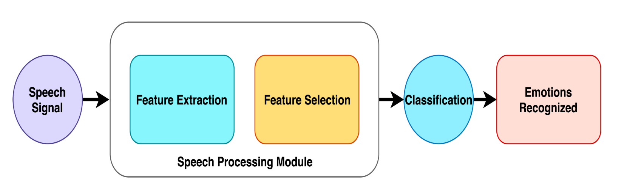

Slide 4
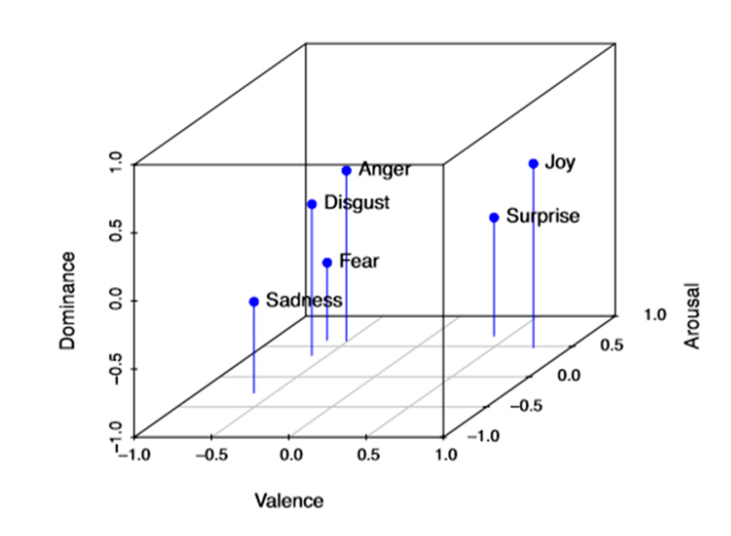
DIMENSIONAL EMOTIONS

Slide 5
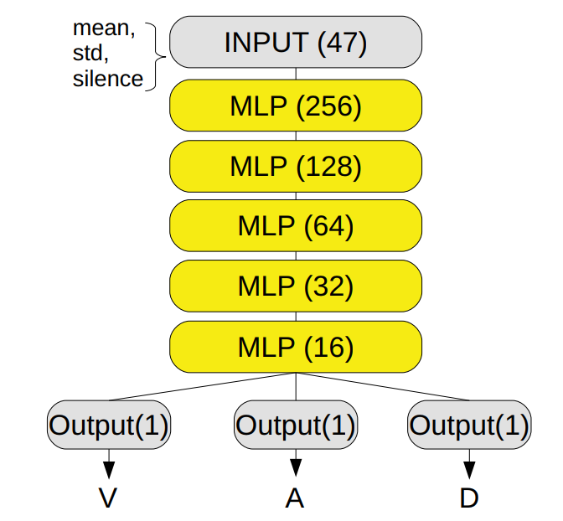
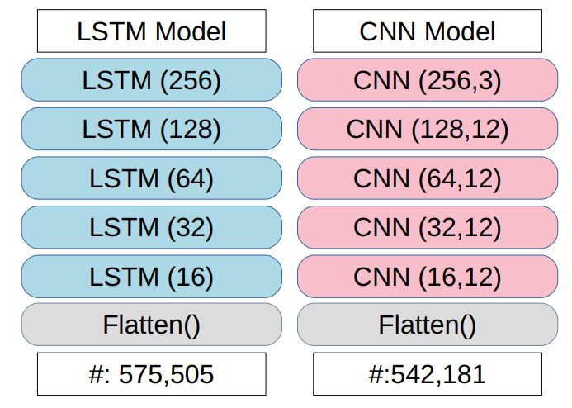
ARCITECTURES
Layer numbers
Computational units in each layer
Number of trainable parameters

Slide 6
DATASETS
MSP-IMPROV
12 hours of speech data, 10039 utterances
IEMOCAP
18 hours of speech data, 8438 utterances

Slide 7
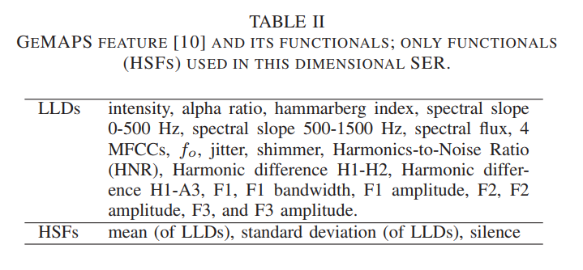


Features
$$th=0.3 ×\sqrt{\sum_{i=1}^{N}{ {x[i]}^{2}}}$$
Silence = $\frac{\#Silent frames}{\#Total frames}$

Slide 8
MELD Dataset

Slide 9

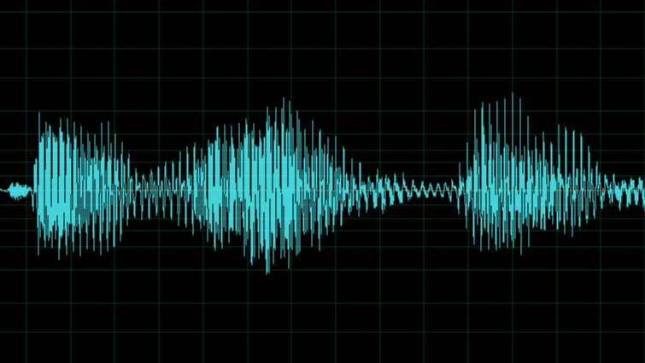
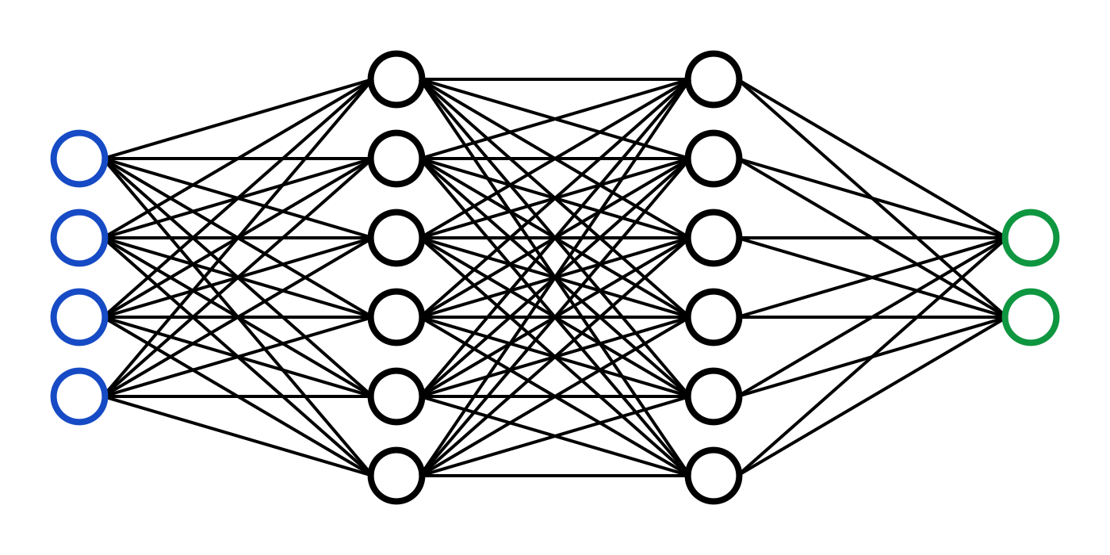
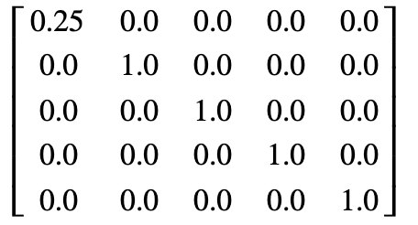
FFMPEG
MP4 to WAV
OPENSMILE
Feature extraction
FEATURE DATA
Data processing
NUMPY

Slide 11
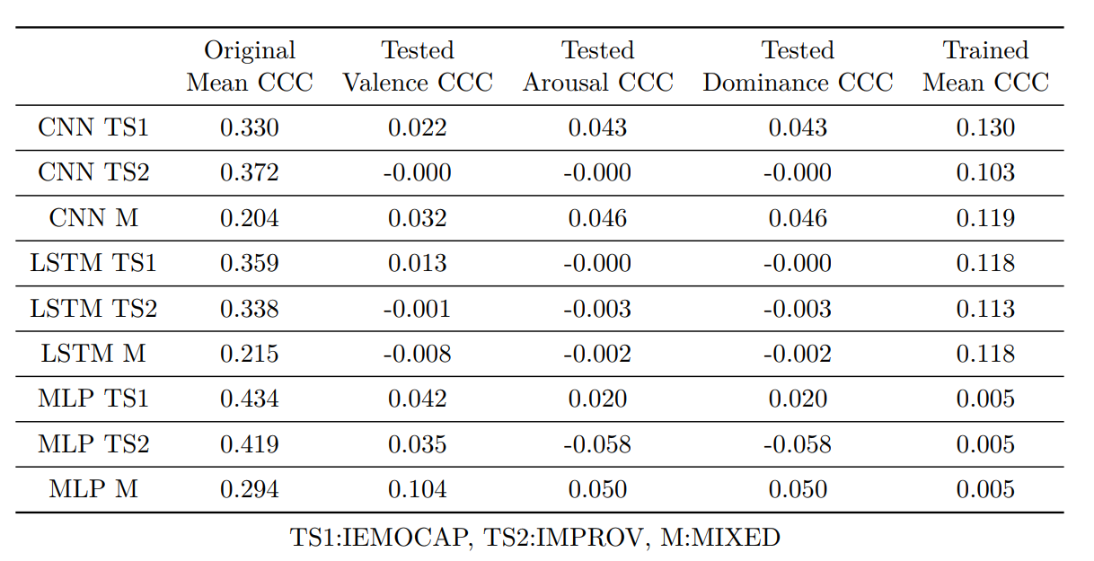
Size of the dataset
Number of training data distributions
Labelling and Human Bias
Architecture

