Slide 1
Analysıs OF Deep Multilayer Perceptrons for Dimensional Speech Emotion Recognition
Kutay Uğurlu

Slide 2
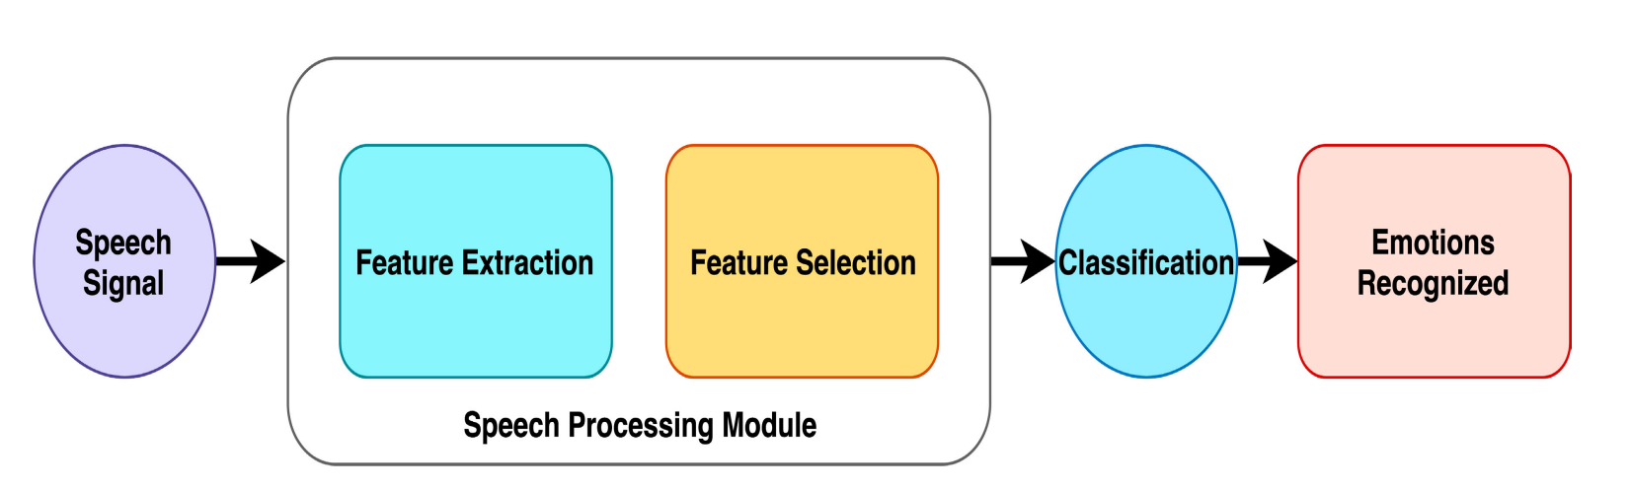

Slide 3
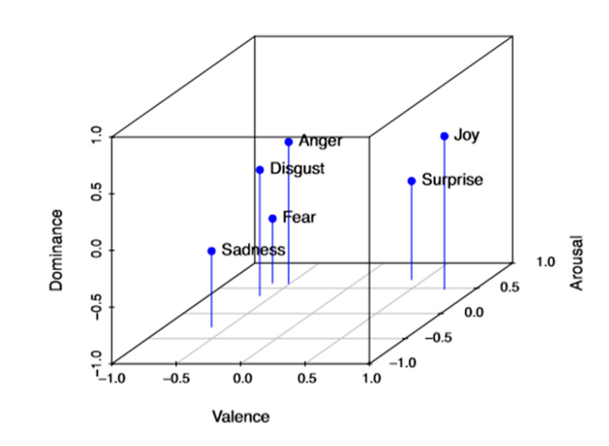
DIMENSIONAL EMOTIONS

Slide 4
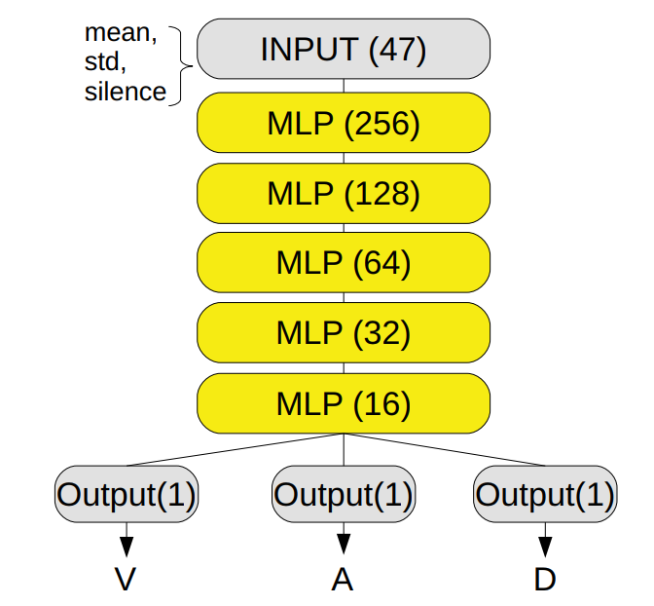
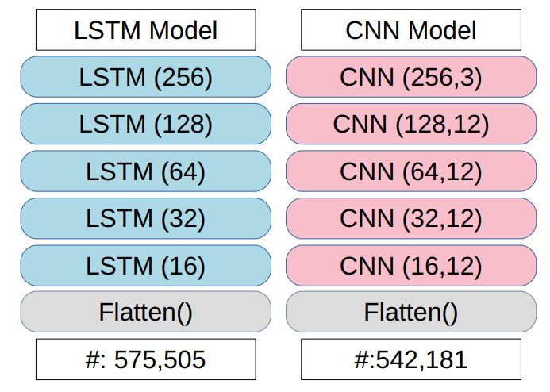
ARCITECTURES
Layer numbers
Computational units in each layer
Number of trainable parameters

Slide 5
DATASETS
MSP-IMPROV
12 hours of speech data, 10039 utterances
IEMOCAP
18 hours of speech data, 8438 utterances

Slide 6
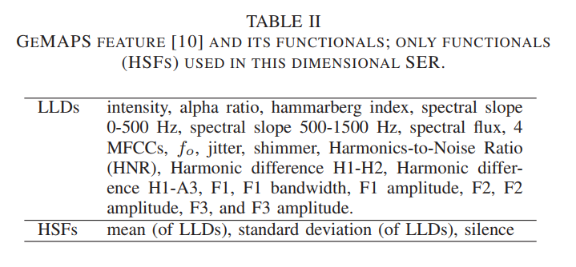


Features
$$th=0.3 ×\sqrt{\sum_{i=1}^{N}{ {x[i]}^{2}}}$$
Silence = $\frac{\#Silent frames}{\#Total frames}$

Slide 7
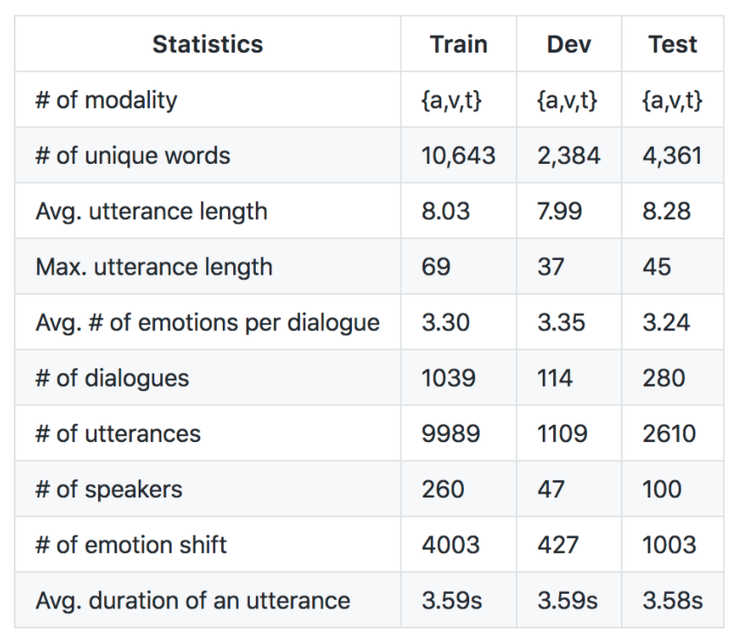
MELD Dataset

Slide 8

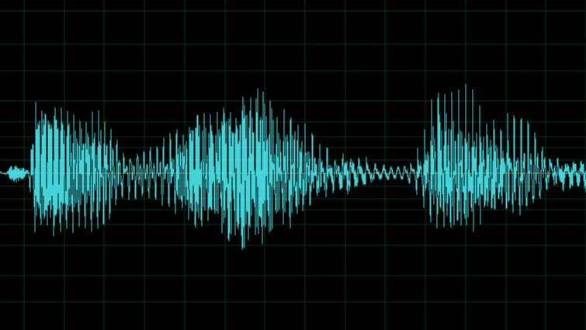
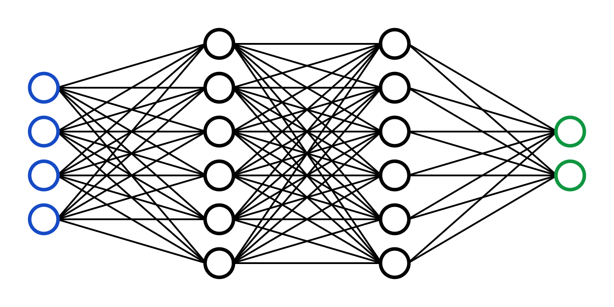
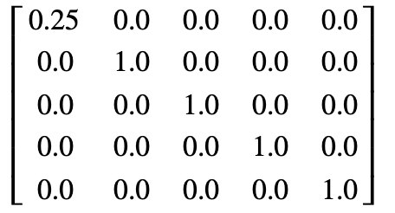
FFMPEG
MP4 to WAV
OPENSMILE
Feature extraction
FEATURE DATA
Data processing
NUMPY

Slide 10
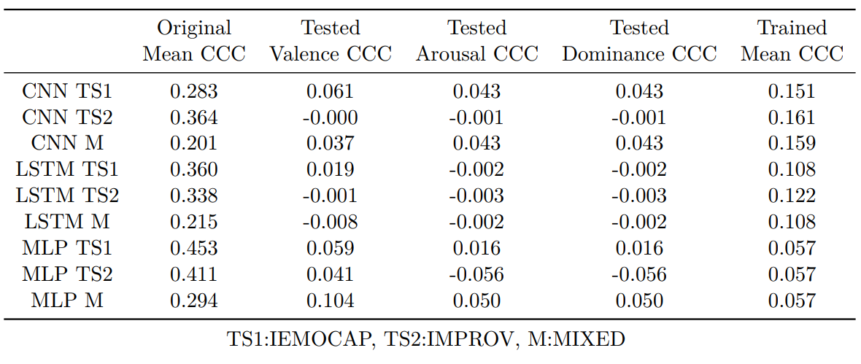
Size of the dataset
Number of training data distributions
Labelling and Human Bias
Architecture

