Slide 1


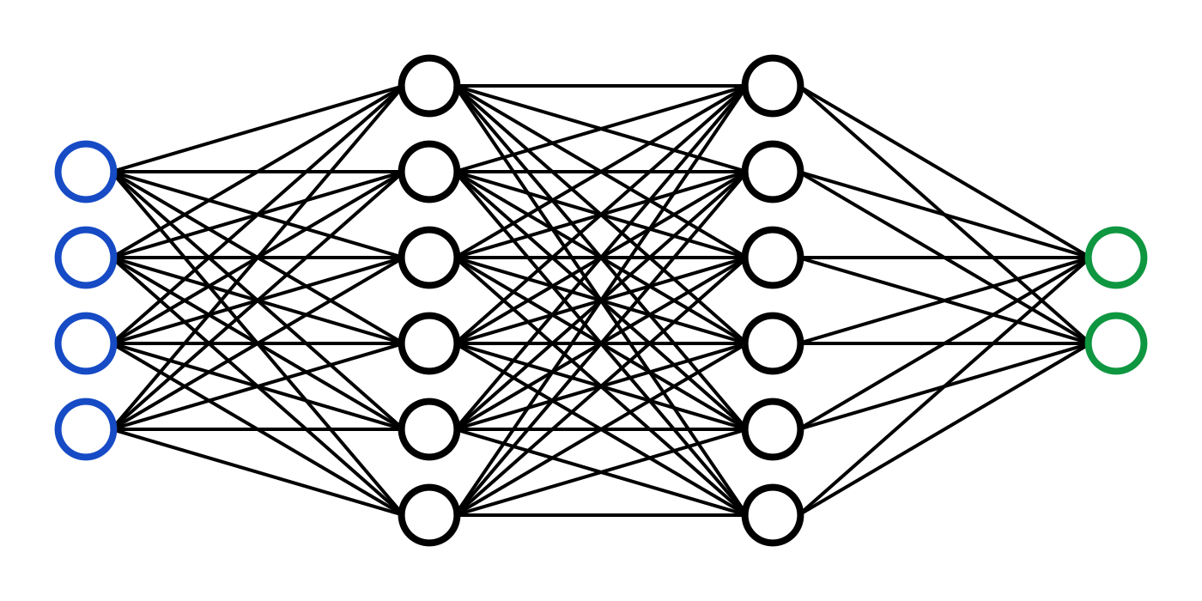
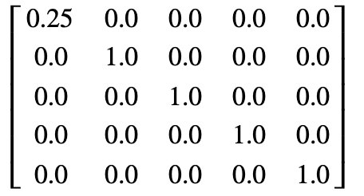
FFMPEG
MP4 to WAV
Feature extraction
OPENSMILE
FEATURE DATA
Data processing
NUMPY

