Slide 1
Analysis of FBPConvNet with Synapse MultiOrgan Dataset
Kutay Uğurlu

Slide 2
Outline
Problem and Background
Computerized Tomography
Radon Transform
Back Projection
Normal Operator
Solution Proposed
FBPConvNet
Replicated Results
Synapse Dataset
Results
Q&A

Slide 3
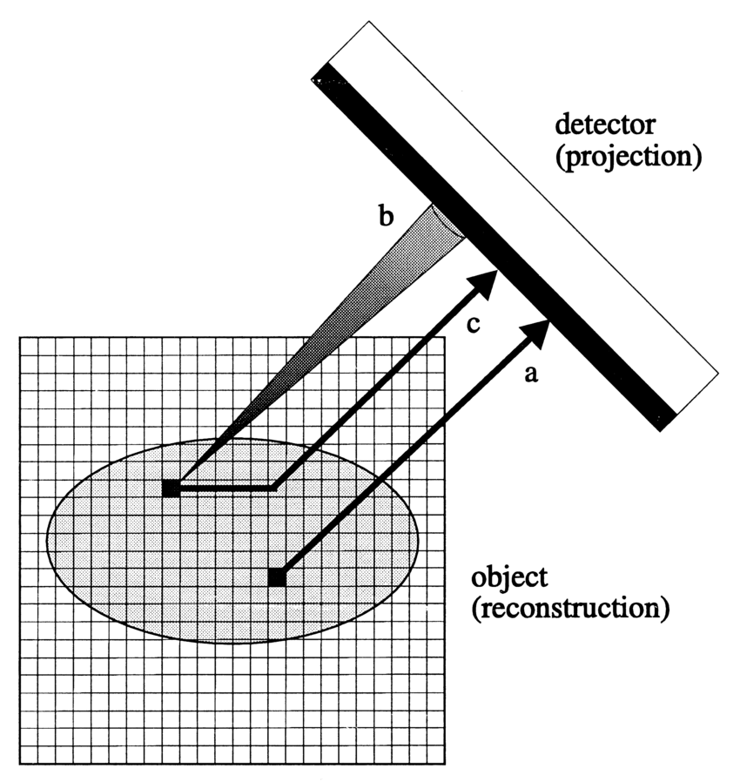
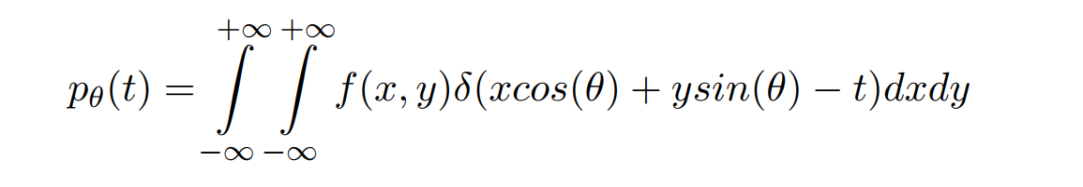
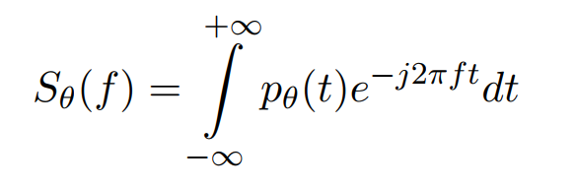
Computerized Tomography
Notes:
I would like to first dive a little deeper into CT problem
In computerized tomography we calculate the X ray projections along a line with a certain slope which we also call Radon transform
I will refer the 1d fourier transform of this as follows

Slide 4
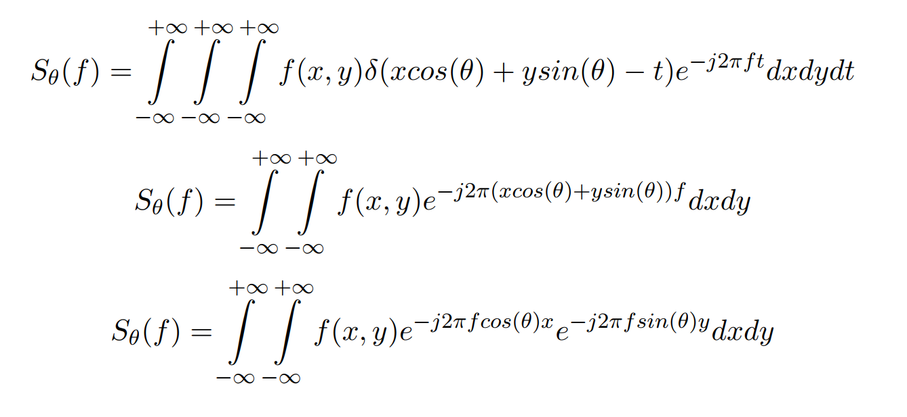
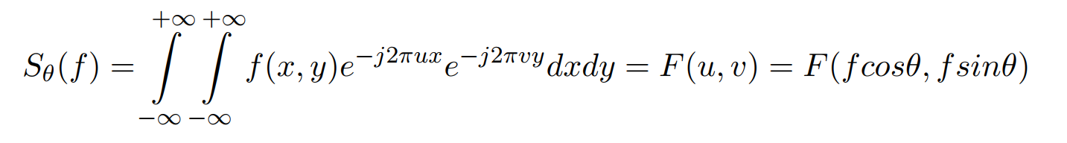
Projection Slice Theorem
Notes:
When we plug the expression for p theta t into the fourier transform reliation we have the first relation

Slide 5
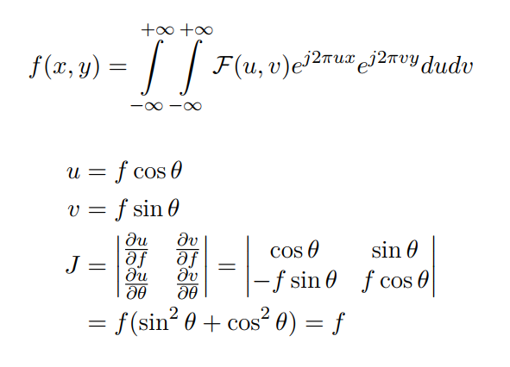
Reversible Change of Variables

Slide 6
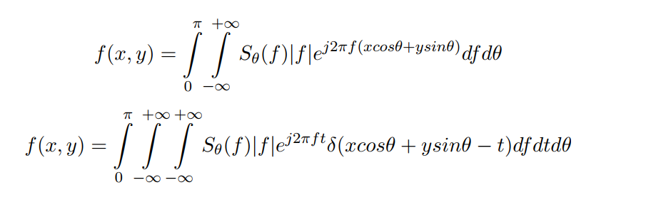
Projection-Back Projection: Impulse Response
Notes:
The latter equation implies we need to weigh the one dimensional fourier transform by the ramp function
So we can think that the impulse response is 1/|f| in all directions in the polar coordinates, hence 1/|w|

Slide 7
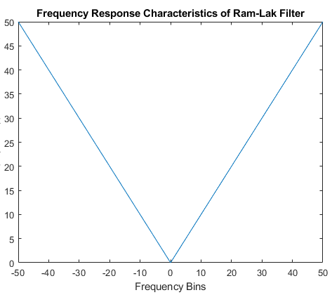
Ram-Lak (Ramp) Filter
Notes:
In medical imaging this ramp filter is called ramlak

Slide 8
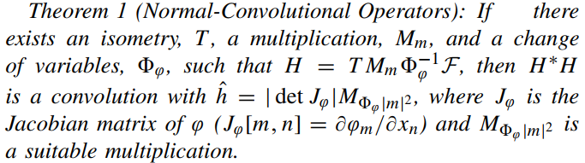


Normal Shift Invariant Operator
Isometry
$T^{∗}T\left\{f\left(x\right)\right\}=f(x)$
Multiplication
$M_{m}\{ f \}(x) = m(x) f (x)$
Convolution
$H_{h} f =F^{∗}∗M_{\hat{h}}F f$
Reversible Change of Variables
Notes:
R∗R is a convolution with hˆ(ω) = | det Jϕ(ω)| = 1/|ω|
where φ changes from Cartesian to polar coordinates (i.e.φ−1(θ,r)=(rcosθ,rsinθ)) and T is the inverse Fourier transform with respect to r. This maps a function, f, of space ,x, to its Fourier transform,ˆf, which is a function of frequency, ω. Then, it performs a change of variables, giving fpolar, which is a function of a polar frequency variables, (θ, r).Finally, T inverts the Fourier transform along r, resulting in a sinogram that is a function of θ and a polar space variable, y. Theorem 1 states that R∗R is a convolution with ˆh(ω)=|detJφ(ω)|=1/‖ω‖, where, again, ω is the frequency variable associated with the 2D Fourier transform, F

Slide 9


Direct Inversion vs Iterative Inversion
Notes:
So we can have different inversion techniques
G = HF
When T is inverse Fourier transform
TV regularization (3d xray phase contrast imaging) using conjugate gradient descent and introduce fast approaches but the content is irrelevant just the result is given for comparison

Slide 10
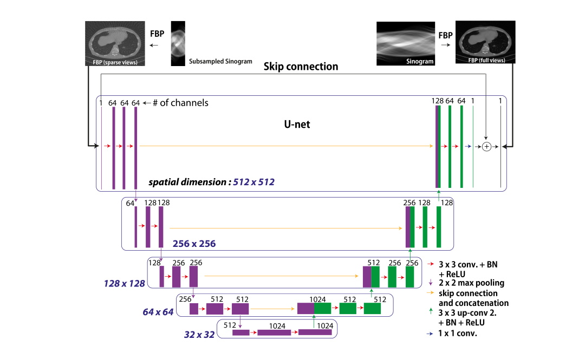
Proposed Method: FBPConvNet
Notes:
Multilevel decomposition This is critical for our application because the filters corresponding to H ∗H (and its inverse) may have non-compact support, e.g. in CT. Thus, a CNN with a small, fixed filter size may not be able to effectively invert H ∗H . MultiChannel filtering: U-net employs multichannel filters, such that there are multiple feature maps at each layer. This is the standard approach in CNNs to increase the expressive power of the network [16], [57].
Skip connection: preserved features coded in the encoder path

Slide 11
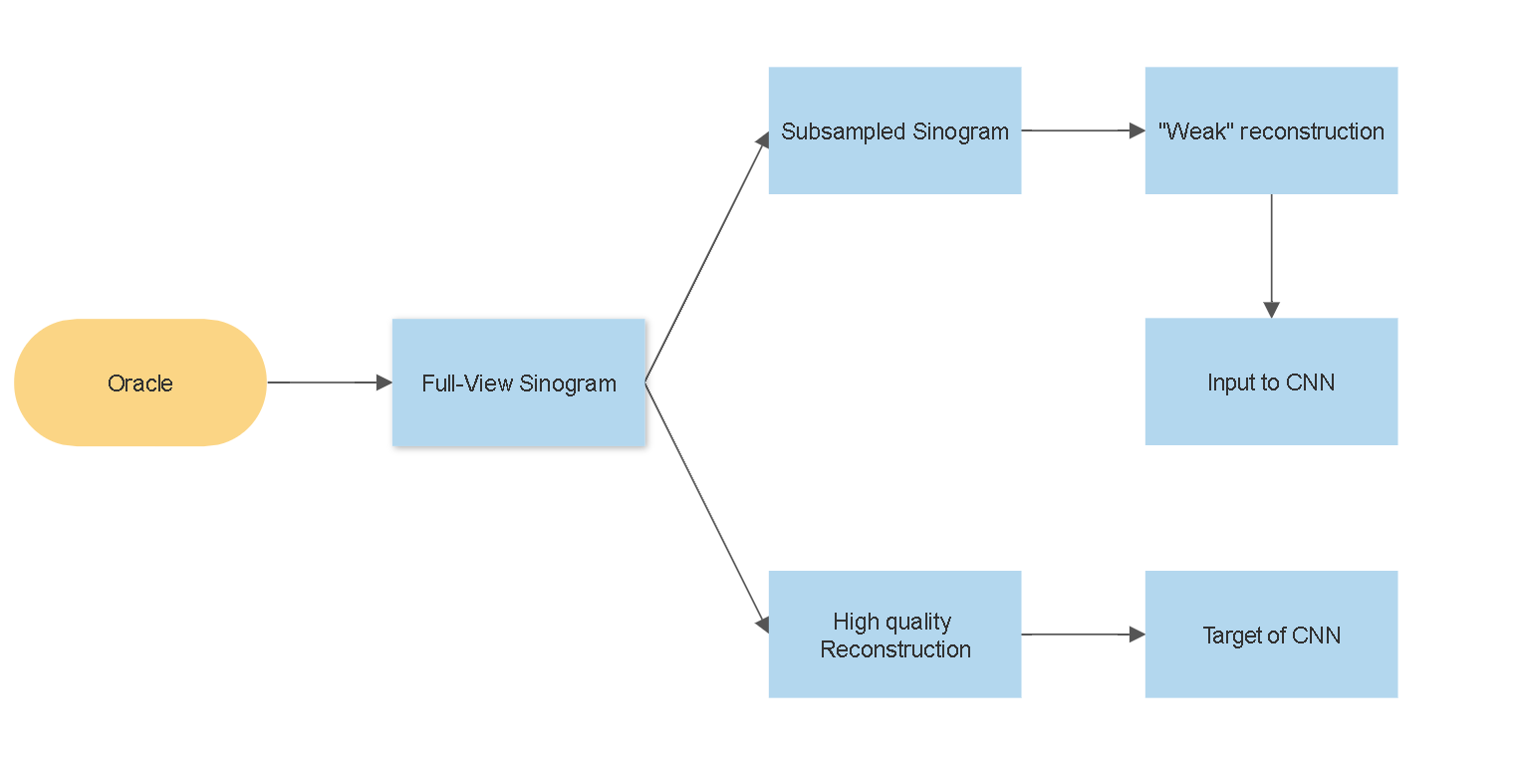
CNN Input Data
CNN
Notes:
Of course, oracle only exists for the synthetic dataset
This setting is considered as more realistic since we wont have any access to oracle information in this case

Slide 12
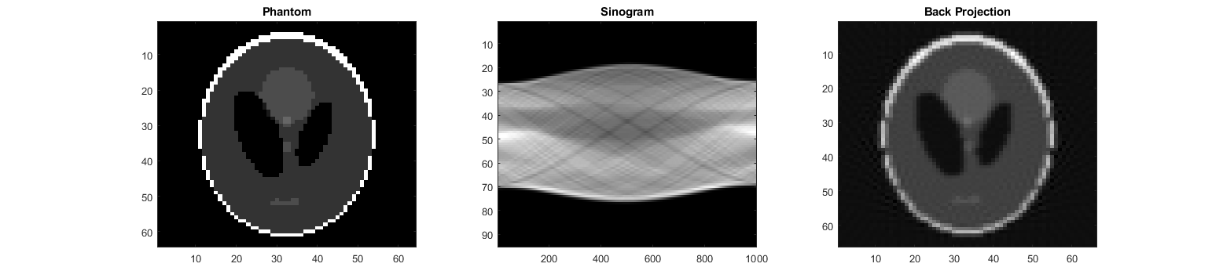
Input type: Sinogram or “Weak” Reconstruction
Notes:
By weak reconstruction I mean the subsampled sinogram for a subsampling factor. This is done by taking the vertical slices in the sinogram which corresponds to the projections for one angle or view

Slide 13
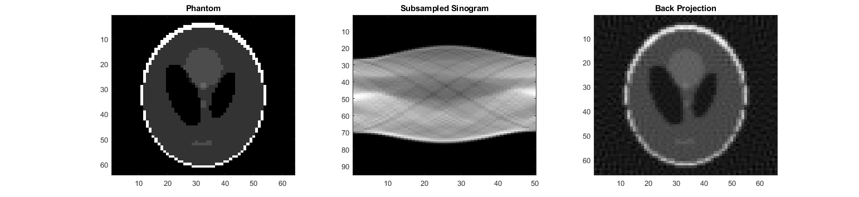
Subsampled Sinogram
Notes:
We see that back projection is distorted when the number of views are lower, we are basically discarding a set of measurements here
You can see the artifacts return back

Slide 14
Modification on U-Net
Zero padding , i.e., “same” convolution
1x1 convolution at the last layer
Skip Connection between input and output
Notes:
U net is originally proposed for segmentation and hence it outputs more than one channels: usually just foreground and background
By 1x1 convolution the output image is modified to have one channels, that is to say, an intensity image

Slide 15
Computational Complexity Difference
Filtered Back Projection
For NxN image and MxV sinogram: O(N²MV).
Convolutional Neural Network
For NxN image, KxK filters, R filters per layer and L layers: O(N² K ² R² L)
Notes:
Although the authors state that it can be reduced to O(N^2V ) when the discretization kernel length is fixed.

Slide 16
Datasets
Ellipsoidal
Biomedical
Experimental
Notes:
500 images of ellipses of random intensity, size, and location. Sinograms for this data contain1,000 views and are created for the analytical expression of x ray radon transform of the ellipse
The biomedical dataset is a synthetic dataset that comprises 500 real in-vivo CT images from the Low-dose
Grand challenge competition. The experimental dataset is a real CT dataset that
comprises 377 sinograms collected

Slide 17
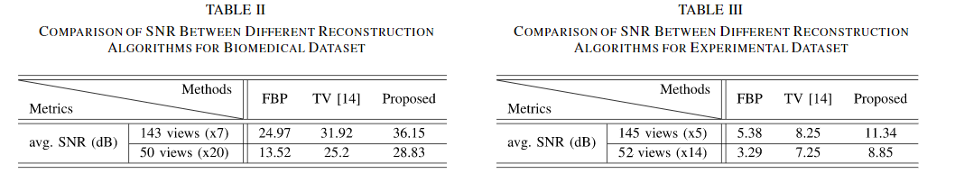

Performance Metrics
$SNR(dB)=\max_{a,b∈ℝ}{20\log{\frac{{\left|\left|x\right|\right|}_{2}}{||x−a \hat{x}+b |{\left.​\right|}_{2}}}}$

Slide 18
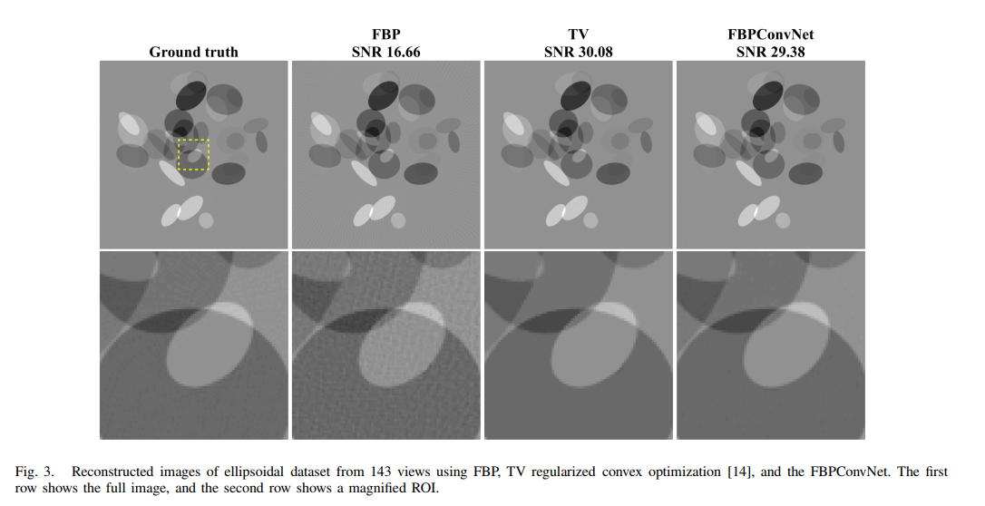

Slide 19
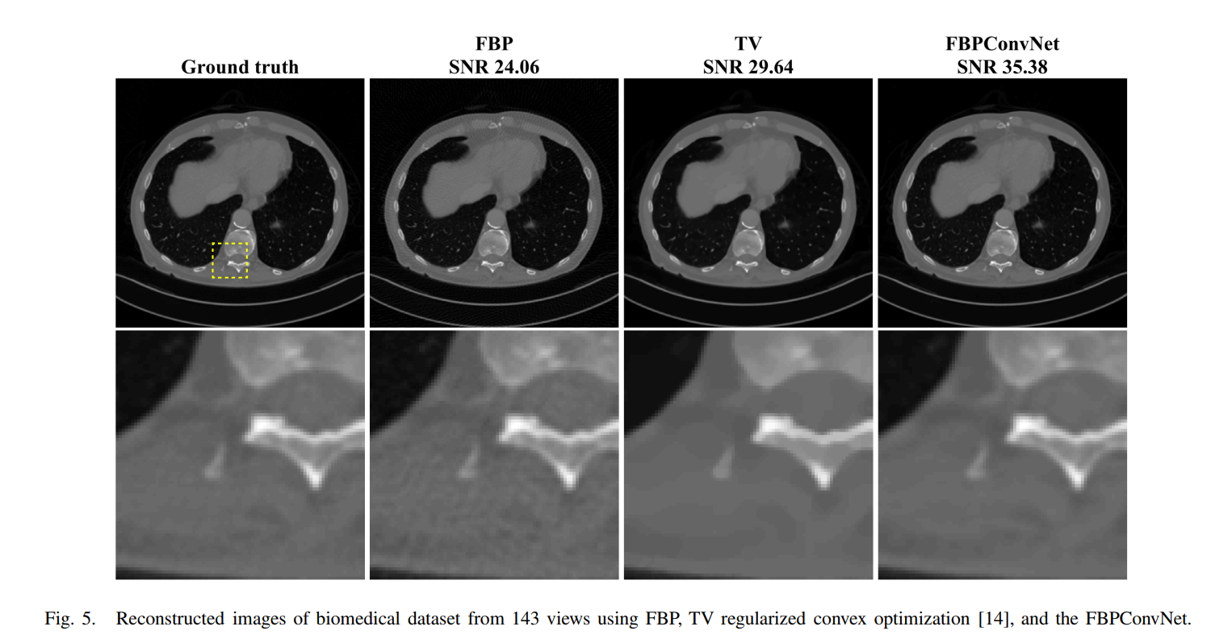

Slide 20
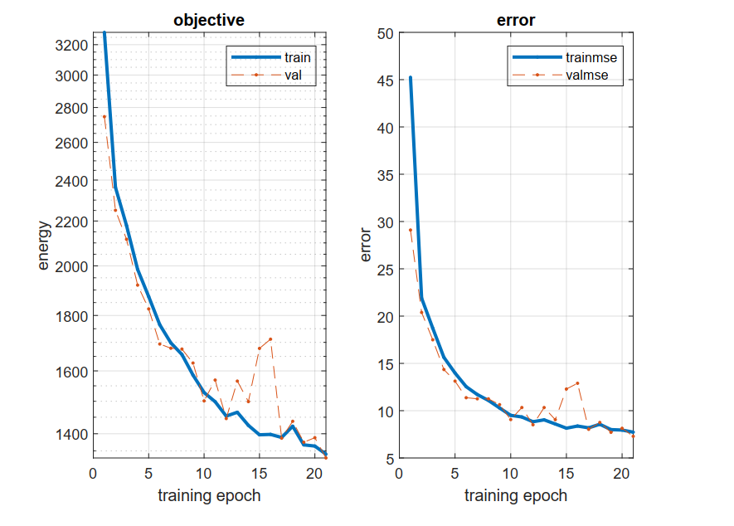
Notes:
I have trained two models on ellipsoidal dataset due to the limited experimentation time
Learning Rate: 5e-4
Took approx. 20 hours on CPU

Slide 21
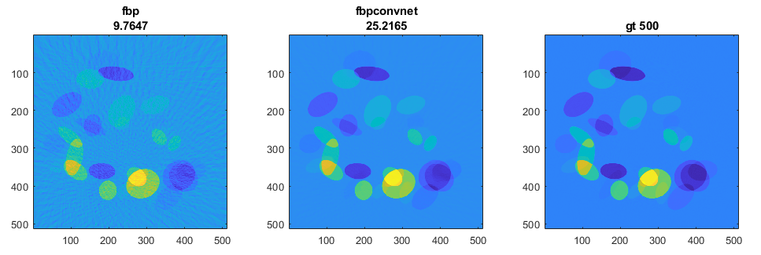
Synthetic Dataset Reconstruction
avg SNR (FBP) : 8.4438
avg SNR (FBPconvNet) : 22.8482
Notes:
Synthetic dataset formed by subsampling the sinogram by factor 20
Average metrics for 25 images

Slide 22
Synthetic dataset
Experiment number | Subsampling factor | Noise dB | Average SNR in dB (FBP) | Average SNR in dB (FBPConvNet)
1 | 10 | - | 15.88 | 11.83
2 | 10 | 10 | 15.88 | 11.83
3 | 20 | - | 10.21 | 17.48
4 | 20 | 10 | 10.21 | 17.48
5 | 25 | - | 8.67 | 17.89
6 | 25 | 10 | 8.67 | 17.89
7 | 50 | - | 4.83 | 8.48
8 | 50 | 10 | 4.83 | 8.48
Notes:
Predictions took about 5 seconds on CPU
With 10 dB noise I observed almost no difference in this precision (Otherwise of course, even in FBP, it was different)
As we see the Filtered back projections performance decreases for increasing subsampling factor
It made me think that it also learns the prior

Slide 23
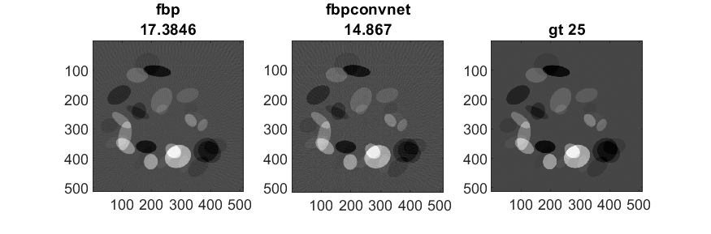
Subsampled by 10, Noise:10 dB SNR

Slide 24
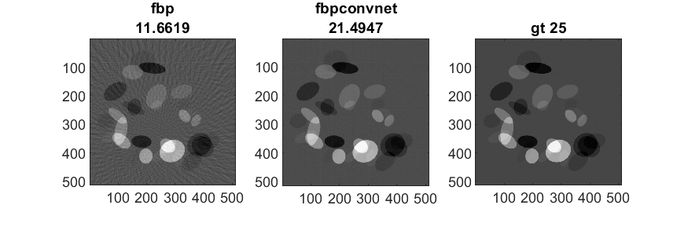
Subsampled by 20, Noise:10 dB SNR

Slide 25
Is the network able to generalize to another dataset?
Training on Ellipses
Testing on Synapse
Notes:
If the model learns to invert the normal operator (we encounter the normal operator frequently in iterative schemes and the convolutional kernels learn it or the inverse of it), does training the model on Ellipses dataset provide good performance

Slide 26
Synapse multi-organ segmentation dataset
30 abdominal CT scans in the MICCAI 2015 Multi-Atlas Abdomen Labeling Challenge were used, with 3779 axial contrast-enhanced abdominal clinical CT images in total.
Each CT volume consists of 85 ∼ 198 slices of 512 × 512 pixels, voxel spatial resolution of ([0.54] × [0.98] × [2.5∼5.0])mm³
Notes:
The dataset is normally for the segmentation task for 12 organs and structures including heart, aorta and spleen contrast stretching between -500 500

Slide 27
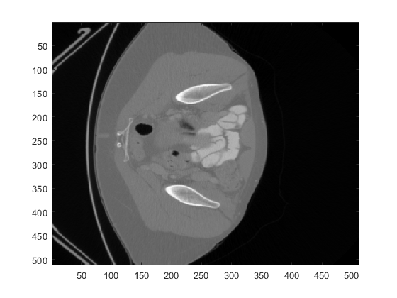
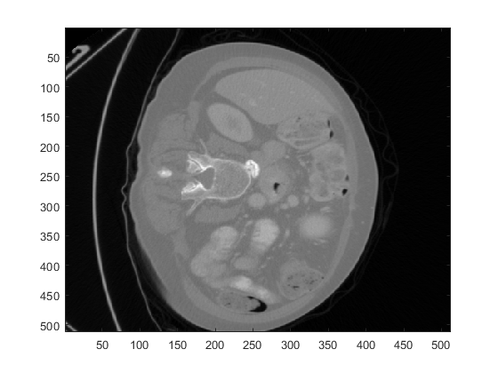
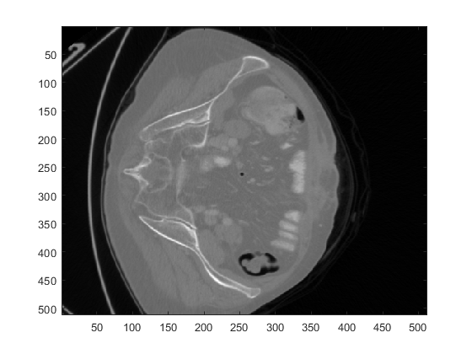
Sample images from Synapse Dataset

Slide 28
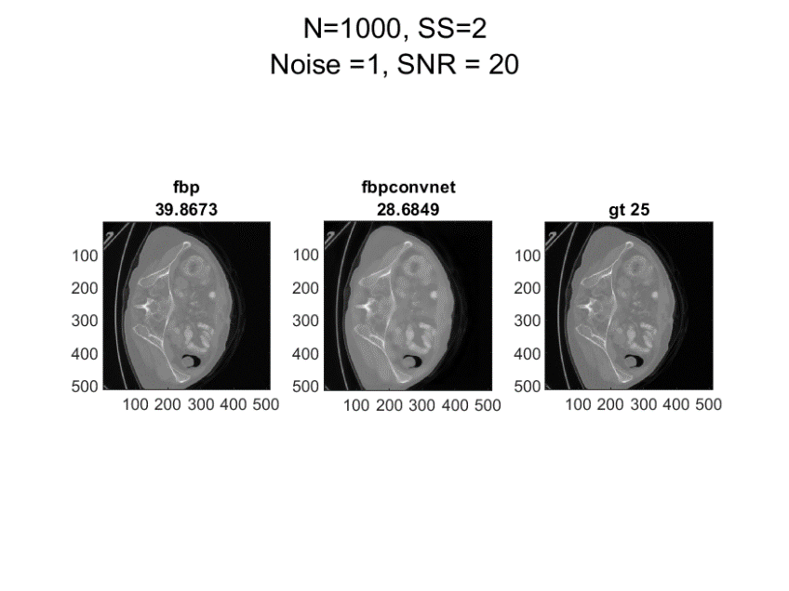
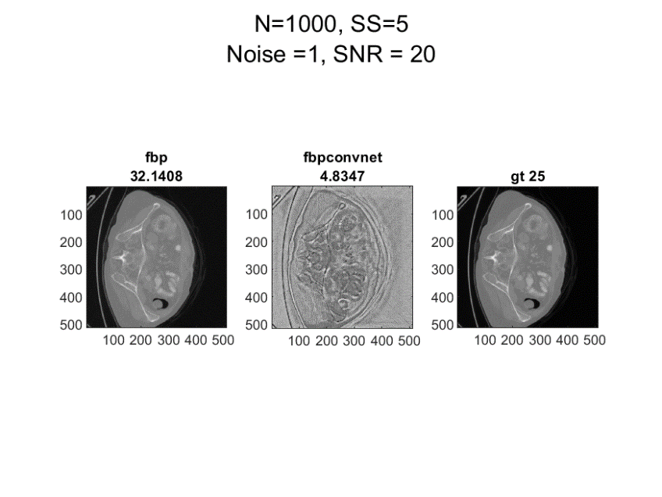

Notes:
For other datasets, as expected both the fbp and cnn performances dropped because it learns the prior of another dataset

Slide 29
Conclusion
Offer performance under the circumstances it trained
Fast to compute, hence lightweight
Inference is limited.
Notes:
Especially in medical imaging, for the increased reliability, the model should generalize to other data distributions
If we were to learn the operator for the inverse of the 20 times subsampled CT reconstruction independent of the prior, we would not have encountered this

Slide 30


Q&A
GitHub
Presentation
Notes:
Thank you

