Slide 1
Analysis of Improving the spatial solution of electrocardiographic imaging: A new regularization parameter choice technique for the Tikhonov method
Kutay Uğurlu

Slide 2
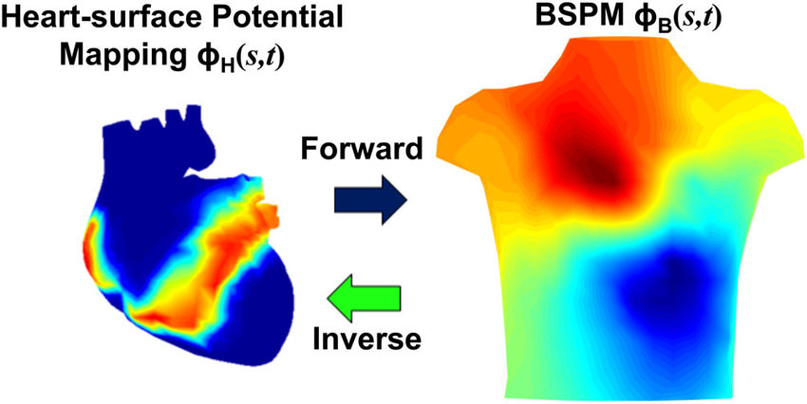
ECGI Inverse Problem

Slide 3
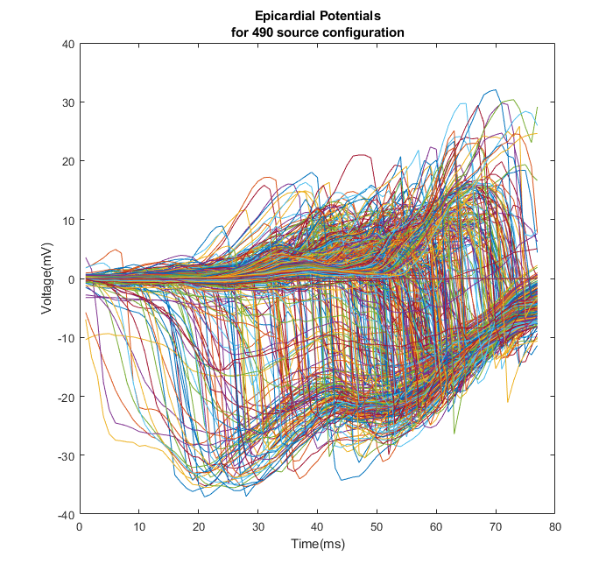

Formulation
$\tilde{y} =Ax+\tilde{n}$
$\tilde{Y}=AX+\tilde{N}$

Slide 4
Methods
Forward Model: Method of Fundamental Solutions (MFS)
Inverse Solution: Tikhonov Regularization

Slide 5


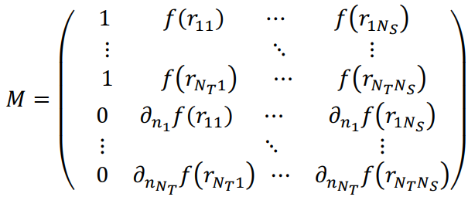
Method of Fundamental Solutions

Slide 6




Tikhonov Regularization Formulation

Slide 7
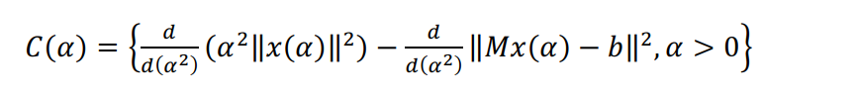


Choice of Regularization Parameter α
CRESO
L-Curve
U-Curve
Automated Discrete Picard Condition **

Slide 8
Discrete Picard Condition

