Slide 1
Analysis of Improving the spatial solution of electrocardiographic imaging: A new regularization parameter choice technique for the Tikhonov method
Kutay Uğurlu

Slide 2
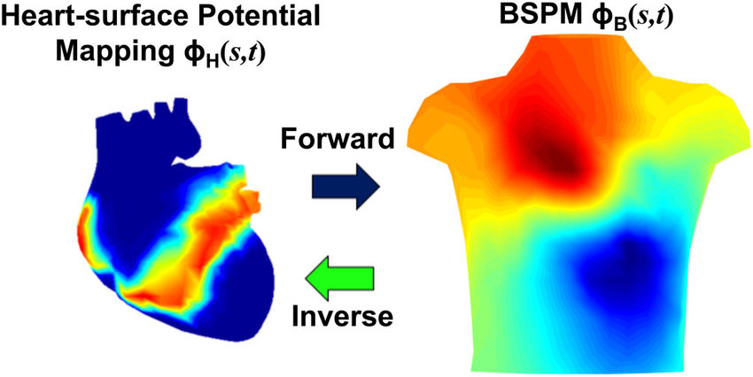
ECGI Inverse Problem

Slide 3
Ill-posedness
Noise on the measured torso potentials
Uncertainty in the location of measurement sites with respect to the source locations
Errors of segmentation of the geometry
Influence of the cardiac motion

Slide 4
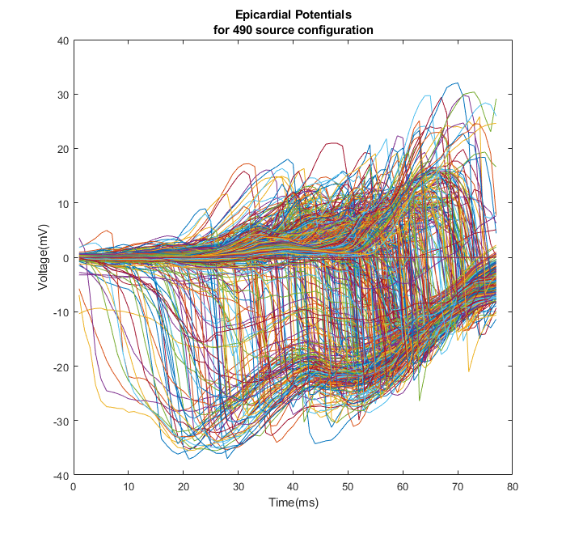

Formulation
$\tilde{y} =Ax+\tilde{n}$
$\tilde{Y}=AX+\tilde{N}$

Slide 5
Methods
Forward Model: Method of Fundamental Solutions (MFS)
Inverse Solution: Tikhonov Regularization

Slide 6


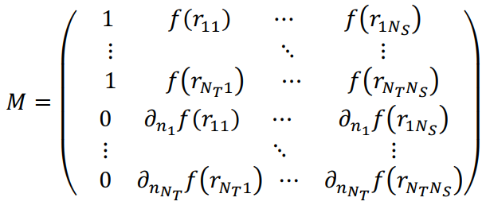
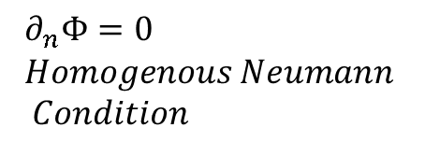
Method of Fundamental Solutions
$$∂_{n}Φ=0 \\ Homogenous Neumann \\ Condition$$

Slide 7




Tikhonov Regularization Formulation

Slide 8
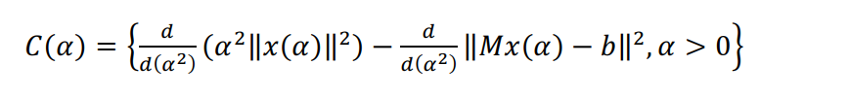


Choice of Regularization Parameter α
CRESO
L-Curve
U-Curve
Automated Discrete Picard Condition **

Slide 9
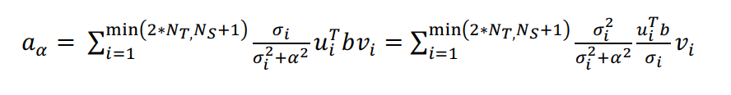
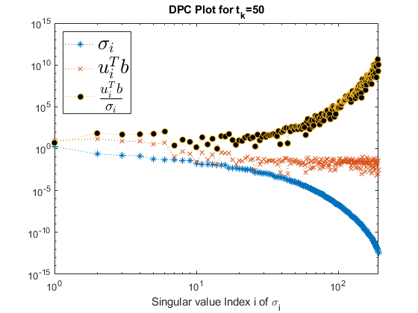

Discrete Picard Condition
DPC starts to fail when $\frac{|u_{i}^{T}b|}{σ_{i}}$ starts to increase and the solution is completely dominated by smaller SVs.
Notes:
That is, the 𝜎𝜎𝑖𝑖 above the regularization parameter 𝛼𝛼 (useful SVs) must decay to zero slower than the corresponding right hand side coefficients, | 𝑢𝑢𝑖𝑖𝑇𝑇𝑏𝑏|

Slide 10
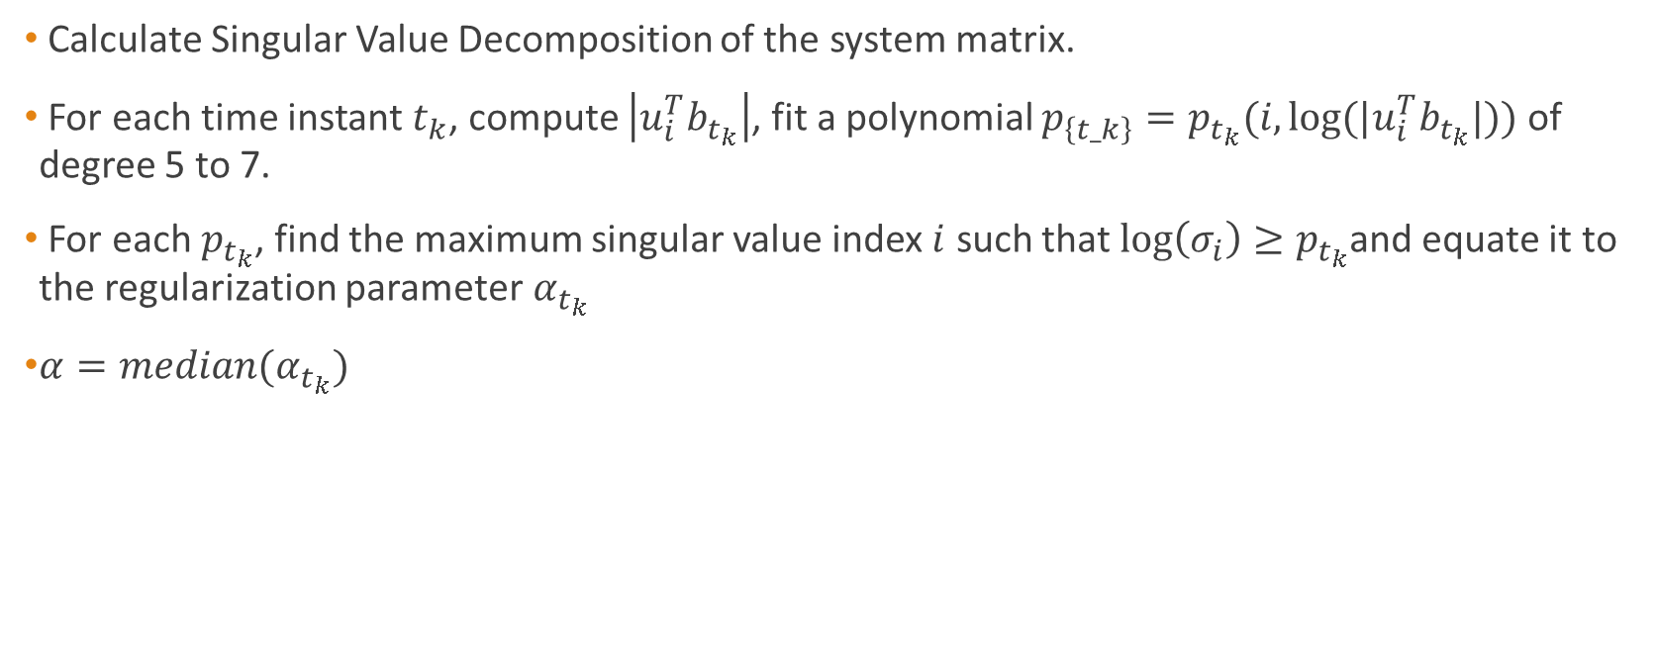
Automated Discrete Picard Condition (ADPC)
Calculate Singular Value Decomposition of the system matrix.
For each time instant $t_{k}$, compute $\left|u_{i}^{T}b_{t_{k}}\right|$, fit a polynomial $p_{\left\{t_k\right\}}=p_{t_{k}}(i,log⁡(|u_{i}^{T}b_{t_{k}}|))$ of degree 5 to 7.
For each $p_{t_{k}}$, find the maximum singular value index $i$ such that $\log\left(σ_{i}\right)≥p_{t_{k}}$and equate it to the regularization parameter$α_{t_{k}}$
$α=median(α_{t_{k}})$

Slide 11
Implementation

Slide 12
Modifications

