Slide 1
Project Delivery #3 Deep Learning based Text Classification
Group Members:
1- 150118065 Şeref Kutay Akgün
2- 150119572 Burak Furkan Ayvalık
3- 150118501 Engin Bektaş
4- 150114058 Oğuzhan Erkol
5- 150119869 Umer Selmani
LECTURER : Assoc. Prof MURAT CAN GANİZ

Slide 2
Lıbraries that We use
NLTK:
This library was developed for parsing text in NLP.
It allows us to perform operations such as tokenize into sentences and words, removing Stopwords, Collocations, Parts of speech identification, Stemming and lemmatization, Corpus
KERAS:
Keras is an API designed for human beings, not machines. Keras follows best practices for reducing cognitive load: it offers consistent & simple APIs, it minimizes the number of user actions required for common use cases, and it provides clear & actionable error messages. It also has extensive documentation and developer guides.

Slide 3
Lıbraries that We use
TenserFlow:
TensorFlow is an end-to-end open source platform for machine learning. It has a comprehensive, flexible ecosystem of tools, libraries and community resources that lets researchers push the state-of-the-art in ML and developers easily build and deploy ML powered applications.
Pandas:
Pandas is a fast, powerful, flexible and easy to use open source data analysis and manipulation tool, built on top of the Python programming language.
Seaborn:
Seaborn is a Python data visualization library based on matplotlib. It provides a high-level interface for drawing attractive and informative statistical graphics.

Slide 4
Models That We Use:
FastText:
FastText is an open-source, free, lightweight library that allows users to learn text representations and text classifiers. It works on standard, generic hardware. Models can later be reduced in size to even fit on mobile devices.
LSTM:
Long Short-Term Memory (LSTM) networks are a type of recurrent neural network capable of learning order dependence in sequence prediction problems. This is a behavior required in complex problem domains like machine translation, speech recognition, and more. LSTMs are a complex area of deep learning. It can be hard to get your hands around what LSTMs are, and how terms like bidirectional and sequence-to-sequence relate to the field.
CNN: A Convolutional Neural Network (ConvNet/CNN) is a Deep Learning algorithm which can take in an input image, assign importance (learnable weights and biases) to various aspects/objects in the image and be able to differentiate one from the other. The pre-processing required in a ConvNet is much lower as compared to other classification algorithms. While in primitive methods filters are hand-engineered, with enough training, ConvNets have the ability to learn these filters/characteristics.

Slide 5
How the project works:
We load test and train datasets with the Pandas library. Next, we perform the tokenization and lemmatization of the dataset with the preprocessing function. Then we make tokenizer and weight adjustments. Then we enumerate our labels with the LabelEncoder function so that they can be processed. Then we start the classification process with the fast_text function we wrote. After printing the results we obtained to the console, we also create a heatmap. We apply the same operations for the CNN and LSTM models and show the results.

Slide 6
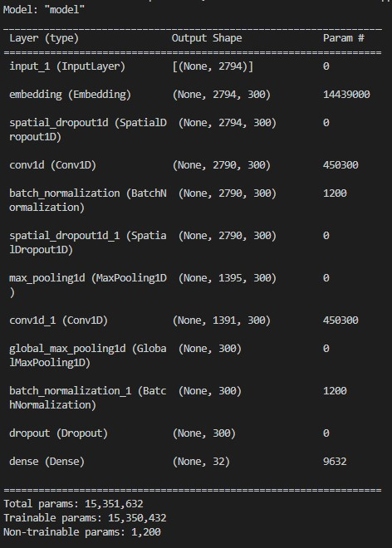
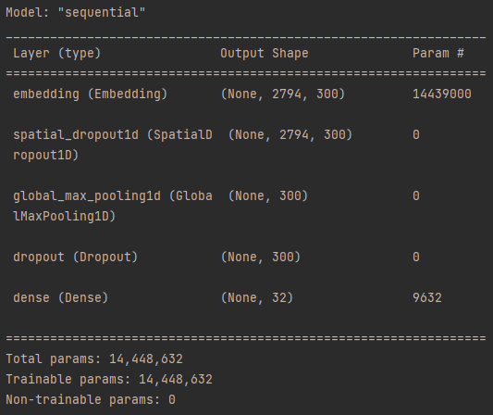
Model of Fast-Text Model
Model of CNN Model

Slide 7
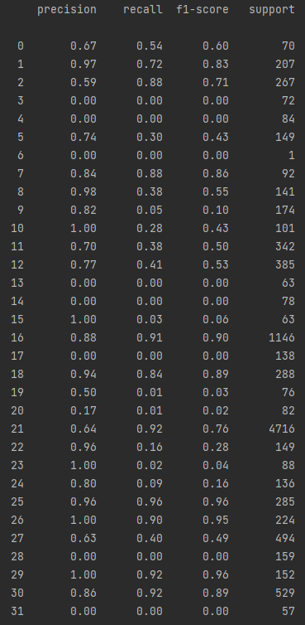
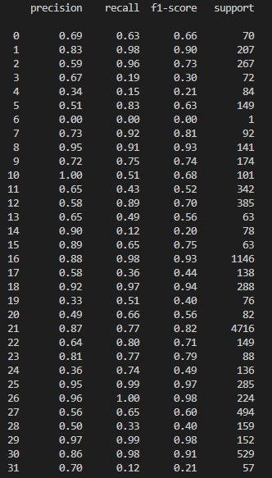

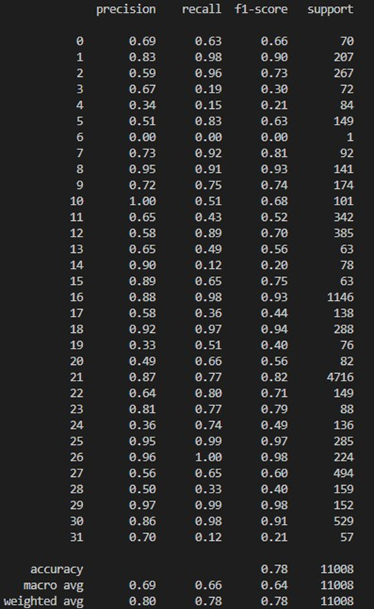
Scores of Fast-Text Model
Scores of CNN Model

Slide 8
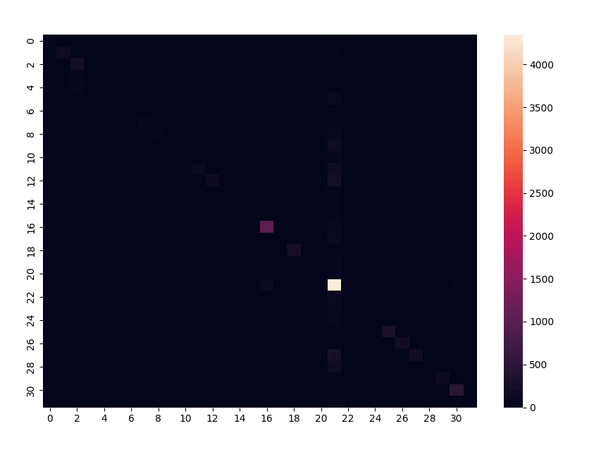
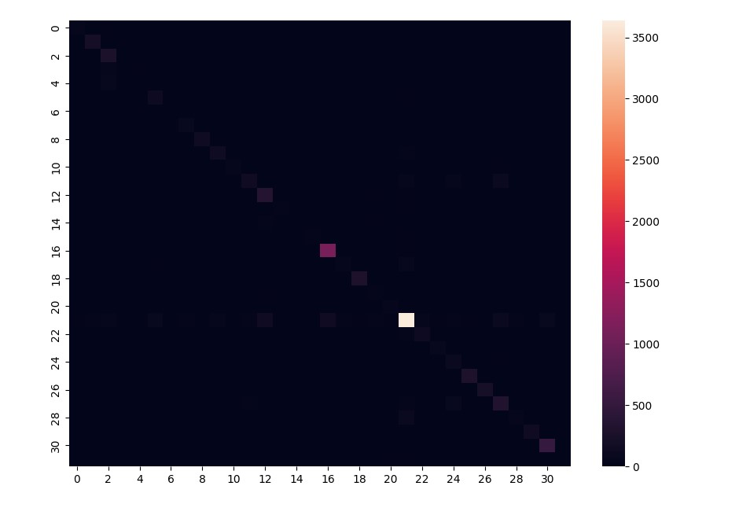
Heat Map of Fast-Text
Heat Map of CNN

Slide 9
Thank You for Listening

