Slide 1
ENGR 350 Project Name: Analysis & Inspection on Cancellation Behavior of Hotel Customers
Fırat Tamur
60534
Kutay Eroğlu
59970

Slide 2
Outline
Data-set
Problem Statement
Data Exploration
Methods Used
Our Model
Potential Improvements

Slide 3
Source
https://www.sciencedirect.com/science/article/pii/S2352340918315191
https://www.kaggle.com/jessemostipak/hotel-booking-demand

Slide 4
Data-set
119390 rows
32 columns
Cleaning and processing
Hotel Booking Demand Datasets

Slide 5
Problem Statement
Most of the hotels in crowded cities have the problem of being full in the most favorable times of the year. Customers who reserve a room but fail to show up and do not pay cause a big problem to the owner and to person who could have booked the room instead.

Slide 6
The Solution
We aim to provide an optimized way, which shows what type of customers are more inclined to cancel their bookings. Furthermore, we aim to show which type of customers are more favorable for hotel owners in terms of profit.
Also, we want to provide condition specific insights for cancellation behavior.

Slide 7
Methods Used
Data cleaning
Data transformation
Data Visualization
Machine Learning

Slide 8
DATA EXPLORATION

Slide 9
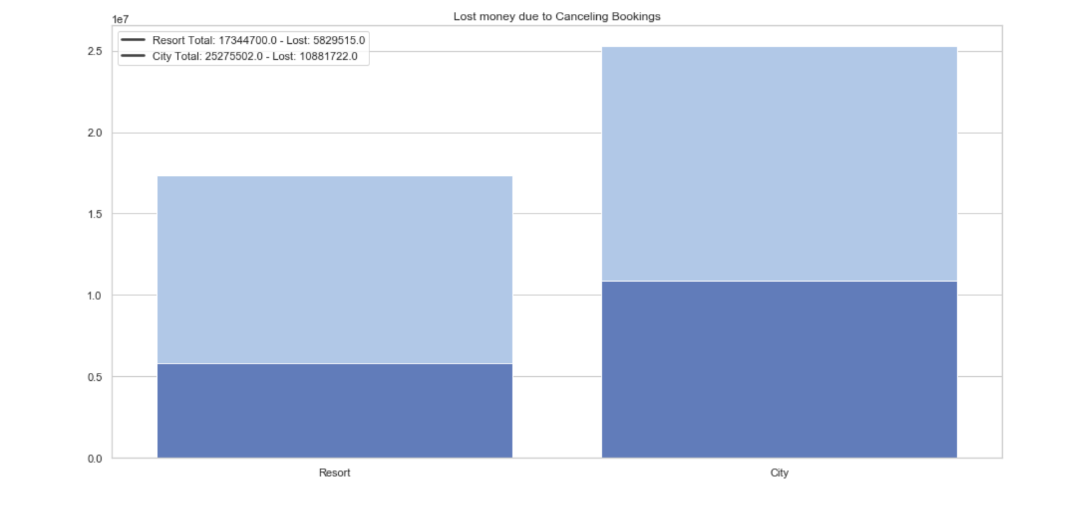
Money loss due to cancellations --by hotels
cancelled
cancelled
*Cancellation causes massive loss in income
Notes:
-

Slide 10
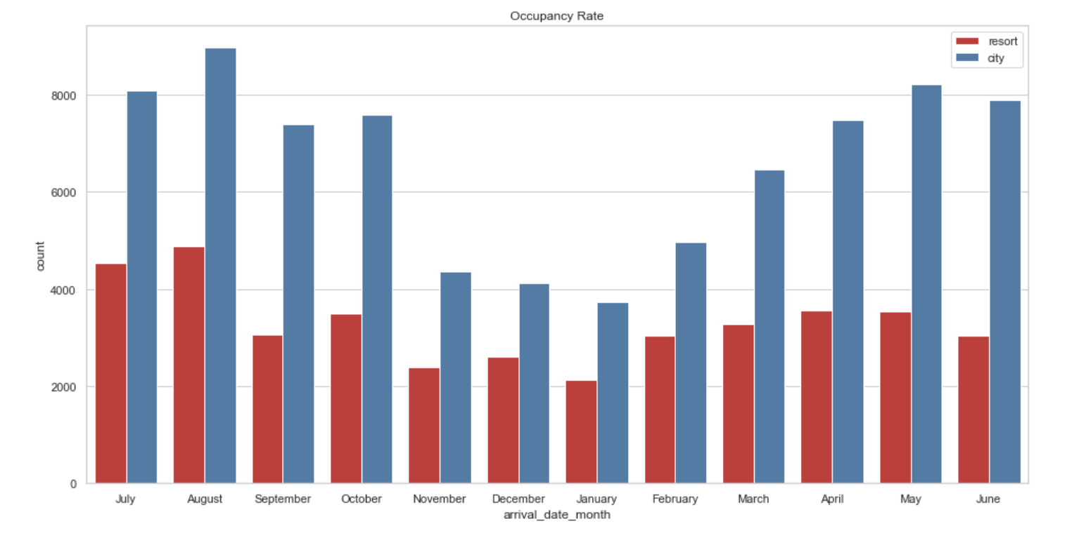
Occupancy Rate

Slide 11
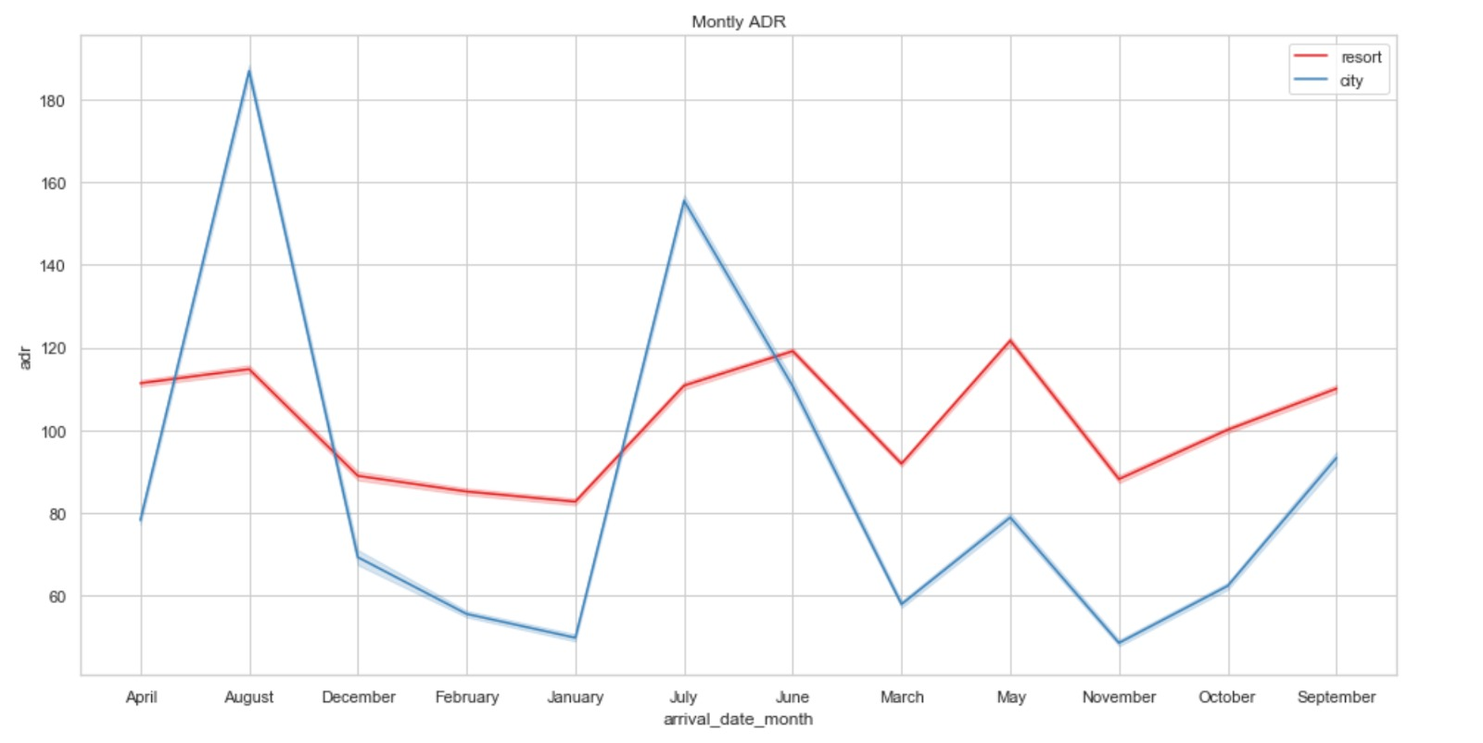
Monthly ADR --average daily rate
*When occupancy rate increases average daily rate increases

Slide 12
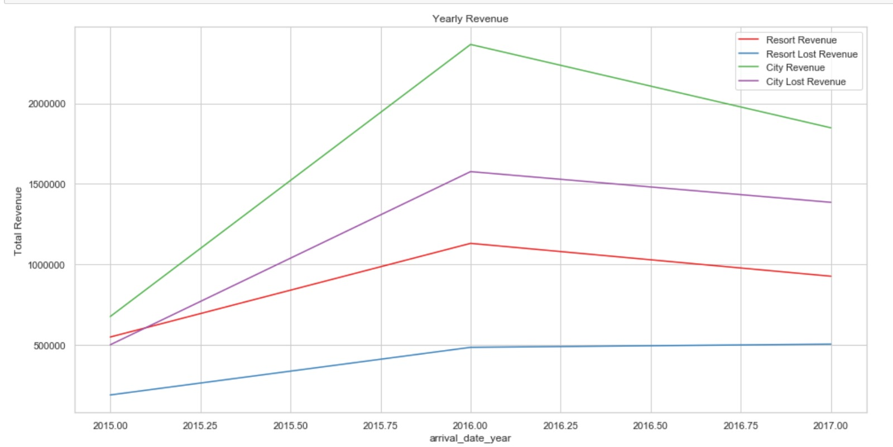
Yearly Revenue
*City loses more revenue than what Resort earns

Slide 13
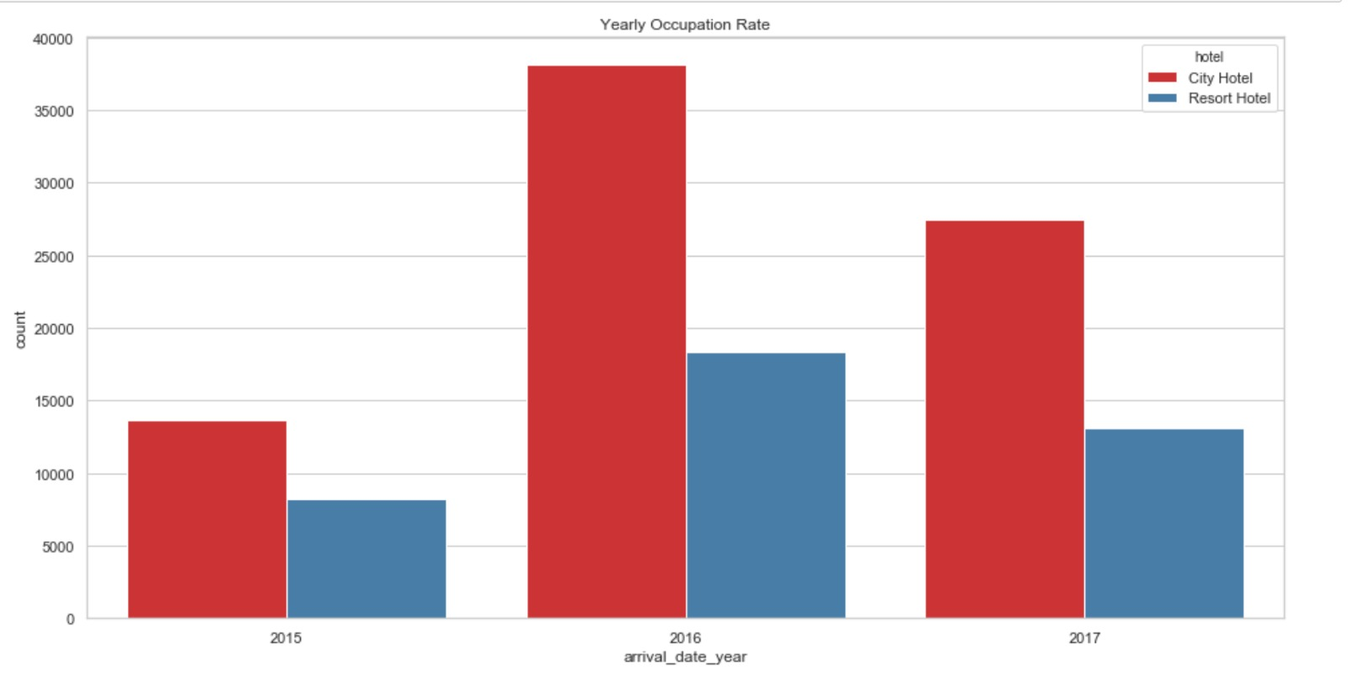
Yearly Occupation Rate
*Data currently available doesn’t explain the massive increase in 2016

Slide 14
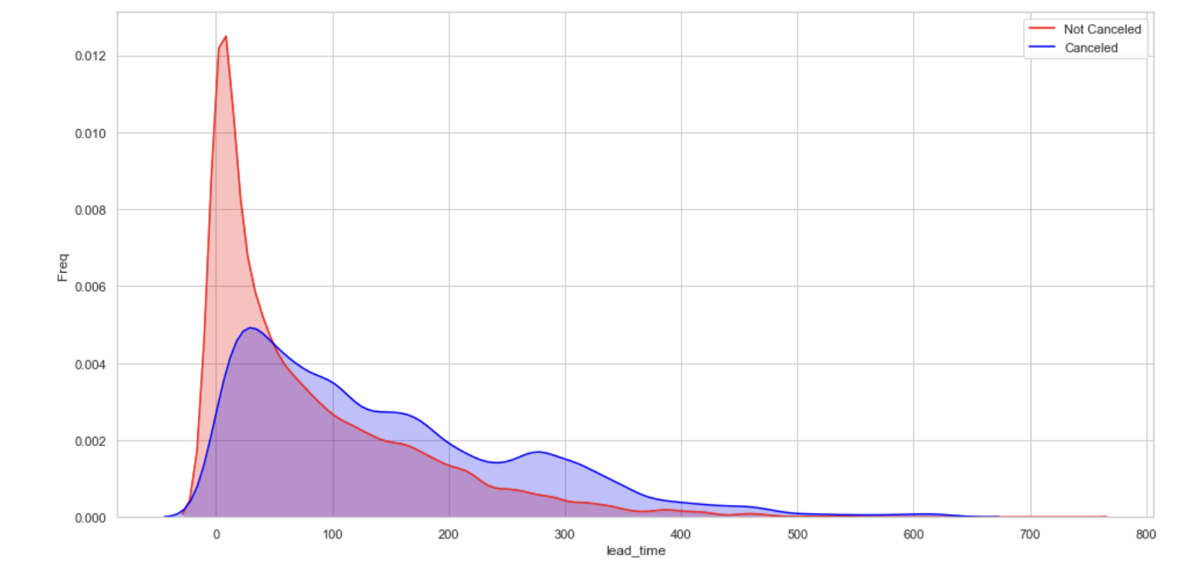
Lead_time Number of days that elapsed between the entering date of the booking into the PMS and the arrival date
*50
*High lead time causes high cancelling probability

Slide 15
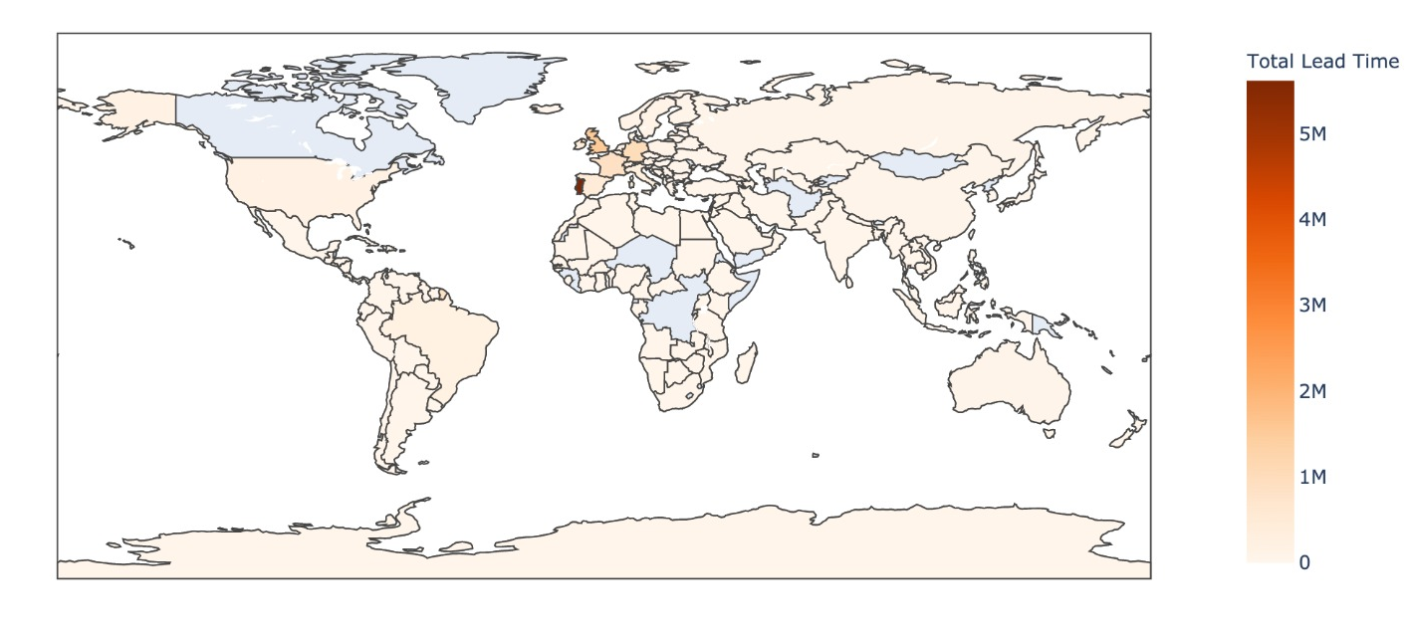
Lead time by country
*High percentage of reservations are in Portugal. Therefore, it is normal for lead time to be highest.

Slide 16
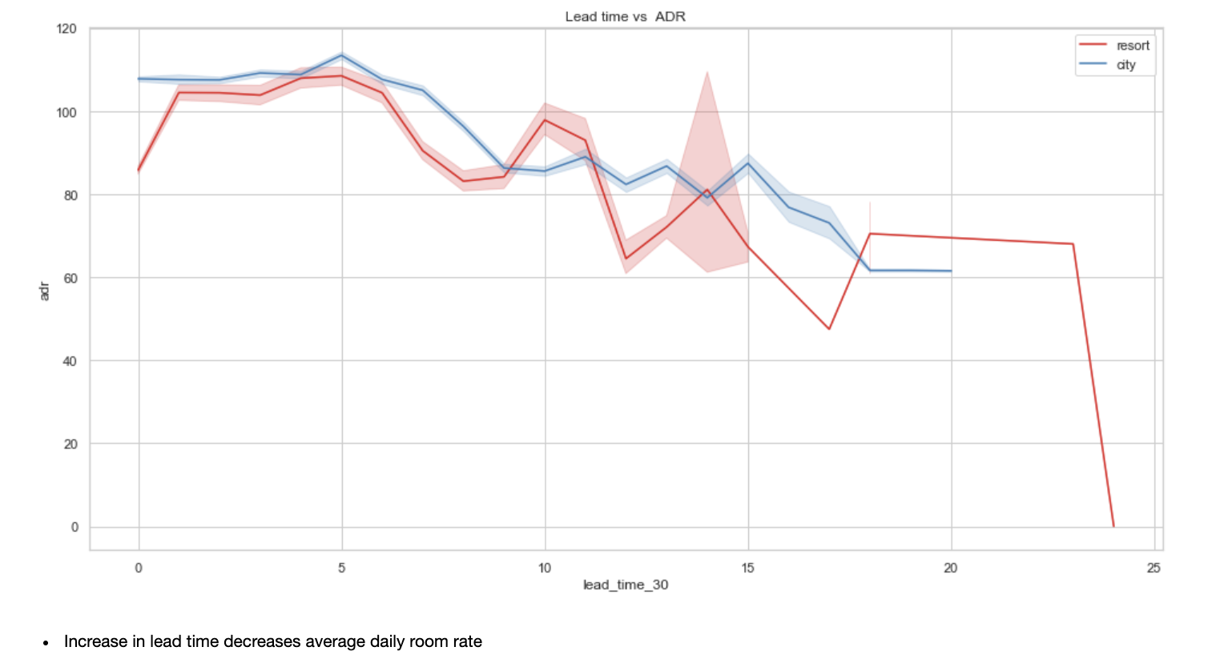
Lead time vs ADR -- monthly
*Drop to 0 is explained with promotion rooms. However, no extra information is provided

Slide 17
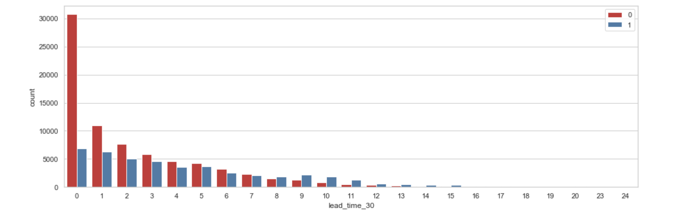
Lead_time_30
*8 months and later months increase the possibility of cancellation drastically

Slide 18
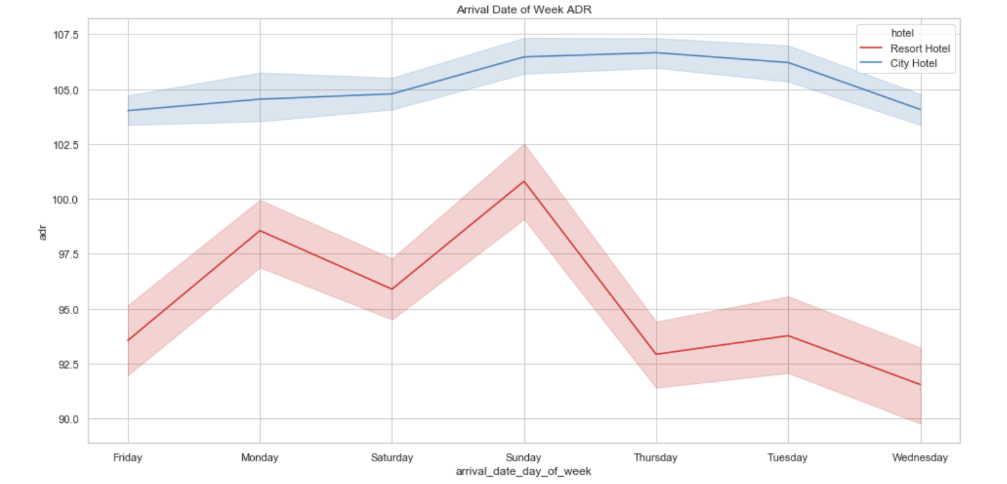
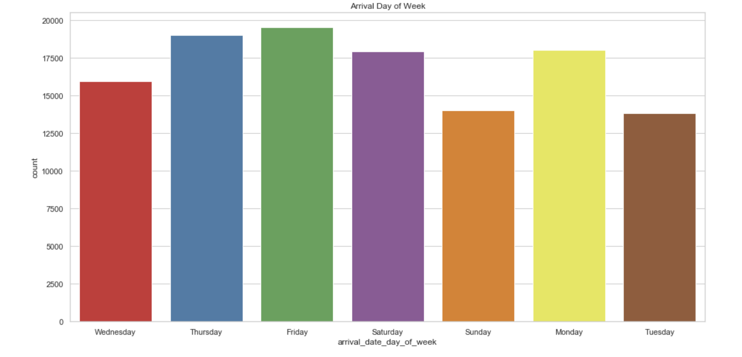
Arrival day of the month
--Using datetime we found out the weekday of the booking
*Friday : since the price is low demand is high

Slide 19
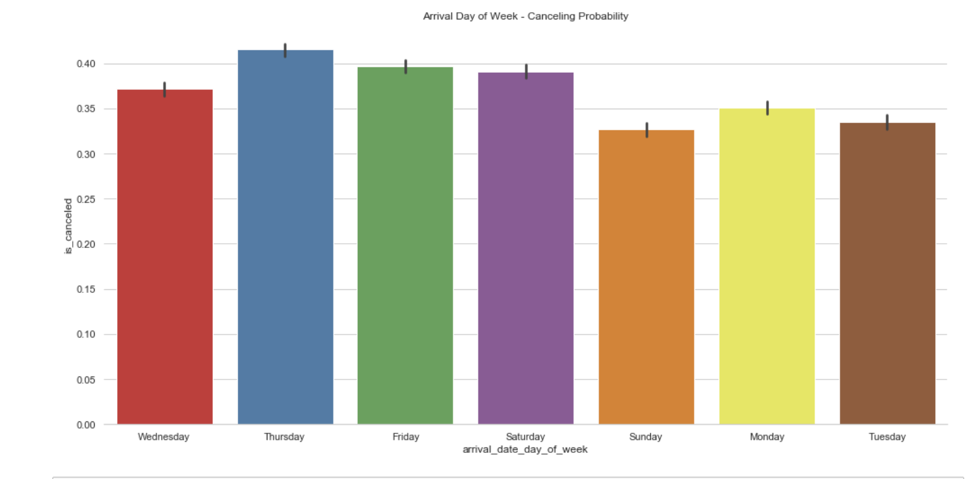
Arrival day of the month
*It can be seen that Saturday is more risky than Monday.
*Also Thursday > Friday

Slide 20
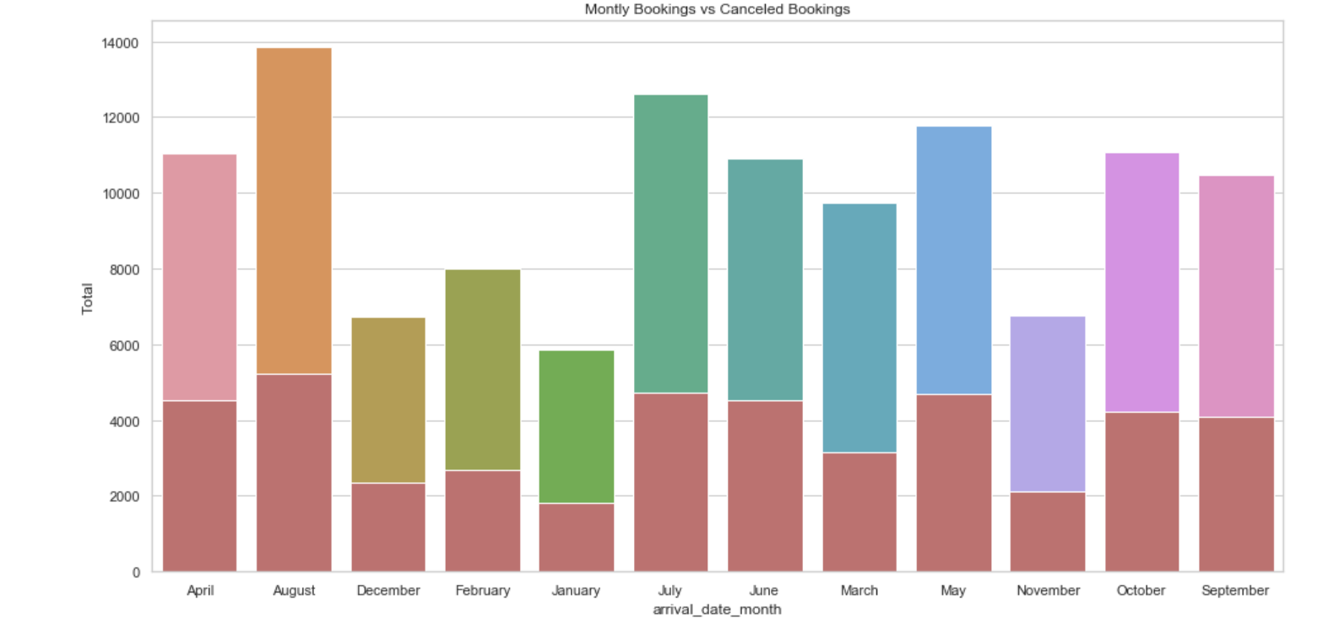
Cancelled booking ratios by Month

Slide 21
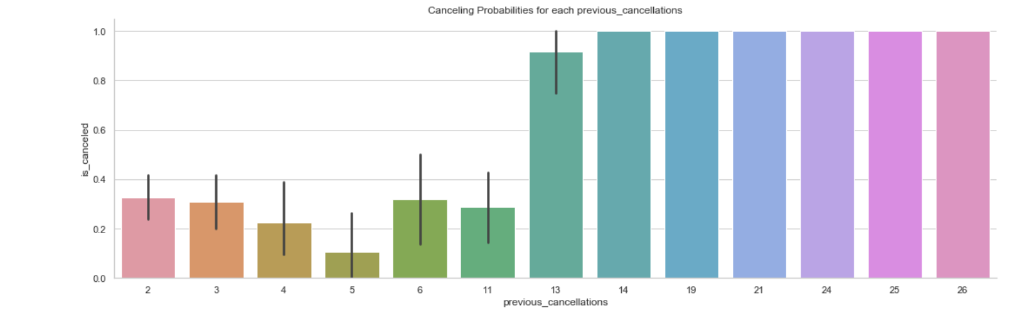
previous_cancellations
*Higher number of cancellations almost gives a certain outcome

Slide 22
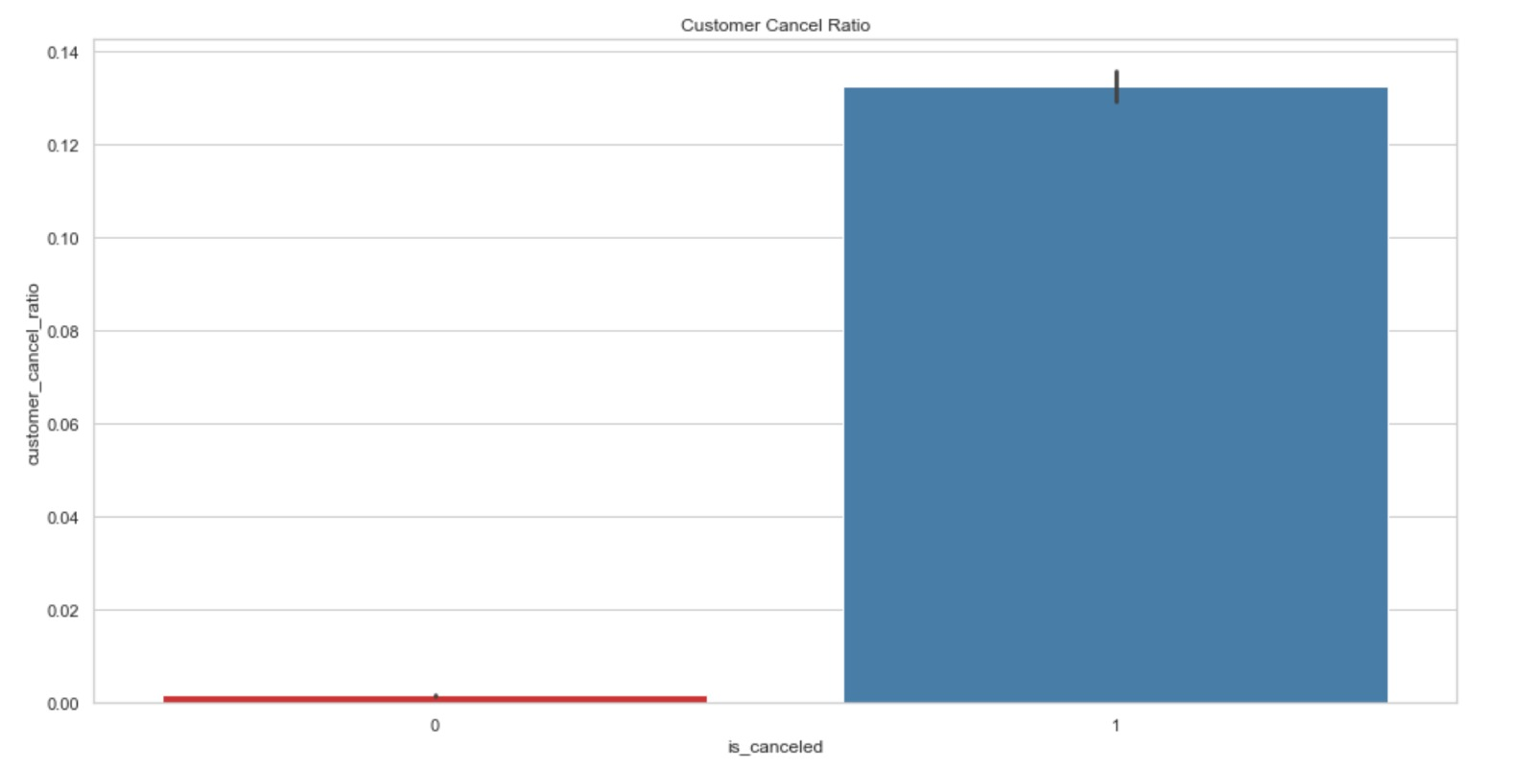
Individual Customer’s Cancellation Ratio

Slide 23
Machine Learning Models

Slide 24
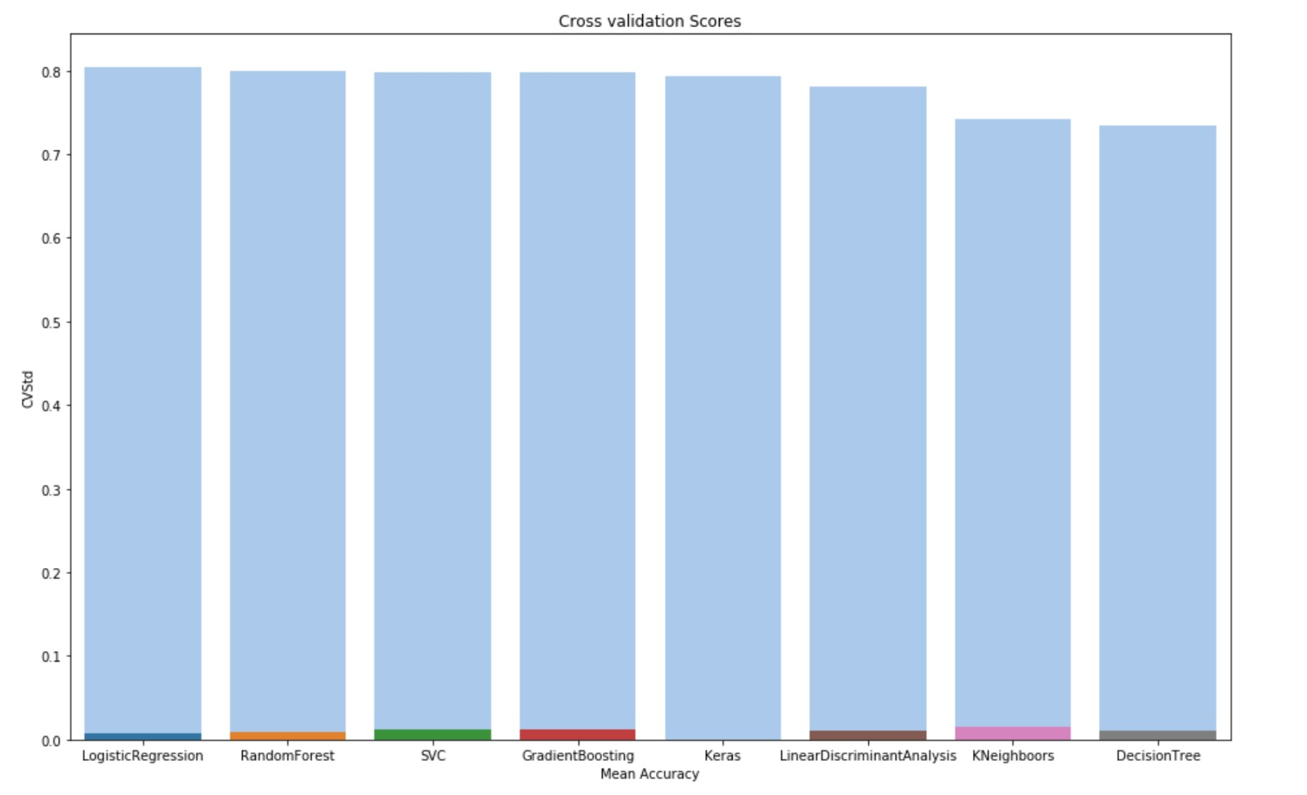
Training Cross Validation Scores (for n = 10 000)

Slide 25
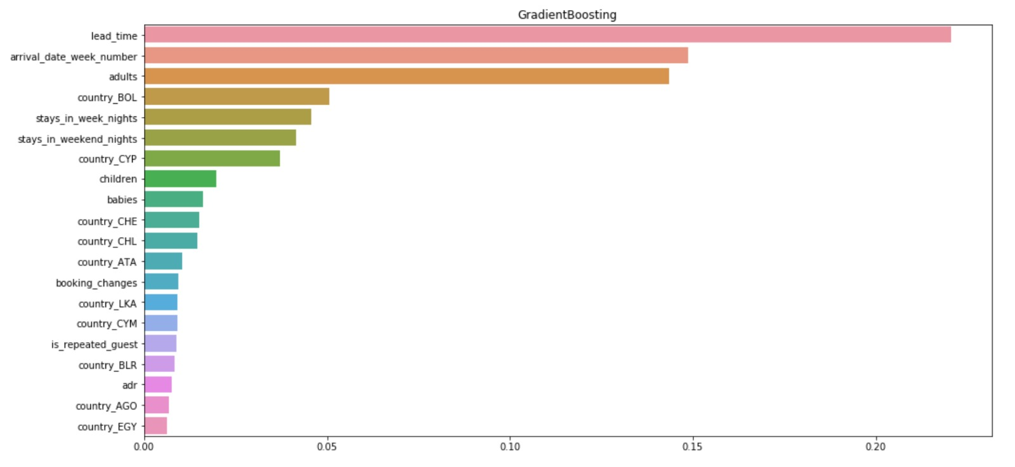
Feature Importance (for n = 10 000)

Slide 26
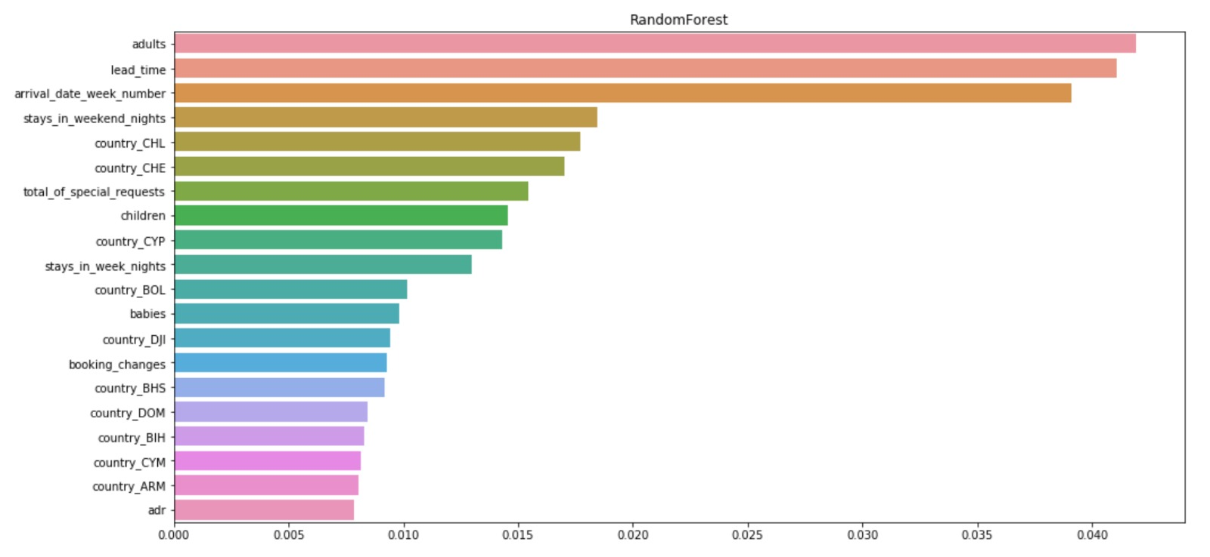
Feature Importance (for n = 10 000)

Slide 27
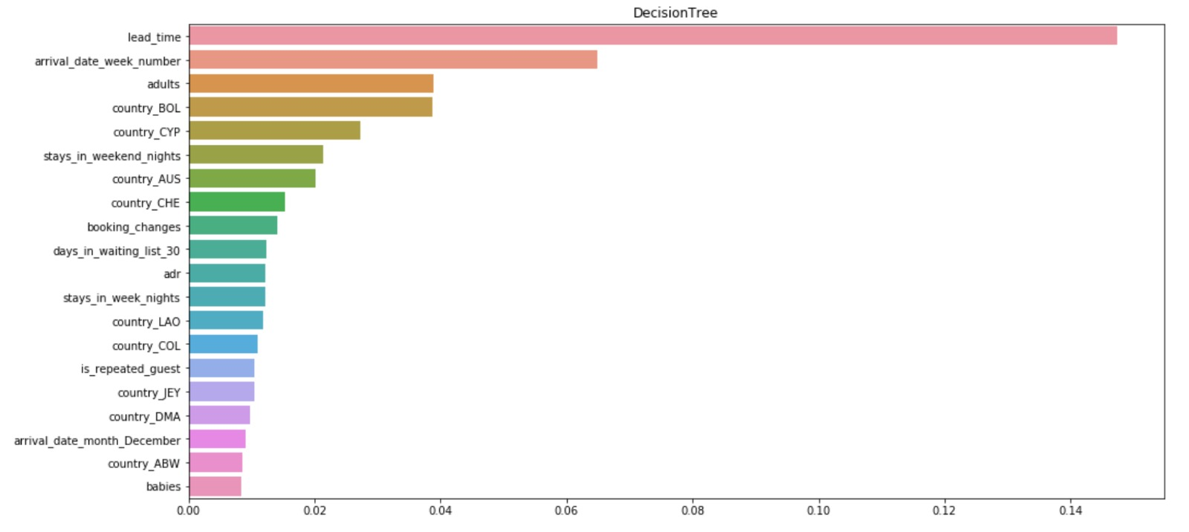
Feature Importance (for n = 10 000)

Slide 28
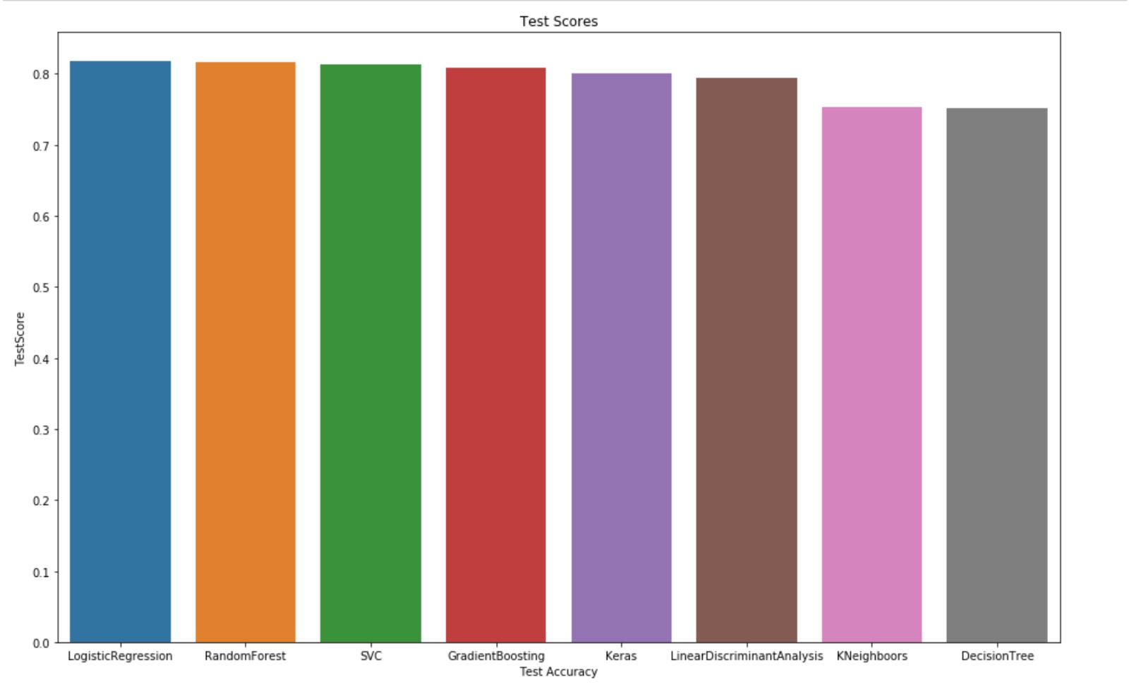
(for n = 10 000)

Slide 29
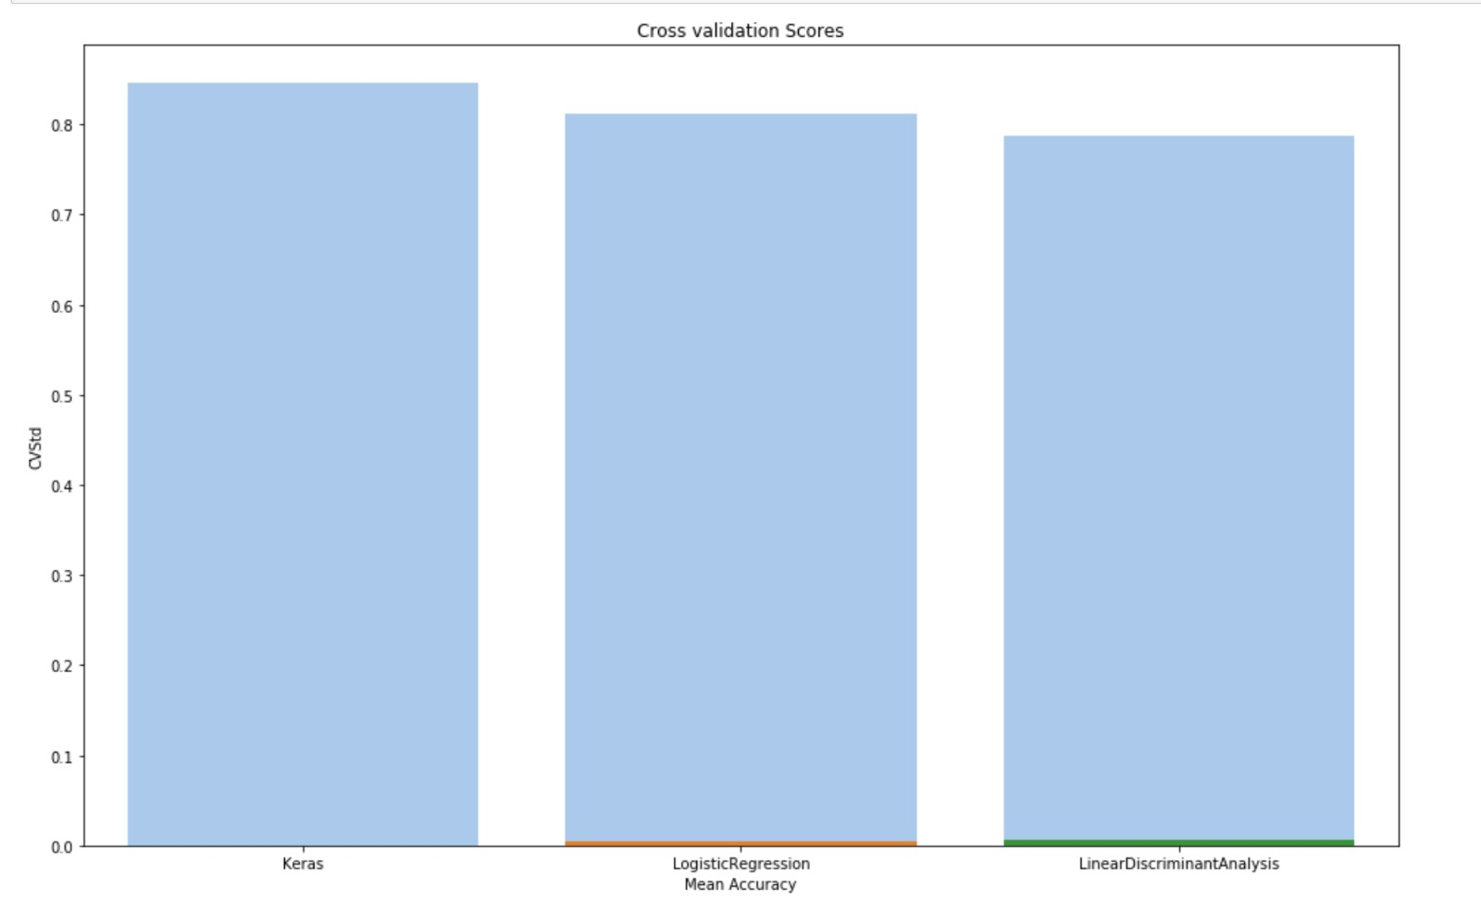
Cross Validation Scores --all data

Slide 30
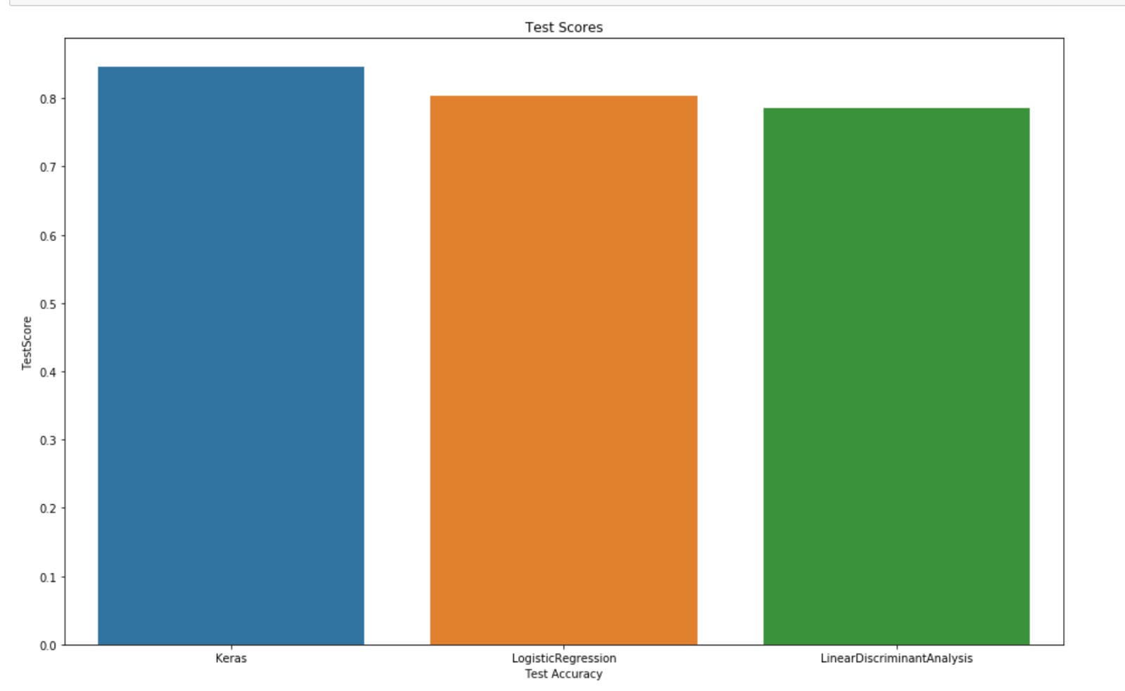
Test Scores --all data

Slide 31
Potential Improvements
Optimized model customers for individual hotels, which differs for seasons, months and even days.
Recommendations to hotels based on more successful ones. (Succesful in terms of receiving less cancellations)
Fine-tuning parameters for models to increase prediction accuracy.
More data could be collected to acquire better insights

