Slide 1
AdaptiveFace
Biometric Systems — MSc Computer Science
Taha & Kutay
Mask-Aware Face Authentication
May 2026
Same person, recognised whether they wear a mask or not — without retraining the recognition model.

Slide 2
The problem
When the lower half of the face goes missing
• User scenario: enrol once with an unmasked photo. Show up masked or unmasked at the camera. System must recognise you in both cases — without re-enrolment.
• Face recognition models like ArcFace are trained on largely unmasked faces. A mask occludes ~50% of the face area.
• Naïve solutions: (a) retrain the model on masked data, (b) refuse to operate when a mask is detected. Both are bad.
Question: can we keep the off-the-shelf model and still solve it?
We tried two ideas in parallel: 1. Mask-aware routing — pick a different matcher when masked. 2. Multi-template enrollment — add a synthetic-masked copy to the gallery.
AdaptiveFace — Mask-Aware Face Authentication | Biometric Systems MSc
2 / 12

Slide 3
Related work
Three past projects shaped our design
Smart Peephole (De Marsico et al., IW-BAAS 2017)
Modular pipeline (local detection + cloud recognition). Set the FAR/FRR + ROC + CMC + sigmoid-fit reporting template we reuse.
BioPen (Scozzafava & Ponzi)
Three-stage acquisition / feature extraction / decision layout. Mirrors our pipeline structure.
Biotouch (Moschella & Spini)
Ensemble methods over multiple classifiers — majority, average, weighted-average. Motivated our score-fusion configurations.
We borrow the modular structure, the evaluation template, and the ensemble vocabulary — but adapt them to masked face recognition.
AdaptiveFace — Mask-Aware Face Authentication | Biometric Systems MSc
3 / 12

Slide 4
Our two mitigation strategies
Pipeline A (routing) vs. Pipeline B (multi-template)
Pipeline A — Mask-aware routing
Pipeline B — Multi-template enrollment
Image → RetinaFace → AIZOO mask classifier ↙ ↘ unmasked masked ↓ ↓ ArcFace(full) ArcFace(aligned-upper-fill) ↓ ↓ gallery_full gallery_upper ↘ ↙ Accept / Reject
Enrolment (one-time): unmasked photo → ArcFace → gallery_real[i] + synthetic mask overlay → ArcFace → gallery_synth[i] Recognition: probe → ArcFace → sim_real = probe · real^T → sim_synth = probe · synth^T → max(sim_real, sim_synth) → Accept / Reject
Each identity has 2 templates from one enrolment photo. Mask classifier picks which one to compare against.
Two gallery rows per identity, both from the same photo. No mask classifier needed at match time.
AdaptiveFace — Mask-Aware Face Authentication | Biometric Systems MSc
4 / 12

Slide 5
Datasets and evaluation protocol
Datasets
Metrics suite
• LFW — 5,749 ids, 13,233 imgs. Unmasked baseline.
• RMFD — 377 paired masked + unmasked ids.
• MFR2 — 53-id paired set, demo sanity check.
• Genuine / impostor score distributions
• FAR & FRR with sigmoid fits (Smart Peephole style)
• EER + threshold at EER
• ROC with AUC
• CMC for identification, ranks 1…20
• Per-probe CSV for failure analysis
Open-set protocol
150 enrolled identities (RMFD) + 80 impostor identities (LFW). Impostors are never enrolled — they exercise the FAR side of every threshold sweep.
AdaptiveFace — Mask-Aware Face Authentication | Biometric Systems MSc
5 / 12

Slide 6
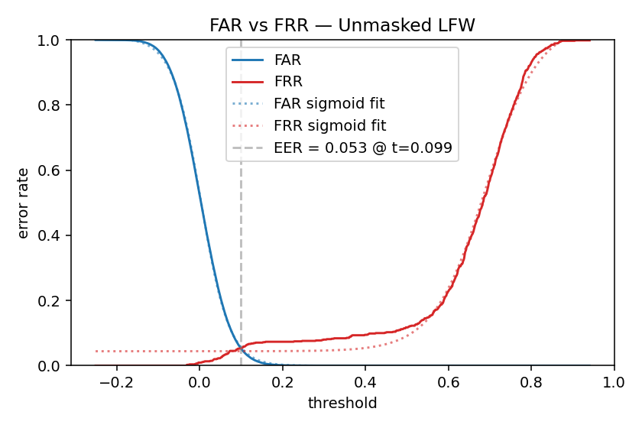
Experiment 1 — Unmasked baseline (LFW)
Establishing the ceiling
Metric | Value
Rank-1 identification rate | 92.7 %
Equal-error rate (EER) | 5.3 %
EER threshold (cosine) | 0.099
ROC AUC | 0.985
200 enrolled identities + 150 impostor identities from LFW. One unmasked photo per identity is the gallery template; the rest are genuine probes. Two impostor probes per impostor identity. Sanity check: the ArcFace stack is healthy before we introduce masks.
AdaptiveFace — Mask-Aware Face Authentication | Biometric Systems MSc
6 / 12

Slide 7
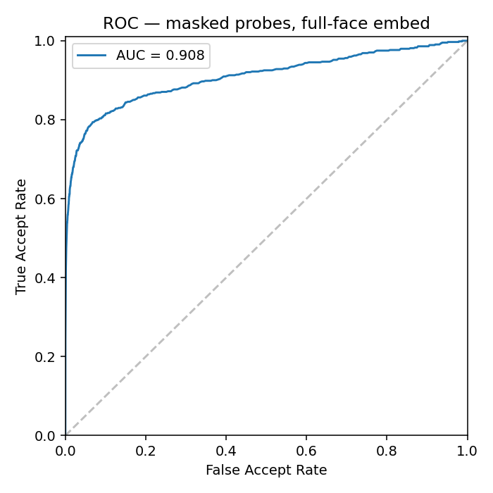
Experiment 2 — Masked-only probes (RMFD)
Isolate the recognition contribution of the upper-face branch
Mode | Rank-1 | EER | AUC
full (naive) | 54.6 % | 15.5 % | 0.908
upper (aligned fill) | 32.4 % | 20.9 % | 0.866
Observation 1: A real mask hurts. Rank-1 drops 92.7 → 54.6 % (≈ 38 pts). Observation 2: The upper-fill embedder is 22 pts WORSE than just feeding the masked image straight into ArcFace. First red flag for the routing approach — but we kept going so we could quantify exactly how much it costs.
AdaptiveFace — Mask-Aware Face Authentication | Biometric Systems MSc
7 / 12

Slide 8
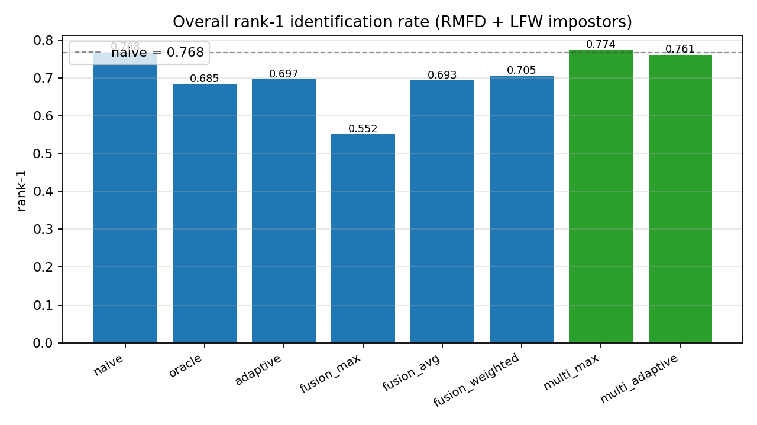
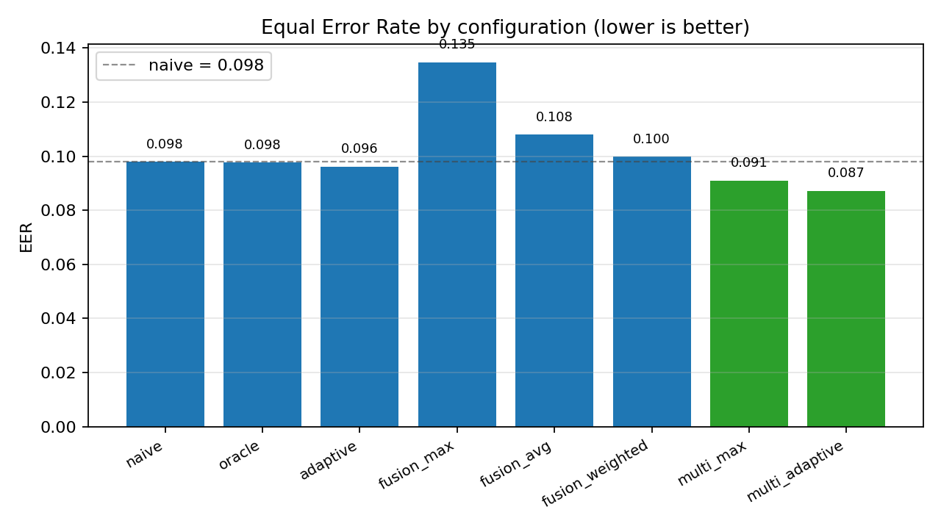
Experiment 3 — Cross-mode end-to-end (headline)
8 configurations, same probe set, RMFD + LFW impostors
Configuration | Rank-1 | EER | Masked-only R-1
naive (always full) | 76.8 % | 9.8 % | 51.9 %
oracle routing | 68.5 % | 9.8 % | 35.3 %
adaptive routing | 69.7 % | 9.6 % | 37.8 %
fusion_max | 55.2 % | 13.5 % | 39.0 %
fusion_avg | 69.3 % | 10.8 % | 45.2 %
fusion_weighted | 70.5 % | 10.0 % | 41.1 %
multi_max ★ | 77.4 % | 9.1 % | 52.7 %
multi_adaptive | 76.1 % | 8.7 % | 50.6 %
AdaptiveFace — Mask-Aware Face Authentication | Biometric Systems MSc
8 / 12

Slide 9
Why does routing fail?
A finding we couldn't predict before running it
Per-probe analysis on masked probes:
 | Cases | Effect
naive wrong, upper right (potential recoveries) | 9 | +9
naive right, upper wrong (regressions) | 57 | −57
Net effect of switching to upper on masked probes | — | −48
Interpretation: ArcFace already extracts useful identity signal from the visible upper face (eyes, brows, forehead) even when the lower half is masked. Our synthetic forehead-colour fill replaces the natural texture transition between mask edge, brow, and eye socket — exactly the cue ArcFace was leaning on. Filling does not add information. It erases information.
A defensible negative result — and the motivation to try Pipeline B.
AdaptiveFace — Mask-Aware Face Authentication | Biometric Systems MSc
9 / 12

Slide 10
Why does multi-template enrollment work?
Distribution match, not better matching
Each enrolled identity contributes two gallery rows from the same photo:
• gallery_real — original unmasked photo, ArcFace embedding.
• gallery_synth — same photo with a synthetic blue surgical mask overlaid, ArcFace embedding.
A real masked probe in the embedding space sits closer to gallery_synth (same mask distribution) than to gallery_real. An unmasked probe sits closer to gallery_real for the same reason. max(sim_real, sim_synth) automatically picks the right row for each probe. No routing, no classifier, no extra cost at recognition time — the work happens once at enrolment.
It's not better recognition. It's gallery augmentation.
AdaptiveFace — Mask-Aware Face Authentication | Biometric Systems MSc
10 / 12

Slide 11
Experiment 4 — Mask classifier sanity
Ruling out the 'maybe the classifier is noisy' explanation
Metric | Value
Backend | AIZOO Caffe (cv2.dnn)
Accuracy | 94 %
AUC | 0.991
Unmasked precision / recall | 0.90 / 1.00
Masked precision / recall | 1.00 / 0.88
Implication: the classifier is solid (near-perfect on unmasked, 88 % recall on masked). Combined with Experiment 3, this confirms that the routing pipeline's failure is NOT a classifier-quality issue. The routing decision is high-fidelity; the destination is the problem. If we had a perfect oracle mask classifier (Exp 3 'oracle' row), rank-1 still drops to 68.5 % vs. naive's 76.8 %.
Confusion matrix (RMFD, 300 + 300):
truth ↓ / pred → | unmasked | masked
unmasked | 299 | 1
masked | 35 | 265
AdaptiveFace — Mask-Aware Face Authentication | Biometric Systems MSc
11 / 12

Slide 12
Conclusion + live demo
What we set out to do
Recognise the same user with or without a mask, without retraining ArcFace.
What we found
• Mask-aware routing fails on pre-trained ArcFace — net loss of 48 probes vs. naive on masked-only rank-1. ArcFace was already robust; our forehead-fill erased the signal it needed.
• Score-level fusion inherits the same disadvantage — the two branches don't make independent errors.
• Multi-template enrollment with synthetic masks wins on every metric (multi_max): rank-1 76.8 → 77.4 %, EER 9.8 → 9.1 %, masked-only rank-1 51.9 → 52.7 %. multi_adaptive reaches the lowest EER overall, 8.7 %. Small but consistent.
Live demo
Enrol unmasked → walk past camera unmasked (accept) → put on a mask (still accept) → stranger appears (reject).
AdaptiveFace — Mask-Aware Face Authentication | Biometric Systems MSc
12 / 12

