Slide 1
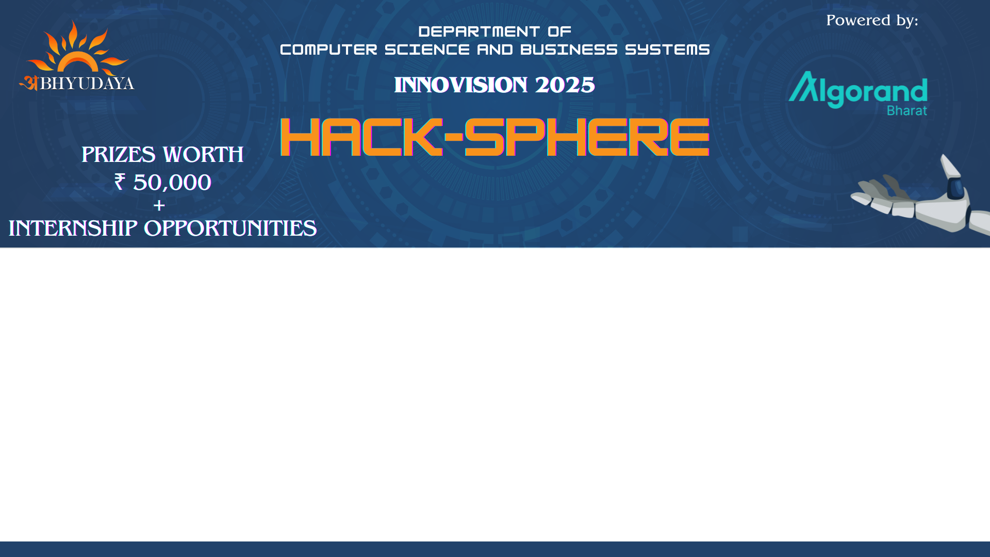




₹75,000
Team Details
Team name: IgnitedMinds
Team leader name: Prasad Kute
Domain : Security
Problem Statement: Biometric Password Vault

Slide 2

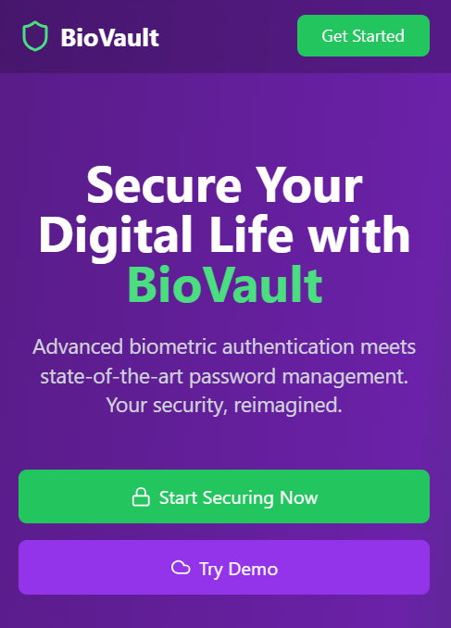
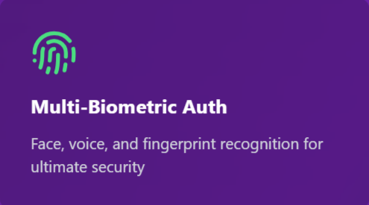
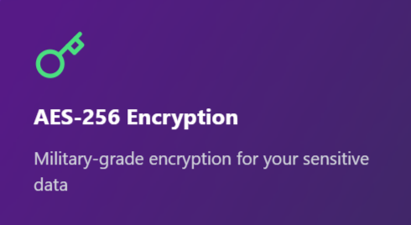
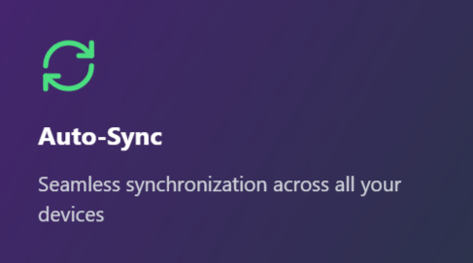
Proposed Solution :
Developing a Cross-platform to securely store, manage, and retrieve passwords using advanced biometric authentication like face, voice and fingerprint recognition. It’s designed to simplify password management while keeping everything safe and synced across devices.
Key Features:
Integration with Google’s password storage.
Cross-platform support (Chrome Extension, Android App, Web Interface).

Slide 3
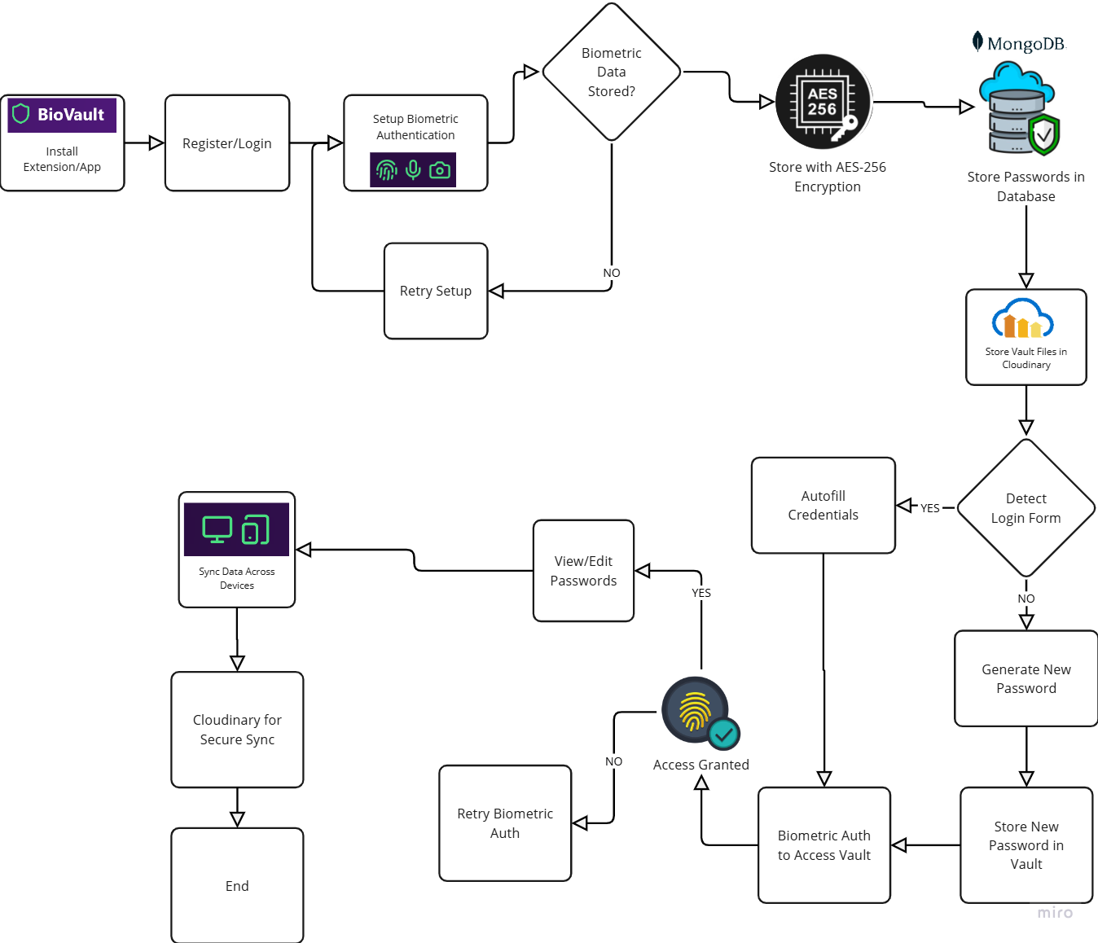











TECHNICAL APPROACH
TECHNICAL INFORMATION
Website using React and FastAPI: Build a secure password vault with React for the frontend and FastAPI for the backend.
Authentication & Security: Integrate biometrics (voice, fingerprint, photo) using WebAuthn, Google APIs, and AES-256 encryption. Passwords and metadata stored in MongoDB, while encrypted vault files and biometric data are stored on Cloudinary.
Cross-Platform: Develop a React Native Android app and a Chrome extension for password management.
Password Management: Enable secure storage, generation, and retrieval with FastAPI, MongoDB, and AWS integration.
Two-Factor Authentication (2FA): Add SMS/email-based tokens for extra security during login and transactions.
TECHOLOGY STACK

Slide 4







UNIQUENESS AND NOVELTY
Feature
Password Generation
Multi-Factor Authentication
Cross-Platform Support
Voice Authentication
Fingerprint Authentication
Photo Authentication
Auto Login Form Filling
Browser Extention Available
TOTP Generation
Unique Value Proposition (UVP) for BioVault
Triple-Biometric Security: Industry-leading multi-biometric authentication with voice, fingerprint, and photo recognition for unparalleled protection and convenience.
Seamless Multi-Platform Integration: Access your vault securely across a website, Android app, and Chrome extension with unified, user-friendly functionality.
Cutting-Edge Backend: Built using FastAPI for lightning-fast performance, scalability, and secure API interactions, paired Cloudinary with for encrypted data storage.
Enhanced Security with TOTP: Native integration of Time-Based One-Time Passwords (TOTP) ensures an extra layer of security for your accounts.
Advanced Encryption Standards: We employ AES-256 encryption, a higher standard than the commonly used ChaCha20, ensuring top-tier security for user data.
User-Centric Design: Our platform offers a seamless and intuitive user experience across multiple platforms, ensuring accessibility and ease of use.
Future-Ready Technology: Embracing multi-biometric authentication positions our solution at the forefront of security technology, catering to evolving user needs and preferences.

Slide 5
FEASIBILITY AND VIABILITY
Technical Feasibility:
Technology Availability: APIs like Google Speech-to-Text, WebAuthn, and BiometricPrompt are accessible for biometrics.
Security: AES-256 encryption and HTTPS ensure secure data handling.
Compatibility: MERN stack and React Native/Kotlin enable scalable, cross-platform development.
Operational Feasibility:
Team: Developers, security experts, and UX designers needed for implementation.
Scalability: Cloud infrastructure like Firebase or AWS supports growth.
Market Feasibility:
Demand: Increasing need for secure password management solutions.
Accessibility: Multi-biometric authentication simplifies user access and improves adoption.
Revenue Model: Freemium plans attract users; subscriptions provide advanced features.
Potential Challenges | Strategies to Overcome:
Technical Risks: Data security concerns and vulnerabilities in APIs and cloud services. | Technical Solutions: Conduct regular security audits and provide offline access features.
Operational Risks: Server downtime during peak usage. | Operational Readiness: Partner with reliable cloud providers to ensure uptime and data security.
Market Risks: Resistance to adopting new biometric technology. | Market Strategies: Run webinars and tutorials to educate users and improve adoption rates.

Slide 6
Team Details
Name | Email | Phone Number
Prasad Rajaram Kute | Prasad.22210330@viit.ac.in | 7558750366
Arya Jalindar Kadam | arya.22210766@viit.ac.in | 8779831758
Chinmay Ashok Kale | chinmay.22210926@viit.ac.in | 9021658271
Tejaswini Jaywant Durge | tejaswini.22210270@viit.ac.in | 8446528408

