Slide 1
Introduction
Attack recognition
Vulnerability recognition

Slide 2
Attack recognition
Normalization
Aggregation
Correlation
Plan Recognition
IDS’s Alerts
Attack plan

Slide 3
Vulnerability recognition
Server’s Info Collecting
Vulnerability Matching
Vulnerability
Vulnerabilities Database
(OSVDB)

Slide 4
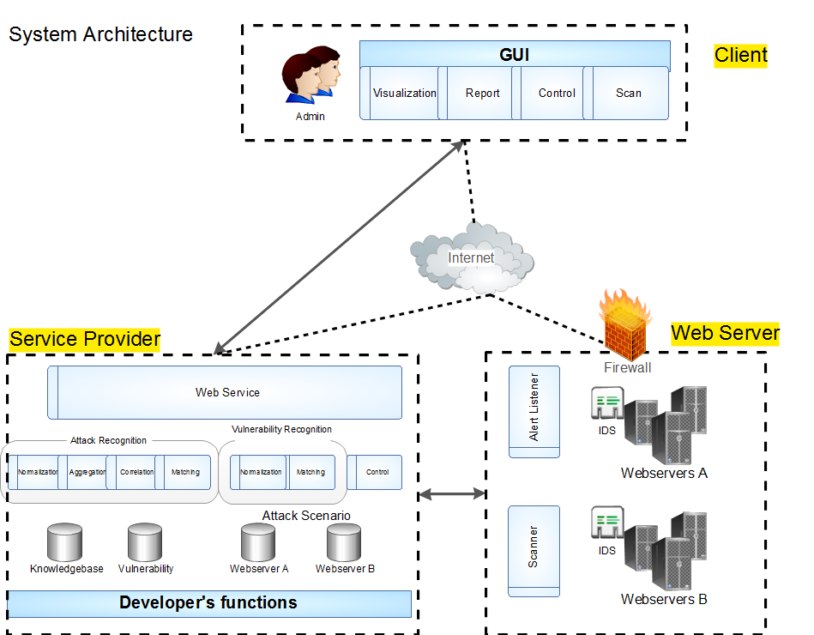
SOAP Message

Slide 5
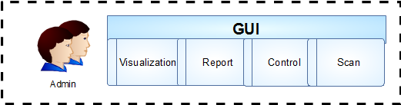
Client
WPF application
GraphViz
DOT Language File

Slide 6
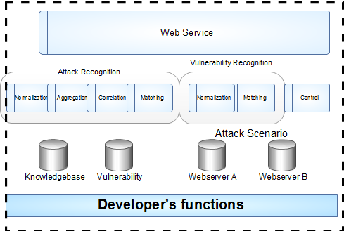
Service Provider
IIS Server
Oracle
DB

Slide 7
ERD

Slide 8
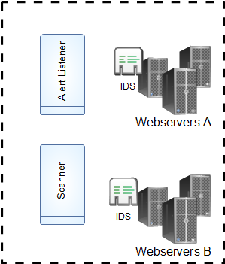
Web server
Snort
IDMEF
NMap

