Slide 1
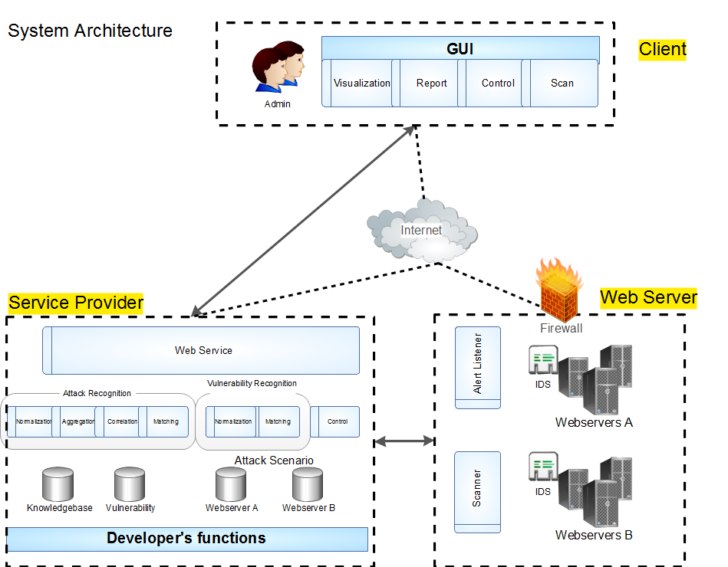
SOAP Message

Slide 2
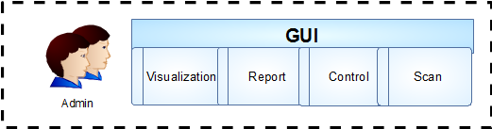
Client
WPF application
GraphViz
DOT Language File

Slide 3
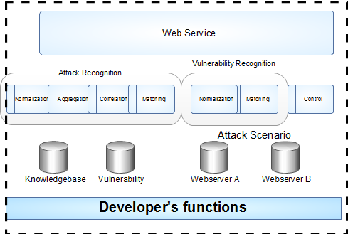
Service Provider
IIS Server
Oracle
DB

Slide 4
ERD

Slide 5
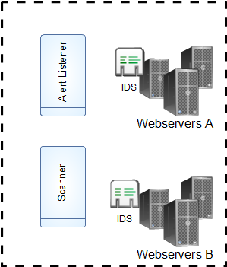
Web server
Snort
IDMEF
NMap

