Slide 1

Reinforcement Learning with Attentional Feedback & Temporally Attenuated Distal Rewards
Kumaran Thulasiraman

Slide 2
No accurate supervision; only delayed rewards
for correct behavior
Agent’s action affects subsequent input from
environment
More suited to game playing and control
problems with no easily programmable
solution
Biologically plausible; inefficient
Reinforcement
Supervised
Unsupervised
Goal: Make reinforcement learning
more biologically plausible
as efficient as supervised learning
ML
Efficient; Biologically implausible

Slide 3
Reinforcement learning: Agent and Environment
observations
Environment
rewards
actions
At each δt,
Agent performs an action, A_{t}
Receives a new observation, I_{t} from the environment
Receives +/- reward for its action, R_{t} from the environment

Slide 4
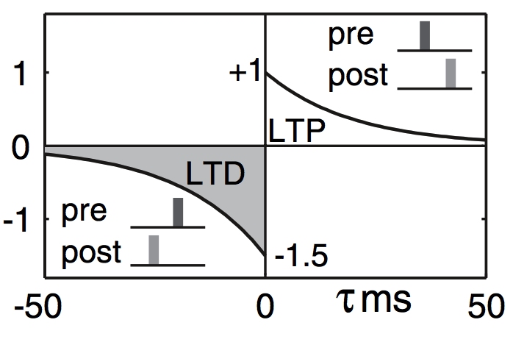
Spike-Timing Dependent Plasticity
pre
post
τ = t_{post} - t_{pre}

Slide 6
Challenges
Distal Reward Problem
How delayed rewards affect behavioral reinforcement
Credit Assignment Problem
Only synapses that contributed to correct behavior must be reinforced
Motor Numbness Problem

Slide 7
Handling the Credit Assignment Problem Attentional Feedback
Feedback from response-selection stage to previous layers

Slide 8

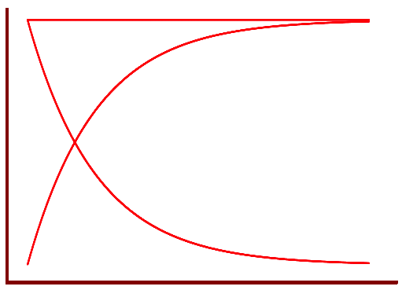

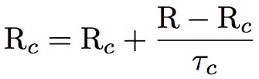

Reward Attenuation
Reward predictor for each channel or output

Slide 9
Custom Network Setup
Izhikevich, LIF neuron models
Feedforward, recurrent network
Sparse hidden > output layer synapses
Attention gating
Instantaneous or delayed attenuated rewards
Roulette Wheel (fitness-proportionate) response selection

Slide 10
Validations

Slide 11
Simple Linear Inseparability (XOR)

Slide 12
Walking Task

Slide 13
Iterative Prisoner’s Dilemma

Slide 14
Distributed Sensor Network

Slide 15

?
Questions

