Slide 1

Enhanced Reinforcement Learning in Spiking Neural Networks with Attentional Feedback & Temporally Attenuated Distal Rewards
Kumaran Thulasiraman

Slide 2
Machine Learning
No accurate supervision; only delayed rewards
for correct behavior
Agent’s action affects subsequent input from
environment
More suited to game playing and control
problems with no easily programmable
solution
Biologically plausible; inefficient
Reinforcement
Supervised
Unsupervised
Goals:
Make reinforcement learning mechanism
more biologically plausible
as efficient as supervised learning
ML
Efficient; Biologically implausible

Slide 3
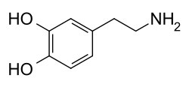
Reinforcement learning: Agent and Environment
observations
Environment
rewards
actions
At each δt,
Agent performs an action, A_{t} ε A(O_{t})
Receives a new observation, O_{t} from the environment
Receives reward ±R_{t+δt} , for its action from the environment

Slide 4
Reinforcement learning
Any real-life goal could be translated to the
objective of maximizing the long-term reward
Create a policy that maps observations to
rewardable actions
Exploration – Discover better actions
Exploitation – Maximize rewards from experience

Slide 5
Learning = Plasticity

Slide 6
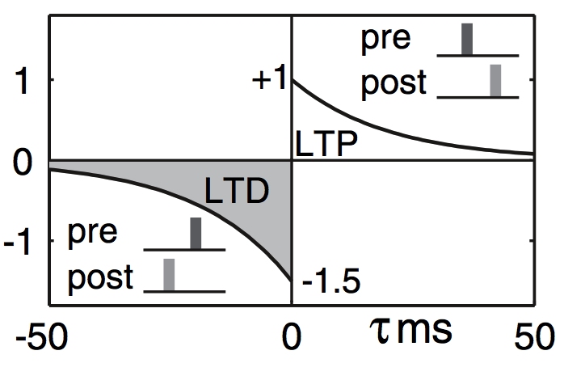
Spike-Timing Dependent Plasticity
Hebbian learning rule: ‘Neurons that fire together wire together’
pre
post
τ = t_{post} - t_{pre}

Slide 7
Dopamine-Modulated STDP
Hebbian learning rule: ‘Neurons that fire together wire together’
pre
post
τ = t_{post} - t_{pre}

Slide 9
Challenges
Distal Reward Problem
How delayed rewards affect behavioral reinforcement
Spatial Credit Assignment Problem
Only synapses that contributed to correct behavior must be reinforced
Motor Numbness Problem

Slide 10
Challenges
Distal Reward Problem
How delayed rewards affect behavioral reinforcement
Spatial Credit Assignment Problem
Only synapses that contributed to correct behavior must be reinforced
Motor Numbness Problem

Slide 11
Handling the Distal Reward Problem Eligibility Traces
Feedback from response-selection stage to previous layers

Slide 12
Handling the Credit Assignment Problem Attentional Feedback
Feedback from response-selection stage to previous layers
Backpropagation-inspired

Slide 13

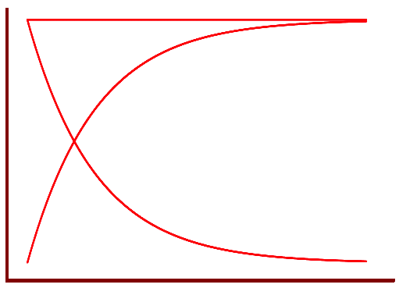

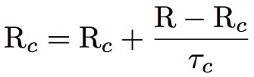

Reward Attenuation
Reward predictor for each channel or output

Slide 14
Custom Network Setup
Izhikevich, LIF neuron models
Feedforward, recurrent network
Sparse hidden > output layer synapses
Attention gating
Instantaneous or delayed attenuated rewards
Roulette Wheel (fitness-proportionate) response selection

Slide 15
Neural Encoding
Izhikevich, LIF neuron models
Feedforward, recurrent network
Sparse hidden > output layer synapses
Attention gating
Instantaneous or delayed attenuated rewards
Roulette Wheel (fitness-proportionate) response selection

Slide 16
Validations

Slide 17
Simple Linear Inseparability (XOR)

Slide 18
Walking Task

Slide 19
Iterative Prisoner’s Dilemma

Slide 20
Distributed Sensor Network

Slide 21
References

Slide 22

?
Questions

