Slide 1

Enhanced Reinforcement Learning in Spiking Neural Networks with Attentional Feedback & Temporally Attenuated Distal Rewards
Kumaran Thulasiraman

Slide 2
Reinforcement learning
Machine learning strategies

Slide 3
Machine Learning
Biologically plausible; inefficient
Reinforcement Learning
No accurate supervision; only evaluations
(delayed rewards for correct behavior)
Agent’s action affects subsequent input from
environment
More suited to game playing and control
problems with no easily programmable
solution
Reinforcement
Supervised
Unsupervised
ML
Efficient; Biologically implausible

Slide 4
Reinforcement learning: Agent and Environment
observations
Environment
rewards
actions
At each δt,
Agent performs an action, A_{t} ε A(O_{t})
Receives a new observation, O_{t+1} from the environment
Receives reward ±R_{t+Δt} , for its action from the environment

Slide 5
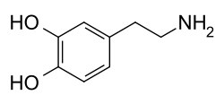
…
Any real-life goal could be translated to the objective of maximizing the long-term reward
The internal goal is to create a policy that maps observations to rewardable actions
Exploration – Discover better actions
Exploitation – Maximize rewards from experience
Goals:
Make reinforcement learning mechanism
more biologically plausible
as efficient as supervised learning

Slide 6
Formal Scenario
Agent
Maximize rewards through
exploration and exploitation
State
S_{t+1}
Reward
R_{t+1}
Action
A_{t}
Environment
R_{t}
R_{t+1}
S_{t}
S_{t+1}
t
A_{t}
δt

Slide 7
Reinforcement learning in neural networks
Biologically viable reinforcement learning

Slide 8
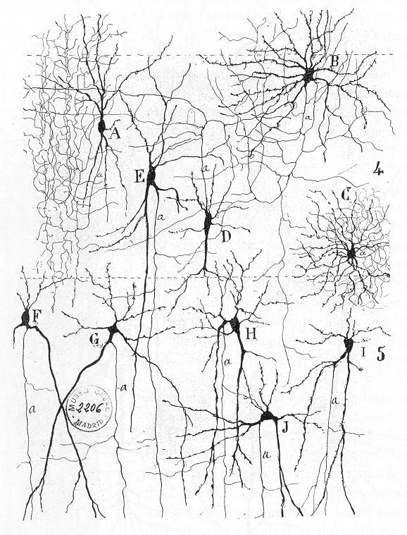
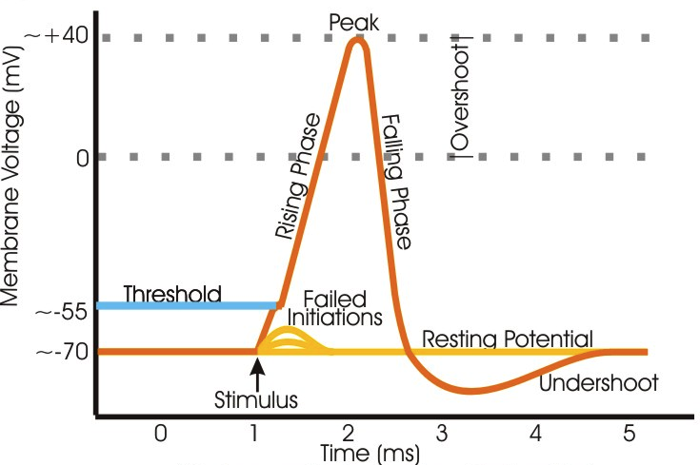
Biological Neural Networks
Texture of the Nervous System of Man and the Vertebrates
Santiago Ramón y Cajal.
Neurons communiate only through spikes
Synaptic plasticity is key to learning

Slide 9
Plasticity = Learning
Long-term potentiation –
“persistent strengthening of synapses based on recent patterns of activity”
Long-term depression –
“activity-dependent reduction in synaptic efficacy following a long patterned stimulus”

Slide 10
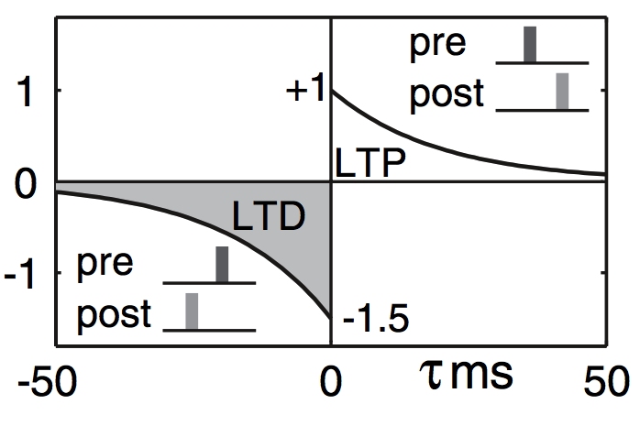
Spike-Timing Dependent Plasticity
Hebbian learning rule: ‘Neurons that fire together wire together’
pre
STDP(τ)
post
τ = t_{post} - t_{pre}

Slide 11
Reinforcements: Dopamine-modulated STDP
ϒ – Learning rate
R(t) – Reward for the last action

Slide 12
STDP demo

Slide 13
Challenges
Distal Reward Problem
How delayed rewards affect behavioral reinforcement
Spatial Credit Assignment Problem
Only synapses that contributed to correct behavior must be reinforced
Motor Numbness Problem
Complete action supression preventing exploration

Slide 14
Distal Reward Problem
Pavlonian, Instrumental conditioning: Rewards arrive seconds after reward-triggering actions for LTP/LTD, unlike STDP
The brain has to determine which firing patterns/synpases to reward
The patterns are no longer active at the rewarding point
To persist these patterns, the brain cannot freeze its state until rewards are delivered
The problem: During an active episode of activity, how to pick or remember the reward-worthy synapses for an earlier action

Slide 15
Handling the Distal Reward Problem Eligibility Traces
pre
post

Slide 16
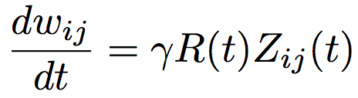
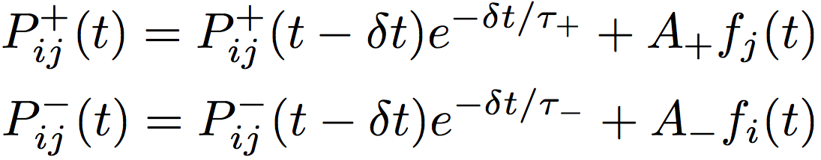
Florian’s Eligibility Traces⁺
i
j
⁺Florian. 2007, Reinforcement Learning Through Modulation of Spike-Timing-Dependent Synaptic Plasticity

Slide 17
An XOR Experiment
Let’s put everything together
Input Encoding
1 ➔ 40 Hz for 500ms
0 ➔ 0 Hz for 500ms
Rewarding policy
Instantaneous:
01,10 ➔ +1 for every output spike
00,11 ➔ −1 for every output spike
Delayed (500ms):
01,10 ➔ +1 if |N_{o}| > N_{th}
−1 if |N_{o}| < N_{th}
00,11 ➔ +1 if |N_{o}| < N_{th}
−1 if |N_{o}| > N_{th}
60
15
A Hz
15
1
1
Poisson
1
15
B Hz
15
Excitatory
Inhibitory

Slide 18
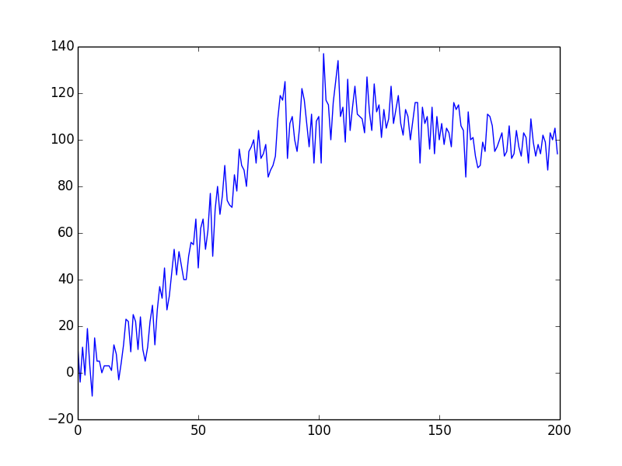
Results
Instantaneous Reward Profile
Output Rate
Some concerns and questions:
When there’s no driving input, there are no output spikes
How to estimate the rate threshold for delayed rewarding?
Is delayed rewarding necessary here?
How does it work for multiple outputs, say for classification tasks?

Slide 19
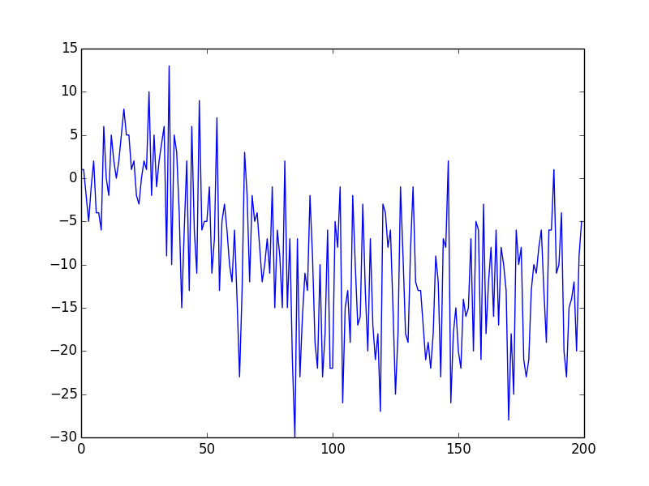
XOR with 2 output neurons
Instantaneous Reward Profile
Output Rate
Rewards oscillate and the system struggles.
Only one of the rewarded behaviors is learnt.
Delayed rewards delay the learning too much

Slide 20
Challenges
Distal Reward Problem
How delayed rewards affect behavioral reinforcement
Spatial Credit Assignment Problem
Only synapses that contributed to correct behavior must be reinforced
Motor Numbness Problem
Avoiding complete action supression preventing exploration

Slide 21
Spatial Credit Assignment Problem
The logical network partitioning task for credit assignment remains tough.
A bad neuron cannot be rewarded just because its neighbors are correct, and vice versa.
How to make the assignments even precise and correct?
We have a backpropagation-inspired gating method to the rescue, now for spiking neural networks.

Slide 22
Handling the Spatial Credit Assignment Problem Attentional Feedback
Feedback from response-selection stage to previous layers
Backpropagation-inspired

Slide 23
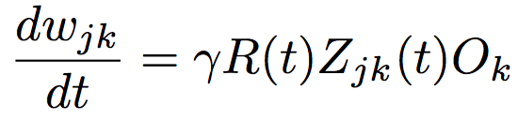
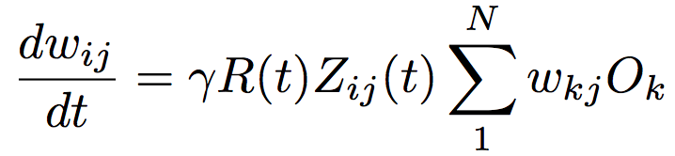
… Attentional Feedback

Slide 24
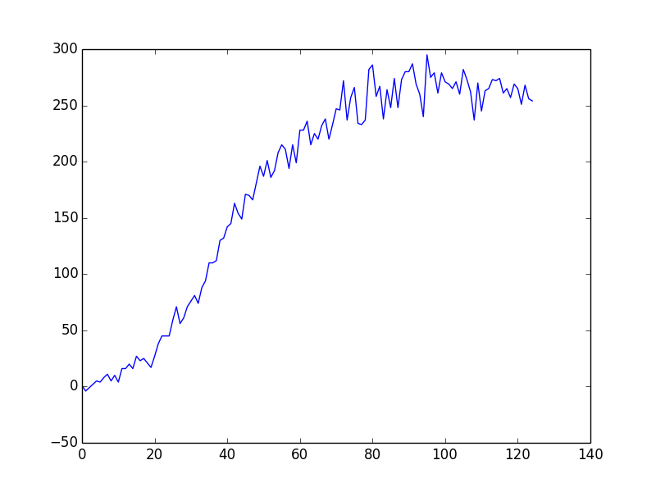
… Attentional Feedback
Instantaneous Reward Profile
Output Rate
Correct response start: Epoch 20

Slide 25
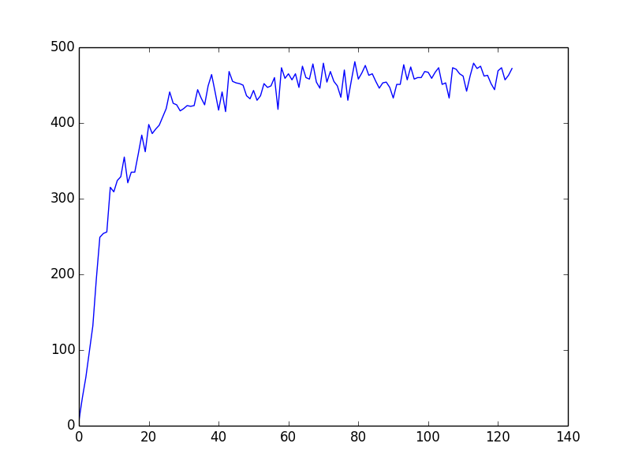
… Attentional Feedback
Instantaneous Reward Profile
Output Rate
Correct response start: Epoch 6 = 3000 msecs

Slide 26
Challenges
Distal Reward Problem
How delayed rewards affect behavioral reinforcement
Spatial Credit Assignment Problem
Only synapses that contributed to correct behavior must be reinforced
Motor Numbness Problem
Avoiding complete action supression preventing exploration

Slide 27
Motor Numbness Problem

Slide 28

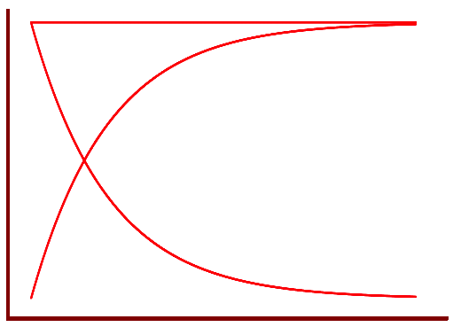

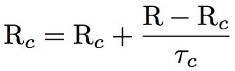

Reward Attenuation
Reward predictor for each channel or output

Slide 29
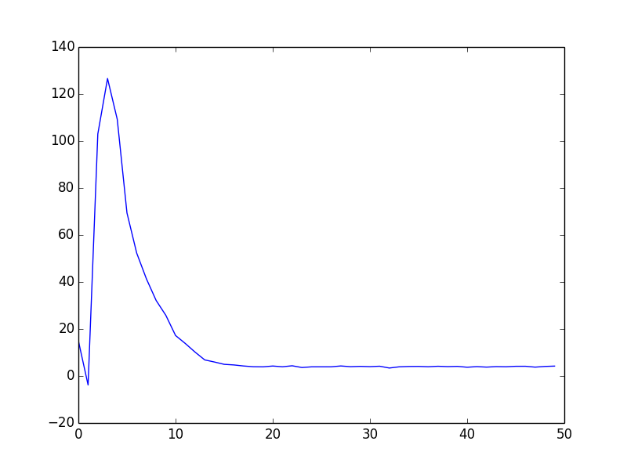
… Reward Attenuation
Instantaneous Reward Profile
Output Rate
Stabilizaton of the output rate

Slide 31
Custom Network Setup
Izhikevich, LIF neuron models
Feedforward, recurrent network
Sparse hidden > output layer synapses
Attention gating
Instantaneous or delayed attenuated rewards
Roulette Wheel (fitness-proportionate) response selection

Slide 32
Neural Encoding
Balanced-Pair Binary Encoding

Slide 33
Coming back: XOR with 2 output neurons
Instantaneous Reward Profile
Output Rate
Rewards oscillate and the system struggles.
Only one of the rewarded behaviors is learnt.
Delayed rewards delay the learning too much

Slide 34
Validations

Slide 35
Simple Linear Inseparability (XOR)

Slide 36
Simple Linear Inseparability (XOR)
Network Design
Rewarding Policy
Case 0, 40 Hz:
Case
80
20
40Hz
20
1
A
1
0.5
Poisson
20
1
B
40Hz
20

Slide 37
Simple Linear Inseparability (XOR)

Slide 38
Walking Task

Slide 39
Multi-agent reinforcement learning
Distributed constraint optimization; greedy agents working for the team

Slide 40
Multi-Agent Reinforcement Learning (MARL)
Agents learn by interacting with each other and with their environment

Slide 41
Iterative Prisoner’s Dilemma
A general-sum game theoretic interaction between two agents
 | Cooperation (C) | Defection (D)
Cooperation (C) | R,R | S,T
Defection (D) | T,S | P,P
R- Reward
S – Sucker’s Payoff
T – Temptation
P – Punishment
Valid reward structure: T > R > P > S

Slide 42
Iterative Prisoner’s Dilemma
Reward Policy
 | C | D
C | RR | ST
D | TS | PP
A general-sum game theoretic interaction between two agents
Agent-Env interaction
80
80
20
1
20
1
0.5
1
1
0.5
1
20
1
20
Agent-Agent Interaction

Slide 43
Distributed Sensor Network
NIPS ‘05 Multi-Agent Reinforcement Learning Benchmark
A sequential decision making variant
of a distributed constraint optimization problem.
For 8 sensors,
System state space: 37
Combined action space: 3⁸ = 6561
cell
1
3
5
7
2
4
6
8
target
sensor

Slide 44
Distributed Sensor Network
Each sensor is modeled by a network of 12 inputs and 3 outputs

Slide 45
References
Florian, R. V. (2007). Reinforcement learning through modulation of spike-timing-dependent synaptic plasticity

Slide 46

?
Questions

