Slide 1
WriteRGBImage Operator

Slide 2
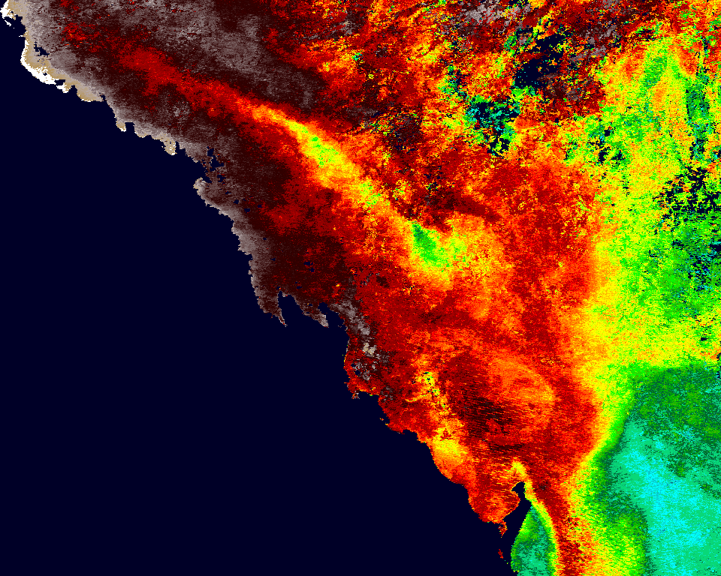
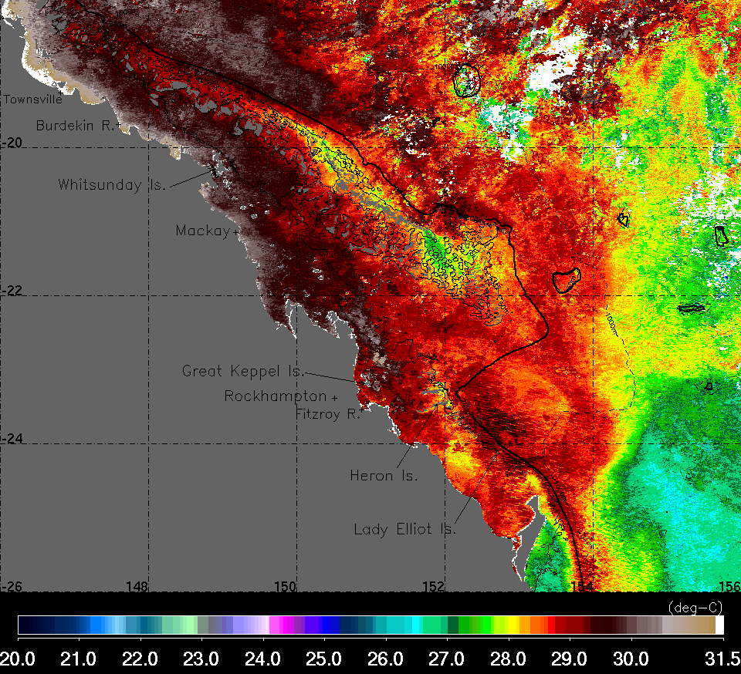
PURPOSE: Generate final image of different processing in our web tool.
Example 1: Generate SST image of selected interval (e.g. 5day) per sub-region. Current image output at top right.
We want to be able to include our own land and reef mask (set as gray, RGB [110,110,110])
Set the missing or cloud pixel value as white
Include bathymetric contour (imported as shape files). -50m (thin black line), -200m (thick black line), -1000m (thin black dashes)
Include annotation of pertinent locations depending on sub-region processed. I know we can now select dots in pin manager, so that might be useful here.
The operator has problem with scaling the colors according to specified range. For example, this image used a range set as [20,31.5]. The operator works fine but once one changes the default color scale range, say make it tighter at [22,28], the output image does not reflect this change. The colors does not get adjusted between the new narrower scale.
Add an option to also output the color scale
WriteRGBImage output
Old SeaDAS 6.4 output
SST D+N, 5D mean 1-5 Feb 2015
Notes:
Files used to generate images:
WriteRGBImage output: M-L3-GBR-5D-1D-XTSST-DN-2015032-2015036.nc
SeaDAS6.4 output: M-L3-GBR-5D-1D-XTSST-D+N-SGBR-5D-2015032-2015036_L3-L3_Mean-100.hdf

Slide 3
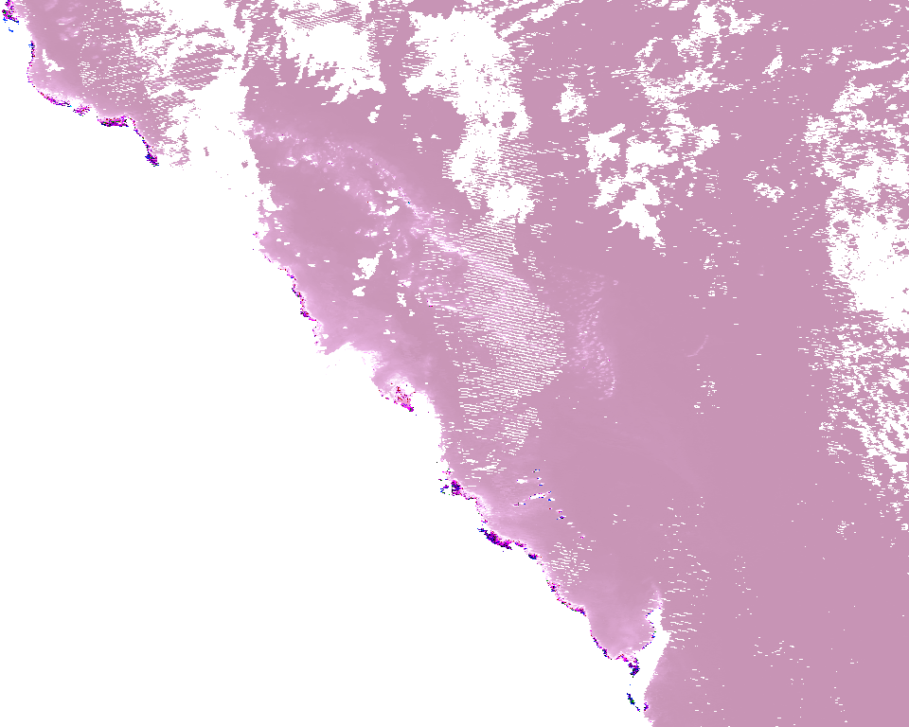
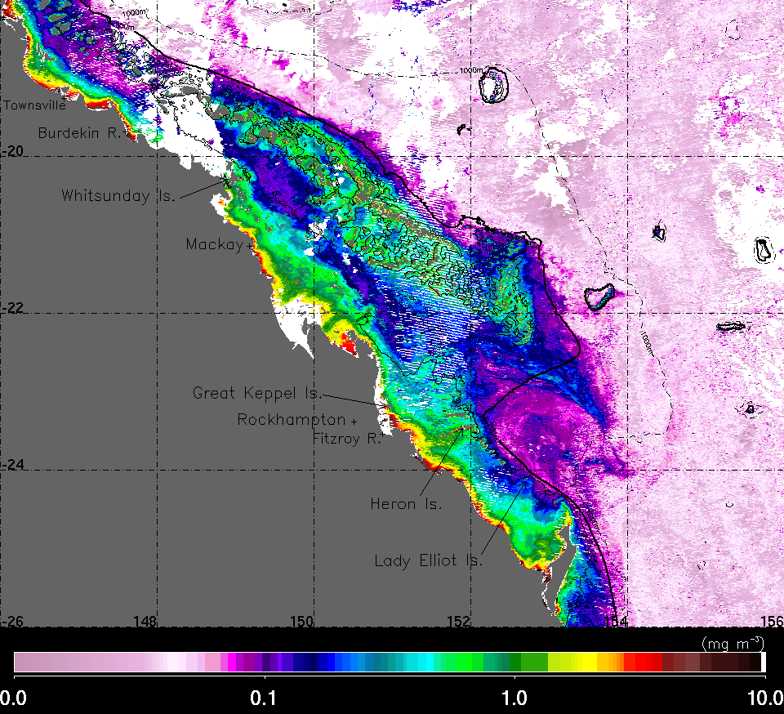
PURPOSE: Generate final image of different processing in our web tool.
Example 2: Generate Chlorophyll image of selected interval (e.g. 7day) per sub-region. Current image output at top right.
Aside from what was mentioned in the SST example, here is the issue with chlorophyll image generated.
The logarithmic scale doesn’t work properly. The correct image output should be the same as the SeaDAS6.4 generated image at the bottom.
WriteRGBImage output
Old SeaDAS 6.4 output
Chlorophyll, 7D mean 1-7 Feb 2015
Notes:
Files used to generate images:
WriteRGBImage output: M-L3-GBR-7D-1D-CHLOR-D-2015032-2015038.nc
SeaDAS6.4 output: M-L3-GBR-7D-1D-CHLOR-D-SGBR-7D-2015032-2015038_L3-L3_Mean-100.hdf

Slide 4
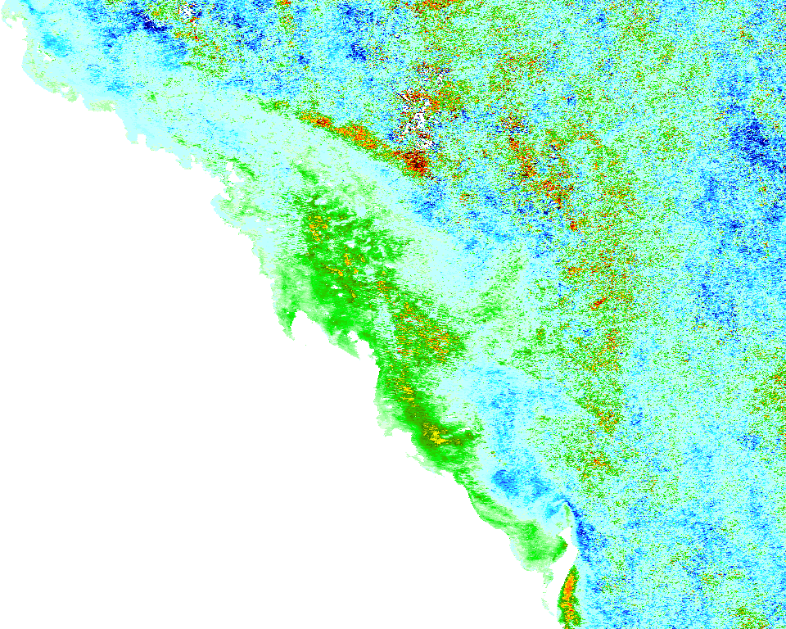
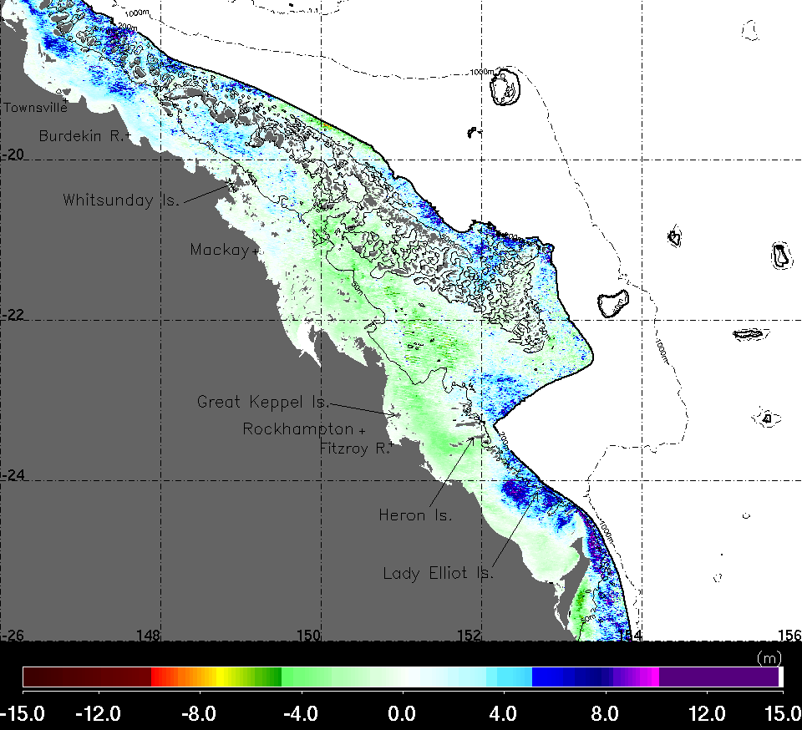
PURPOSE: Generate final image of different processing in our web tool.
Example 3: Generate monthly anomaly of photic depth image per sub-region with offshore region masked out in the display. Current image output at top right.
Additionally, we would sometimes want to just create an image of the photic depth on the shelf only. To do this in SeaDAS6.4, we would use a mask based on bathymetry that sets pixels deeper than 200m as zero then just give them a white color in the output image. The output anomaly data (hdf in our case) is not changed though.
The difference in color may be due to different cpd/lut
WriteRGBImage output
Old SeaDAS 6.4 output
ZSD (Photic Depth) anomaly image, February 2015
Notes:
Files used to generate images:
WriteRGBImage output: M-L3-GBR-1M-1M-ZSD-D-2015032-2015059.nc
SeaDAS6.4 output: M-L3-GBR-1M-1M-ZSD-D-SGBR-1M-2015032-2015059_rlord-anomaly-100.hdf

