Slide 1
TRANSITION II: Earthsharing
A Public Ledger system enabling equality of opportunity
Rammy Kuttaineh [working draft]

Slide 2
Public Ledger?
Records transactions
No interest component
No reserves as the ledger represents the value of Earth
RAMMY KUTTAINEH [working draft]

Slide 3
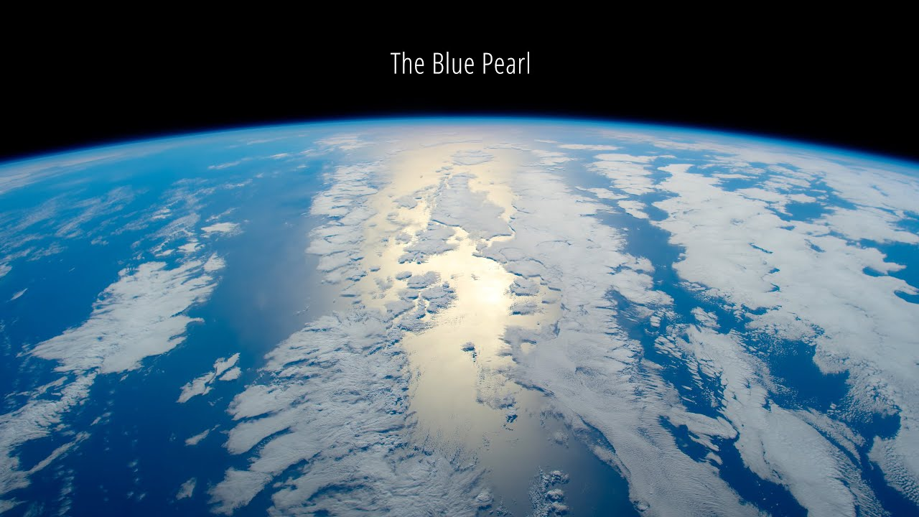
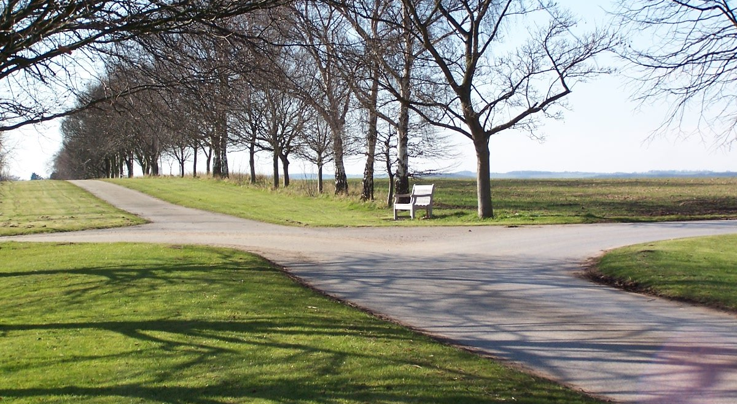
The Physical Universal Unit
Let each being begin with an equal share of the Earth.
The share is not fixed but rather it is derived from the sum of natural resources divided by the population.
Upon conception each shall have right
to their share.
Let each share be highly divisible so that flows of micropayments may be automated: to enable people to not only have their land value tax, any pigovian assessment, and extraction fees deducted but, also resident dividends and any stipend be received.
@elkfish
Rammy Kuttaineh [working draft]

Slide 4
Tax, no tax, or stipend
Whether you’re net paying tax, no tax, or receiving a stipend is
a result of your exclusive usages.
Your ledger entry is yours because your private key is yours exclusively,
see Public & Private Key Explained.
Only as many active ledger entries recording claims of value as there are living human beings.

Slide 5
Complimentary Currency ← PUU
As Geoism is the natural conclusion of the idea that people possess equal
moral worth — each human being, as a function of their humanity, has an
equal claim to the resources of the Earth — their Physical Universal Unit.
Let that P.U.U. ledger entry, which is essentially money because it is a
claim to wealth, have legal tender status.
With legal tender status, taxes may be paid out of the entry, as well as
dividends from lease payments paid in.

Slide 6
What does this have to do with you?
PUU Defined
Physical Universal Unit
Complementary public money ledger system
With PUU one can pay their taxes; what determines
whether you are paying tax or receiving a refund is based
upon your exclusive usage of natural resources.

Slide 7
Let the Unit be codified into a Coin
PUC Defined
Physical Universal Coin
Complementary public money ledger system
Individuals able to have their personal
Walden Pond life tax-free. Taxation would only
kick in when a person exceeds their
inheritance share.

Slide 8
Why?
Enable people to live unharassed according to nature
Reduces taxation down to the cost of usages past the inheritance share
Remove limits to commonwealth
Rammy Kuttaineh [working draft]

