Slide 1
TRANSITION
How a Tax Shift enables new prosperity
Rammy Kuttaineh

Slide 2
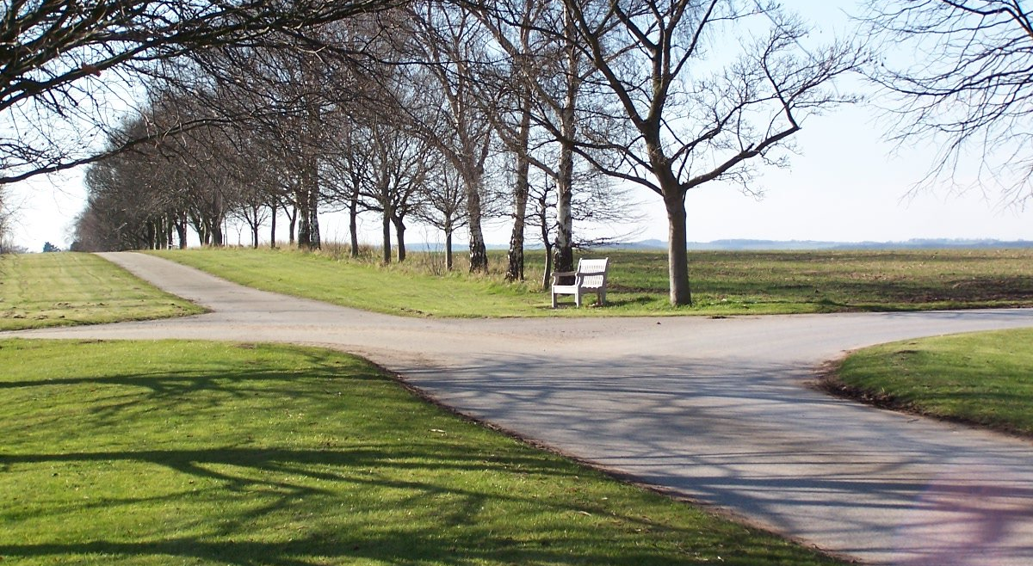
From redistribution to Predistribution
Redistribution works but as a fix with more costs than the alternative.
Predistribution requires a basic transition from the current system.
Systems of taxation affect the opportunities available to families everywhere & the health of the Earth.
@elkfish
Rammy KuttaineH

Slide 3
Taxes fund Public Goods
Taxes are the charge for the upkeep of our civilizations.
They pay for our defense, for our courts system, and police to keep order.
Some taxes are enacted for additional features found helpful for the purpose
of enabling greater economic throughput such as roads and ports.

Slide 4
Tax with Unintended Costs
We allow ourselves to be taxed in order to expand these throughputs since
time shows their construction and upkeep result in better living conditions.
Most taxation today is hidden.
Most taxation today comes at a cost known as deadweight loss.

Slide 5
Deadweight Loss
measures the lost economic efficiency
when the socially optimal quantity of
a good or a service is not produced.
also known as excess burden

Slide 6

Deadweight Loss
In other words:
Loss of work opportunities
Loss of travel
Loss of life experience
Loss of public revenue from said losses
Loss of purchasing power
Loss of knock-on effects of wider wealth

Slide 7
What does this have to do with you?
FICA maintained.
Am asking for your support
Looking to abolish the following taxes:
sales, capital gains, property, and income tax except for
that portion of rental income which comes from location-
value, and tariffs

Slide 8
What does this have to do with you?
FICA maintained.
Am asking for your support
Looking to establish in their place the following taxes:
appropriately assessed natural resource extraction
fees, pigovian, and location-value taxation

Slide 9
Why?
Cut the costs of making a decent living
Restore just grounds for economic inequality
Boost the economy thru the elimination of deadweight losses
Rammy Kuttaineh

