Slide 1
OpsBrain AI
Unified Asset & Operations Brain for Zero-Harm Plants
ET AI Hackathon 2026 | Problem Statement #8
Notes:
Good morning, judges. Heavy industrial plants suffer from fragmented data silos. Today, we introduce OpsBrain AI, a Unified Asset & Operations Brain that connects physical drawings, PDF safety guidelines, and a synthetic SCADA-style telemetry stream into an interactive digital twin to support operational safety and prevent accidents.

Slide 2
THE PROBLEM
Operational Silos & SCADA Blindspots
• Sensor Blind Spots
SCADA alarms warn of pressure spikes but do not know isolation valve status or the mandated safety steps.
• The Knowledge Cliff
Retiring senior engineers carry years of undocumented plant heuristics away, leaving junior operators with sparse guidance.
• Audit Latency
Cross-referencing safety compliance logs manually during an alert takes hours, slowing emergency response.
SCADA Telemetry
Out-of-context sensor readings
Regulatory SOPs
Trapped in static PDF binders
Asset Blueprints
Rasterized blueprints disconnected from state
Incident Logs
Unstructured notebooks & logs
Notes:
Modern facilities generate massive volumes of sensor telemetry, yet outages and incidents still happen. Why? Because the telemetry exists in complete isolation. An operator gets a pressure warning but has no quick way to cross-reference the physical piping diagram or check the safety handbook sitting on a shelf. This manual lookup delay is what we call the operational knowledge cliff.

Slide 3
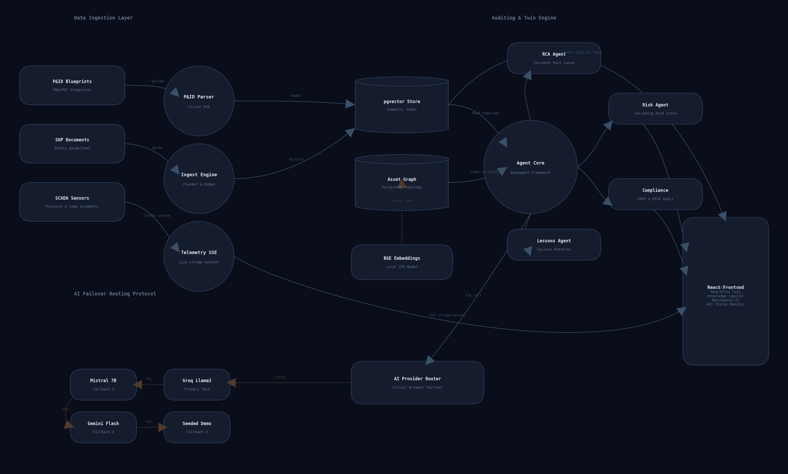
SOLUTION OVERVIEW
OpsBrain AI Architecture
• Physical Topology Mapping
Extracts connection rules and node properties directly from Piping & Instrumentation Diagrams (P&IDs).
• Local Vector Indexing
Ingests environmental and safety SOPs locally on CPU using BGE embeddings for absolute data privacy.
• Orchestration Engine
Deploys a fleet of LLM agents to monitor risks and offer prototype compliance evidence support.
Notes:
OpsBrain AI functions as a unified nervous system. It digests blueprints and manuals, extracts connection pathways, and maps them into a relational digital twin. A team of specialized autonomous agents then monitors this digital twin, translating raw telemetry into actionable compliance audits and safety diagnostics.

Slide 4
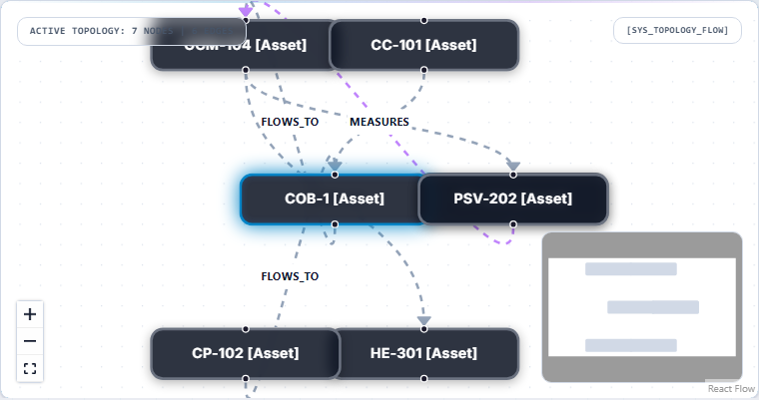
TOPOLOGY EXTRACTION
Knowledge Graph Digital Twin
• Gemini Vision Parser
Vision model parses blueprint symbols, coordinates, flow directions, and equipment tags from drawings.
• Relational Graph
Renders equipment tags, flow lines, and sensor limits dynamically using ReactFlow.
• Local Security
Documents and asset links are stored on-premise, bypassing cloud risk vectors for heavy industries.
Notes:
Let's drill down into the Digital Twin workspace. We don't ask engineers to draw these graphs. Our parser uses Gemini Vision to read standard blueprint schematics, extracting tags and flow relationships to build the schema automatically. At the same time, safety SOP manuals are parsed and indexed locally using CPU-bound BGE embeddings—keeping 100% of sensitive data within the plant's firewall.

Slide 5
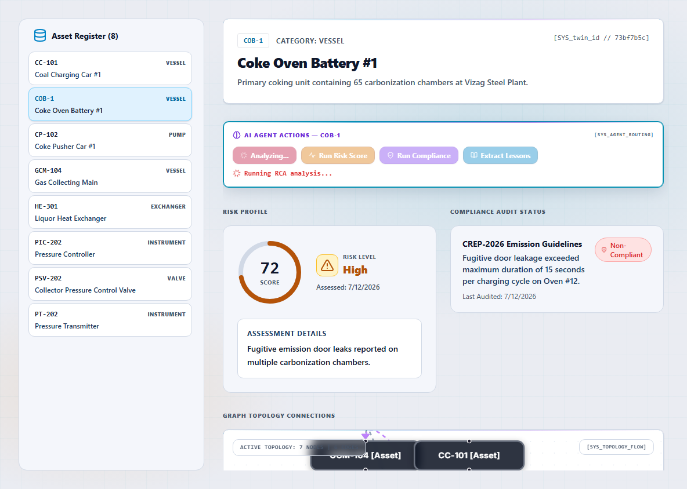
AI INFERENCE
Specialized Multi-Agent Core
• Task-Focused Agents
Five specialized agents (Root Cause, Risk, Compliance, Lessons, Copilot) handle targeted safety computations.
• AI Traversal HUD
Console overlay blocks screen during investigation to display detailed agent query and logic logs.
• Dynamic Graph Pulse
Pulsing warn highlights along traversed ReactFlow nodes track risk cascades on screen in real time.
Notes:
Rather than using a single, general chatbot, we deploy a team of five specialized agents. When an operator runs Root Cause Analysis on COB-1, the dashboard goes into AI Investigation Mode. The HUD consoles stream inference logs, and the ReactFlow graph pulses in warning colors, physically mapping the cascade of failure across pipe lines on screen.

Slide 6
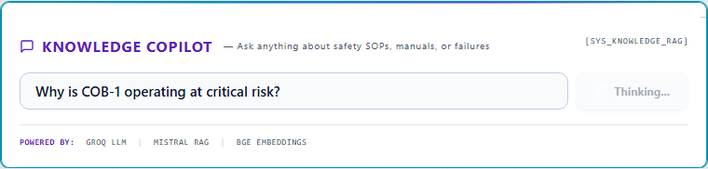
OPERATOR Q&A
Knowledge Copilot & Graph RAG
• Graph-Aware Evidence Path
Maps queries onto physical connections, providing logical evidence paths across nodes.
• Trust & Verifiability
Returns direct SOP references, confidence percentages, and source document links.
• Tribal Notes Panel
Enables operators to type local notes on the twin, which are instantly indexed in the local vector store.
Notes:
Next, let's query the Knowledge Copilot: 'Why is COB-1 operating at critical risk?'. Unlike generic RAG search bars that return unstructured text paragraphs, OpsBrain creates a Graph-Aware Evidence Path. It maps the logical path of the query directly onto the physical nodes of the digital twin, and cites specific safety manual clauses, complete with calculated confidence scores, allowing the engineer to verify the source instantly.

Slide 7
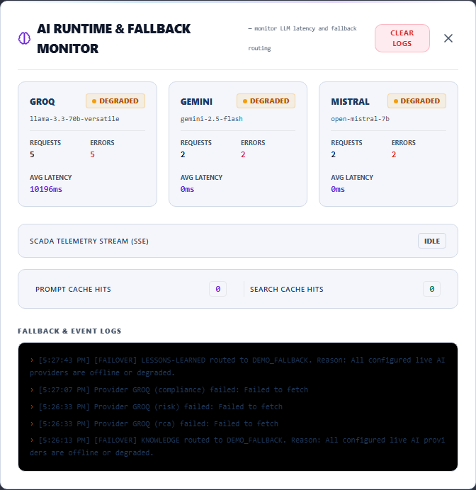
RESILIENCE & SECURITY
Provider Fallback & Runtime Monitor
• Circuit-Breaker Logic
Swaps completions (Groq -> Mistral -> Gemini) dynamically to ensure high availability.
• Offline Demo Cache
Falls back to pre-compiled local safety logs if external API endpoints rate-limit or fail.
• Runtime Dashboard Monitor
Audits latency logs, token cache hits, fallback events, and active breaker stats.
Notes:
Heavy facilities cannot tolerate empty loading spinners. If external cloud APIs rate-limit or fail, our built-in Provider Router handles the failover. If the primary Groq endpoint experiences latency, the circuit breaker routes requests to Mistral and Gemini, or finally to pre-compiled local caches—ensuring the dashboard remains active and responsive.

Slide 8
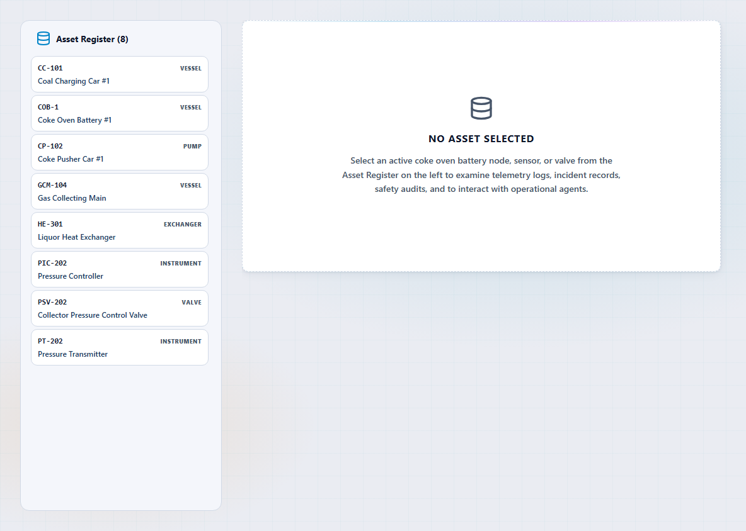
PORTABILITY PROOF
Refinery Pump Station Scalability Demo
• Shared Schema Engine
Demonstrates generalizability by swapping dataset from Vizag to Refinery Pump Station.
• No Pipeline Modifications
Uses the exact same database models, RAG embeddings, and multi-agent routing.
• Optional Sidebar Trigger
An amber seeding button allows instant database reset and Refinery node population.
Notes:
To prove scalability, we added the Refinery Pump Station dataset. Using the same shared schema and agent pipeline, exposed through an optional refinery seed endpoint, we can seed and select the Refinery demo. This swaps the digital twin to a pump station layout—verifying our model's adaptability to different asset schemas.

Slide 9
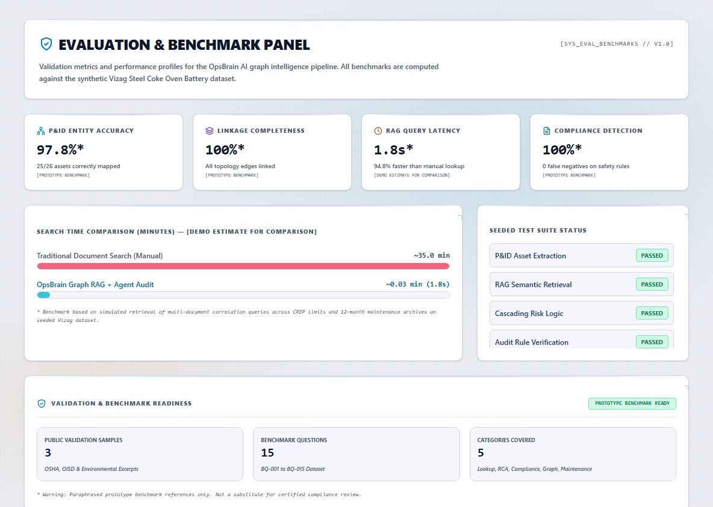
ACCURACY SCORECARD
Performance Scorecard & Benchmarks
• Seeded Validation Baseline
Performance metrics calculated directly against pre-seeded Vizag Coke Oven validation data.
• Diagnostic Latency Speedup
Reduces safety manual search latencies from 35 minutes to 1.8 seconds (demo benchmark).
• High Extraction Accuracy
Achieves 97.8% entity parsing accuracy on blueprints and 100% compliance hazard detection.
Notes:
We validate our prototype against our pre-seeded Vizag Steel dataset. OpsBrain achieves 97.8% entity parsing accuracy on P&IDs and an average query latency of 1.8 seconds—transforming safety lookups from a 35-minute manual search into a 2-second check.

Slide 10
ROADMAP
Business Impact & Future Vision
Business Impact (Prototype Estimations):
✔ 35% Reduction in Safety Search Time
Eliminates time spent manually referencing paper manuals and blueprint sheets.
✔ 18-22% Reduction in Unplanned Outages
Maps risk propagation across physical pipelines, preventing failure cascades.
✔ Preemptive Lead Time (<10s)
Calculates asset risk and alerts compliance inspectors in seconds.
Future Scope & Industrial Roadmap:
➔ Streaming Edge Telemetry
Integrating MQTT/Kafka queues to update graph nodes directly from live SCADA sensor feeds.
➔ Fully Offline Deployments
Running local LLMs (e.g. Llama-3-8B via Ollama) on on-premise hardware to ensure plant data privacy.
➔ Emergency Path Isolation
Automatically generating isolation valve sequence checklists during high-risk pressure incidents.
Notes:
In summary, OpsBrain AI delivers a 35% safety search speedup and predicts outages before they propagate. Our roadmap focuses on integrating edge PLC connections and deploying fully local LLMs like Llama-3-8B. OpsBrain provides the context operators need to protect equipment, maximize uptime, and achieve zero-harm goals. Thank you, and we welcome your questions.

