Slide 1
OPSBRAIN AI
UNIFIED ASSET & OPERATIONS BRAIN
AI-Powered Safety Intelligence Platform for Zero-Harm Industrial Operations ET AI Hackathon 2026 | Problem Statement #8
Notes:
Good morning, judges. Today we are presenting OpsBrain AI, a Unified Asset & Operations Brain designed specifically to solve the critical knowledge fragmentation problem in heavy industrial plants. We built this platform to prevent industrial accidents and optimize complex maintenance operations.

Slide 2
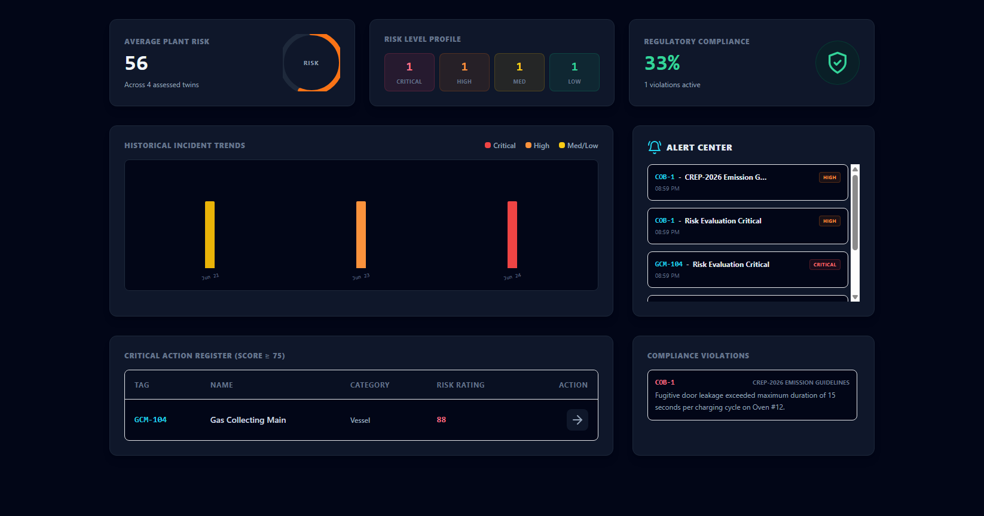
THE HEAVY INDUSTRIAL KNOWLEDGE GAP
Why Safety Systems Fail in Modern Plant Operations
Critical Pain Points:
• Information Fragmentation: Plant documents (SOPs, P&IDs, work orders, telemetry) sit in disconnected data silos.
• The Visakhapatnam Tragedy (Jan 2025): 8 lives lost in a coke oven battery explosion despite functioning SCADA sensors, because warning signals were never unified to inform active decisions.
• Operational Blindspots: Over 60% of large facilities rely on slow, manual handoffs to coordinate digital safety tools.
• The Knowledge Cliff: 25% of senior industrial operators are retiring, taking undocumented operational experience with them.
Notes:
To understand why this is critical, let's look at the Vizag Steel Coke Oven Battery tragedy of January 2025. Eight lives were tragically lost because SCADA alerts, safety SOPs, and active maintenance work orders were locked in separate databases. Shift operators could not connect the dots in time. OpsBrain AI bridges this gap.

Slide 3
OPSBRAIN AI SOLUTION
Fused Plant Intelligence & Preemptive Safety Guardrails
Real-Time Risk Fusion
Fuses sensor feeds, SCADA metrics, shift logs, and maintenance logs into a single analytical layer.
• Multi-source telemetry
• SOP semantic RAG search
• Alert center feed
Dynamic Graph digital twin
Generates interactive topologies mapping physical assets, limits, and dependencies in real-time.
• P&ID computer vision parsing
• ReactFlow graph visualizer
• Cascading risk calculations
Autonomous Agent Core
Orchestrates LLM agents for instant Root Cause Analysis, Risk Calculation, and Compliance Auditing.
• Llama-3.3 diagnostics
• OISD regulatory tracking
• Failure intelligence lookup
Notes:
OpsBrain AI provides three core pillars: first, Real-Time Risk Fusion that merges telemetry and text; second, a Dynamic Graph Digital Twin showing asset topology; and third, an Autonomous Agent Core that runs specialized safety audits on demand. This replaces guesswork with deterministic insights.

Slide 4
SYSTEM OPERATIONAL WORKFLOW
Fusing Data, Models, and Human Intervention seamlessly
1. Ingestion
Upload drawings (P&IDs) & SOP documents.
2. Extraction
Gemini parses blueprint components & BGE embeds text.
3. Digital Twin
Graph relationships stored in Supabase DB.
4. Execution
Agents calculate risk, RCA, and emit alerts.
Result: Provides shift operators and safety supervisors with a unified cockpit, removing manual handoffs.
Notes:
Our system operates in four seamless steps: ingestion of drawings and safety manuals, extraction of components and text embeddings, building the digital twin graph, and running real-time agent diagnostics to feed the operator control room and prevent hazards before they occur.

Slide 5
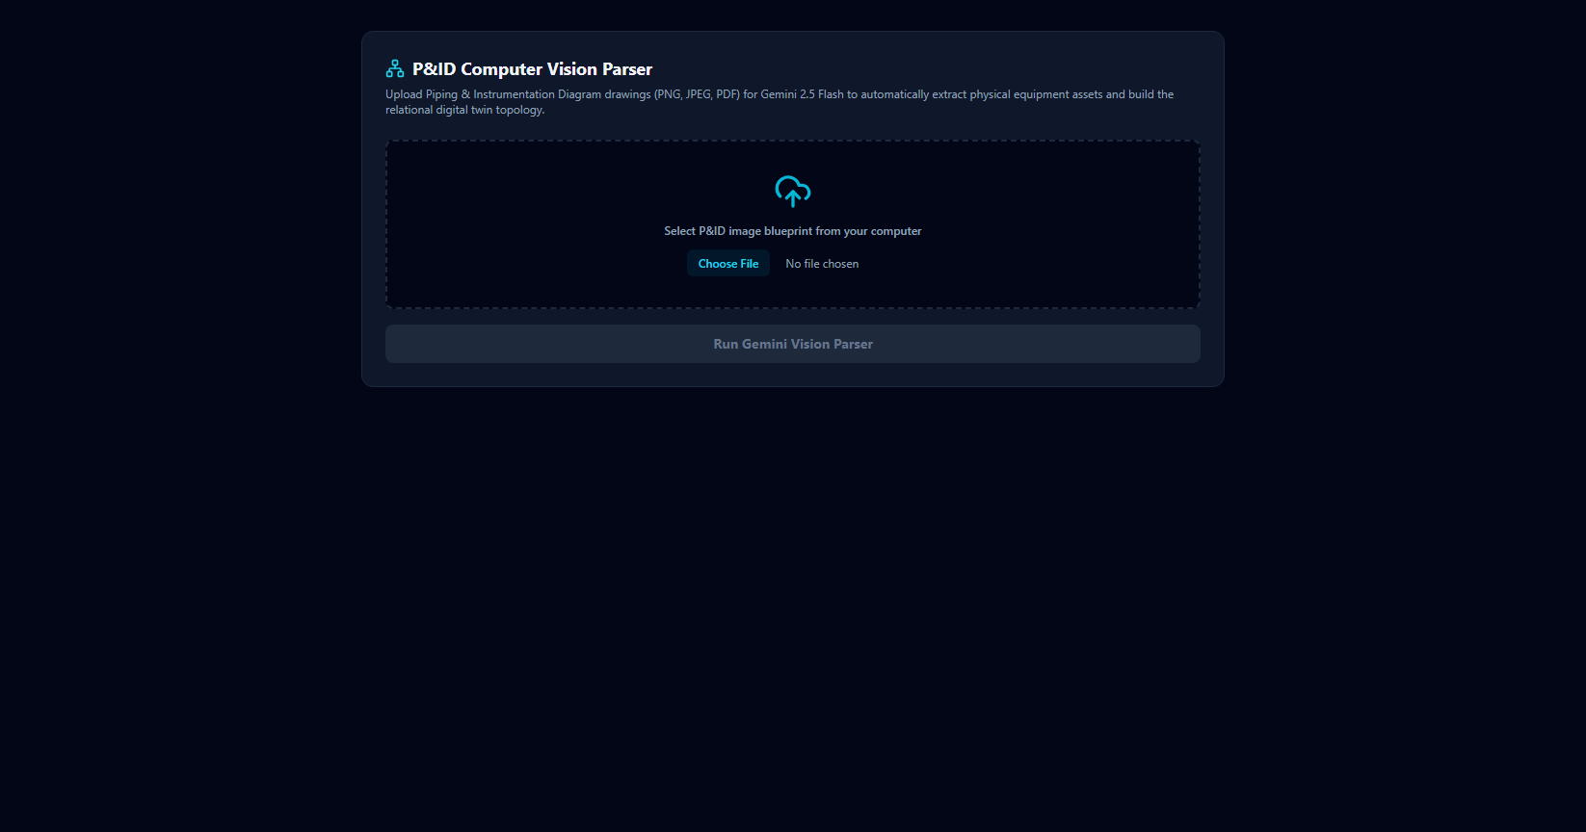
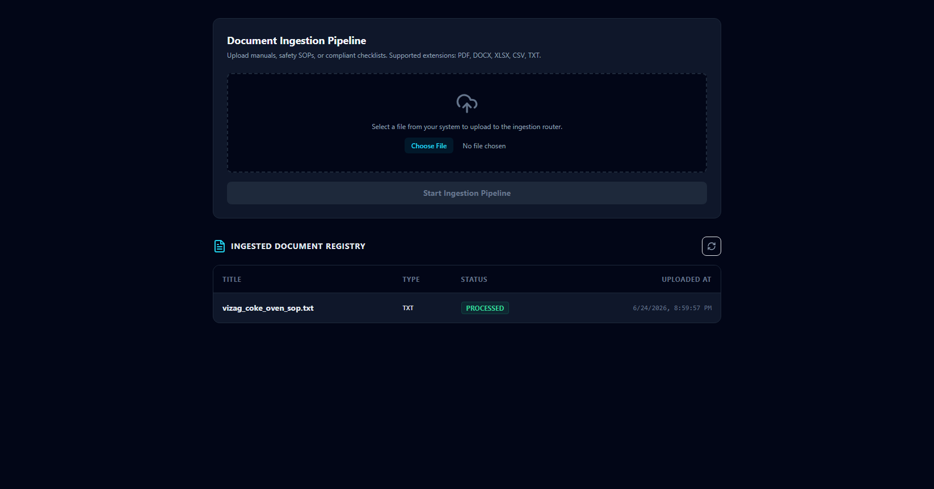
P&ID VISION TO GRAPH DIGITIZATION
Automating Asset Topology Parsing via Gemini-2.5-Flash
Key Pipeline Mechanics:
• Zero-Config Blueprint Ingestion: Operators upload standard P&ID images directly into the system.
• Computer Vision Mapping: Gemini Vision Service analyzes component symbols (Vessels, Valves, Controllers) and flow directions.
• Graph Construction: Automatically inserts assets, nodes, and relational edges (FLOWS_TO, MEASURES) into SQL/Supabase.
• Local Vector Search (RAG): Chunks safety SOPs and indexing using local BGE embeddings (384 Dimensions) for real-time compliance matching.
Notes:
Here we see our ingestion pipeline. When an operator uploads a P&ID blueprint, Gemini-2.5-Flash instantly digitizes the components, piping, and controllers, inserting them as nodes and edges. Simultaneously, safety SOPs are chunked and embedded using local BGE embeddings for real-time compliance checks.

Slide 6
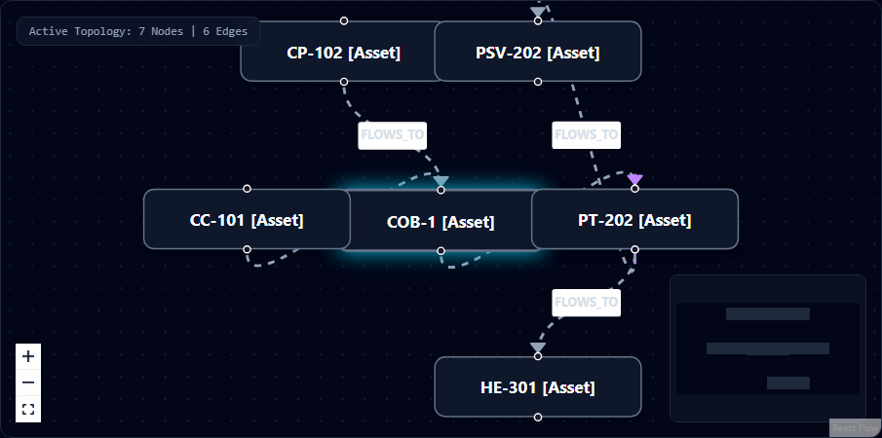
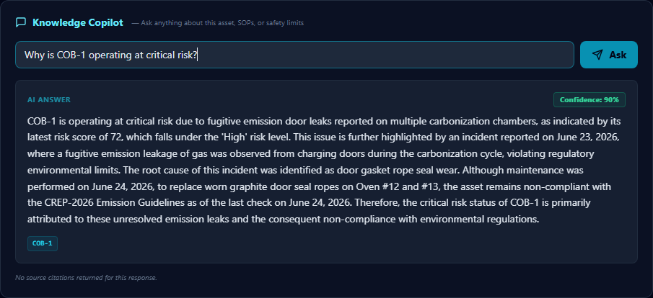
THE SPECIALIZED AGENT CORE
Four Coordinated AI Agents Operating on the Digital Twin
Root Cause Analysis (RCA) Agent
Fuses work orders, maintenance history, and incident texts via Llama-3.3 to diagnose active anomalies.
Dynamic Risk Calculation Agent
Computes a mathematical hazard score (0-100) based on active alerts, compliance failure, and graph neighbor stress.
Regulatory Compliance Agent
Continuously audits plant operations against OISD standards, CREP guidelines, and the Factory Act.
Lessons Learned Failure Engine
Scans local and industry failure logs to proactively push preventative safety alerts to operators.
Notes:
Once the digital twin is built, our specialized agent fleet goes to work. The digital twin dashboard allows engineers to visualize node connections and trigger agents. These agents analyze real-time states and historical records to provide clear, actionable safety assessments via the chat interface.

Slide 7
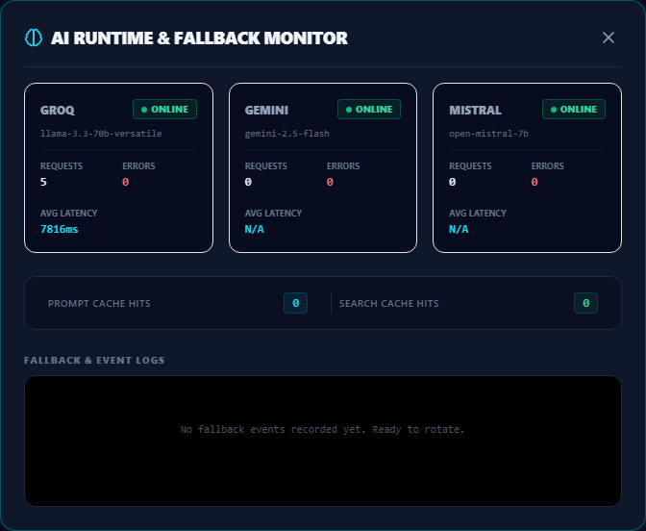
SYSTEM ARCHITECTURE & TELEMETRY
Low-Latency, Privacy-Preserving Industrial Integration
Data & Model Pipeline:
• FastAPI Gateway: Lightweight REST API + Capability-Aware AI Provider Router (Groq -> Mistral -> Gemini -> seeded demo fallback) with circuit-breaker protection.
• Local Vector Search: Ingests documents, chunks them, and generates 384-dimensional embeddings locally via BAAI/bge-small-en-v1.5.
• Dual Storage Strategy: PostgreSQL (Supabase) for vector indexing, SQLite for asset data, topology nodes, and incident history.
• Foundation Models: Groq Llama-3.3-70b-versatile (RCA/Risk), Gemini-2.5-Flash (P&ID parsing), and Mistral (RAG output generation).
Notes:
OpsBrain AI is built for privacy and performance. We use a local BGE vector index, a PostgreSQL/SQLite database, and a FastAPI gateway. Our live telemetry monitor tracks provider status, request latencies, and fallback events to guarantee high availability in critical operations where downtime is not an option.

Slide 8
FINALIST-GRADE RESILIENCE UPGRADE
AI PROVIDER ROUTER & FAILOVER SYSTEM
Capability-Aware Multi-Provider Failover with Circuit-Breaker Protection
TEXT AGENTS
Groq Llama-3.3
Primary
->
Mistral API
Fallback 1
->
Gemini Flash
Fallback 2
->
Seeded Demo
Fallback 3 - labeled
RCA, Risk, Compliance, Lessons Learned
RAG COPILOT
Groq Llama-3.3
Primary
->
Mistral API
Fallback 1
->
Gemini Flash
Fallback 2
->
Seeded Demo
Fallback 3 - labeled
Knowledge Copilot answers with citations
P&ID VISION
Gemini Flash Vision
Primary
->
Cached P&ID Extract
Fallback
->
Graceful Error
Final
Gemini Vision -> Cached P&ID extraction -> Graceful error
EMBEDDINGS
Local BAAI/bge-small-en-v1.5 (CPU-only, 384-dim, never routed to cloud)
Always local CPU BGE-small-en-v1.5 (no cloud routing)
Circuit Breaker: 3 consecutive failures -> provider marked DEGRADED for 60s. Fallback label always visible to judges - no silent fake success.

Slide 9
INDUSTRIAL EFFICIENCY & SAFETY ROI
Tangible Business Value & Life-Saving Prevention
35%
TIME SEARCH REDUCTION
Decreases the McKinsey-cited time engineers spend looking for documentation, SOPs, and drawing logs.
18-22%
DOWNTIME PREVENTED
Fuses equipment history and active warnings, mitigating unplanned outages caused by missing information.
< 10s
PREEMPTIVE LEAD TIME
Triggers compound risk alerts in seconds rather than waiting for manual supervisor shifts.
Notes:
Our platform delivers real business value. By automating information retrieval, we reduce document search time by 35%. Fusing telemetry prevents unplanned outages, saving 18-22% in maintenance costs. Most importantly, it calculates compound risk in under 10 seconds, giving operators preemptive warnings.

Slide 10
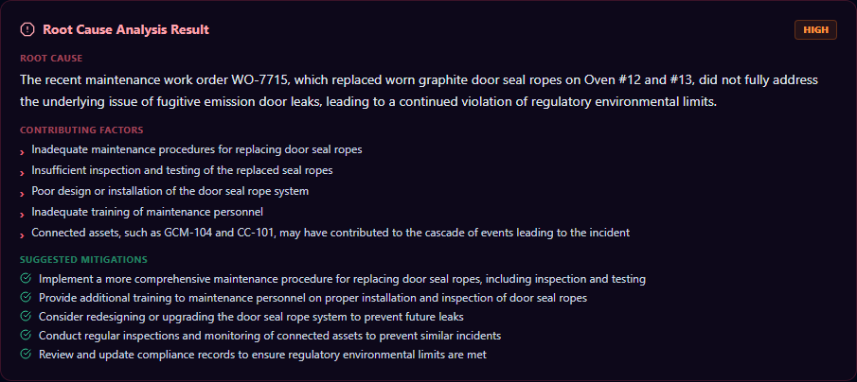
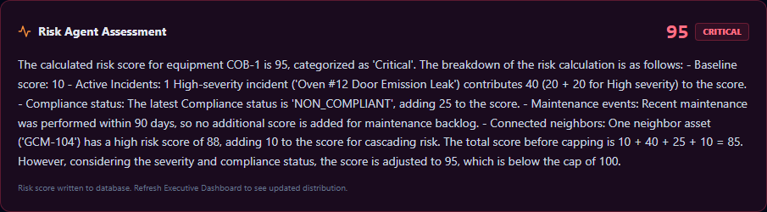
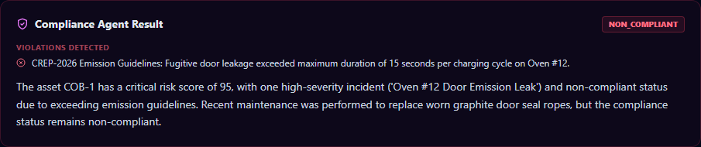
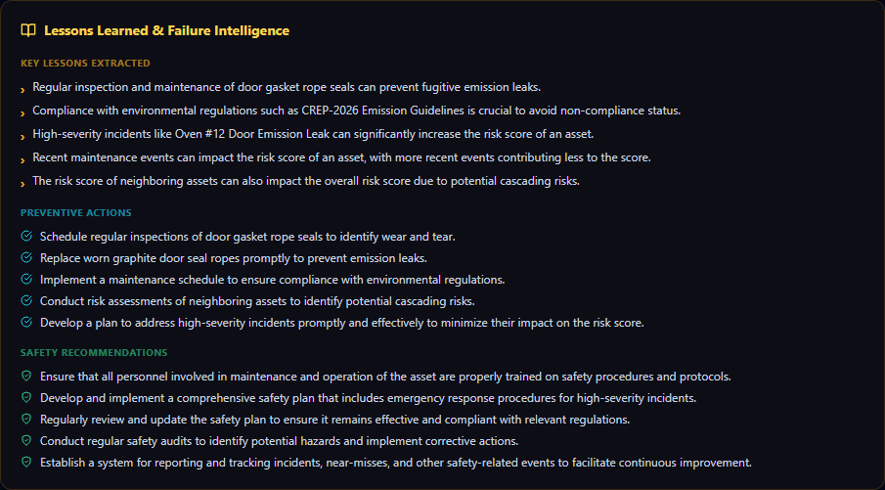
OPSBRAIN AI IN ACTION
Direct telemetry screenshots from our running system
Notes:
Here are the live results from our agent execution. On the top row, the RCA agent diagnoses the frozen controller feedback, and the Risk agent calculates a compound hazard score. The bottom row shows compliance violations against CREP guidelines and lessons extracted from past failures.

Slide 11
🧠 OPSBRAIN AI
Unified Asset & Operations Brain for Industrial Knowledge Intelligence
Thank You! Ready for Live Demonstration and Q&A.
Notes:
Thank you for your time. OpsBrain AI is ready to bring heavy industrial safety into the AI era. Our codebase is verified, our models are running, and our integration is complete. We are now open for questions and would love to show you a live demonstration.

