Slide 1
BLUESTOCK FINTECH
Mutual Fund Analytics Platform
End-to-End Data Engineering, ETL Pipeline & Interactive Dashboard
Capstone Project | Mutual Fund / Fintech Domain
Prepared by: Intern / Data Analyst — Bluestock Fintech
June 2026

Slide 2
Problem & Objective
Why this platform needed to exist
The Problem
The Objective
NAV, AUM, and SIP data are fragmented across disconnected AMFI formats
Investors can't easily compare funds on a risk-adjusted basis
Most retail investors don't know if their fund beats its benchmark
Limited visibility into how demographics shape investor behaviour
Monthly reports are static PDFs — slow to produce, slower to act on
Build a unified ETL pipeline from raw AMFI data into one database
Design a normalised star-schema database for all MF data
Compute Sharpe, Sortino, Alpha, Beta, and drawdown per scheme
Build a self-service, interactive Power BI dashboard
Surface investor behaviour and benchmark-relative performance
Bluestock Fintech — Mutual Fund Analytics Capstone
2 / 12

Slide 3
Data Sources
Ten datasets, anchored to real AMFI India data
40
10
87K+
4.5
Real Fund
Schemes
Datasets
Provided
Transaction
Rows
Years of
NAV History
Dataset | Rows | Description
fund_master.csv | 40 | Master list of 40 real mutual fund schemes
nav_history.csv | 46,000 | Daily NAV, Jan 2022 – May 2026
investor_transactions.csv | 32,778 | SIP, Lumpsum, and Redemption transactions
benchmark_indices.csv | 8,050 | Daily closing values for 7 benchmark indices
scheme_performance.csv | 40 | Returns, Sharpe, Sortino, Alpha, Beta, Max Drawdown
Bluestock Fintech — Mutual Fund Analytics Capstone
3 / 12

Slide 4
System Architecture
Extract → Transform → Load → Analyse → Visualise
EXTRACT
TRANSFORM
LOAD
ANALYSE
VISUALISE
AMFI NAV files,
mfapi.in REST API,
10 provided CSVs
▶
Python & Pandas —
clean, validate,
compute returns
▶
PostgreSQL
star schema,
11 tables
▶
Jupyter notebooks —
EDA, risk metrics,
cohort analysis
▶
Power BI dashboard —
4 pages, slicers,
KPI cards
Mirrors real-world fintech data pipelines used at companies like Zerodha, Groww, and Paytm Money.
Layer | Detail
Database | PostgreSQL — 2 dimension + 9 fact tables, ~89,000 rows total
Indexing | All foreign keys and date columns indexed for fast dashboard queries
Bluestock Fintech — Mutual Fund Analytics Capstone
4 / 12

Slide 5
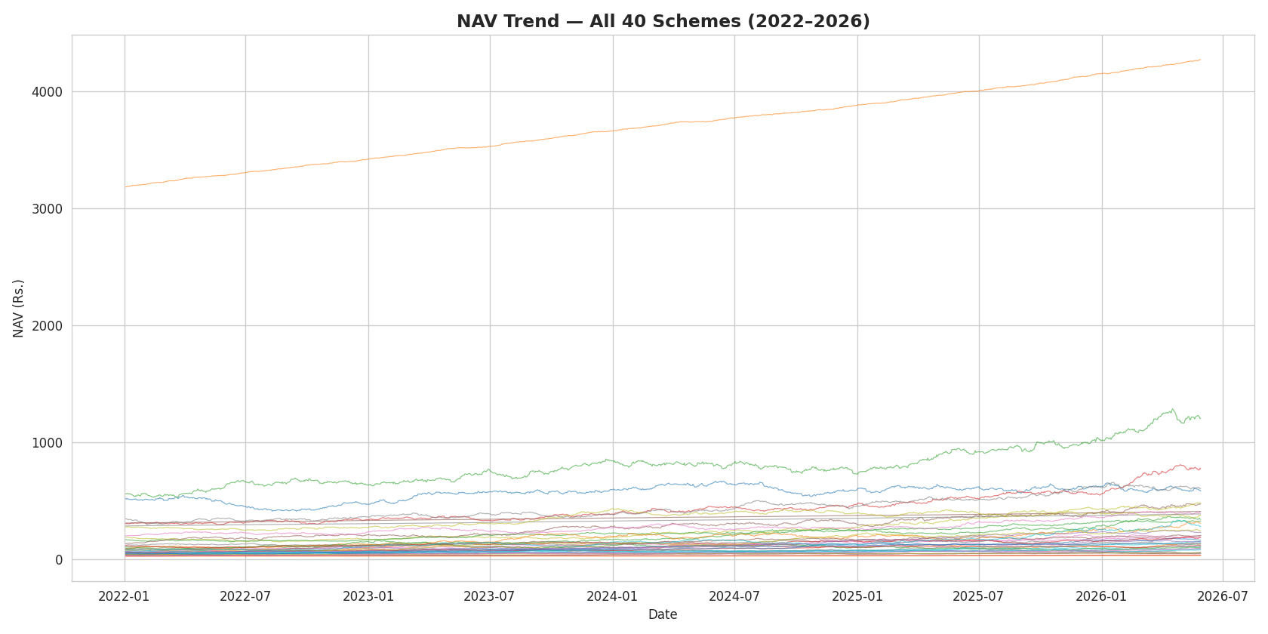
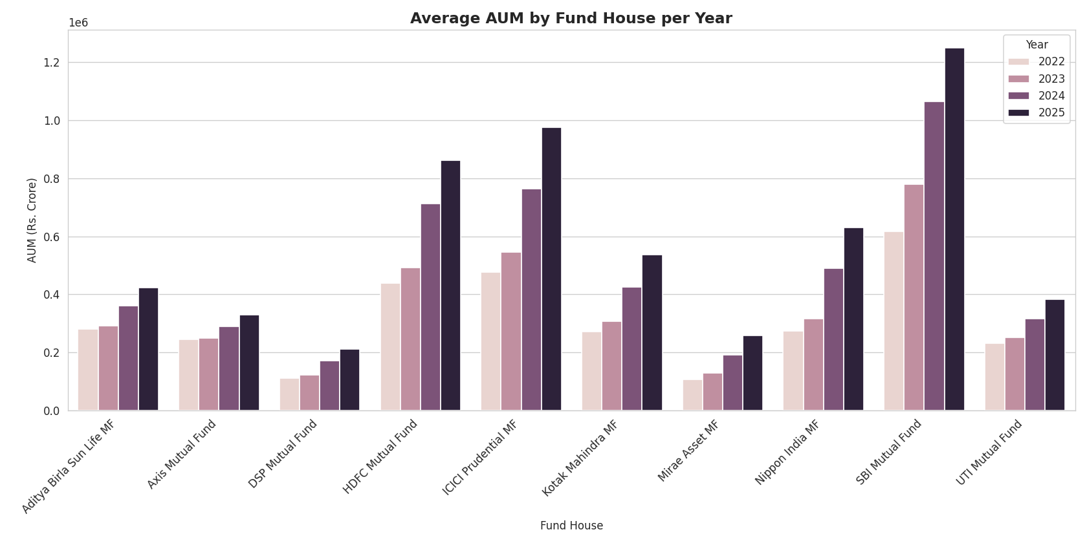
EDA Highlights
NAV trends and fund-house AUM growth
NAV trends across all 40 schemes show broad upward momentum from 2022 to 2026.
AUM growth is concentrated among a handful of large fund houses — SBI Mutual Fund leads on average AUM.
Bluestock Fintech — Mutual Fund Analytics Capstone
5 / 12

Slide 6
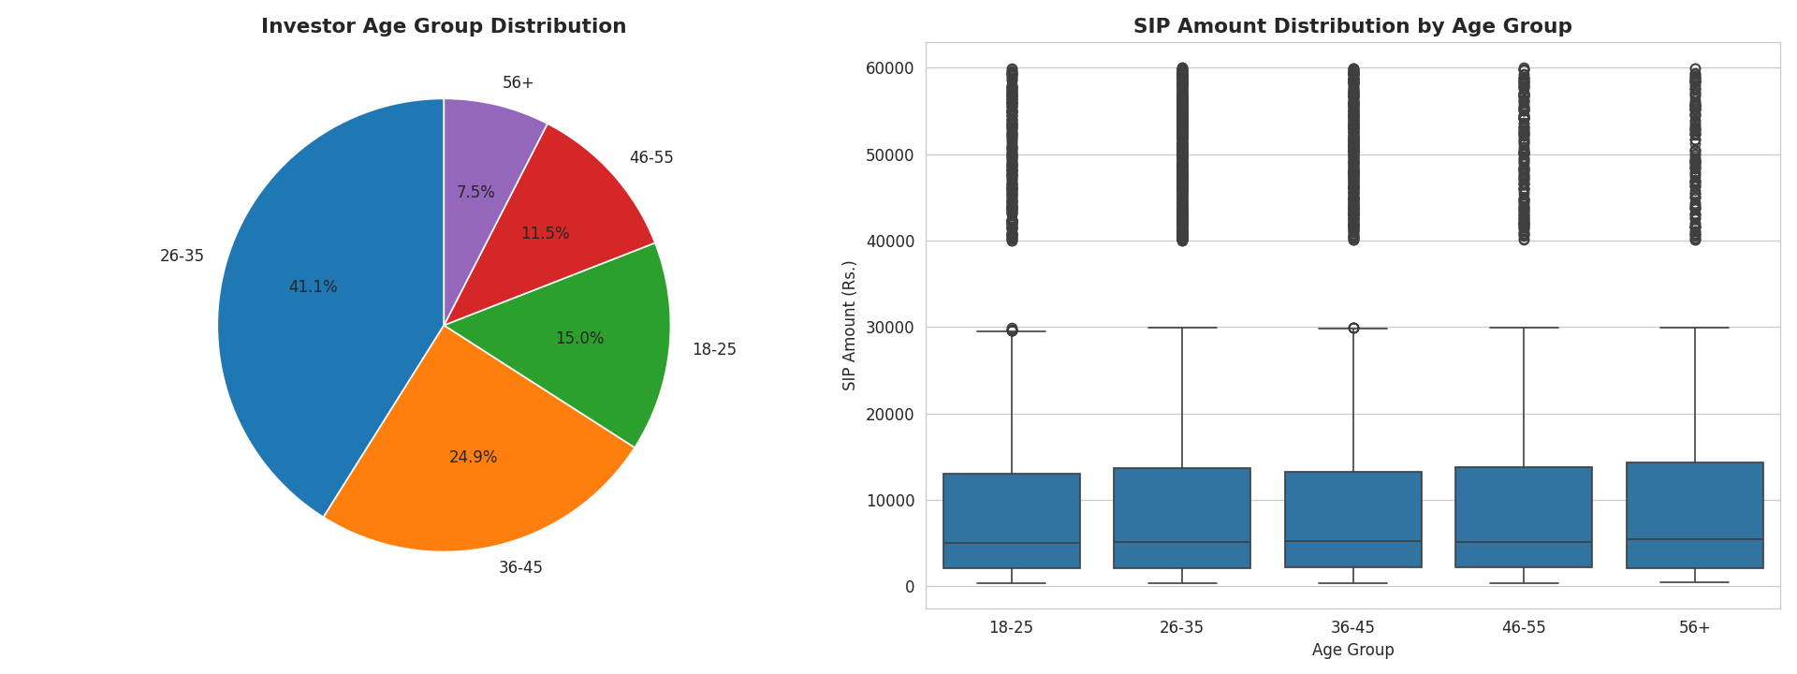
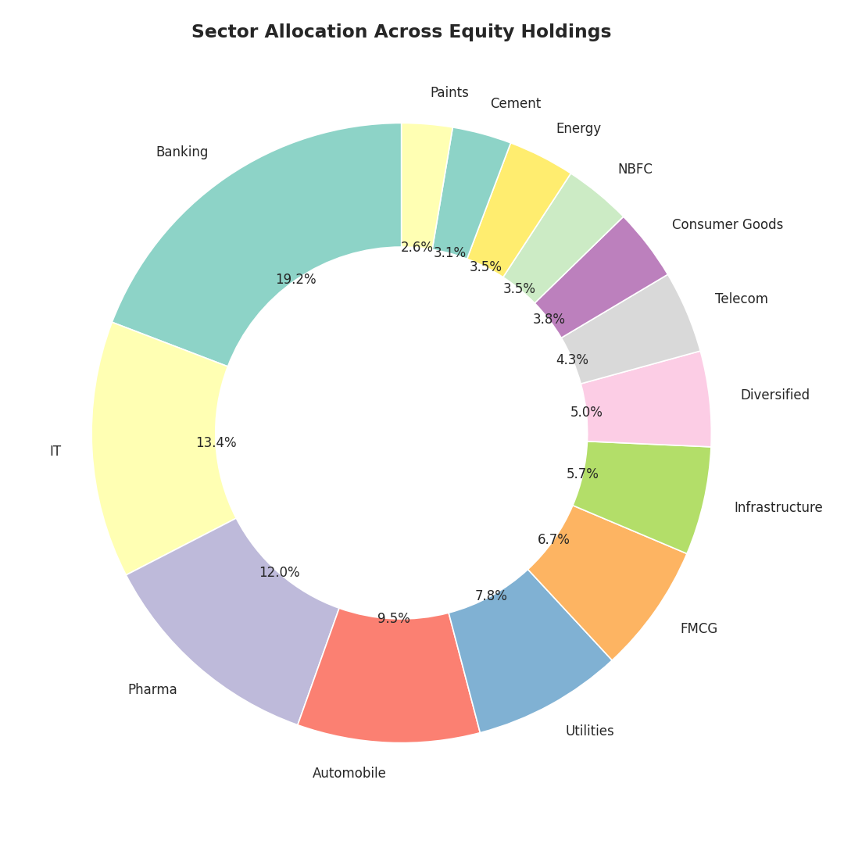
EDA Highlights
Investor demographics and sector allocation
The 26–35 and 36–45 age groups drive the largest share of SIP volume.
Equity sector exposure is concentrated in Banking and Financial Services, ahead of IT and Pharma.
Roughly one-third of transactions originate from B30 (beyond top-30) cities.
Bluestock Fintech — Mutual Fund Analytics Capstone
6 / 12

Slide 7
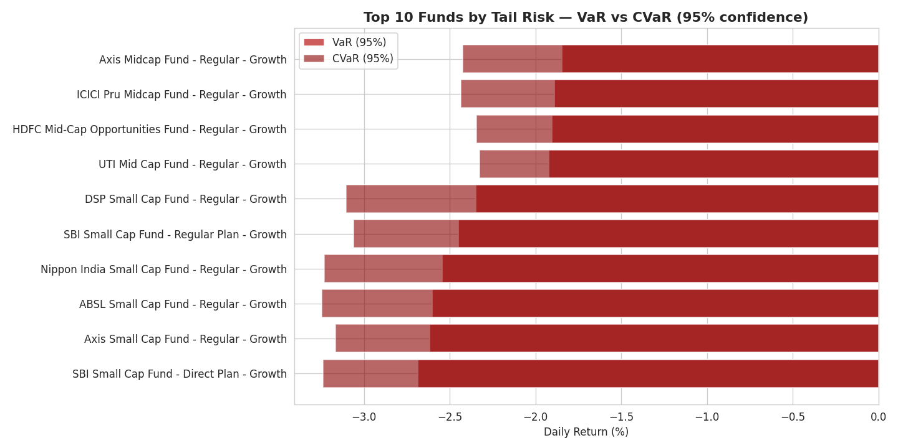
Fund Performance Metrics
Risk-adjusted returns computed from NAV history
Sharpe Ratio
Sortino Ratio
Alpha / Beta
Max Drawdown
(Rp − Rf) / σ(Rp)
(Rp − Rf) / Downside σ
OLS vs Nifty 100
min(NAV / Peak − 1)
Return per unit of total risk taken
Penalises only downside volatility
Excess return & market sensitivity
Worst peak-to-trough decline
Risk-free rate used throughout: 6.5% (RBI repo rate proxy), annualised with √252 trading days.
Bluestock Fintech — Mutual Fund Analytics Capstone
7 / 12

Slide 8
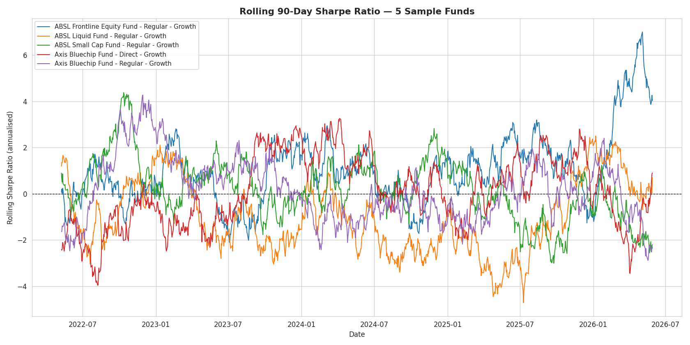
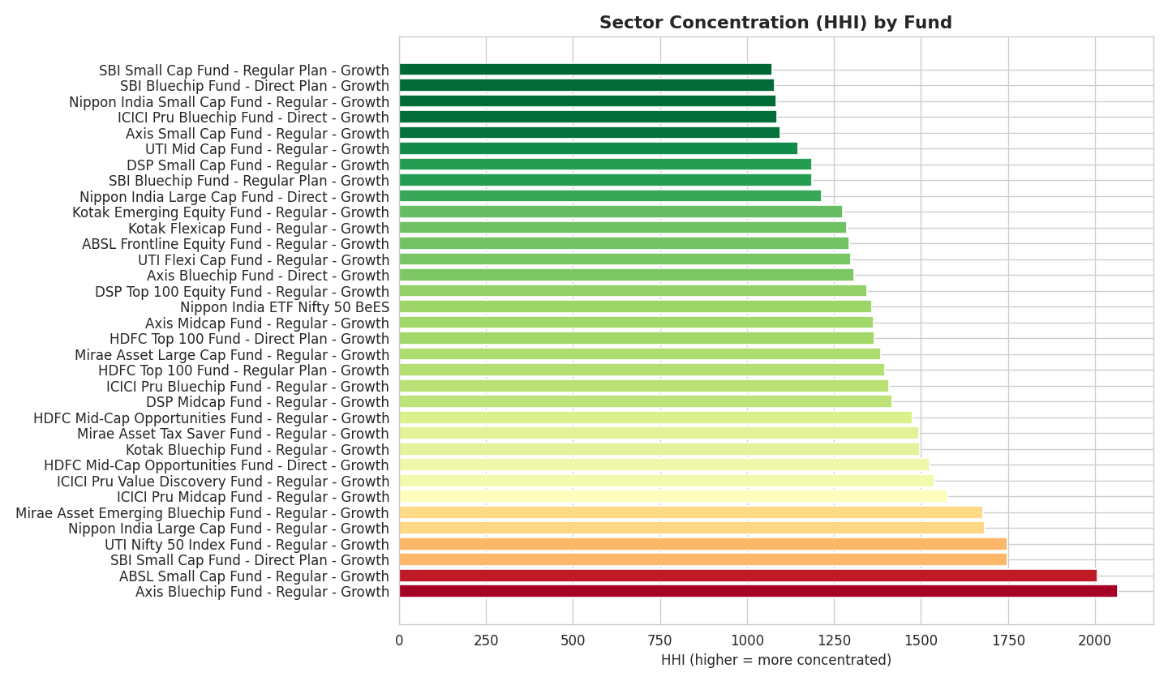
Risk & Behavioural Analytics
Time-varying risk and sector concentration
Rolling 90-day Sharpe shows risk-adjusted performance varies meaningfully over time, not just at one snapshot.
Sector concentration (HHI) reveals diversification differences within equity funds beyond category labels alone.
Bluestock Fintech — Mutual Fund Analytics Capstone
8 / 12

Slide 9
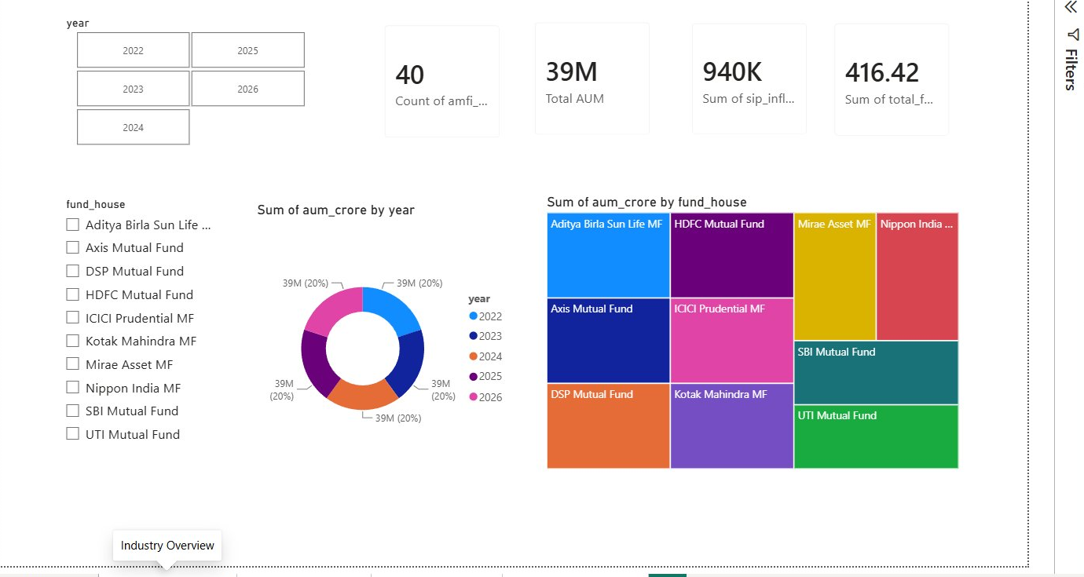
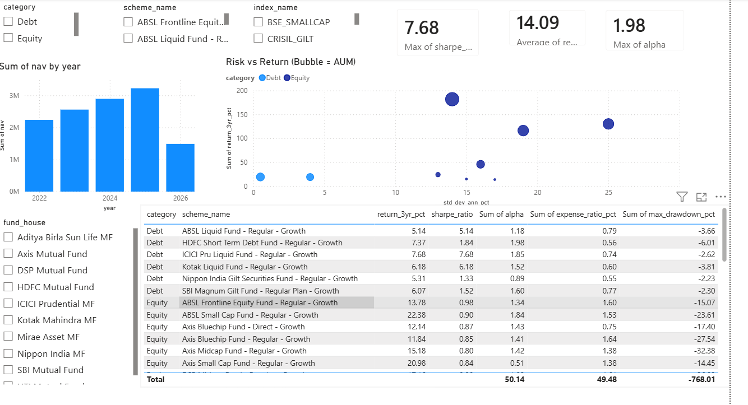
Interactive Dashboard
Industry Overview & Fund Performance pages
Industry Overview
Fund Performance
KPIs, AUM by year, AUM by fund house, year/fund-house slicers
Risk-vs-Return bubble chart, sortable scorecard, category/fund-house slicers
Bluestock Fintech — Mutual Fund Analytics Capstone
9 / 12

Slide 10
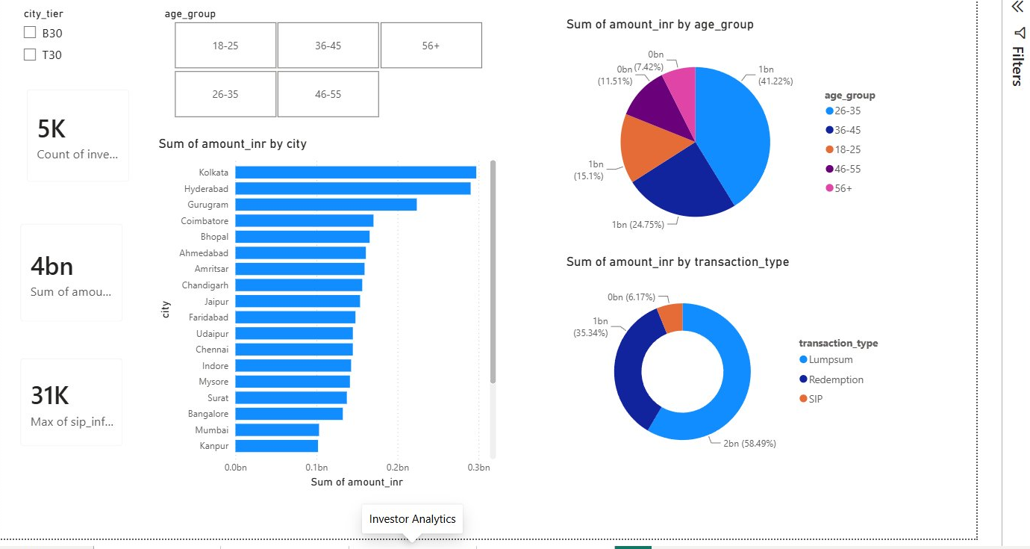
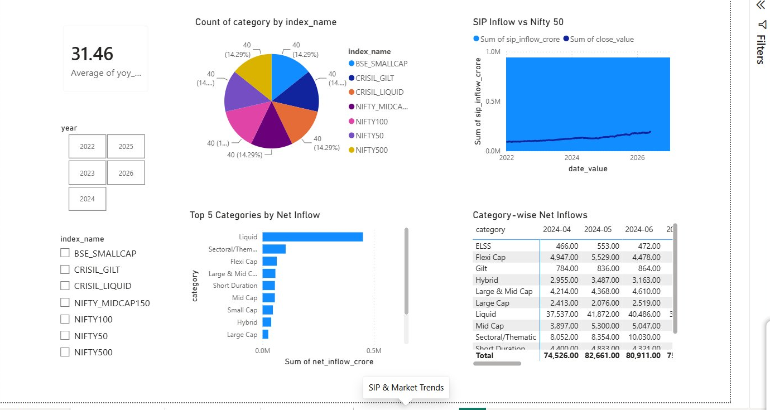
Interactive Dashboard
Investor Analytics & SIP / Market Trends pages
Investor Analytics
SIP & Market Trends
City, age group, and transaction-type breakdowns with city-tier slicer
Dual-axis SIP vs Nifty 50, category inflow matrix, top-5 categories
Bluestock Fintech — Mutual Fund Analytics Capstone
10 / 12

Slide 11
Key Findings
What the data tells us
SBI Mutual Fund leads the industry on average AUM across the observed period
Liquid funds show the strongest and most consistent SIP-category inflows
1
2
Small Cap and Mid Cap schemes carry the highest tail risk (VaR/CVaR)
Risk-adjusted performance (Sharpe) varies meaningfully over time, not just at a point in time
3
4
Sector exposure in equity funds is concentrated in Banking & Financial Services
B30 cities contribute roughly one-third of total transaction volume
5
6
Bluestock Fintech — Mutual Fund Analytics Capstone
11 / 12

Slide 12
Thank You
Bluestock Fintech — Mutual Fund Analytics Capstone
Questions & Discussion

