Slide 1
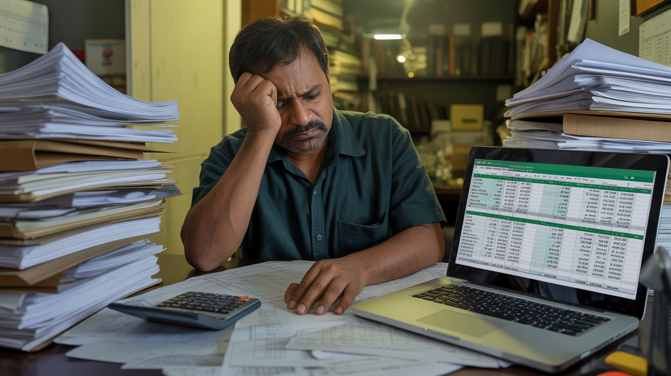
The Hidden Problem
4-5 hours per PVC bill.
Searching indices. Calculating percentages.
Is this really the best use of your experience?

Slide 2

Your Time Is Disappearing
10 different indices to hunt.
34 JPC steel items to extract.
Same formulas, again and again.
This work is below your level.

Slide 3

Introducing IR-PVC
One click. All 10 indices auto-fetched.
Upload JPC PDF. 34 items extracted in 2 minutes.
100% Railway-compliant calculations.

Slide 4

Before vs After
Manual: 4-5 hours, errors, frustration
IR-PVC: 15 minutes, 100% accuracy, peace of mind

Slide 5

Your Time. Better Spent.
Visit another site. Attend that meeting.
Spend time with your family.
irpvc.in

