Slide 1

NETWORK AND COMPUTER SECURITY COURSE (SIRS) - 2024/2025
Messagist
Group A07
ist1112191 - Xiting Wang
ist1112269 - Laura Cunha
ist1112270 - Rodrigo Correia
github

Slide 2


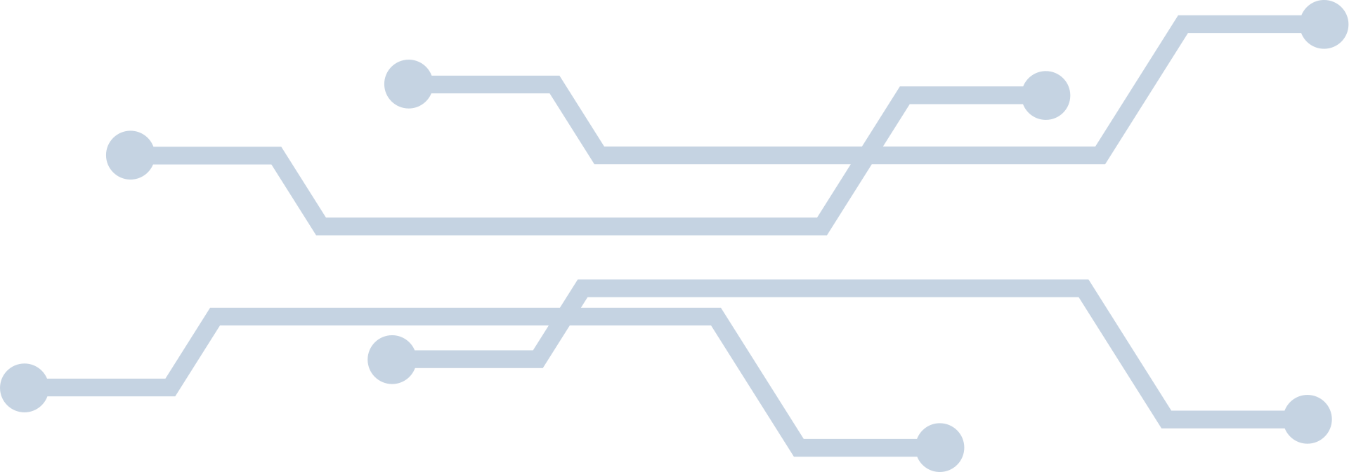
Secure Document FOrmat
Design
SSL/TLS
Ciphertext with ChaCha20Poly1305 (256-bits)
Random nonce (96-bits)
Message (Formatted Document)
{
"sender_istid": "ist1123123",
"receiver_istid": "ist1321564",
"timestamp": "2022-01-01T12:00:00Z",
"content": "Hi! Do you know the solution for the SIRS exercise?",
"sent_counter": 1,
"receive_counter": 0,
}

Slide 3

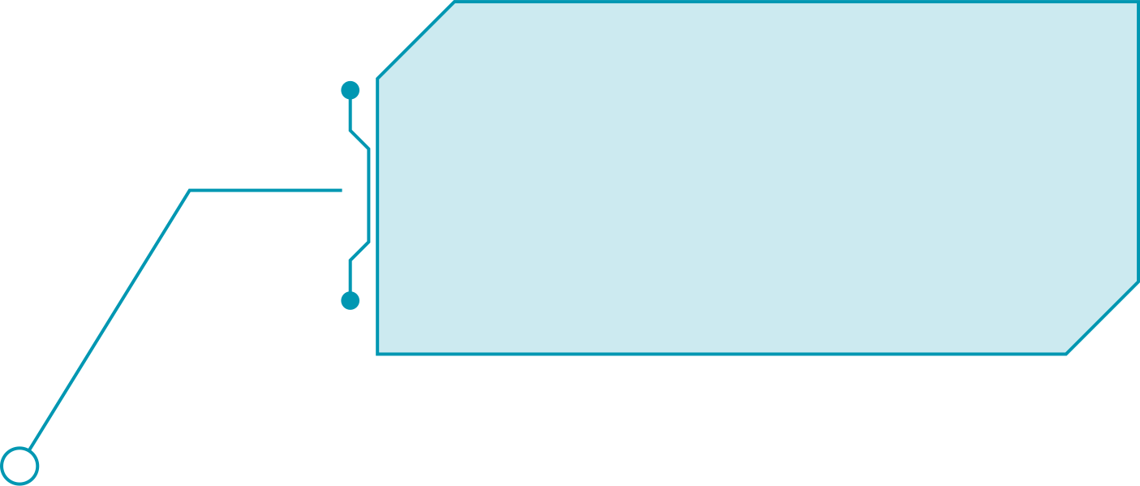



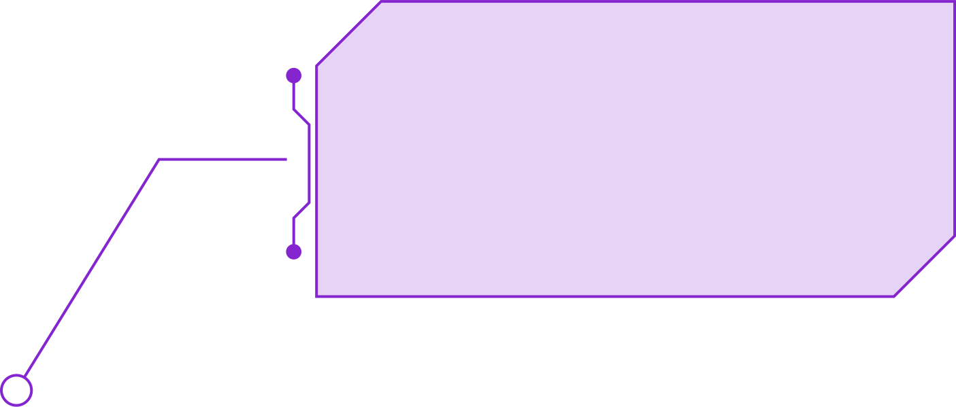



Secure Document FOrmat
RustCrypto library
Criptolib
Funcionalities
Algorithms
Freshness
Communications occur over SSL/TLS
Nonce sent with the formatted document
$_
> help
> protect
> check
> unprotect
> hash-password
> verify-password
> gen-secret-key
> gen-rsa-keypair
> encrypt-key-with-pub-key
> decrypt-key-with-priv-key
ChaCha20-Poly1305
Reliable Rust library
Stream cipher with a hash function
Confidentiality, integrity, and authenticity in a single operation
No padding
Lower latency compared to block ciphers
High-performance parallelism
256-bit key
Secret key is generated for each message sent
Stored for long term on database
Random nonce
Unique cipher
No Signed
Complexity and computational cost
Unnecessary additional properties (non-repudiation, non-forgery, non-reusable)

Slide 4
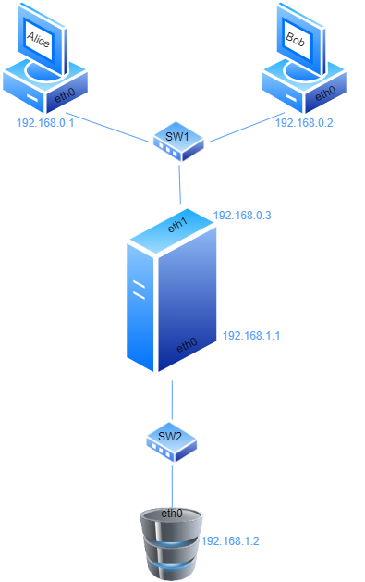
Networks and machines
Network
192.168.0.0/24
Network
192.168.1.0/24

Slide 5
Built Infraestructure
Alice Client
TUI
Login/ Logout
Register
Send and view messages
Add and view contacts
Profile
Firewall
Local Database (SQLite)
HTTPS (SSL/TLS)
DMZ
PostgreSQL Database
Table Contact
(istId, name, public_key)
Firewall
Websocket (SSL/TLS)
Server
Table StoredMessages
(id, sender_ist, receiver_istid, timestamp, content, secret_key, hmac_key, sent_counter, receiver_counter, server_id)
Firewall
Table Users
(istId, name, password_hash, public_key)
HTTP Client
SSL/TLS
(mutal)
Session
Cookie
Web Server
REST API
Table InMessages
(id, user_id, content, sender_encrypted_secret_key)
Bob Client
HTTPS (SSL/TLS)
Firewall
Websocket (SSL/TLS)
Table OutMessages
(id, user_id, content, receiver_encrypted_secret_key)
TUI
Login/ Logout
Register
Send and view messages
Add and view contacts
Profile
Local Database (SQLite)
Table Contact
(istId, name, public_key)
Table StoredMessages
(id, sender_ist, receiver_istid, timestamp, content, secret_key, sent_counter, receiver_counter, server_id)
CA
Self-signed certificate
HTTP Client
Session
Cookie

Slide 6

SecurIRY MECHANISMS
SSL/TLS
DBs
Confidentiality, integrity, authenticity
Robust face man-in-the-middle, replay (freshness), interception of passwords, downgrade attacks, etc
Connection authentication:
Server <-> Database
Client <- Server
All databases have sanitization inputs
User Authentication
Password-based login
Cipher session cookie
Local SQL database’s file encrypted with KDF from the login’s password
Firewall
All VMS have firewalls that allow only essential traffic

Slide 7









Key Distribution
CA
2.
1.
Server
CA
Database
Label:
Private Key
Sign
Certificate

Slide 8

Key Distribution
Register
1.
Client
3.
2. Register
Server
Label:
Private Key
Public Key

Slide 9















Key Distribution
Send Message
3.
5.
1.
Server
Client
4.
2.
6.
Label:
Private Key
Public Key
Message
Secret Key
Nonce

Slide 10

Challenges
Protection Needs
SR1: COnfidentiality
SR2: Integrity 1
ChaCha20
Shared symmetric keys
Poly1305 hash function
Integrity and authenticity
SR3: Integrity 2
SR4: Authentication
Message counters
Prevent replay attacks, and out-of-order messages
Checked and maintained by clients
Password-based login
Session cookies (with expiration time)

Slide 11

Challenges
Challenge A
SRA1: COnfidentiality
SRA2: COnfidentiality
End-to-end encryption
Server cannot read message content nor keys
Encrypt the secret key with the public key of both clients
Add contact by inserting the public key manually
Side channel for authentication
SRA3: Availability
Client has always a backup copy of his private key
Can request server the message history
Private key used to decrypt the symmetric keys so it can access the message’s content

Slide 12

Attacker model
Trust Levels
Attacker capabilities
Brute force password
Exploitation Vulnerabilities
Phishing
Ping Flood, DDoS, DoS, Spamming Attacks
Access to Encrypted Data on client’s local database
Modify or Delete Data
Physical Device Theft
Fully Trusted
Client
CA
Server
Database
Attacker limitations
Partially Trusted
MITM
Intercepting Connections
Memory Exploits
Replay Attacks
Encrypted and Secure Communication
Unable to send valid messages
Firewalls
Database sanitizing and limited privileges
Untrusted
Unverified Client

Slide 13

Conclusions
Main Results
End-to-end Encryption
Data Recovery Mechanism
Local Data Security
User Authentication
Secure Code
Secure Communication
Key Management

Slide 14
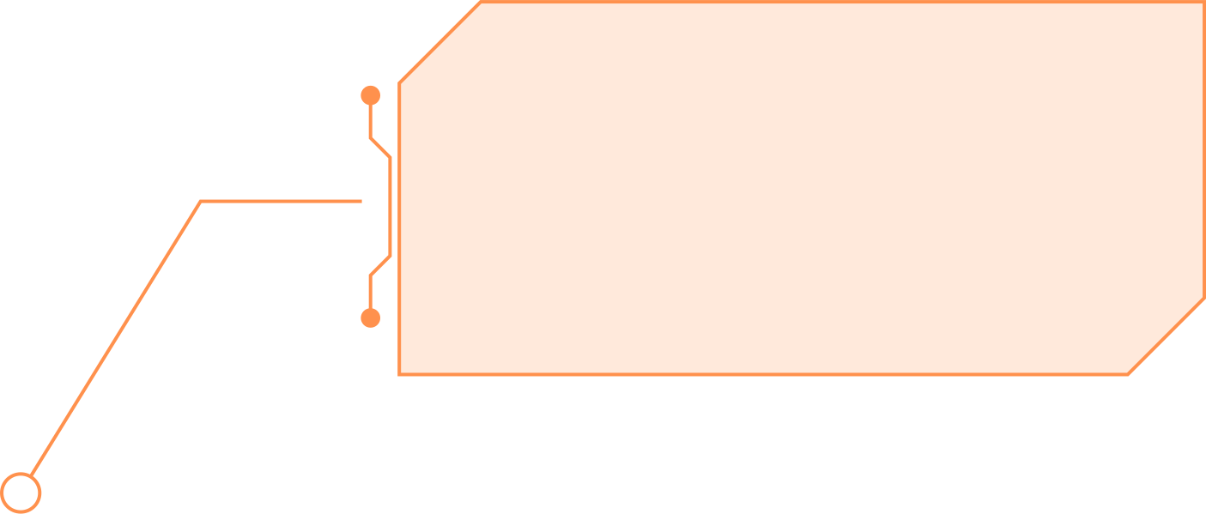
Conclusions
Future ENchancements
Robust Gateway Architecture
Simple Gateway Dual-Homed
DMZ, Firewall, and Routing
Security-Enhancing Technologies
Authorized access only from the Técnico network
IDS
(Intrusion Detection System)
Notify port scanning and flood attacks
Improved Key Management
PKI
Automated Key Revocation List
2FA Authentication

Slide 15
DEMO
demo youtube

Slide 16
Questions

