Slide 1
音樂訊號分析與檢索
悲傷快樂頌

Slide 2

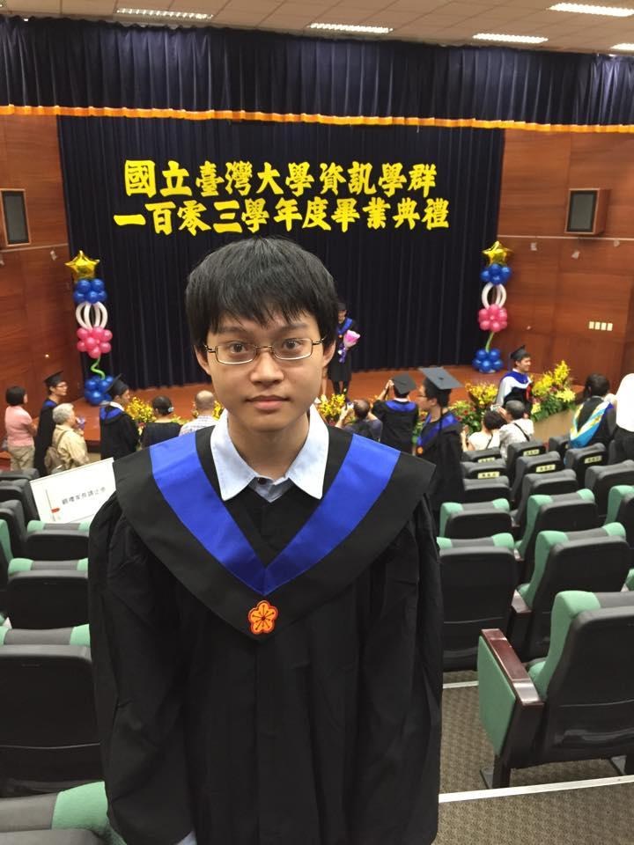
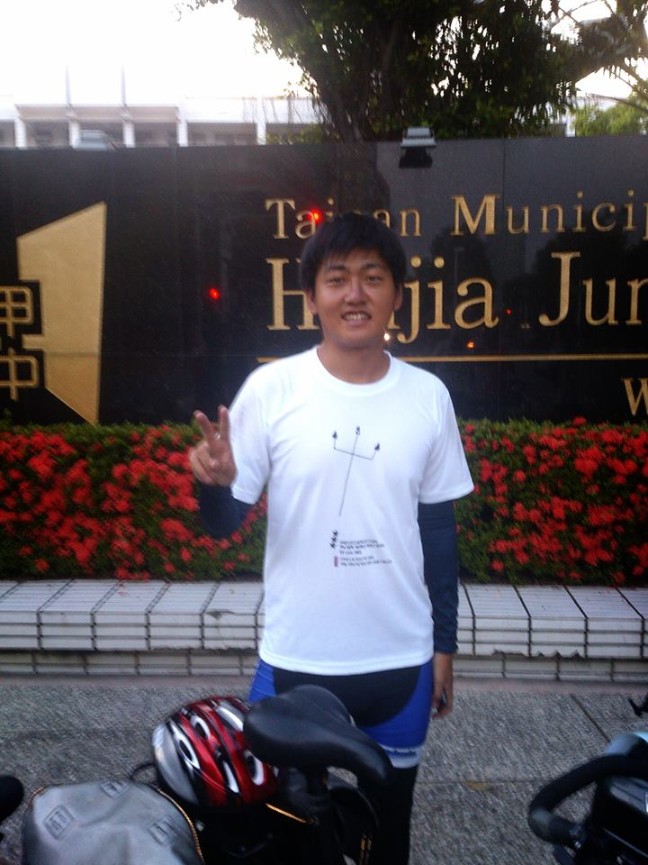
Member
資工碩一
蘇兆為
R03922126
資工大四
廖唯辰
B00902102
生醫電子碩一
何偉
R03945010

Slide 3
Cooperation
蘇兆為 : 調性分析，轉調
廖唯辰 : 介面製作
何偉 : 聲音疊合

Slide 4


Motivation

Slide 5

Motivation

Slide 6
Objective
Major

Slide 7
Objective
Minor
Major
Blue
Other modification

Slide 8
Method
What is major?

Slide 9
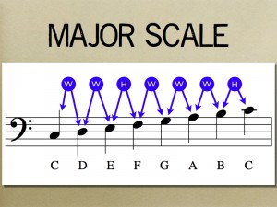
Method
What is major?
W : 2 semitones
H : 1 semitones

Slide 10
Method
Counting the number of pitches

Slide 11
Method
Counting the number of pitches
Pitch (in semitone) | ... | 50 | 51 | 52 | ...
Number | ... | 10 | 8 | 4 | ...

Slide 12
Method
Counting the number of pitches
Pitch (in semitone) | ... | 50 | 51 | 52 | ...
Number | ... | 10 | 8 | 4 | ...
Pitch (in semitone) | 0 | 1 | 2 | ... | 10 | 11
Number | 23 | 2 | 35 | ... | 8 | 14
Mode 12

Slide 13
Method
0 | 1 | 2 | ... | 10 | 11
23 | 2 | 35 | ... | 8 | 14
Pitch
Count

Slide 14
Method
0 | 1 | 2 | ... | 10 | 11 | 0 | 1 | 2 | ... | 10 | 11
23 | 2 | 35 | ... | 8 | 14 | 23 | 2 | 35 | ... | 8 | 14
Pitch
Count

Slide 15
Method
0 | 1 | 2 | ... | 10 | 11 | 0 | 1 | 2 | ... | 10 | 11
23 | 2 | 35 | ... | 8 | 14 | 23 | 2 | 35 | ... | 8 | 14
Pitch
Count
Major
1 | 0 | 1 | 0 | 1 | 1 | 0 | 1 | 0 | 1 | 0 | 1

Slide 16
Method
0 | 1 | 2 | ... | 10 | 11 | 0 | 1 | 2 | ... | 10 | 11
23 | 2 | 35 | ... | 8 | 14 | 23 | 2 | 35 | ... | 8 | 14
Pitch
Count
Major
1 | 0 | 1 | 0 | 1 | 1 | 0 | 1 | 0 | 1 | 0 | 1
16
Inner product

Slide 17
Method
0 | 1 | 2 | ... | 10 | 11 | 0 | 1 | 2 | ... | 10 | 11
23 | 2 | 35 | ... | 8 | 14 | 23 | 2 | 35 | ... | 8 | 14
Pitch
Count
Major
1 | 0 | 1 | 0 | 1 | 1 | 0 | 1 | 0 | 1 | 0 | 1
16 | 23
Inner product

Slide 18
Method
0 | 1 | 2 | ... | 10 | 11 | 0 | 1 | 2 | ... | 10 | 11
23 | 2 | 35 | ... | 8 | 14 | 23 | 2 | 35 | ... | 8 | 14
Pitch
Count
Major
1 | 0 | 1 | 0 | 1 | 1 | 0 | 1 | 0 | 1 | 0 | 1
16 | 23 | 189
Inner product

Slide 19
Method
0 | 1 | 2 | ... | 10 | 11 | 0 | 1 | 2 | ... | 10 | 11
23 | 2 | 35 | ... | 8 | 14 | 23 | 2 | 35 | ... | 8 | 14
Pitch
Count
Major
1 | 0 | 1 | 0 | 1 | 1 | 0 | 1 | 0 | 1 | 0 | 1
16 | 23 | 189 | 25 | 31 | 26 | 12 | 24 | 23 | 13 | 12 | 22
Inner product

Slide 20
Method
0 | 1 | 2 | ... | 10 | 11 | 0 | 1 | 2 | ... | 10 | 11
23 | 2 | 35 | ... | 8 | 14 | 23 | 2 | 35 | ... | 8 | 14
Pitch
Count
Major
1 | 0 | 1 | 0 | 1 | 1 | 0 | 1 | 0 | 1 | 0 | 1
16 | 23 | 189 | 25 | 31 | 26 | 12 | 24 | 23 | 13 | 12 | 22
Inner product

Slide 21
Method
Major | 1 | 0 | 1 | 0 | 1 | 1 | 0 | 1 | 0 | 1 | 0 | 1
Minor | 1 | 0 | 1 | 1 | 0 | 1 | 0 | 1 | 1 | 0 | 0 | 1

Slide 22
Method
Pitch shift
Pitch shift
Major | 1 | 0 | 1 | 0 | 1 | 1 | 0 | 1 | 0 | 1 | 0 | 1
Minor | 1 | 0 | 1 | 1 | 0 | 1 | 0 | 1 | 1 | 0 | 0 | 1

Slide 23
Method
Other effect
Original
Up shifting 4 semitones
New song
Original

Slide 24
Method
Other effect
1 | 0 | 1 | 0 | 1 | 1 | 0 | 1 | 0 | 1 | 0 | 1
New song
Shift 4 semitone
1 | 0 | 1 | 0 | 1 | 1 | 0 | 1 | 0 | 1 | 0 | 1

Slide 25
Method
Other effect
1 | 0 | 1 | 0 | 1 | 1 | 0 | 1 | 0 | 1 | 0 | 1
New song
Shift 4 semitone
1 | 0 | 1 | 0 | 1 | 1 | 0 | 1 | 0 | 1 | 0 | 1

Slide 26
Method
Other effect
1 | 0 | 1 | 0 | 1 | 1 | 0 | 1 | 0 | 1 | 0 | 1
New song
Shift 4 semitone
1 | 1 | 0 | 1 | 0 | 1 | 0 | 1 | 0 | 1 | 0 | 1

Slide 27
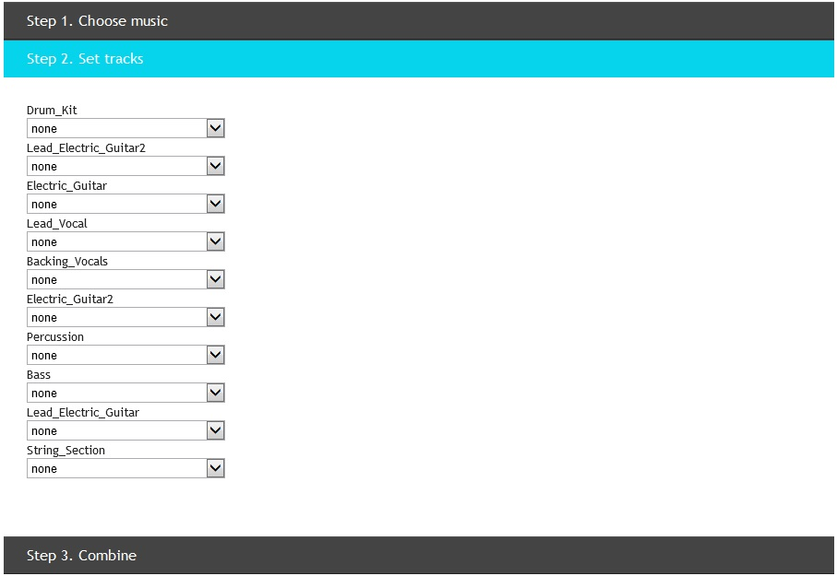
Result

Slide 28
Demo

