Slide 1

VII. INTERNATIONAL APPLIED STATISTICS CONGRESS
UYIK-2026 · Istanbul, Türkiye · May 11-13, 2026
Directional Forecasting of Pension Investment Funds
Evidence on the Majority Class Illusion from ARIMA, CNN, and LSTM Models
AUTHOR
AUTHOR
SUPERVISOR · ASSIST. PROF. DR.
Şevval Demir
Mehmet Ali Kurt
Övgücan Karadağ Erdemir
Department of Actuarial Sciences · Hacettepe University
Department of Actuarial Sciences · Hacettepe University
Department of Actuarial Sciences · Hacettepe University
dsevval5@gmail.com
m.alikuurt0@gmail.com
ovgucan@hacettepe.edu.tr
Data: TEFAS · Period: April 2021 – April 2026 · Funds: ALZ • AZS • AMZ · 3 seeds × 81 configs / fund

Slide 2

2 / 25
Outline
Motivation & Research Gap
Data, Funds & Class Balance
01
Why directional forecasting on BES?
02
ALZ / AZS / AMZ — risk profiles and label distribution
Methodology & Search Space
The Majority-Class (MC) Illusion
03
ARIMA + LSTM + 1D-CNN • 3 × 9 × 3 = 81 configs/fund
04
Why high accuracy can be empty
Champion Configurations
Conclusions & Reporting
05
AMZ LSTM (2,3) and AZS 1D-CNN (4,3), seed stability, optimizer
06
Results, limitations, references

Slide 3
3 / 25
Literature Review
Classical ARIMA
Evaluation Methodology Gap
Box-Jenkins ARIMA remains the dominant benchmark in pension-fund return forecasting. Karadağ Erdemir & Kırkağaç (2024) applied ARIMA to Turkish BES pension funds. Eşsiz & Ordu (2024) applied ARIMA to S&P 500 fund baskets. Strong parametric baseline, blind to non-linear structure.
Finance DL studies frequently report raw accuracy without specificity, sensitivity or baseline comparison. Majority-Class illusion (Spec=0 or Sens=0) is rarely flagged, leading to overstated predictive performance on imbalanced data. This study addresses this gap explicitly.
Deep Learning in Finance
Research Contribution
Fischer & Krauss (2018) showed LSTM networks outperform memory-free models on S&P 500 constituents. Siami-Namini et al. (2019) reported LSTM/BiLSTM improvements over ARIMA on economic time-series. 1D-CNN offers a competitive and computationally cheaper alternative (Van der Burgt, 2023).
First systematic application of ARIMA + LSTM + 1D-CNN to TEFAS pension funds (ALZ/AZS/AMZ) under a multi-seed, multi-window framework — with Majority-Class detection, Balanced Accuracy and Naïve-Baseline comparison built in from the start.

Slide 4
4 / 25
Motivation — Why BES, Why Directional?
Why Pension Funds?
Research Gap
Turkey's TEFAS platform manages billions in pension assets. ALZ, AZS and AMZ represent three distinct risk profiles (low ±2%, medium ±18%, high ±38%). Directional prediction directly impacts retirement income and portfolio-rebalancing decisions.
Prior work (Karadağ Erdemir & Kırkağaç, 2024; Eşsiz & Ordu, 2024) relies on ARIMA for pension-fund returns. No prior study systematically applies LSTM and 1D-CNN with multi-seed validation to TEFAS pension funds.
Adapted Methodology
Why Balanced Accuracy?
Van der Burgt (2023) NASDAQ-100 framework extended to weekly TEFAS data: multi-seed (23/27/98), rolling windows (In∈{2,4,6}, Out∈{1,3,5}), 3 feature sets (full · technical · closing), Majority-Class detection and Naïve-Baseline comparison.
Data is heavily imbalanced (AZS: 84.85% Up). Raw accuracy is misleading — always predicting Up gives 84.85% but captures no Down signal. Balanced Accuracy = (Sensitivity + Specificity) / 2 penalises the Majority-Class illusion and is the primary metric throughout.

Slide 5
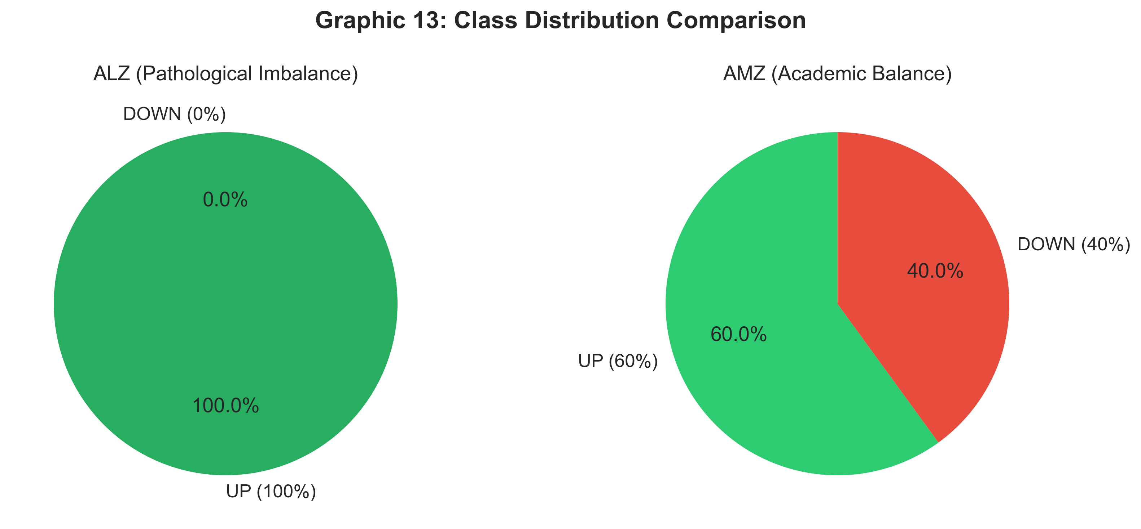
5 / 25
Data & Pension Funds — ALZ / AZS / AMZ
Figure1 : Two-Fund Profile
Low-Risk
ALZ
Conservative • Swing ± 2 % • MC: 27 / 27 MC
Allianz Yaşam — Money-market dominant. Almost monotone series.
Medium-Risk
AZS
Mixed • Swing ± 18 % • MC: 9–13 / 27 MC
Mixed equity/debt fund. Moderate volatility, partial signal.
DATA SUMMARY
High-Risk
Source: TEFAS (Turkish Electronic Fund Trading Platform)
Period: April 2021 – April 2026 (~260 weekly observations)
Split: 70 % train / 15 % val / 15 % test (chronological)
Target: binary direction (close[t+h] > close[t] ?)
AMZ
Equity-Heavy • Swing ± 38 % • MC: 9–10 / 27 MC
High-volatility equity fund — highest learnable directional signal.

Slide 6
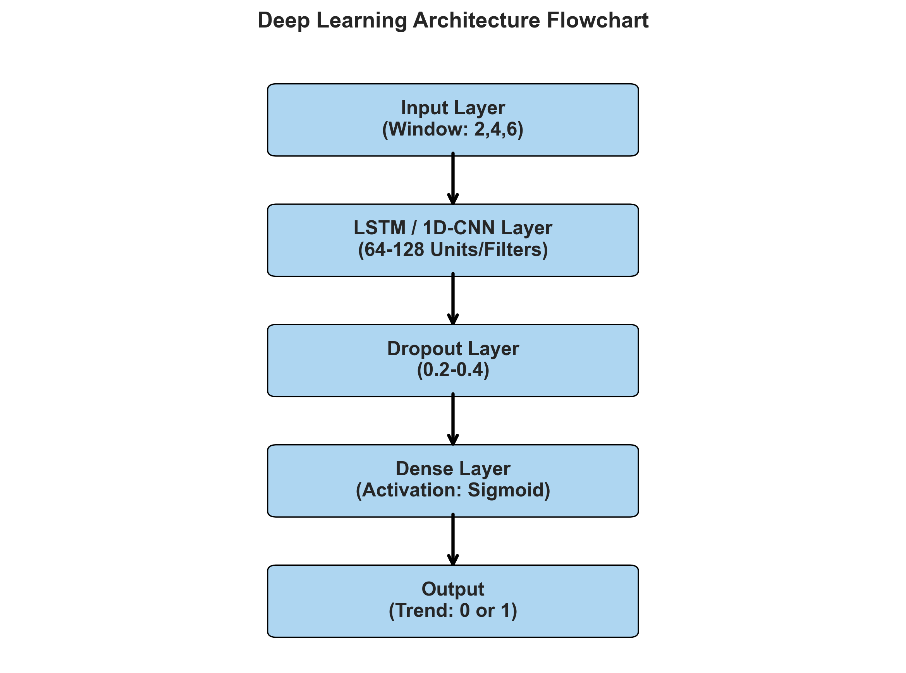
6 / 25
Methodology — Three-Model Pipeline
ARIMA
Grid d∈{0,1,2,3,4,5}, CSS fit Classical baseline
Box-Jenkins
LSTM
Adam / SGD • ReLU/Tanh Dropout {0, 0.2, 0.4} • class_weight
Recurrent
1D-CNN
Filters {32-64-128, 64-128-256} Kernel 3 • Dense 64 • class_weight
Convolutional
All models share the same 9 (Input × Output) windows and 3-seed protocol

Slide 7
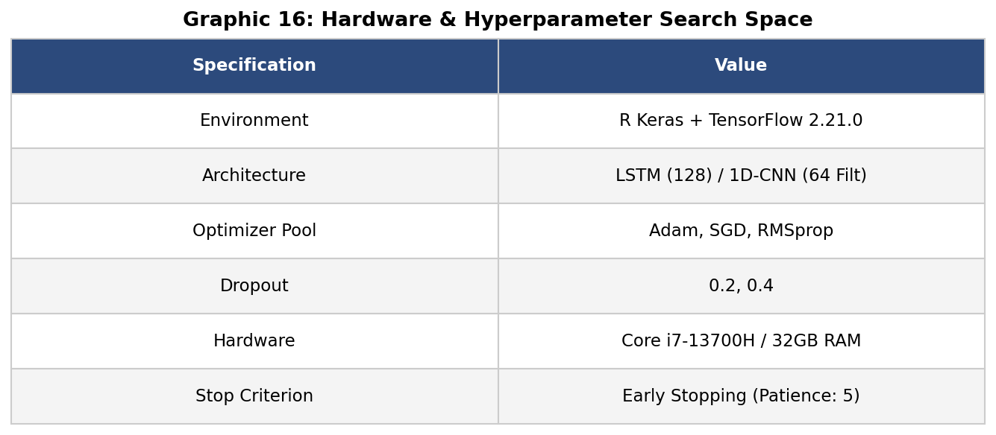
7 / 25
Search Space — 81 Configurations per Fund
3
9
3
81
Feature Sets
(In, Out) Windows
Random Seeds
Configs / Fund
closing • technical • full
(2.4.6) × (1.3.5) weeks
23 • 27 • 98
3 × 9 × 3
Figure2 : Hardware & Hyperparameter
FEATURE SETS
closing — 1 var
Weekly close only
technical — 3 vars
RSI(14) • MACD • Momentum(10)
full — 7 vars
Close, RSI, MACD, EMA12, EMA26,
Momentum, Volatility
Training: epochs = 50 • batch = 16 • patience = 5 (early stopping) • class_weight balancing • CSS fit for ARIMA

Slide 8
8 / 25
The Majority-Class Illusion
Why a 90 % accuracy can mean a 0 % learner.
27/27
of ALZ low-risk configurations are majority-class — perfect-looking accuracy without any learning.

Slide 9
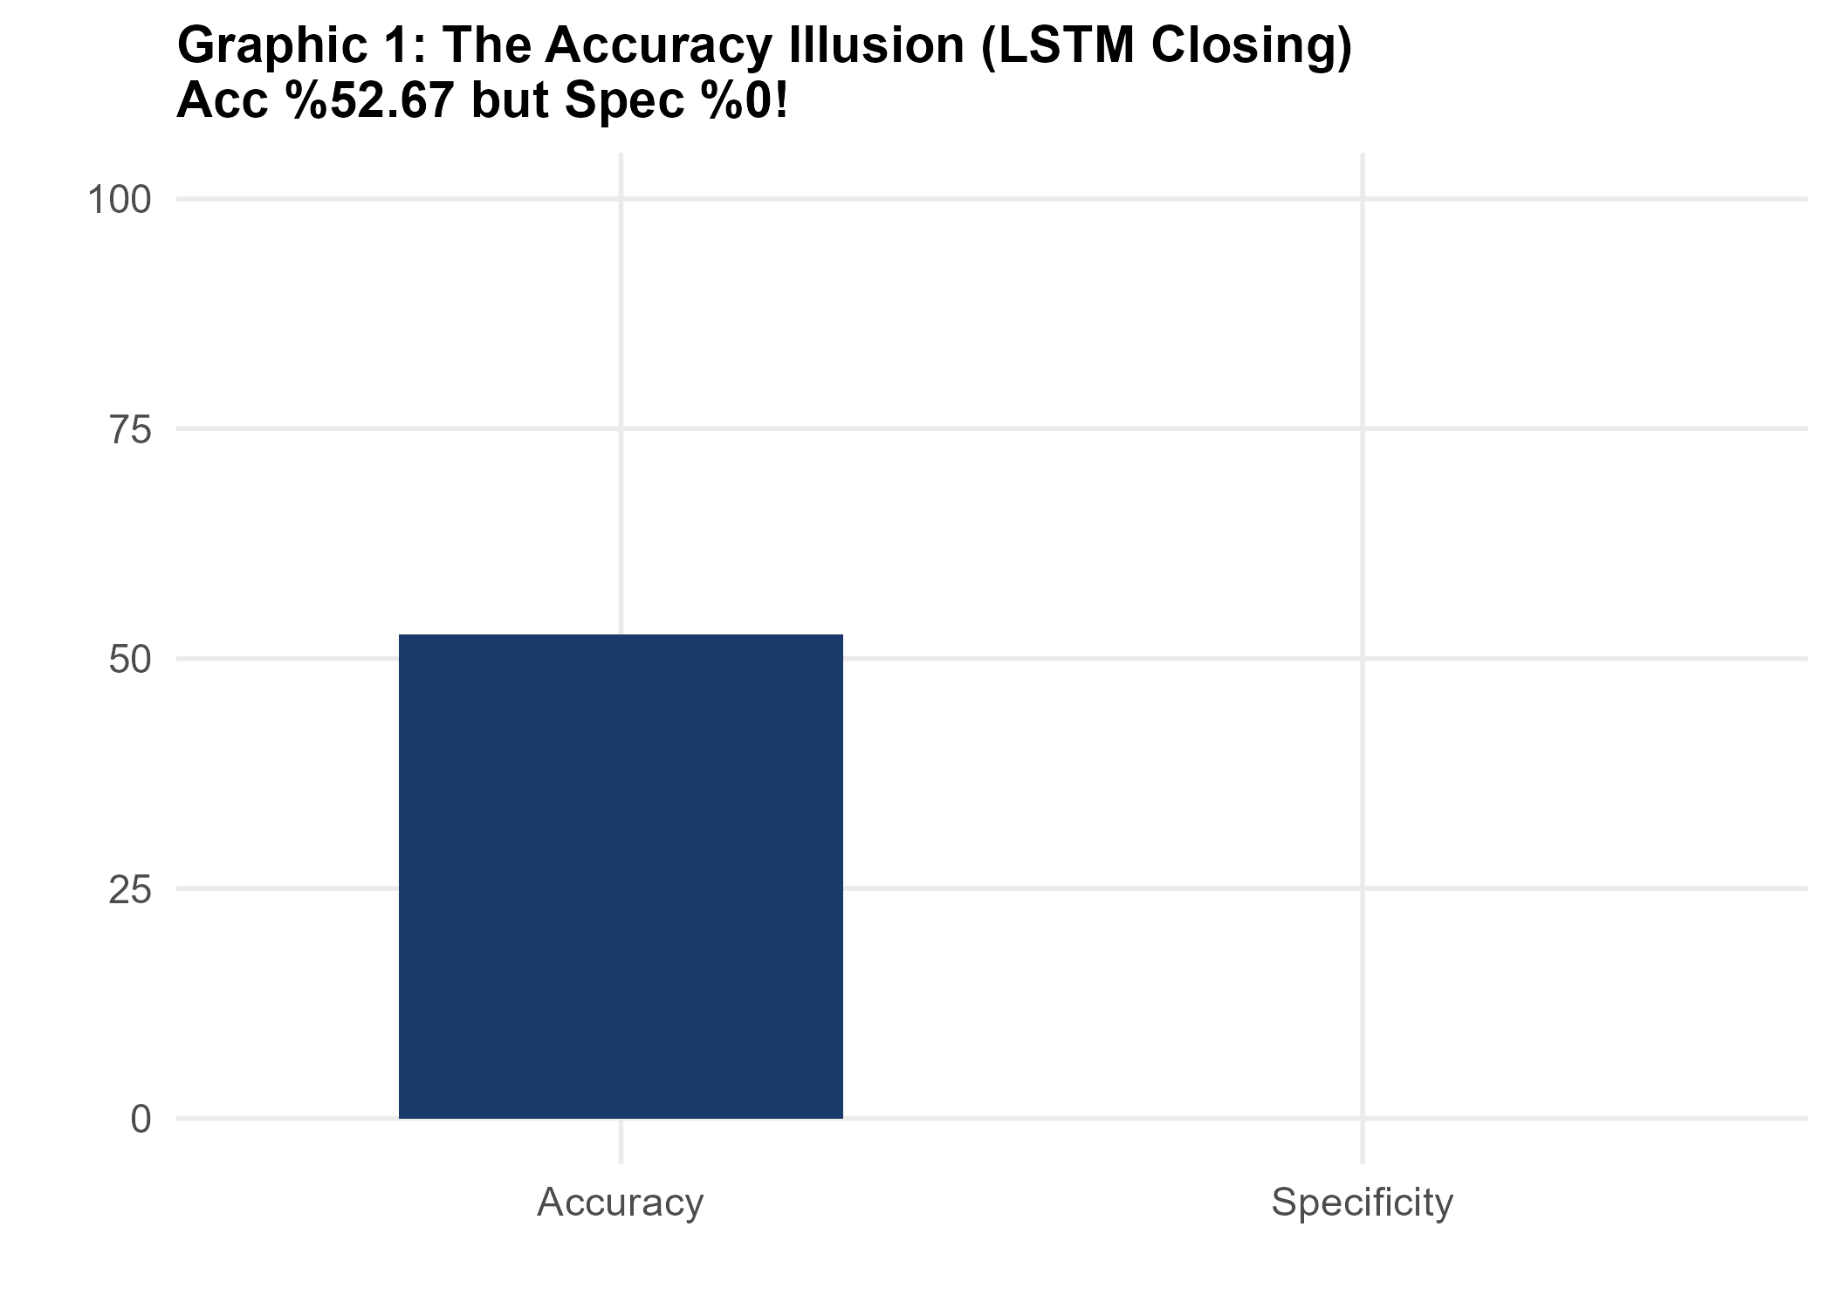
9 / 25
The Accuracy Illusion in Action
Figure3 : LSTM Closing Accuary
MC DEFINITION (broad)
A configuration is flagged as Majority-Class when Spec = 0 or Sens = 0 or Spec = NA — the model picks one class on every test sample.
MC RATES BY FUND × MODEL
ALZ • LSTM
27 / 27
ALZ • CNN
27 / 27
AZS • LSTM
13 / 27
AZS • CNN
9 / 27
AMZ • LSTM
10 / 27
AMZ • CNN
9 / 27

Slide 10
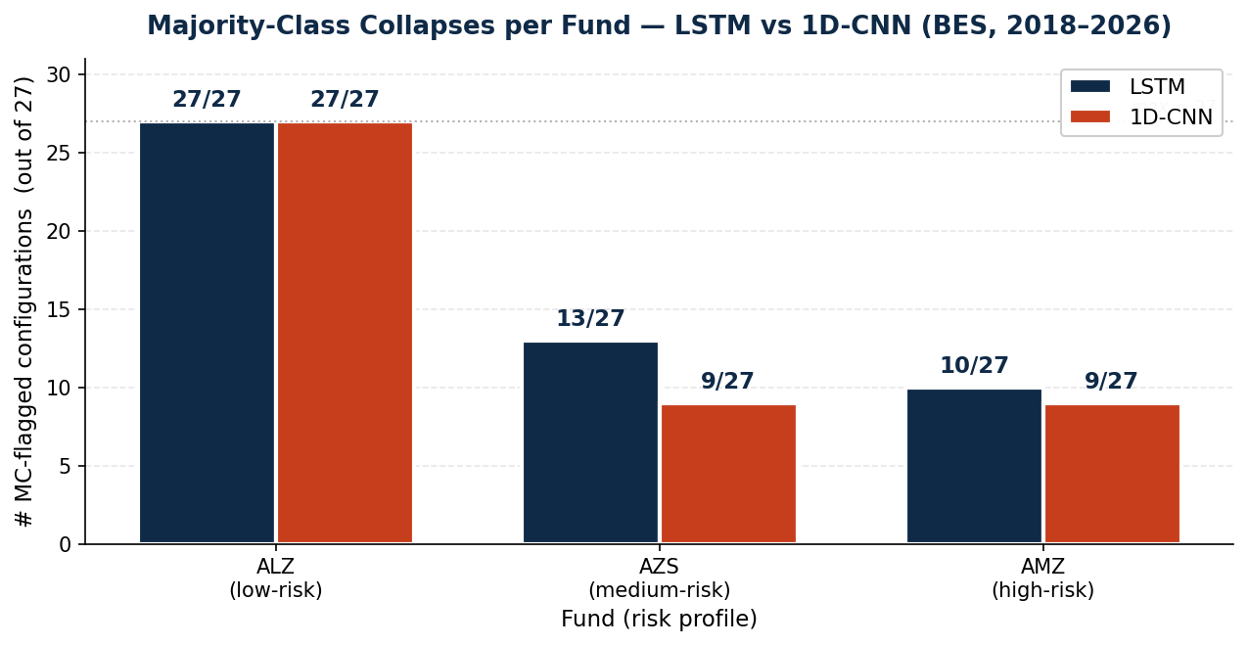
10 / 25
Finding 1 — 1D-CNN Resists the MC Trap
Figure4 : MC Collapses per Fund
KEY CONCLUSION
Across AZS and AMZ, 1D-CNN's convolutional inductive bias delivers fewer collapsed predictions than LSTM — a robustness, not just accuracy, win.
AT A GLANCE
AZS: CNN 9/27 vs LSTM 13/27
AMZ: CNN 9/27 vs LSTM 10/27
MC drop: ~15 pp on AZS

Slide 11
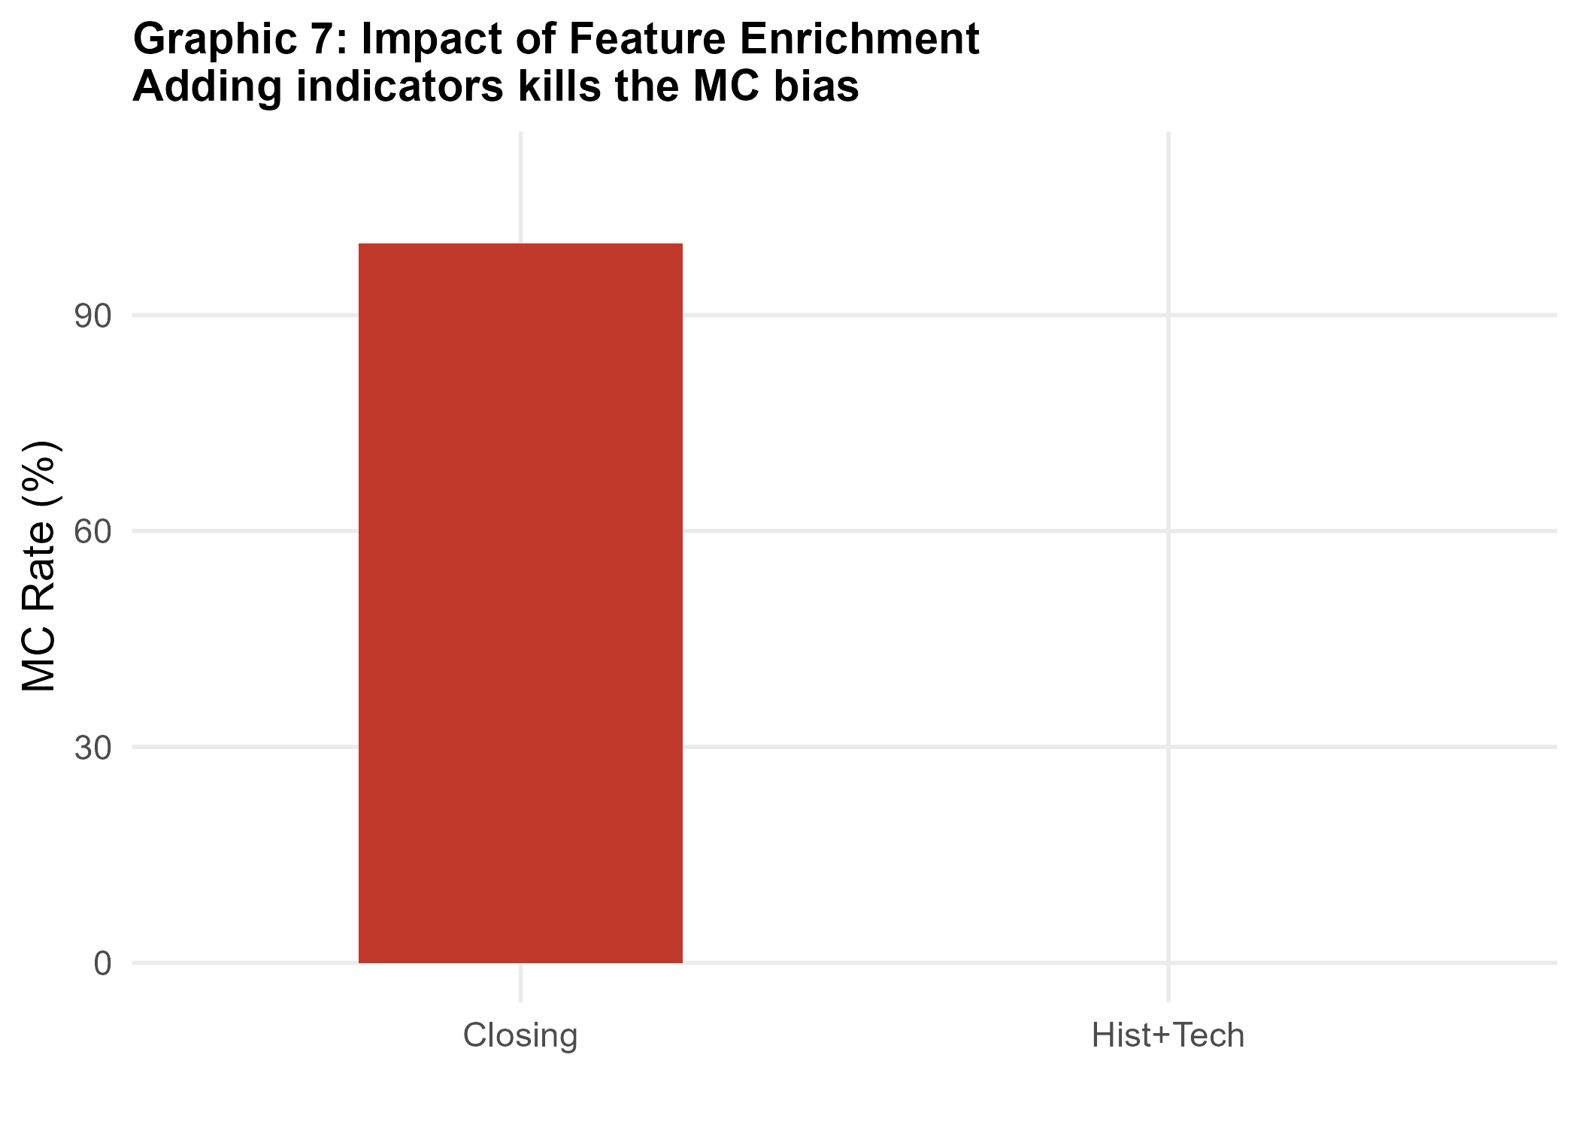
11 / 25
Finding 2 — Feature Set Drives Performance
OBSERVATIONS
Figure5 : MC Rates for Features
full
best for AMZ LSTM — only configuration where MC = 0/9 with the full set
technical
best for AZS 1D-CNN — RSI + MACD + Momentum lifts BA to 76.70 %
closing
fragile — collapses to MC under low volatility
Feature engineering ≠ optional

Slide 12
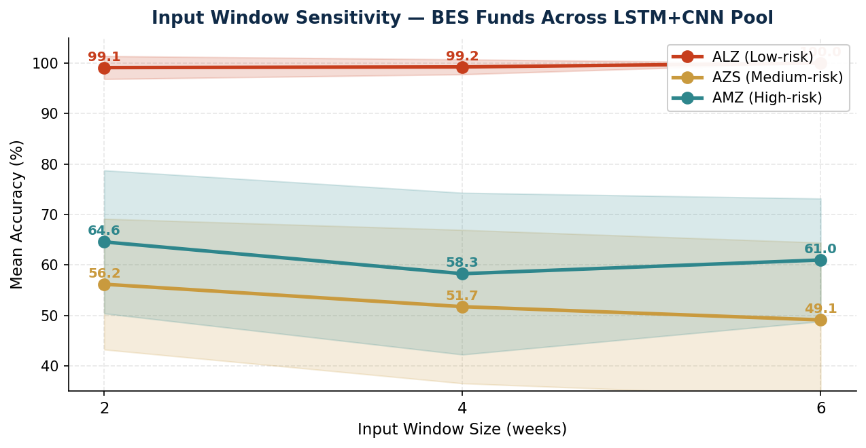
12 / 25
Finding 3 — Input/Output Window Sensitivity
OPTIMAL WINDOWS
Figure6 : Input Window Sensitivity LSTM+CNN Pool
AMZ • LSTM
(2, 3)
Mean Acc 80.21 %
AZS • CNN
(4, 3)
Mean Acc 75.56 %
ALZ
—
Any (collapses to MC)
h = 3 weeks dominates

Slide 13
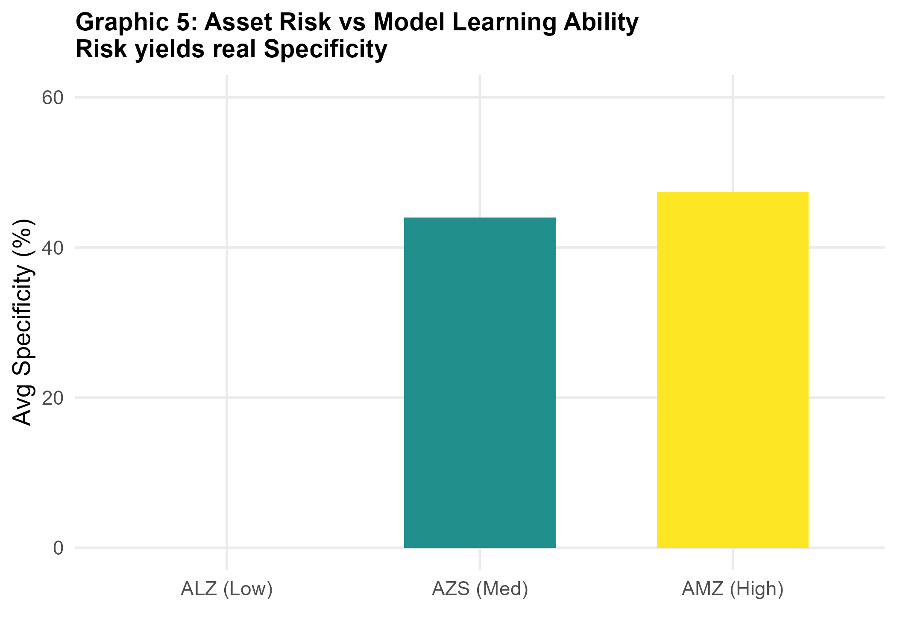
13 / 25
Finding 4 — Risk Profile Predicts Learnability
Figure7 : Specificity
INTERPRETATION
Low-risk funds (ALZ) are nearly monotone — their direction is degenerate, so deep learners memorise the trend rather than learn it.
Higher volatility (AMZ) creates genuine class balance, giving the model something to discriminate.
Bottom line: directional ML on BES is most useful where conventional advisers say it is hardest.

Slide 14
14 / 25
Champion Configurations
Two statistically-significant directional learners

Slide 15
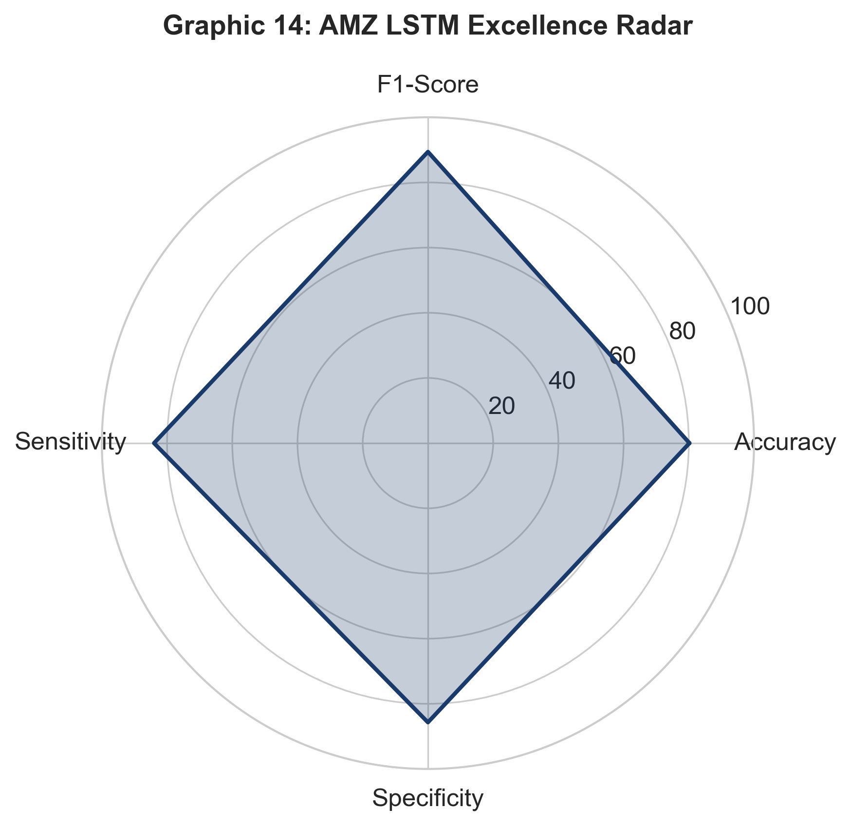
15 / 25
Champion 1 — AMZ • LSTM • full • (2, 3)
80.21 %
84.86 %
89.36 %
0.0001
Mean Accuracy
Balanced Accuracy
F1-Score
p-value (binomial)
Figure8 : AMZ LSTM Excellence Radar
PER-METRIC BREAKDOWN
Sensitivity 84.00 % • Specificity 85.71 %
BA = (Sens + Spec) / 2 = (0.84 + 0.8571) / 2 = 0.84855 → 84.86 %
Seed accuracies: 0.8438 / 0.7188 / 0.8438
SD = 7.22 % across seeds (transparently reported)
HYPERPARAMETERS
Optimizer Adam • Activation Tanh • Dropout 0.4
Epochs 50 • Batch 16 • Patience 5
Feature set: full (7 vars) • class_weight balanced

Slide 16
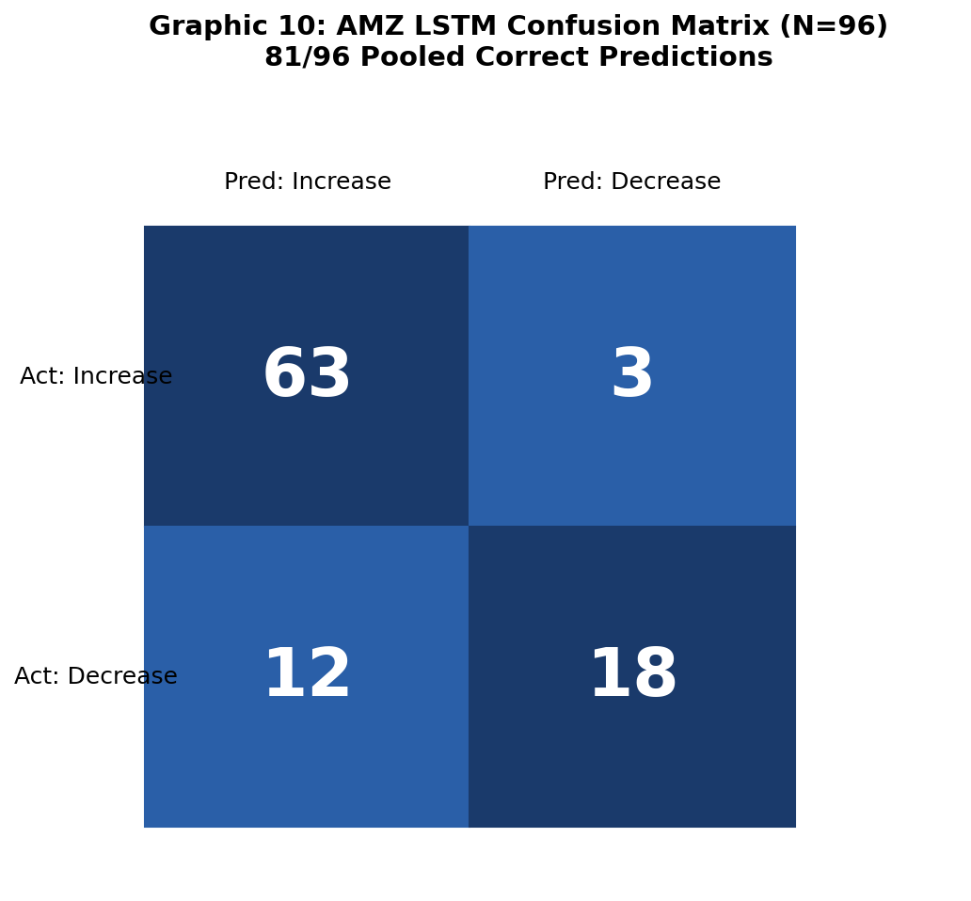
16 / 25
Champion 1 — Confusion Matrix & Reporting
Figure9 : AMZ LSTM Confusion Matrix
POOLED MATRIX (N = 96)
TP = 63 TN = 18
FP = 3 FN = 12
Diagonal: 63 + 18 = 81 → Pooled Acc = 81/96 = 84.38 %
REPORTING NOTE
Two valid summaries of the same evaluation:
Pooled accuracy = 81 / 96 = 84.38 % (concatenated test sets)
3-seed mean accuracy = 77 / 96 = 80.21 % (mean of {0.8438, 0.7188, 0.8438})
We adopt the 3-seed mean as the headline Figure :.
Pooled is exposed for full transparency — never as the headline.

Slide 17
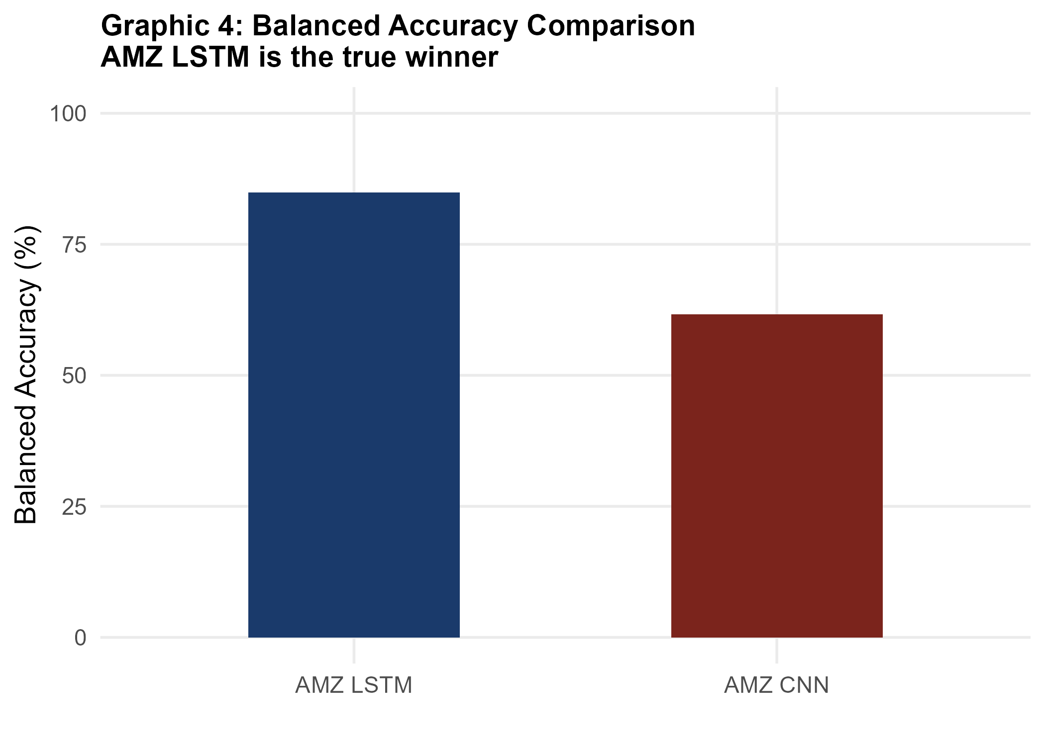
17 / 25
Champion 2 — AZS • 1D-CNN • technical • (4, 3)
75.56 %
76.70 %
88.89 %
0.0002
Mean Accuracy
Balanced Accuracy
F1-Score
p-value (binomial)
INTERPRETATION
Sens 90.91 % • Spec 62.50 %
BA = (0.9091 + 0.625) / 2 = 0.76705 → 76.70 %
Asymmetric strength: strong recall on "up" weeks but weaker discrimination on "down" weeks — typical for medium-volatility mixed funds.
Hyperparameters
Filters 64-128-256 • Kernel 3 • Dense 64 • Dropout 0.2
Feature set technical (RSI, MACD, Momentum) • Window (4, 3)
Seed accuracies 0.7000 / 0.7333 / 0.8333 • SD 6.94 %
Figure10 : Balanced Accuracy Comprasion

Slide 18
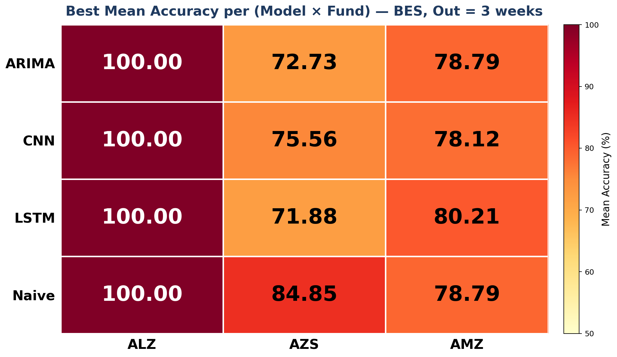
18 / 25
Cross-View — Model × Asset Performance Heatmap
Figure11 : Heatmap Model x Fund
READING THE HEATMAP
Each cell = best Mean Accuracy of any configuration of that (Model, Fund) pair.
ALZ column = 100 %: pathological monotone — every model collapses to majority class.
AMZ × LSTM = 80.21 %: only configuration above its Out=3 naive (78.79 %).
AZS × Naive = 84.85 %: persistence dominates — CNN champion 75.56 % falls below.
ARIMA: dominated by naive on AZS, tied with naive on AMZ.

Slide 19
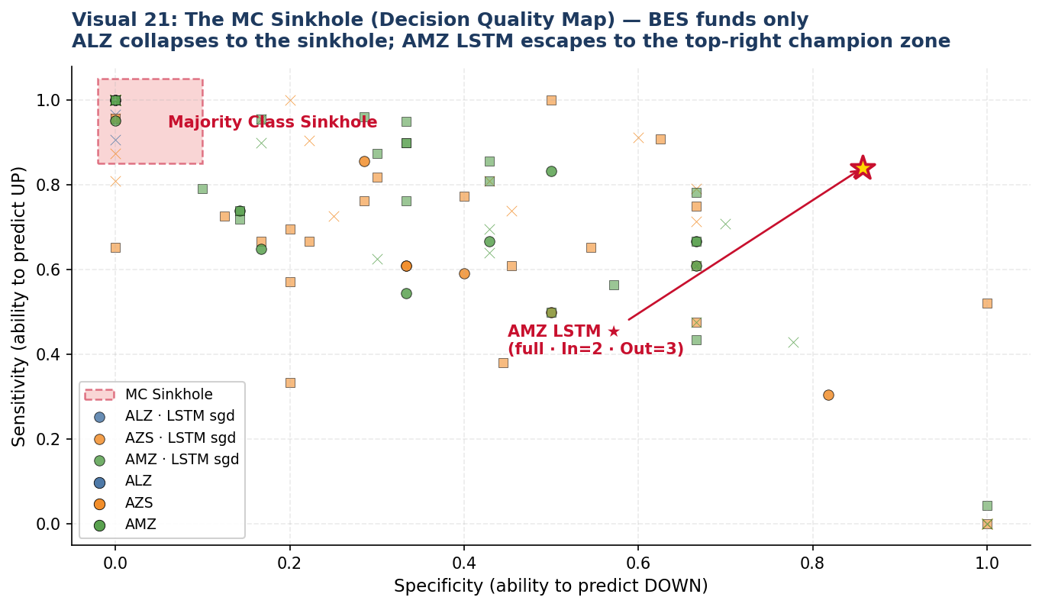
19 / 25
Decision Quality Map — Escape from the MC Sinkhole
Figure12 : MC Sinkhole
READING THE MAP
• X-axis: Specificity (ability to predict DOWN).
• Y-axis: Sensitivity (ability to predict UP).
• Top-left red zone = MC Sinkhole — Sens≈1, Spec≈0 (predicts only UP).
• ALZ collapses into the sinkhole on every model — pathological monotone.
• Healthy learning lives in the upper-right quadrant (Sens>0.5 AND Spec>0.5).
• AMZ LSTM (full · In=2 · Out=3) ★ escapes to the champion zone — true bidirectional learning.
• Take-away: high accuracy alone is not learning; only points outside the sinkhole are honest predictions.

Slide 20
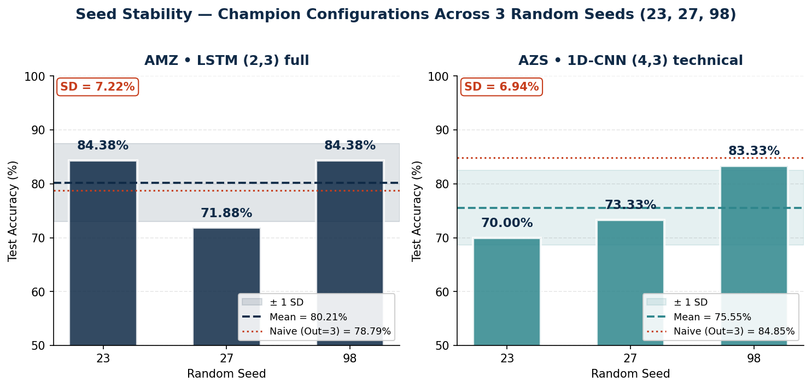
20 / 25
Seed Stability of Champions
Figure13 : Champion Configurations Across 3 Seed
STABILITY NOTES
AMZ LSTM: 84.38 / 71.88 / 84.38 % → SD = 7.22 %.
AZS CNN: 70.00 / 73.33 / 83.33 % → SD = 6.94 %.
Both means clear the random-guess line (50 %) at p < 0.001.
note: only AMZ LSTM exceeds its Out=3 persistence-naive (78.79 %).
3-seed
23 · 27 · 98
weighted
class_weight balancing
p < 0.001
champion significance
CSS-fit
ARIMA stable

Slide 21
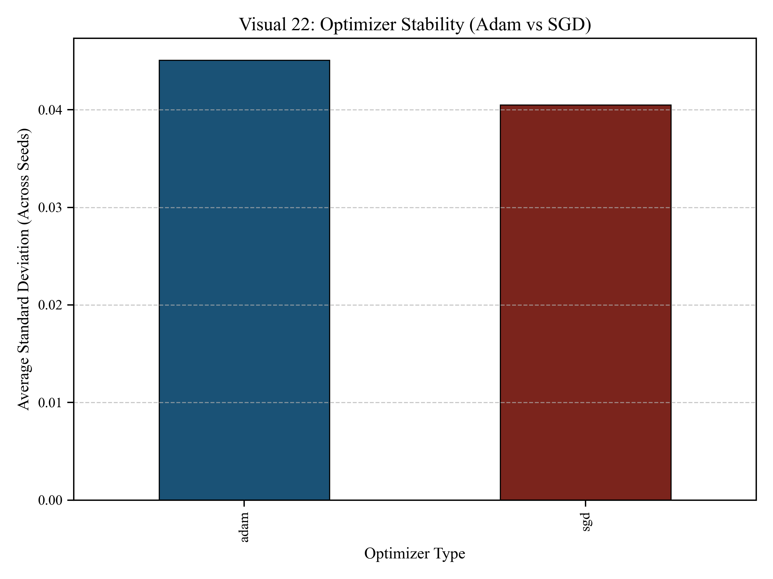
21 / 25
Optimizer & Activation Sensitivity
Figure14 : Optimizer Stability
CONCLUSION
Adam + Tanh wins for the AMZ champion — gradient stability matters under high seed-variance.
SGD competitive on AZS but no statistically significant lift over Adam.
Dropout 0.4 — high regularisation helps the small-sample BES regime.
ReLU collapsed several configurations to MC — inactive units on near-monotone targets.

Slide 22
22 / 25
Limitations & Reporting
Sample size
Pooled vs Mean
~260 weekly observations across 5 years — small-sample variance dominates.
Pooled accuracy (84.38 %) > 3-seed mean (80.21 %). Mean is the headline; pooled is fully disclosed.
Single market
Cost-aware loss
TEFAS only; cross-market transfer to NASDAQ/EuroStoxx left for future work.
Class_weight balancing applied, but not full asymmetric utility (e.g., max-drawdown-aware loss).

Slide 23
23 / 25
Conclusions
1D-CNN is more MC-resistant than LSTM
01
On AZS and AMZ, convolutional bias yields ~15 pp fewer collapsed configurations.
Risk profile = learnability ceiling
02
ALZ (low-risk) is monotone → 27/27 MC across both deep models. AMZ is the clearest signal.
Two statistically significant champions
03
AMZ LSTM (2,3) full → BA 84.86 %, p<0.0001 • AZS CNN (4,3) tech → BA 76.70 %, p=0.0002.
Reporting is non-negotiable
04
Mean accuracy as headline, pooled CM disclosed, MC defined broadly (Sens=0 OR Spec=0 OR Spec=NA).

Slide 24
24 / 25
References
[1]
Van der Burgt, J.J. (2023). Navigating trends in the digital era: NASDAQ-100 directional forecasting with deep learning. Tilburg University.
[7]
Appel, G. (2005). Technical Analysis: Power Tools for Active Investors. FT Press.
[2]
Hochreiter, S., & Schmidhuber, J. (1997). Long Short-Term Memory. Neural Computation, 9(8), 1735–1780.
[8]
Brock, W., Lakonishok, J., LeBaron, B. (1992). Simple technical trading rules and stochastic properties of stock returns. JoF, 47(5).
[3]
Kim, Y. (2014). Convolutional Neural Networks for Sentence Classification. EMNLP.
[9]
TEFAS (2026). Türkiye Elektronik Fon Alım Satım Platformu — pension fund daily NAV. https://www.tefas.gov.tr
[4]
Box, G., Jenkins, G. (1976). Time Series Analysis: Forecasting and Control. Holden-Day.
[10]
Allianz Yaşam ve Emeklilik (2026). BES fund prospectuses (ALZ, AZS, AMZ).
[5]
Hyndman, R., Athanasopoulos, G. (2021). Forecasting: Principles and Practice (3rd ed.). OTexts.
[11]
Chollet, F. (2021). Deep Learning with Python (2nd ed.). Manning.
[6]
Wilder, J. W. (1978). New Concepts in Technical Trading Systems. Trend Research.
[12]
Goodfellow, I., Bengio, Y., Courville, A. (2016). Deep Learning. MIT Press.

Slide 25

QUESTIONS & DISCUSSION
UYIK-2026 · Hacettepe University · Department of Actuarial Sciences

