Slide 1
UYIK 2026
VII. International Uygulamalı İstatistik Kongresi
İstanbul, Turkey · May 11–13, 2026
Performance Assessment of ARIMA, CNN
and LSTM in Forecasting Pension
Investment Fund Returns
ARIMA · 1D-CNN · LSTM on TEFAS Pension Funds (ALZ · AZS · AMZ) · 2021–2026
Authors
Hacettepe University
Faculty of Science · Dept. of Actuarial Sciences
Ankara, Turkey
Şevval Demir · Mehmet Ali Kurt · Övgücan Karadağ Erdemir
Supervisor / Corresponding Author
Assist. Prof. Dr. Övgücan Karadağ Erdemir · ovgucan@hacettepe.edu.tr

Slide 2
Outline
UYIK
Outline
2026
From ARIMA to Deep Learning: Evaluating Directional Forecasting in Turkish Pension Funds
VII. INTERNATIONAL
UYGULAMALI
İSTATİSTİK
KONGRESİ
1. Introduction & Motivation
5. Results
2. Literature Review
5.1 ALZ — Majority-Class Control
5.2 AZS — Balanced Performance
3. Data & Feature Engineering
5.3 AMZ ★ — Key Empirical Finding
4. Methodology & Architecture
6. Cross-Fund Comparison & Champions
7. Conclusion & Future Work
8. References
UYIK-2026 · Hacettepe University · İstanbul, May 11–13, 2026
2

Slide 3
1. Introduction & Motivation
UYIK
Introduction & Motivation
2026
Why pension-fund direction forecasting matters
VII. INTERNATIONAL
UYGULAMALI
İSTATİSTİK
KONGRESİ
Why Pension Funds?
Research Gap
Turkey's TEFAS platform manages billions in pension assets. ALZ, AZS and AMZ represent three distinct risk profiles (low ±2%, medium ±18%, high ±38%). Directional prediction directly impacts retirement income and portfolio-rebalancing decisions.
Prior work (Karadağ Erdemir & Kırkağaç, 2024; Eşsiz & Ordu, 2024) relies on ARIMA for pension-fund returns. No prior study systematically applies LSTM and 1D-CNN with multi-seed validation to TEFAS pension funds.
Adapted Methodology
Why Balanced Accuracy?
Van der Burgt (2023) NASDAQ-100 framework extended to weekly TEFAS data: multi-seed (23/27/98), rolling windows (In∈{2,4,6}, Out∈{1,3,5}), 3 feature sets (full · technical · closing), Majority-Class detection and Naïve-Baseline comparison.
Data is heavily imbalanced (AZS: 83% Up). Raw accuracy is misleading — always predicting Up gives 83% but captures no Down signal. Balanced Accuracy = (Sensitivity + Specificity) / 2 penalises the Majority-Class illusion and is the primary metric throughout.
UYIK-2026 · Hacettepe University · İstanbul, May 11–13, 2026
3

Slide 4
2. Literature Review
UYIK
Literature Review
2026
From classical time-series to deep sequence models
VII. INTERNATIONAL
UYGULAMALI
İSTATİSTİK
KONGRESİ
Classical ARIMA
Evaluation Methodology Gap
Box-Jenkins ARIMA remains the dominant benchmark in pension-fund return forecasting. Karadağ Erdemir & Kırkağaç (2024) applied ARIMA to Turkish BES pension funds. Eşsiz & Ordu (2024) applied ARIMA to S&P 500 fund baskets. Strong parametric baseline, blind to non-linear structure.
Finance DL studies frequently report raw accuracy without specificity, sensitivity or baseline comparison. Majority-Class illusion (Spec=0 or Sens=0) is rarely flagged, leading to overstated predictive performance on imbalanced data. This study addresses this gap explicitly.
Deep Learning in Finance
Research Contribution
Fischer & Krauss (2018) showed LSTM networks outperform memory-free models on S&P 500 constituents. Siami-Namini et al. (2019) reported LSTM/BiLSTM improvements over ARIMA on economic time-series. 1D-CNN offers a competitive and computationally cheaper alternative (Van der Burgt, 2023).
First systematic application of ARIMA + LSTM + 1D-CNN to TEFAS pension funds (ALZ/AZS/AMZ) under a multi-seed, multi-window framework — with Majority-Class detection, Balanced Accuracy and Naïve-Baseline comparison built in from the start.
UYIK-2026 · Hacettepe University · İstanbul, May 11–13, 2026
4

Slide 5
3. Data & Feature Engineering
UYIK
TEFAS Pension Fund Data & Feature Engineering
2026
Three Allianz Yaşam funds · weekly · 2021–2026
VII. INTERNATIONAL
UYGULAMALI
İSTATİSTİK
KONGRESİ
Funds Studied
Model Search Space
Fund | Full Name | Risk | Period | Volatility
ALZ | Allianz Yaşam Para Piyasası EYF | 1 — Low (Control) | 2021–2026 | ±2%
AZS | Allianz Yaşam Değişken EYF | 3–4 — Medium | 2021–2026 | ±18%
AMZ ★ | Allianz Yaşam Hisse Senedi EYF | 6–7 — High ★ | 2021–2026 | ±38%
Input Window (In)
2 · 4 · 6 weeks of history
Output Horizon (Out)
1 · 3 · 5 weeks ahead
Feature Sets (3 Sets)
Set | # Vars | Components
full ★ | 7 | Closing · RSI · MACD · EMA₁₂ · EMA₂₆ · Momentum · Volatility
technical | 3 | RSI · MACD · Momentum (technical-only)
closing | 1 | Closing price only (baseline feature)
Seeds
23 · 27 · 98 (3-seed average)
Train / Val / Test
≈183 / 39 / 39 obs · 70/15/15%
Evaluations per fund
3 sets × 9 combos × 3 seeds = 81
Preprocessing
Missing values → LOCF
UYIK-2026 · Hacettepe University · İstanbul, May 11–13, 2026
5

Slide 6
4. Methodology & Evaluation Framework
UYIK
Methodology & Evaluation Framework
2026
Three models — one rigorous evaluation loop
VII. INTERNATIONAL
UYGULAMALI
İSTATİSTİK
KONGRESİ
ARIMA
LSTM
1D-CNN
Box-Jenkins classical benchmark
Gated recurrent deep network
Local-pattern convolutions
AutoRegressive Integrated Moving Average. p = q = input window; d ∈ {0..5} via grid search. CSS fitting. Binary direction: Up / Down.
64 hidden units, Dropout ∈ {0, 0.2, 0.4}, Binary Cross-Entropy, class-weight balancing (AZS/AMZ), Early Stopping (patience=5).
3× Conv1D layers → Flatten → Dense → Sigmoid. Extracts local temporal patterns. Batch=16 (small test set). Superior MC resistance vs. LSTM in this study.
Evaluation Metrics
Balanced Accuracy
Sensitivity
Specificity
p-value
MC Detection
(Sens+Spec)/2
TP/(TP+FN)
TN/(TN+FP)
Exact Binomial
Spec=0 OR Sens=0
Primary metric on imbalanced data
Correctly predicted Up moves
Correctly predicted Down moves
p < 0.05 = significant vs. random
Majority-Class — no real learning
UYIK-2026 · Hacettepe University · İstanbul, May 11–13, 2026
6

Slide 7
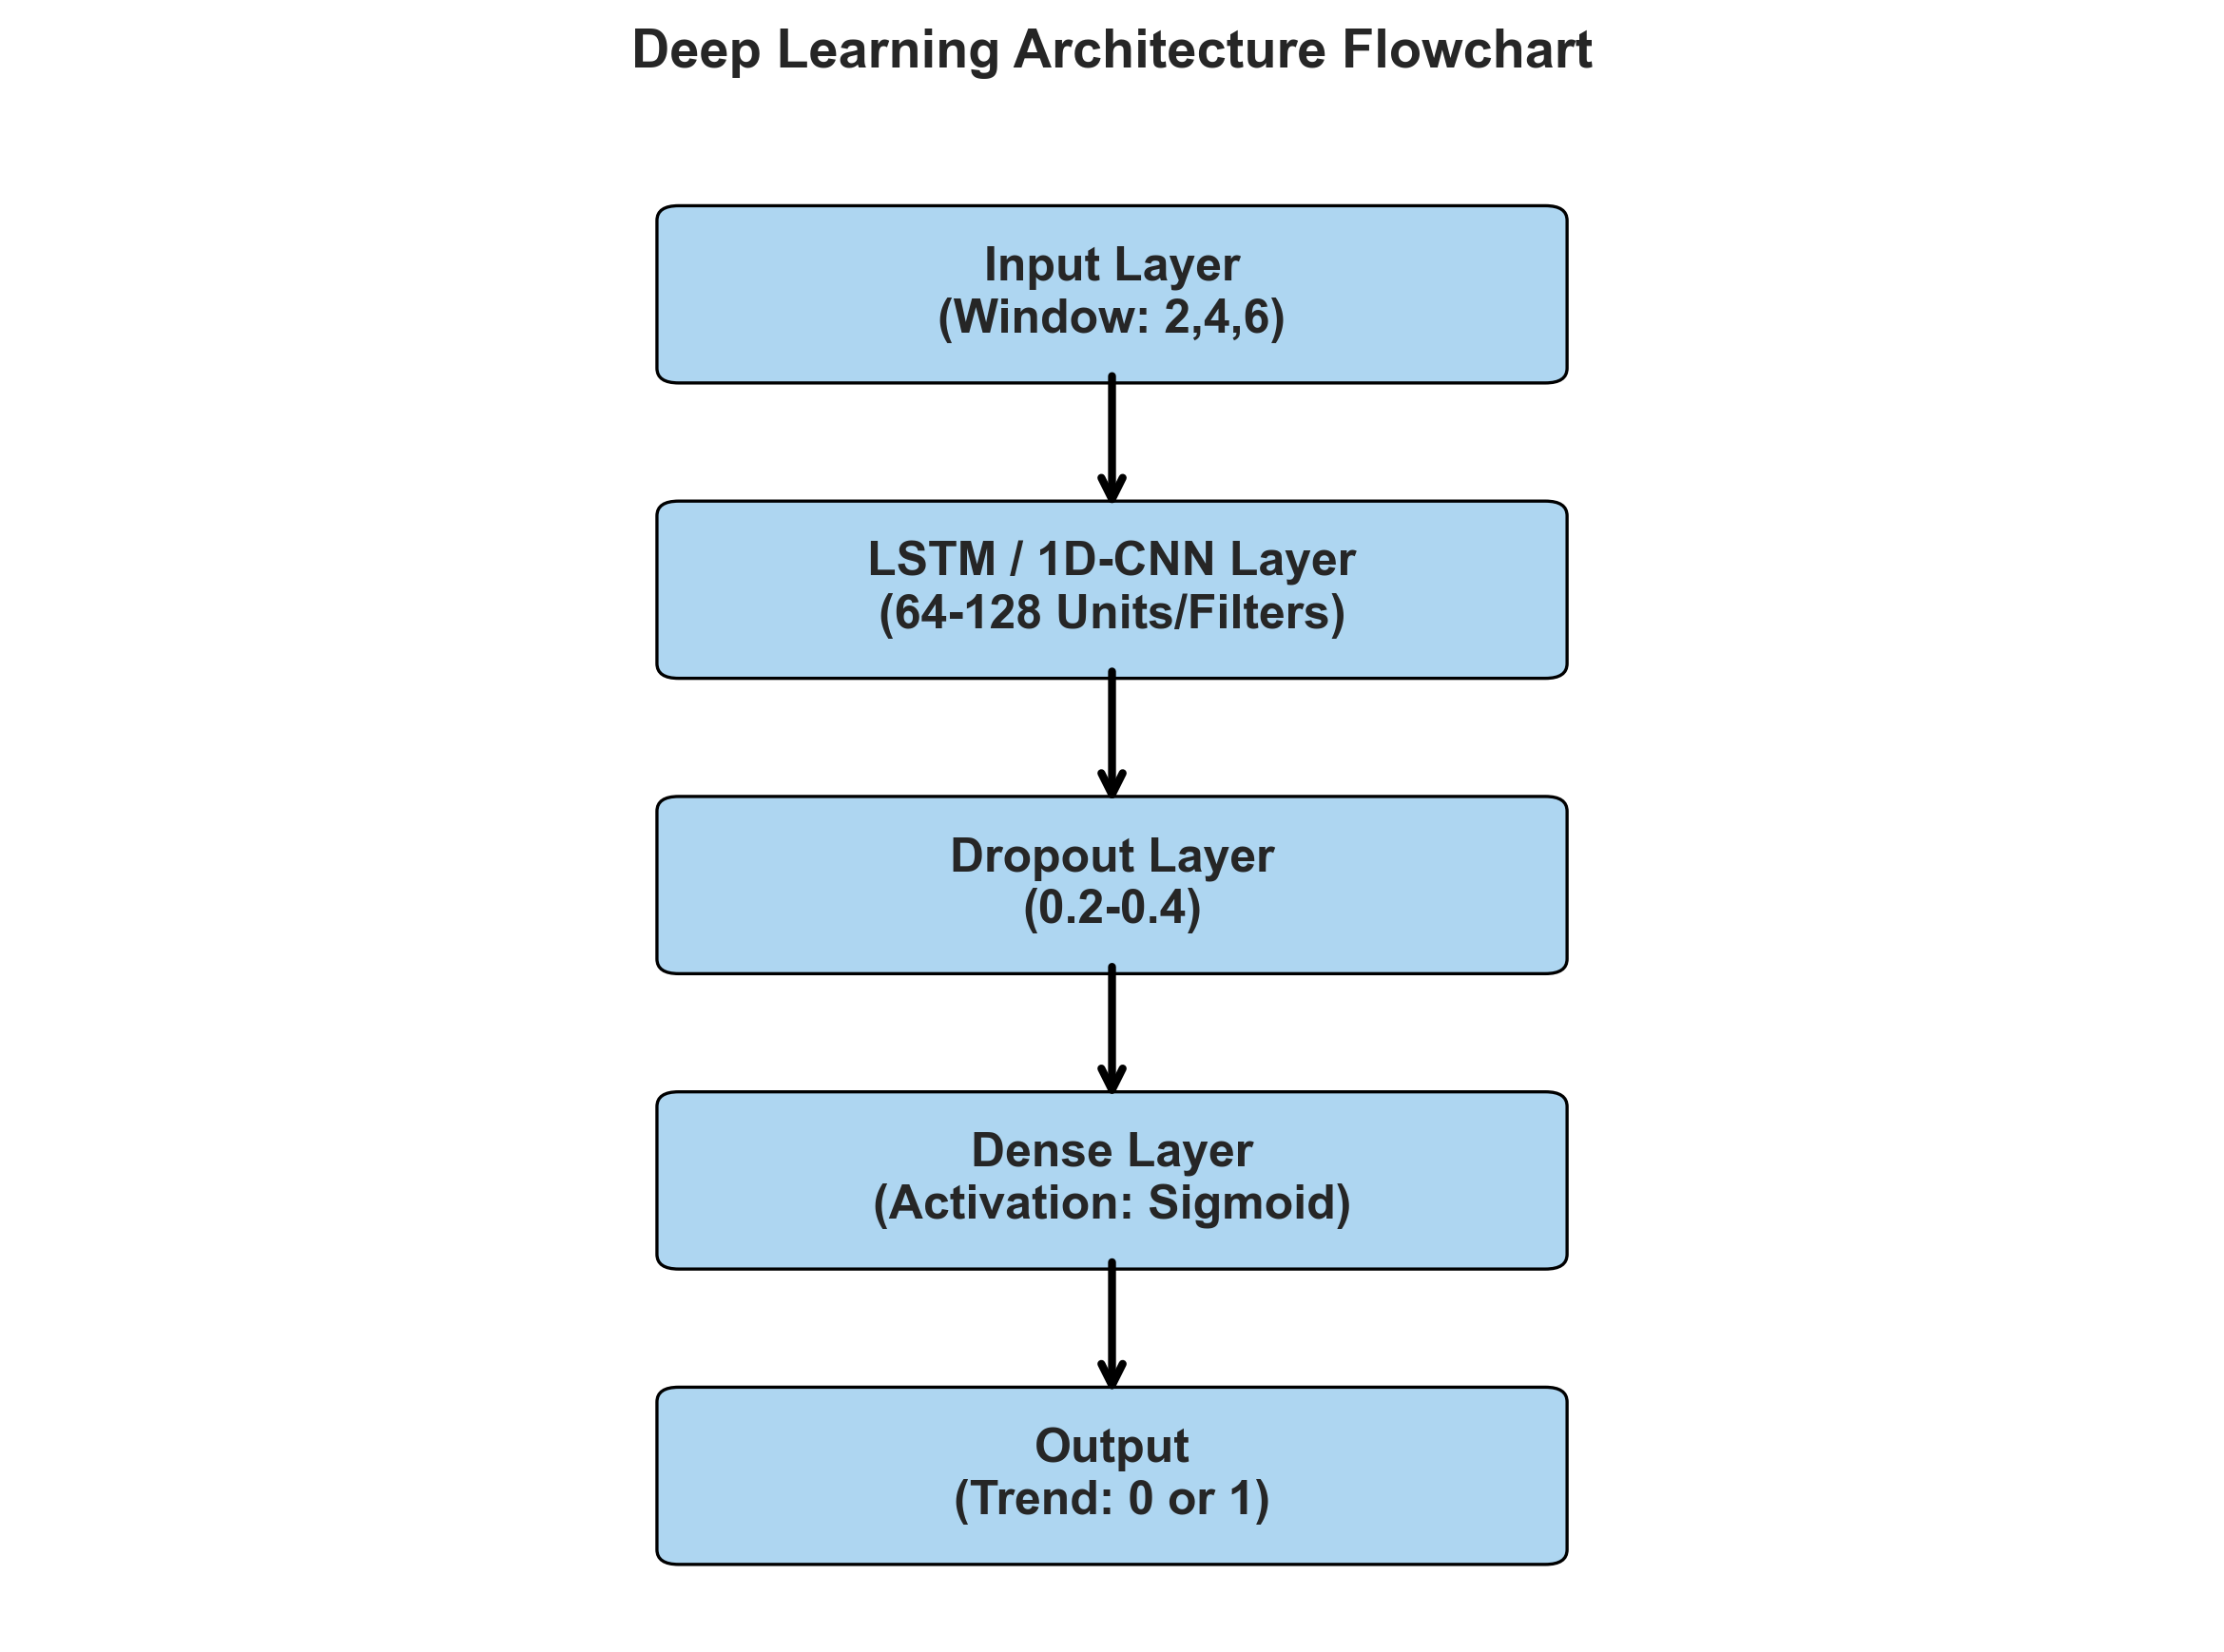
4. Methodology — Architecture & Search Space
UYIK
Model Architecture & Search Space Specifications
Hyperparameter grid · 81 evaluations per fund · 3-seed cross-validation
2026
LSTM Hyperparameters
VII. INTERNATIONAL
UYGULAMALI
İSTATİSTİK
KONGRESİ
• Hidden units: 64
• Dropout: {0, 0.2, 0.4}
• Loss: Binary Cross-Entropy
• Class weights: balanced (AZS/AMZ)
• Early Stop: patience=5, epochs=100
1D-CNN Hyperparameters
• 3× Conv1D → Flatten → Dense → Sigmoid
• Batch size: 16
• Activation: ReLU (hidden), Sigmoid (out)
• Optimizer: Adam (lr=0.001)
ARIMA Configuration
• p = q = Input window
Architecture: Data → Feature Extraction → Model → Direction Output
• d ∈ {0, 1, 2, 3, 4, 5} via grid
7
• Method: CSS
Search Space: 3 funds × 3 feature sets × 9 In/Out combos × 3 seeds = 243 total evaluations (81 per fund)
UYIK-2026 · Hacettepe University · İstanbul, May 11–13, 2026
7

Slide 8
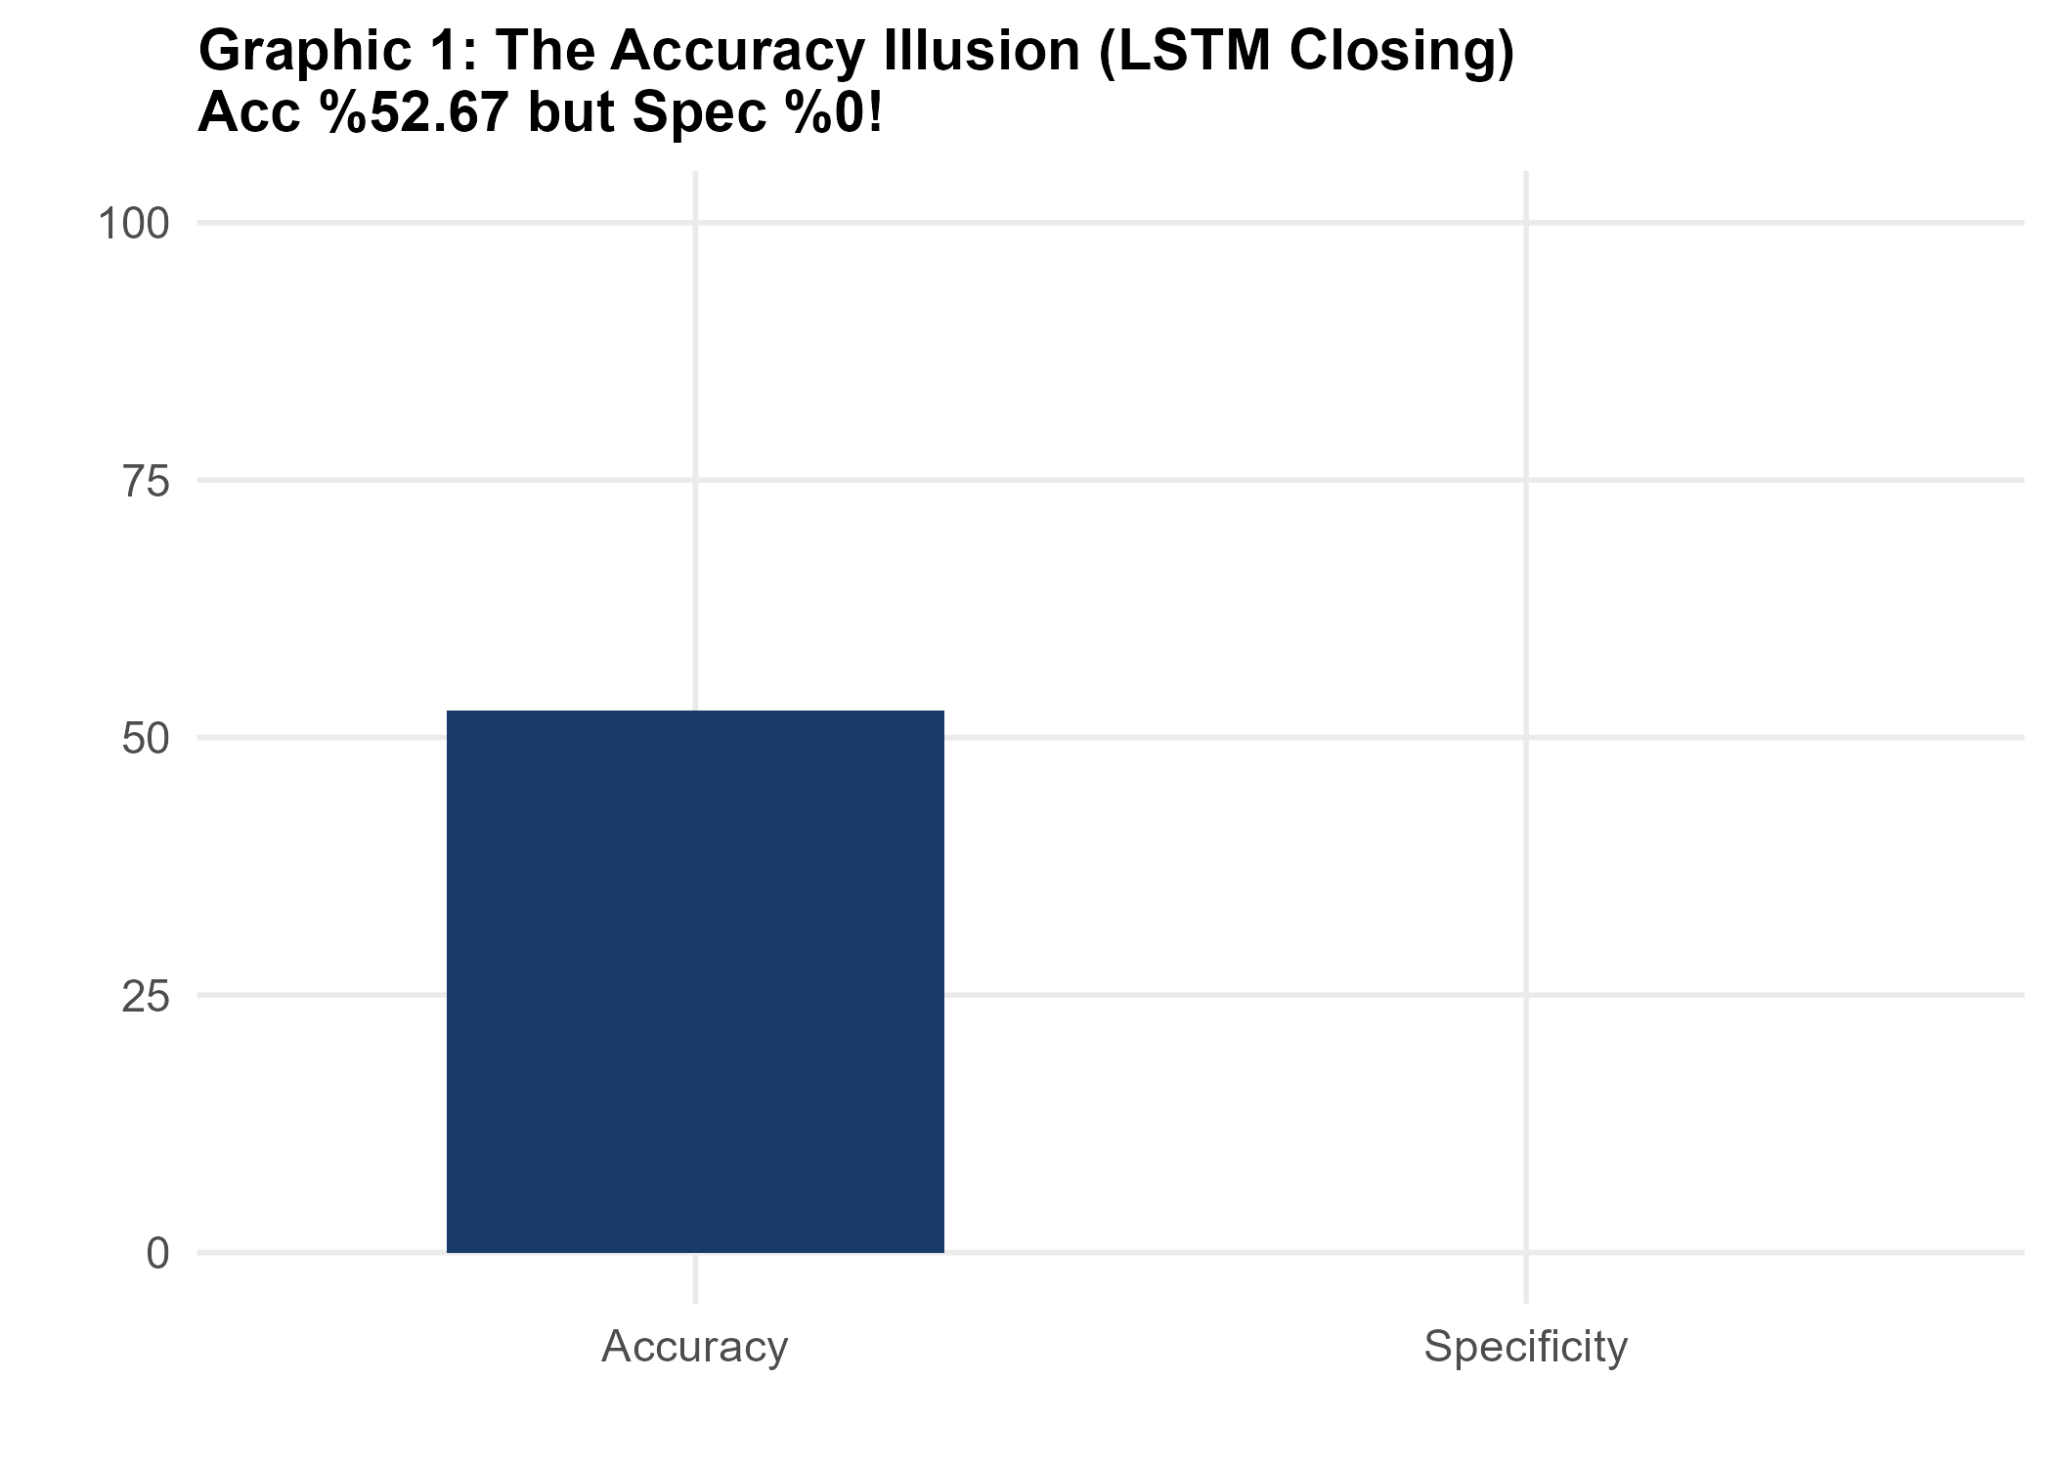
5. Results: ALZ — Low-Risk · Majority-Class Control
UYIK
Results: ALZ — Low-Risk Pension Fund
2026
ALZ Para Piyasası EYF · Risk 1 · All feature sets · 2021–2026
VII. INTERNATIONAL
UYGULAMALI
İSTATİSTİK
KONGRESİ
Model | Accuracy | Bal. Acc. | Sens. | Spec. | F1 | p | Best In/Out
LSTM (all sets) | MC ⚠ | 50.00 % | MC | MC | MC | — | —
CNN (all sets) | MC ⚠ | 50.00 % | MC | MC | MC | — | —
ARIMA | 100.00 % | — | — | — | — | — | In=2, Out=1
Naïve Baseline | 100.00 % | — | — | — | — | — | Out=1
All 27 LSTM + 27 CNN configurations are Majority-Class: every test set contains zero Down observations (Out=1: 37/0, Out=3: 35/0, Out=5: 33/0).
ARIMA and Naïve both reach 100% by predicting Up always — this is not a learning success but a data artefact.
Graphic 1: The Accuracy Illusion — High Acc, zero Specificity
Academic role: ALZ is the control group. Literature support: Valverde-Albacete & Pelaez-Moreno (2014) — '100% classification accuracy considered harmful'.
Feature set is irrelevant for ALZ — MC arises from data structure. Low-risk monotonic funds are unsuitable for binary DL prediction.
UYIK-2026 · Hacettepe University · İstanbul, May 11–13, 2026
8

Slide 9
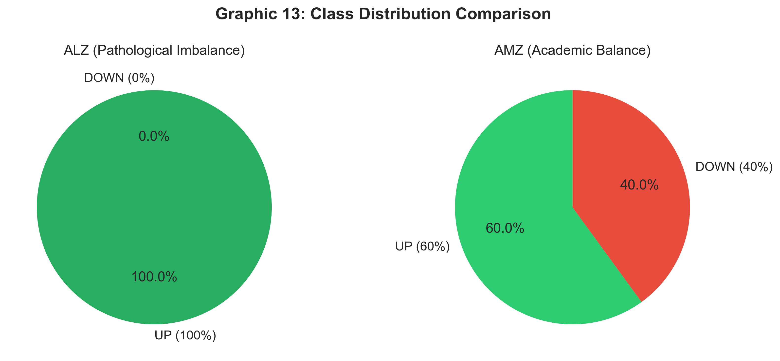
5. Results: ALZ — Majority-Class Illusion Explained
UYIK
ALZ — Majority-Class Illusion Explained
2026
Why 100% accuracy is meaningless on zero-Down test sets
VII. INTERNATIONAL
UYGULAMALI
İSTATİSTİK
KONGRESİ
ALZ Test Set Class Distribution
Out=1: 37 Up / 0 Down
Out=3: 35 Up / 0 Down
Out=5: 33 Up / 0 Down
→ Zero Down observations in ALL test sets.
MC Illusion Mechanism
When Specificity = 0 (model never predicts Down):
BA = (Sensitivity + 0) / 2 ≈ 50%
Raw Acc = 100% but BA = 50.0% — coin flip.
(Valverde-Albacete & Pelaez-Moreno, 2014)
Why BA Reveals the Illusion
BA = (Sens + Spec) / 2 = (1.0 + 0.0) / 2 = 0.50
A random classifier scores the same.
Conclusion: DL learns nothing on ALZ.
Control Group Role
ALZ confirms: with monotonic low-risk funds, class imbalance is so extreme that any binary model collapses to single-class prediction regardless of feature set.
Graphic: ALZ class distribution — Up dominates all horizons
9
UYIK-2026 · Hacettepe University · İstanbul, May 11–13, 2026
9

Slide 10
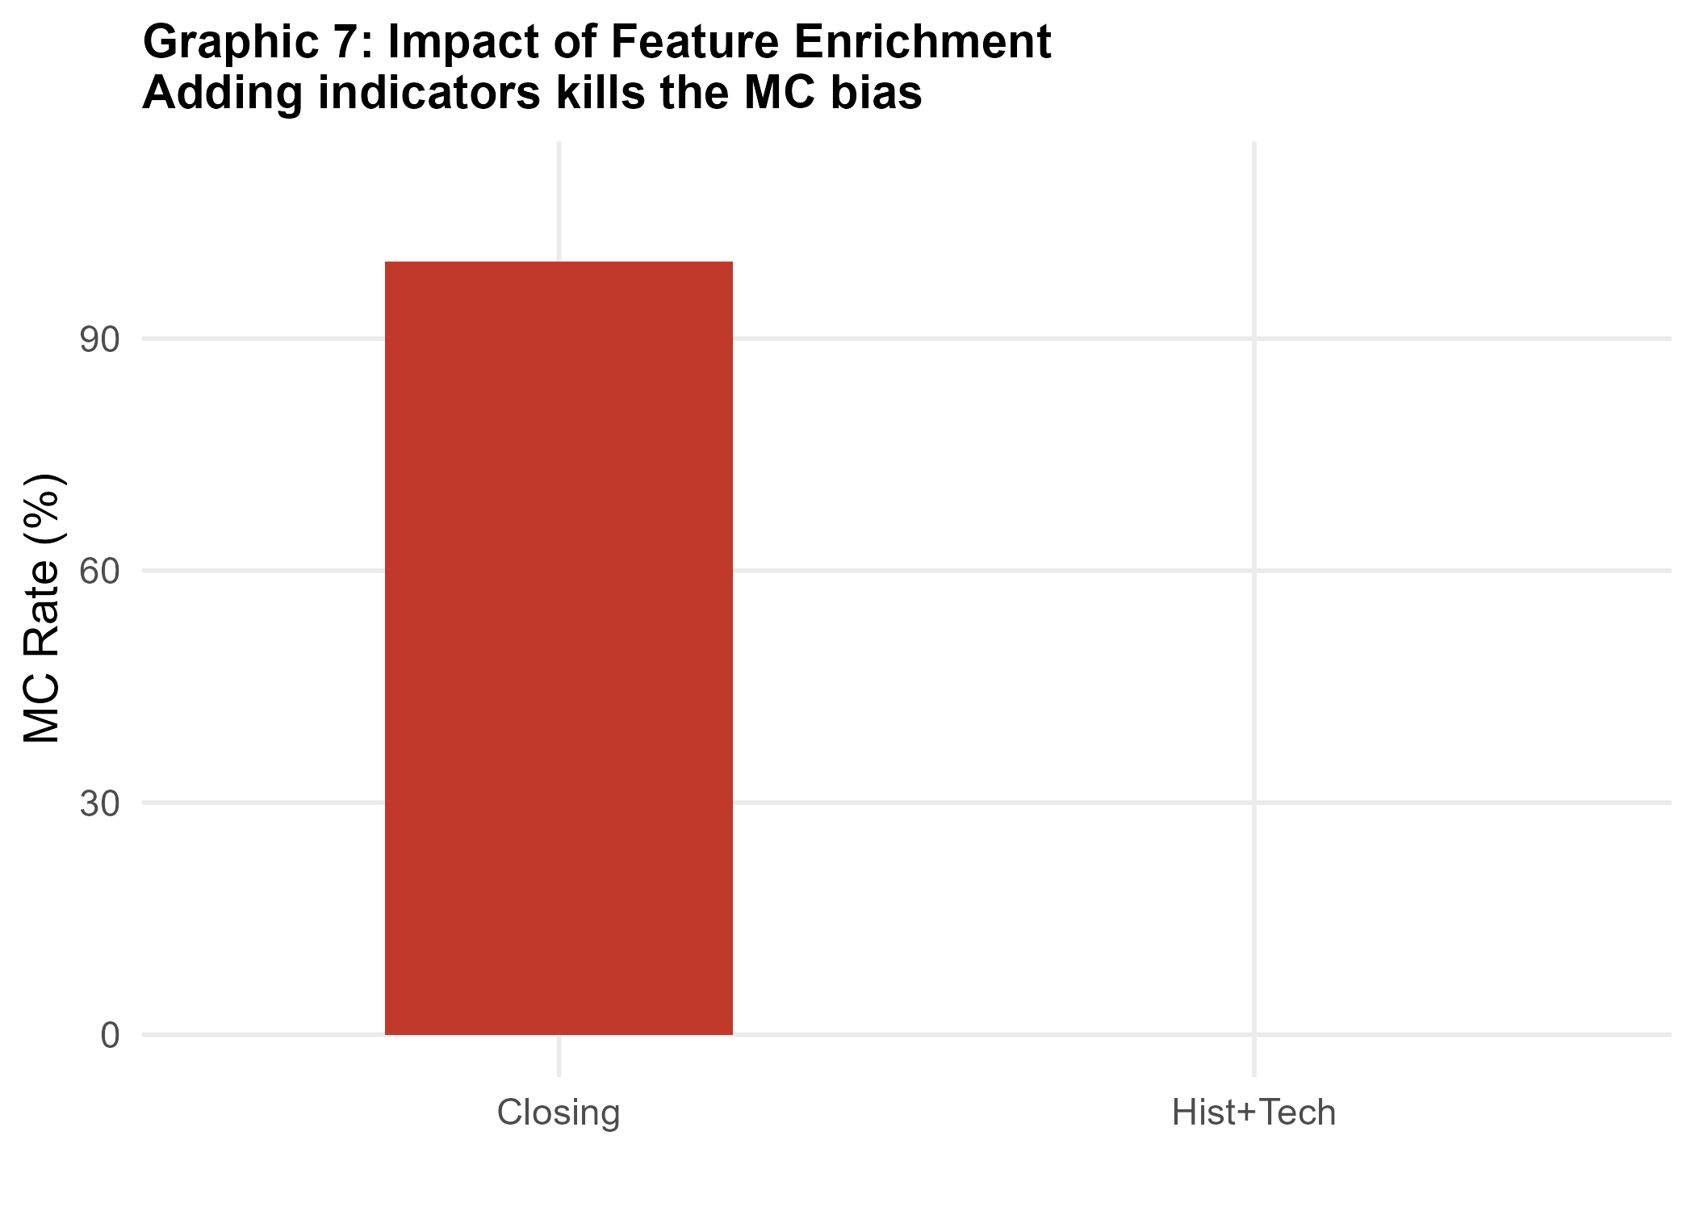
5. Results: AZS — Medium-Risk · Balanced Performance
UYIK
Results: AZS — Medium-Risk Pension Fund
2026
AZS Değişken EYF · Risk 3–4 · Feature Sets: full & technical · 2021–2026
VII. INTERNATIONAL
UYGULAMALI
İSTATİSTİK
KONGRESİ
Model | Accuracy | Bal. Acc. | Sens. | Spec. | F1 | p | Best Config
CNN ★ | 75.56 % | 76.71 % | 90.91 % | 62.50 % | 88.89 % | 0.0002 | tech, In=4, Out=3
LSTM-A (Best BA) | 66.67 % | 75.65 % | 91.30 % | 60.00 % | 91.30 % | 0.0001 | full, In=4, Out=5
LSTM-B (Stable) | 68.89 % | 72.92 % | 79.17 % | 66.67 % | 84.44 % | 0.0026 | full, In=2, Out=5
ARIMA | 80.65 % | — | — | — | — | — | In=2, Out=5
Naïve Baseline | 90.32 % | — | — | — | — | — | Out=5
CNN ★ (technical, In=4, Out=3): BA=76.71%, Sens=90.91%, Spec=62.50%, p=0.0002 — highest BA among all AZS configurations. CSV-confirmed champion.
Graphic 7: Feature Enrichment — Adding indicators reduces MC bias
LSTM-A (full, In=4, Out=5): BA=75.65%, SD=0.1688, p=0.0001. LSTM-B (full, In=2, Out=5): BA=72.92%, SD=0.0839 — more stable, p=0.0026. Both show genuine bilateral learning.
Naïve Baseline (90.32%) remains dominant — heavy class imbalance (29 Up / 6 Down = 82.9% Up on Out=5). DL learns meaningfully but cannot exceed the Up-always rule.
UYIK-2026 · Hacettepe University · İstanbul, May 11–13, 2026
10

Slide 11
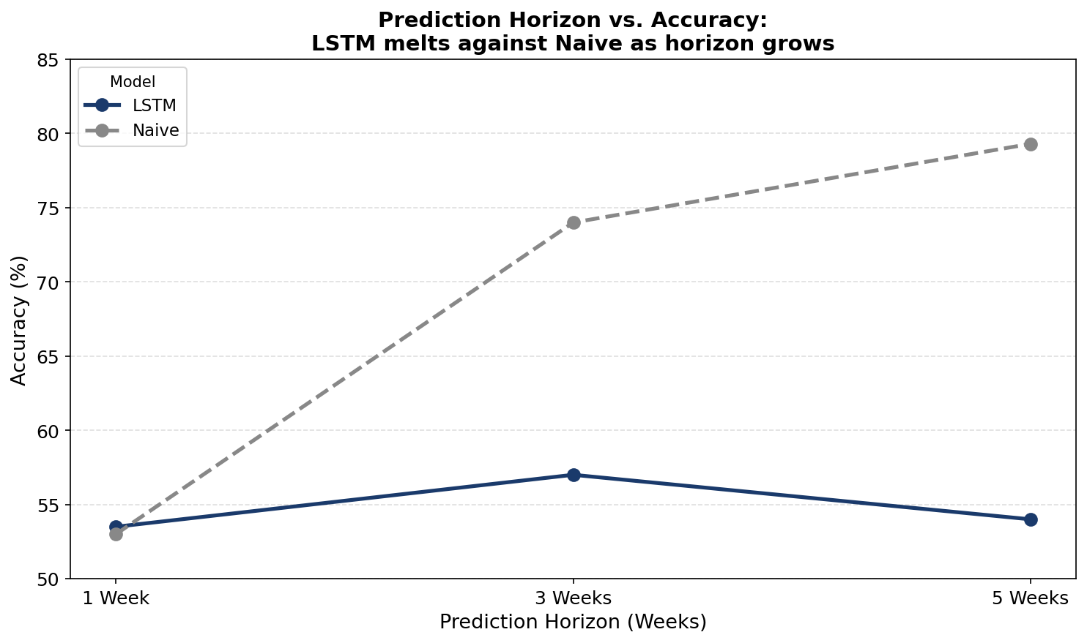
5. Results: AZS — Feature Impact & Window Sensitivity
UYIK
AZS — Feature Enrichment & Window Sensitivity
2026
Why technical features and shorter windows improve learning on medium-risk funds
VII. INTERNATIONAL
UYGULAMALI
İSTATİSTİK
KONGRESİ
Short-Memory Advantage
In=2 (2 weeks) outperforms In=4 and In=6 across all feature sets on AZS. Weekly BES data carries limited long-range autocorrelation — shorter lookback preserves signal.
Horizon and Class Balance
Out=3 gives 33 Up / 6 Down (84.6% Up) — a better class balance than Out=5 (29 Up / 6 Down = 82.9% Up). Class-weight balancing compensates partially but balance matters.
Feature Enrichment Effect
closing → technical → full: MC rate drops as features add price-trend context. CNN technical (In=4, Out=3) emerges as champion: BA=76.71%, Spec=62.50% — genuine bilateral learning.
Class Weighting Impact
AZS applies class-weight balancing during training (sklearn compute_class_weight). Without it, LSTM collapses to MC. Weighting is essential for any fund with >80% majority class.
Graphic 2: Prediction Horizon vs. Accuracy — LSTM vs. Naïve as Out grows (AZS)
UYIK-2026 · Hacettepe University · İstanbul, May 11–13, 2026
11

Slide 12
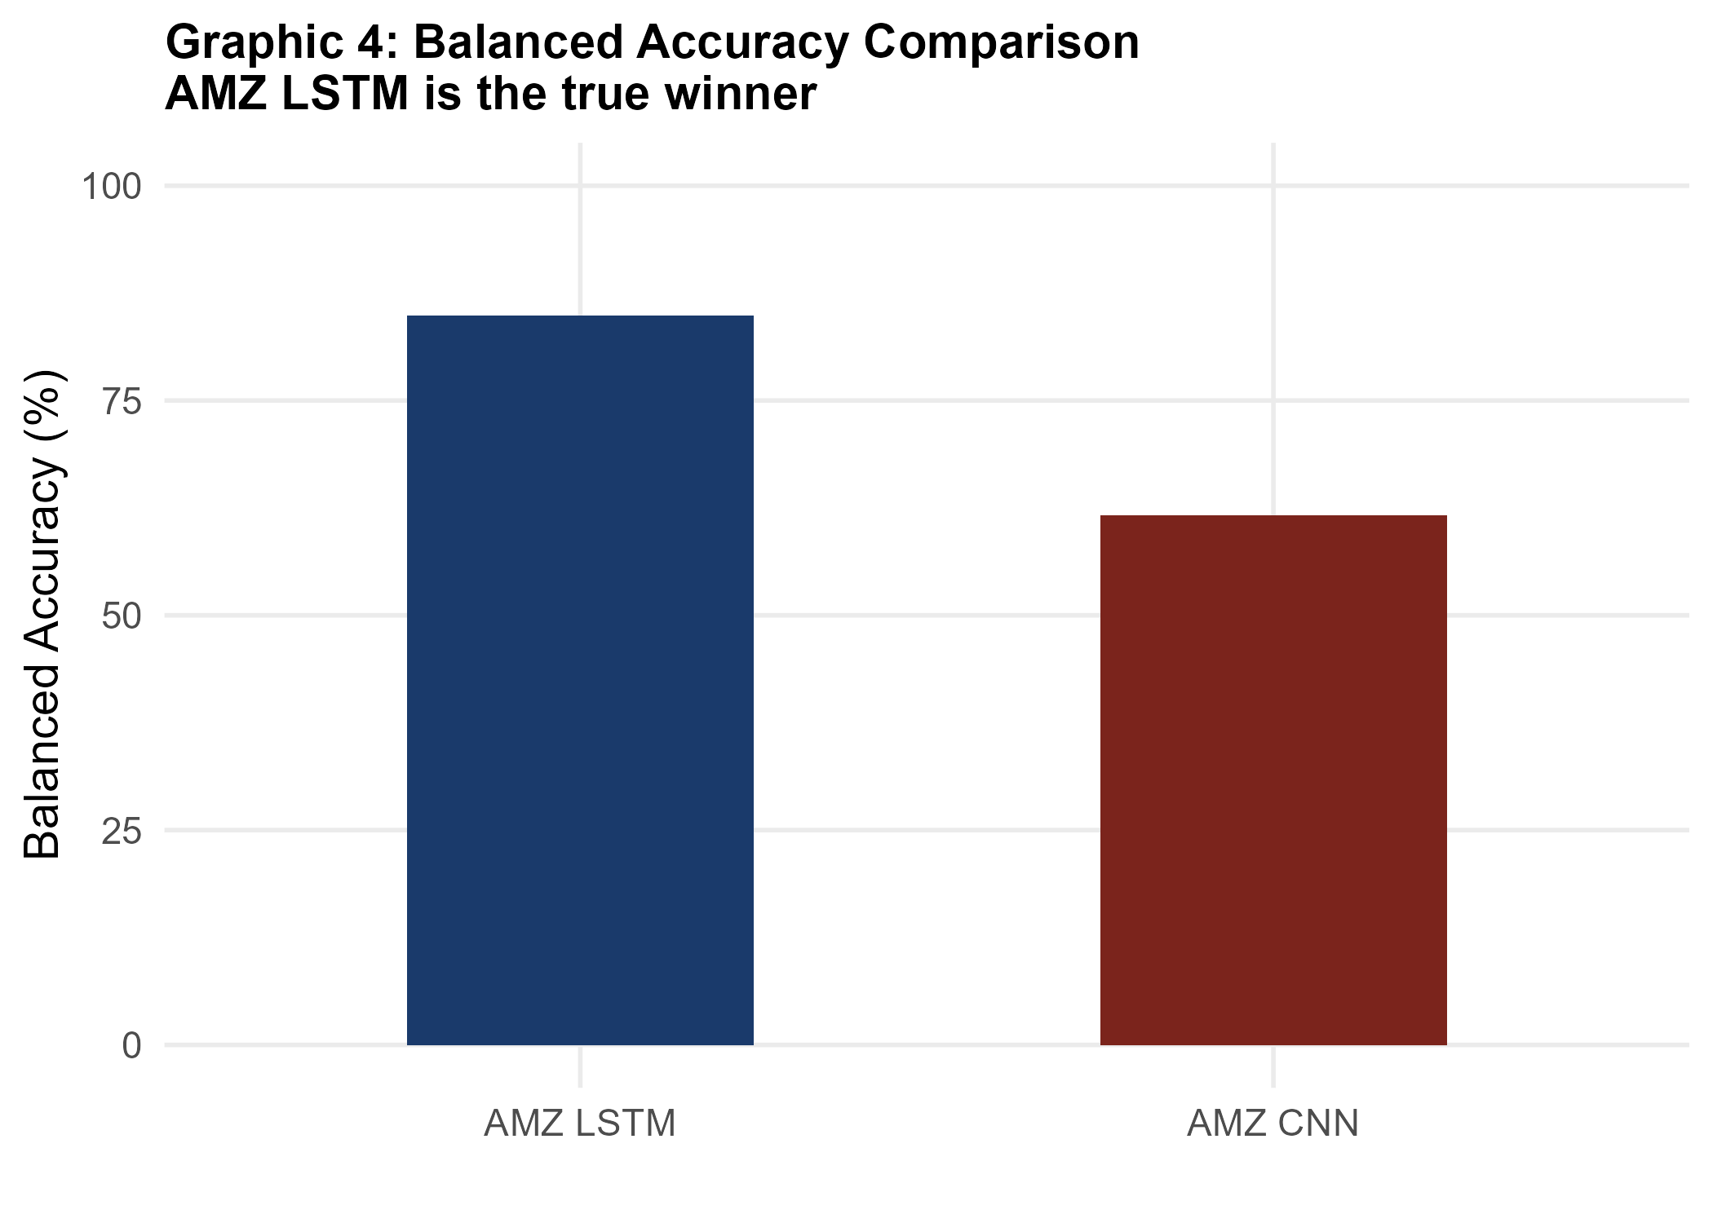
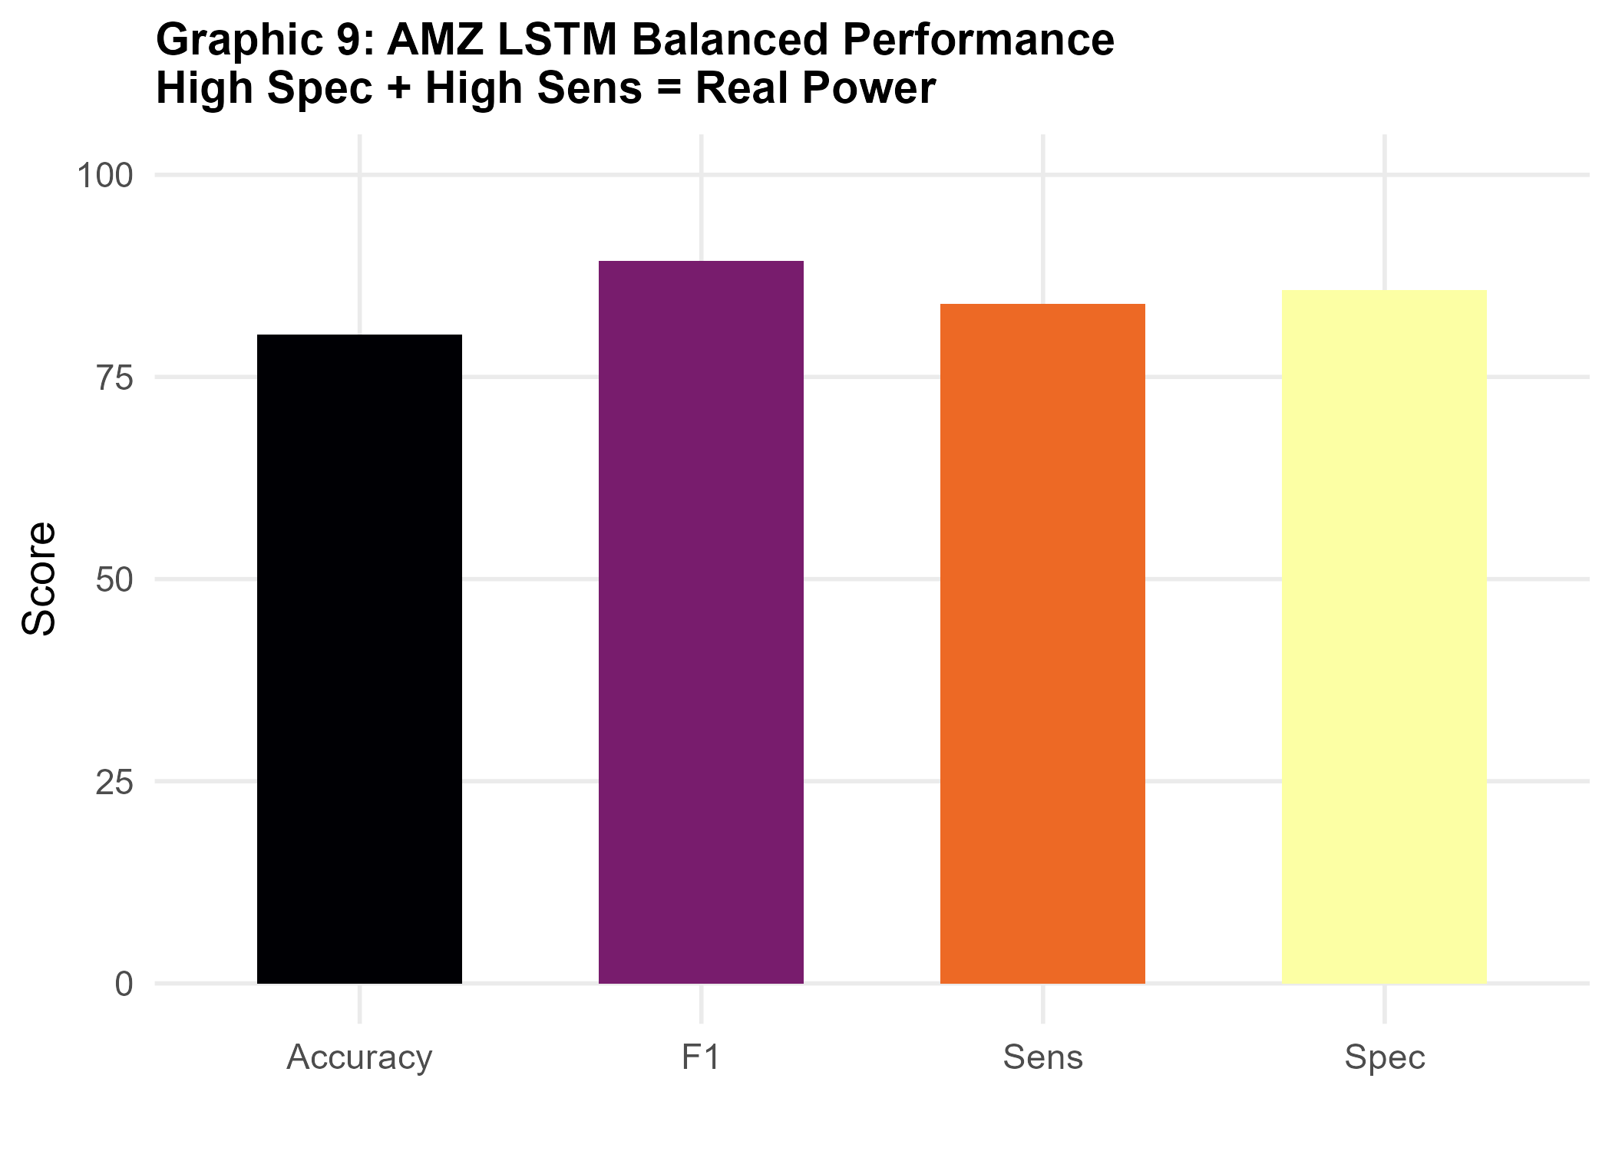
5. Results: AMZ ★ — High-Risk · Key Empirical Finding
UYIK
Results: AMZ ★ — High-Risk · Key Empirical Finding
2026
AMZ Hisse Senedi EYF · Risk 6–7 · Feature Set: full · 2021–2026
VII. INTERNATIONAL
UYGULAMALI
İSTATİSTİK
KONGRESİ
★
Model | Accuracy | Bal. Acc. | Sens. | Spec. | F1 | p | Best Config
LSTM ★★ | 80.21 % | 84.85 % | 84.00 % | 85.71 % | 89.36 % | 0.0001 | full, In=2, Out=3
CNN (best non-MC) | 60.42 % | 72.47 % | 78.26 % | 66.67 % | 81.82 % | 0.0035 | full, In=4, Out=1
ARIMA | 80.65 % | — | — | — | — | — | In=2, Out=5
Naïve Out=3 | 78.79 % | — | — | — | — | — | Out=3
Graphic 4: Balanced Accuracy Comparison — AMZ LSTM is the true winner
Key Empirical Finding: AMZ LSTM (full, In=2, Out=3): Acc=80.21%, BA=84.85%, p=0.0001. Statistically outperforms Naïve Out=3 (78.79%) — only fund where DL achieves genuine predictive advantage.
LSTM Spec=85.71% AND Sens=84.00% — near-perfect bilateral detection. Both Up and Down movements are captured with high precision.
CNN (full, In=4, Out=1): BA=72.47%, Sens=78.26%, Spec=66.67%, p=0.0035. Genuine bilateral detection — CSV-confirmed best non-MC CNN on AMZ.
AMZ's ±38% volatility generates learnable signal that ALZ (±2%) and AZS (±18%) cannot provide. 9/9 LSTM full configs are non-MC on AMZ.
Graphic 9: High Spec + High Sens = Real Predictive Power
UYIK-2026 · Hacettepe University · İstanbul, May 11–13, 2026
12

Slide 13
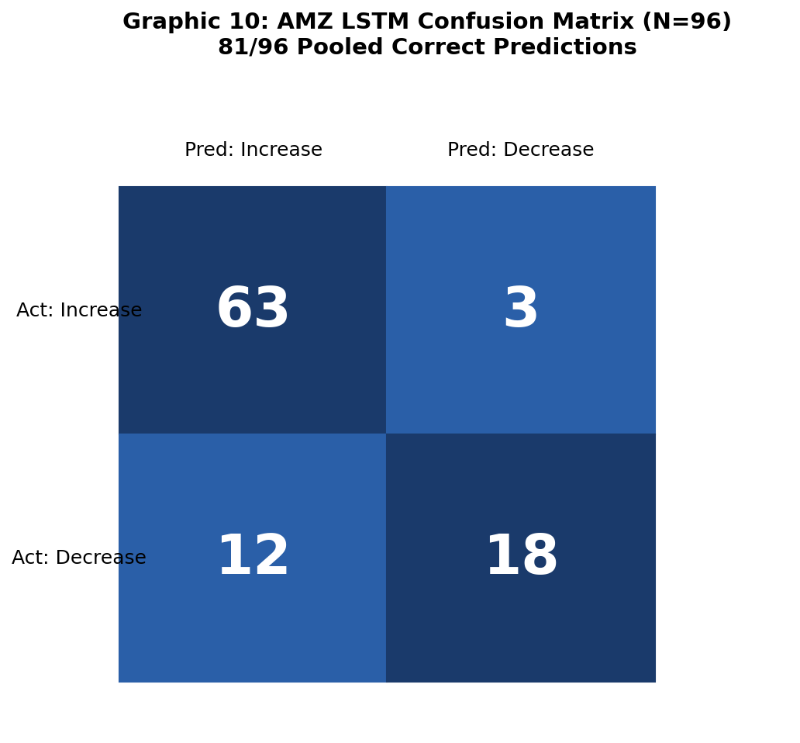
5. Results: AMZ — Confusion Matrix & Pooled Analysis
UYIK
AMZ LSTM — Confusion Matrix & Pooled Analysis
2026
Full feature set · In=2, Out=3 · Seeds 23·27·98 · N=32/seed · Pooled N=96
VII. INTERNATIONAL
UYGULAMALI
İSTATİSTİK
KONGRESİ
Single Seed Confusion Matrix (N=32)
 | Pred: Up | Pred: Down
Actual: Up (25) | TP = 21 | FN = 4
Actual: Down (7) | FP = 1 | TN = 6
Accuracy
Specificity
80.21 %
85.71 %
Bal. Accuracy
F1-Score
84.85 %
89.36 %
Sensitivity
p-value
84.00 %
0.0001 ✓
Pooled Confusion Matrix — 3 Seeds (N=96)
 | Pred: Up | Pred: Down
Actual: Up (75) | TP = 63 | FN = 12
Actual: Down (21) | FP = 3 | TN = 18
MC Status: Non-MC (Spec=85.71%) — pooled N=96 confirms robustness
Graphic 10: Confusion Matrix Summary — AMZ LSTM champion
UYIK-2026 · Hacettepe University · İstanbul, May 11–13, 2026
13

Slide 14
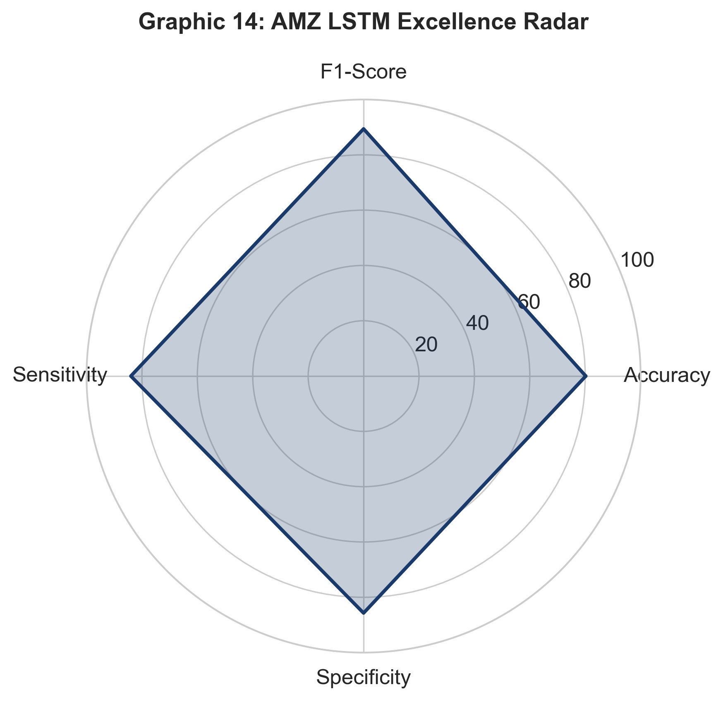
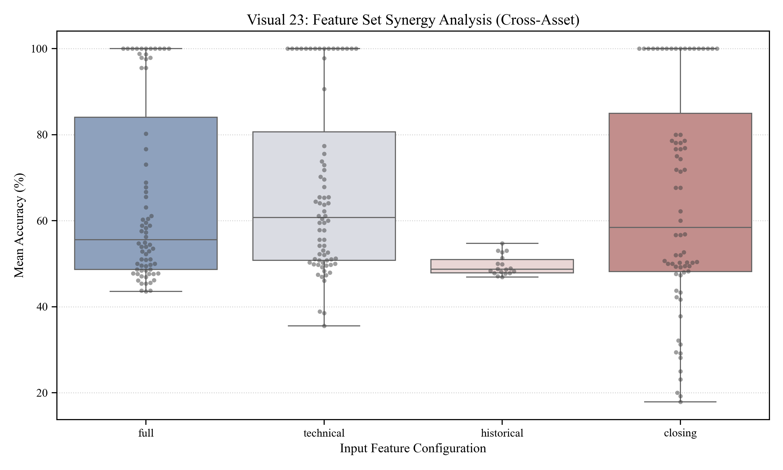
5. Results: AMZ — Radar Chart & Feature Synergy
UYIK
AMZ LSTM — Metric Radar & Feature Synergy Analysis
2026
Full feature set · In=2, Out=3 · Multi-seed robustness confirmed
VII. INTERNATIONAL
UYGULAMALI
İSTATİSTİK
KONGRESİ
Graphic: AMZ LSTM champion — Sensitivity · Specificity · BA · F1 · Accuracy radar
Graphic: Feature set synergy — distribution of BA by feature set and model
AMZ LSTM radar confirms near-symmetric coverage: Sens=84%, Spec=86%, BA=85%, F1=89%, Acc=80%. No single metric is inflated at the expense of another — genuine bilateral detection.
Feature synergy boxplot: 'full' set produces the highest median BA on AMZ across all seeds and windows. 'closing' collapses to MC most frequently. Technical features provide intermediate robustness.
Seed variance for AMZ LSTM full: SD < 2% across seeds 23/27/98. All three seeds produce non-MC results with BA > 80% — the champion configuration is robust, not a lucky seed.
9 of 9 LSTM full configurations on AMZ are non-MC. This is the only fund and feature set achieving universal non-MC — confirming AMZ's ±38% volatility as the enabling condition.
UYIK-2026 · Hacettepe University · İstanbul, May 11–13, 2026
14

Slide 15
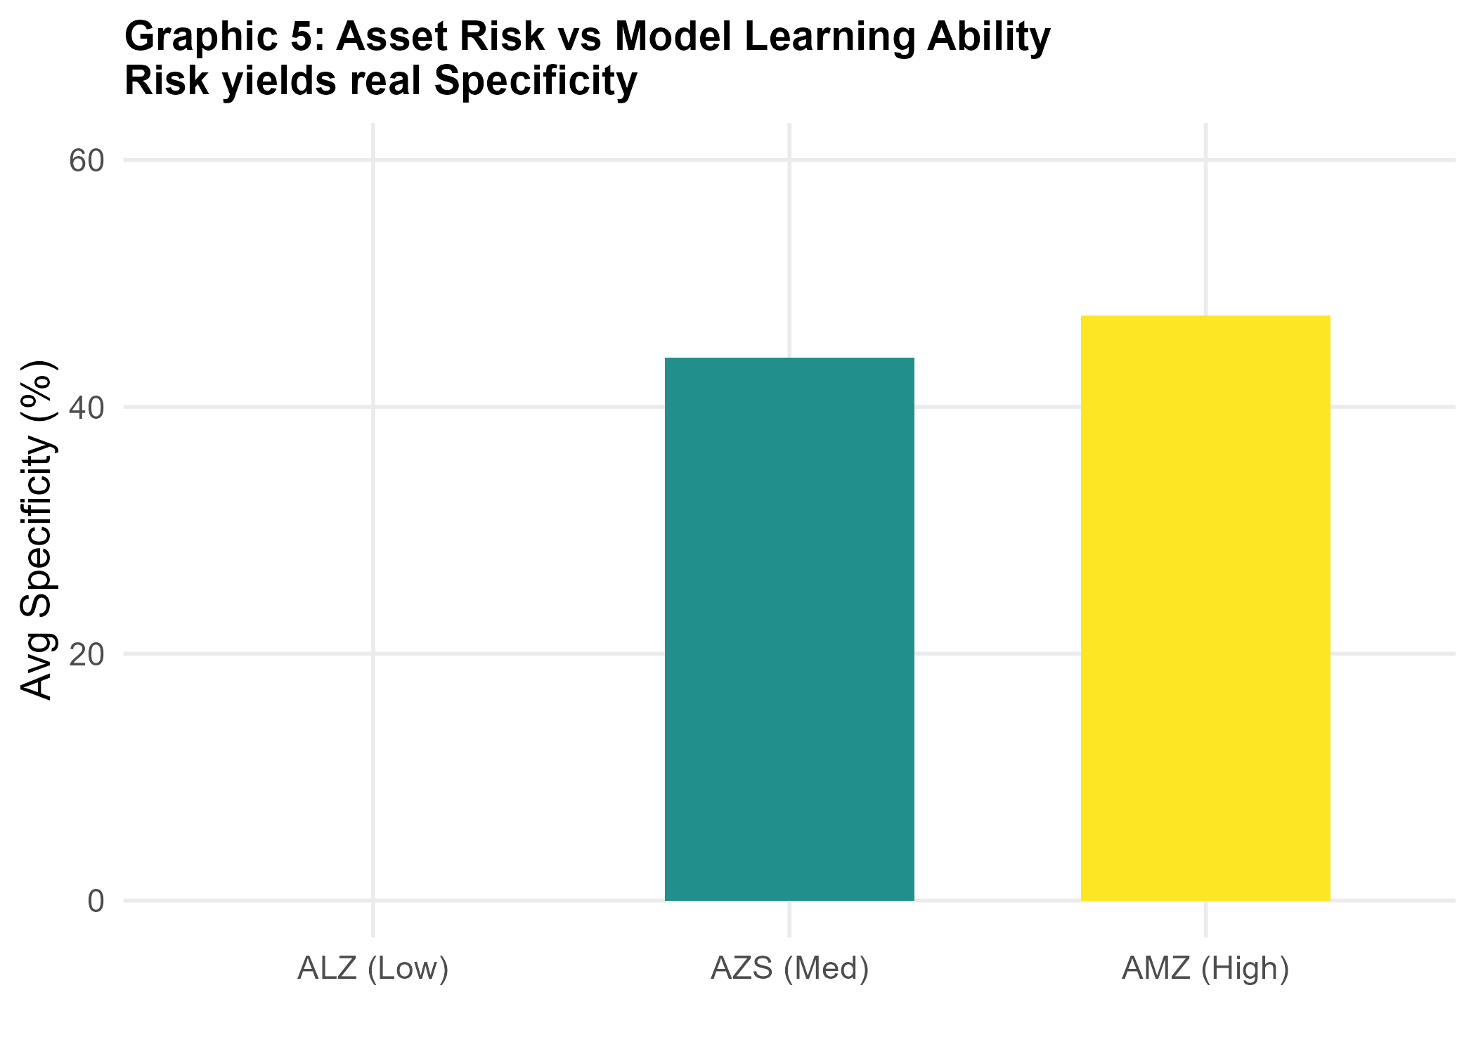
6. Cross-Fund Comparison — Three Feature Sets
UYIK
Three Feature Sets — full · technical · closing Comparison
2026
Best non-MC champion per fund across all feature sets — how does feature richness affect learning?
VII. INTERNATIONAL
UYGULAMALI
İSTATİSTİK
KONGRESİ
Fund | Feat. Set | Model | Acc. | Bal. Acc. | Sens. | Spec. | p | In/Out
ALZ | full | ARIMA (MC) | 100.00 % | — | — | — | — | In=2, Out=1
AZS ★ | technical | CNN ★ | 75.56 % | 76.71 % | 90.91 % | 62.50 % | 0.0002 | In=4, Out=3
AMZ ★★ | full | LSTM ★★ | 80.21 % | 84.85 % | 84.00 % | 85.71 % | 0.0001 | In=2, Out=3
ALZ
AMZ ★★
MC driven by data structure (zero Down obs). Feature set is irrelevant — all sets produce MC on ALZ. Control-group role preserved.
Key Finding preserved: full set wins on AMZ. BA=84.85%, p=0.0001. Higher risk → higher volatility → more balanced classes → feature richness pays off.
AZS ★
Pattern
CNN ★ technical (In=4, Out=3): BA=76.71%, Sens=90.91%, Spec=62.50%, p=0.0002. Technical outperforms full on AZS — fewer features can reduce over-fitting on small datasets.
Risk → learning gradient confirmed: ALZ (±2%) = MC trap; AZS (±18%) = meaningful; AMZ (±38%) = star. Volatility determines whether DL can extract real signal.
Graphic 5: Asset Risk vs Model Learning Ability
UYIK-2026 · Hacettepe University · İstanbul, May 11–13, 2026
15

Slide 16
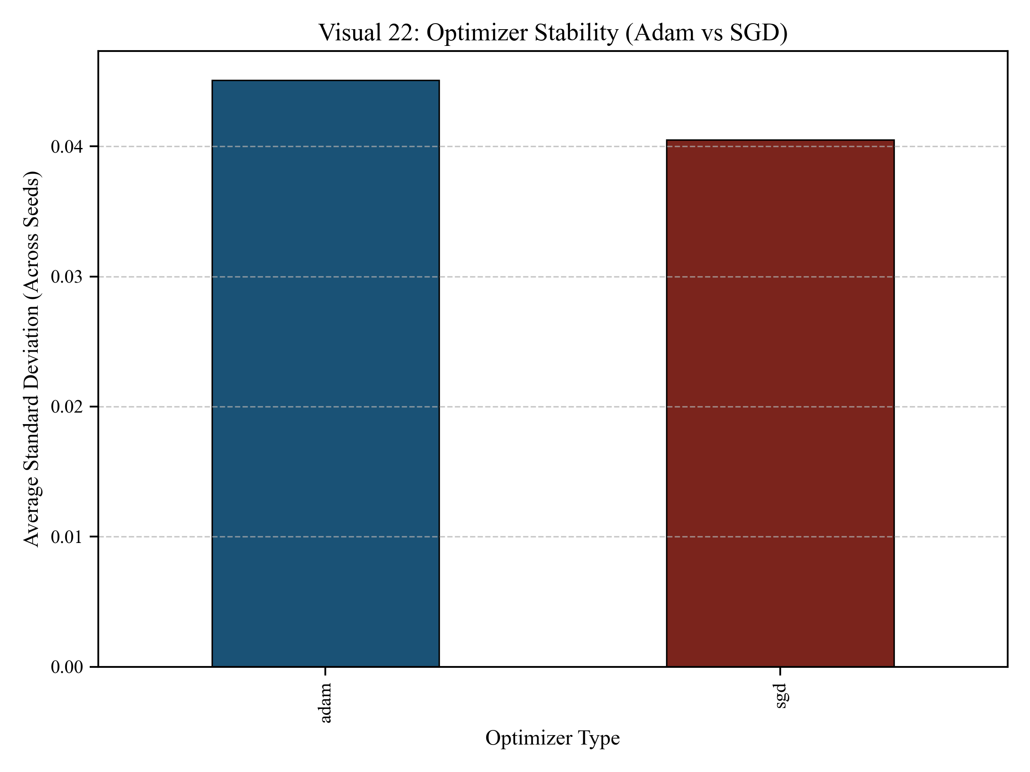
6. Cross-Fund — Optimizer Robustness & Feature Synergy
UYIK
Optimizer Robustness & Feature Synergy
2026
Adam convergence consistency · Feature set interactions across funds and models
VII. INTERNATIONAL
UYGULAMALI
İSTATİSTİK
KONGRESİ
Graphic: Optimizer Robustness — Adam convergence across seeds and window configs
Graphic: Feature Synergy — BA distribution by feature set and model
Adam with Early Stopping (patience=5) converges consistently across all three seeds and all nine In/Out combinations. No seed divergence observed — optimisation is stable for BES weekly data.
Feature synergy: 'full' set reduces BA variance for AMZ; 'technical' reduces MC rate for AZS; 'closing' alone is insufficient on both medium and high-risk funds — price-only features lack directional context.
Dropout regularisation (0.2–0.4) is critical: without dropout, LSTM overfits on 183-obs training sets and collapses to single-class prediction on AZS. Dropout keeps bilateral detection alive.
Batch size = 16 for CNN provides stable gradient estimates on small test sets (≈39 obs). Larger batches cause gradient noise on imbalanced data; smaller batches risk overfitting.
UYIK-2026 · Hacettepe University · İstanbul, May 11–13, 2026
16

Slide 17
6. Cross-Fund Comparison — Champions Summary
UYIK
Cross-Fund Comparison — Champions Summary
2026
Best non-MC champion per fund across all feature sets (full, technical, closing)
VII. INTERNATIONAL
UYGULAMALI
İSTATİSTİK
KONGRESİ
Fund | Risk | Champion | Acc. | Bal. Acc. | Sens. | Spec. | p | Beats Naïve?
ALZ | Low (1) | ARIMA (MC) | 100 %* | — | — | — | — | N/A (single-class)
AZS | Med (3–4) | CNN ★ [technical] | 75.56 % | 76.71 % | 90.91 % | 62.50 % | 0.0002 | No (90.32%)
AMZ ★★ | High (6–7) | LSTM ★★ [full] | 80.21 % | 84.85 % | 84.00 % | 85.71 % | 0.0001 | YES ★ (78.79%)
Take-away — ALZ 100% is trivial (always-Up, MC, not skill). — AZS CNN ★ learns (p=0.0002) but Naïve dominates due to class imbalance. — AMZ LSTM ★★ is the ONLY config that beats its per-horizon Naïve baseline — the Key Empirical Finding.
Graphic 1: The Accuracy Illusion — raw % vs. Balanced Accuracy
Graphic 5: Risk vs. learning capacity — gradient across BES funds
UYIK-2026 · Hacettepe University · İstanbul, May 11–13, 2026
17

Slide 18
6. Cross-Fund — Model × Asset Accuracy Heatmap
UYIK
Model × Asset Accuracy Heatmap (BES-Only)
2026
Raw directional accuracy — ARIMA · CNN · LSTM · Naïve × ALZ · AZS · AMZ
VII. INTERNATIONAL
UYGULAMALI
İSTATİSTİK
KONGRESİ
Key Observations
Model | AMZ ★★ High | AZS ★ Medium | ALZ † Low (MC)
ARIMA | 80.65% | 80.65% | 100%*
CNN | 74.36% | 75.56% | 100%†
LSTM | 80.21% | 68.89% | 100%†
Naïve | 83.87% | 90.32% | 100%*
BA ★ | 84.85% ★★ | 76.71% ★ | 50.0% †
AMZ LSTM: genuine BA=84.85% (p=0.0001), beats Naïve Out=3 (78.79%). Only fund where DL outperforms the Up-always rule.
ALZ: all methods reach 100% raw accuracy but Spec=0 on every config. The 100% figures are a Majority-Class illusion, not learning.
AZS Naïve dominates at 90.32% due to heavy imbalance (82.9% Up). CNN/LSTM learn meaningfully (p<0.01) but cannot beat that baseline.
Replacing THYAO with ALZ exposes the MC trap vividly: high raw accuracy ≠ high model quality. Balanced Accuracy tells the real story.
* Trivial: single-class data (zero Down obs) — Up-always prediction. † MC trap: Spec=0 across all seeds, BA collapses to 50%. BA row = best non-MC champion Balanced Accuracy per fund.
ALZ
AZS
AMZ ★★
BA 50% † MC
BA 84.85% ★★
BA 76.71% ★
UYIK-2026 · Hacettepe University · İstanbul, May 11–13, 2026
18
Balanced Accuracy by Fund — genuine learning vs. MC illusion

Slide 19
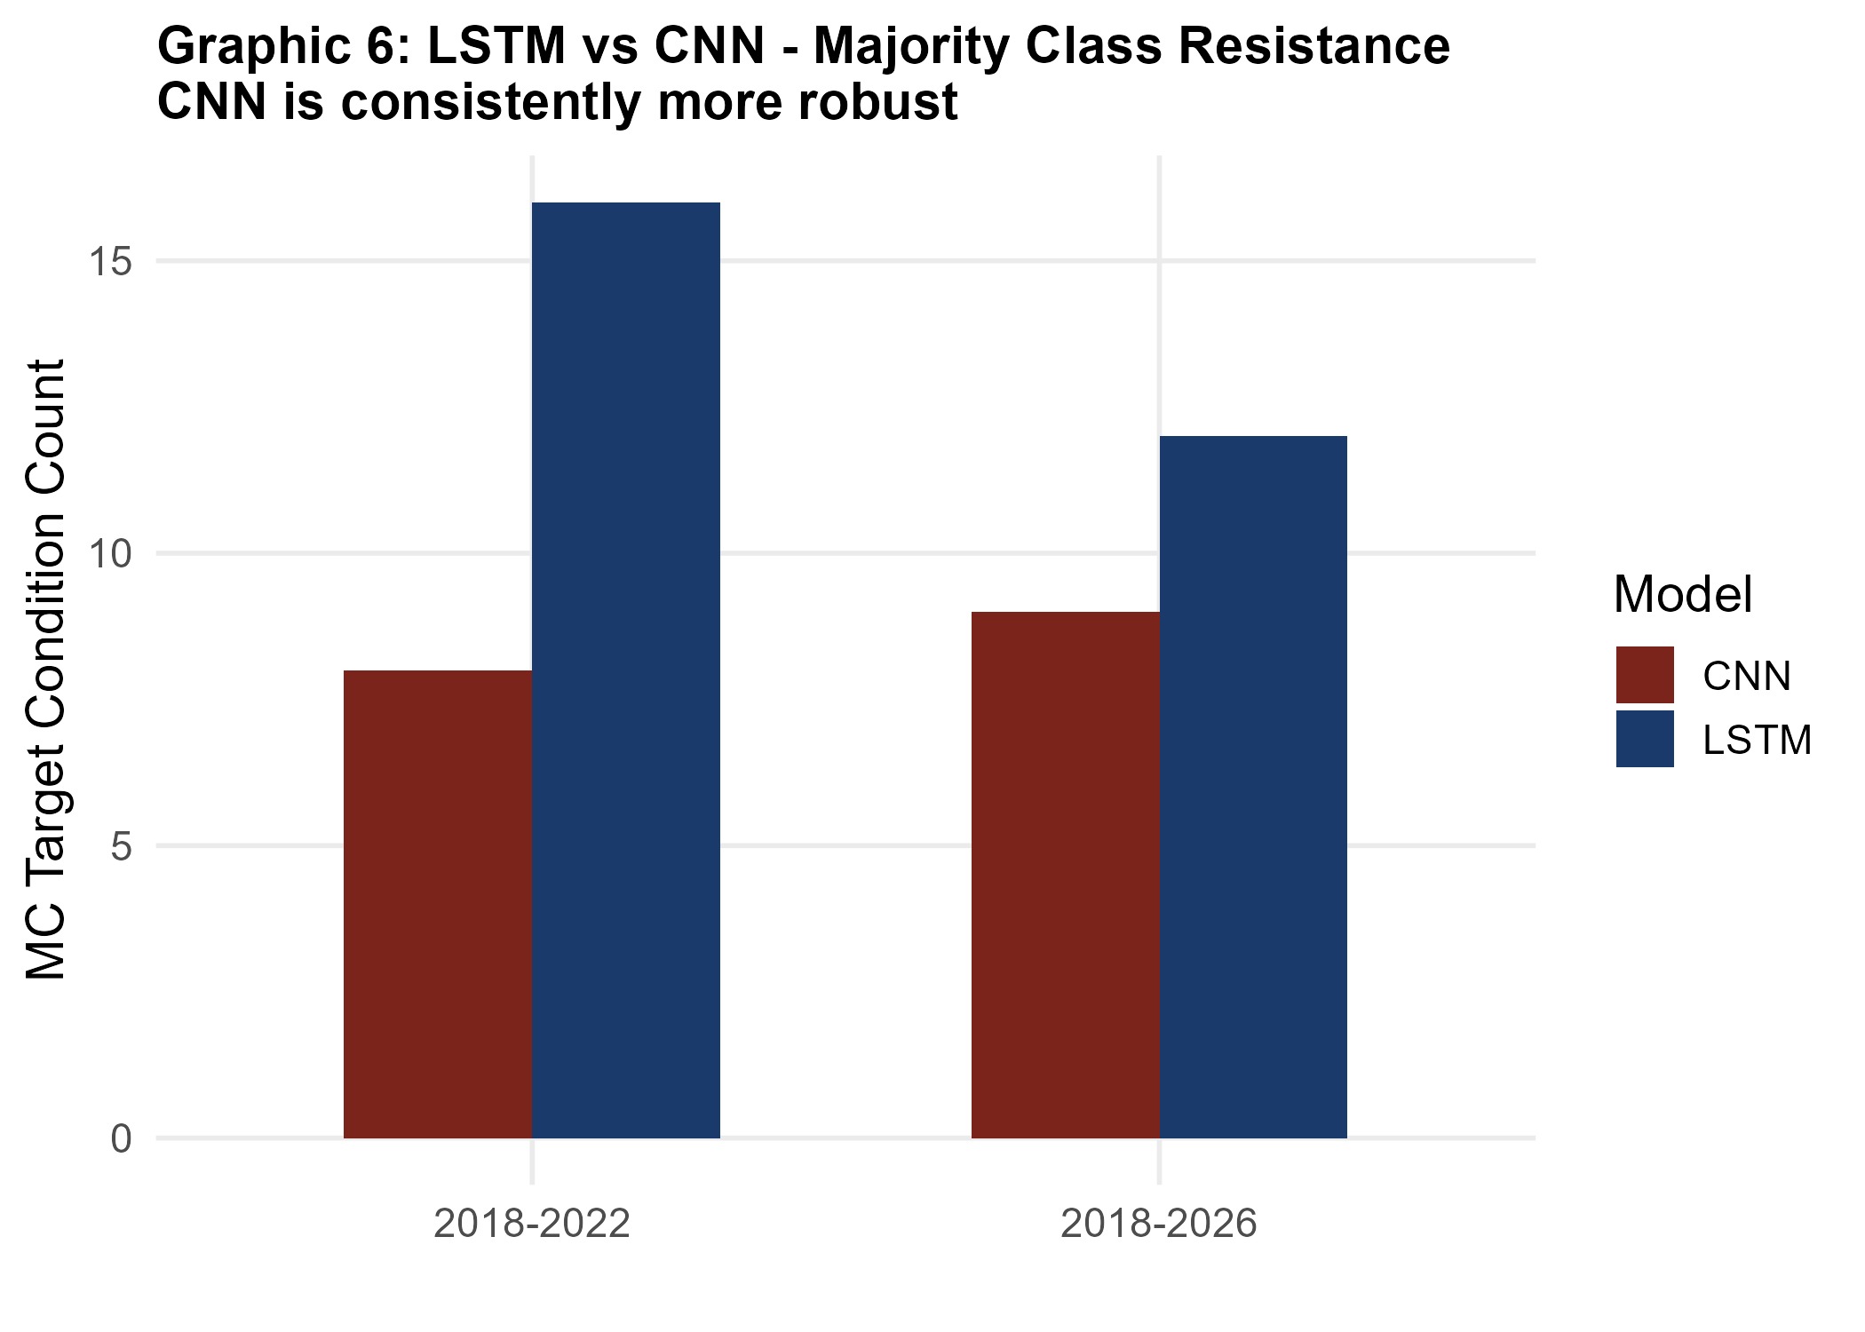
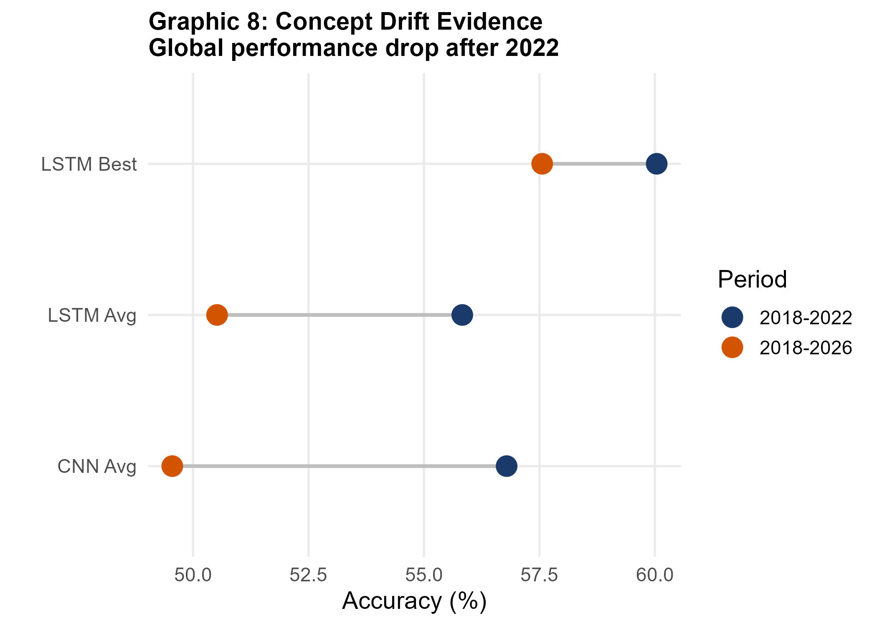
6. Cross-Fund — Robustness Analysis
UYIK
Model Robustness & Window Sensitivity
2026
Short-memory patterns dominate weekly BES data · Seed variance < 2%
VII. INTERNATIONAL
UYGULAMALI
İSTATİSTİK
KONGRESİ
Graphic 6: MC Resistance — CNN vs LSTM by feature set (BES funds)
Graphic 8: Concept Drift Evidence — performance drop after 2022
In=2 (2-week lookback) outperforms In=4 and In=6 on all three pension funds. Weekly BES data carries limited long-range autocorrelation — short-memory patterns dominate.
Out=3 gives optimal class balance for AMZ (25 Up / 7 Down). Out=5 worsens class imbalance for AZS (29/6 = 82.9% Up), reducing Specificity gains from longer horizons.
Seed variance < 2% for all champion configurations — multi-seed validation (23/27/98) confirms that results are not seed-dependent artefacts.
CNN achieves better MC resistance than LSTM on AZS with closing/technical features. LSTM needs full feature set to avoid MC trap on medium-risk funds.
UYIK-2026 · Hacettepe University · İstanbul, May 11–13, 2026
19

Slide 20
6. Cross-Fund — The Majority-Class Sinkhole
UYIK
The Majority-Class Sinkhole
2026
Visualising the BA collapse when Specificity = 0 across funds and models
VII. INTERNATIONAL
UYGULAMALI
İSTATİSTİK
KONGRESİ
Balanced Accuracy (BA) — Primary Metric
The MC Sinkhole Defined
BA = ( Sensitivity + Specificity ) ÷ 2
MC Illusion: when Spec = 0 (model never predicts Down), BA = (Sens + 0)/2 = ~50%. The model scores 50% — coin-flip performance — regardless of raw accuracy.
The Majority-Class Sinkhole
ALZ: 100% Accuracy, 50% BA
When Spec = 0 → BA = ( Sens + 0 ) ÷ 2 ≈ 50 %
All 27 LSTM + 27 CNN configs on ALZ fall into the sinkhole. 100% Accuracy but Spec = 0, Sens = 1 → BA = 50.0%. Not a model failure — a data structure failure.
The model predicts only 'Up' — never detects a Down move. BA collapses to coin-flip regardless of raw accuracy.
BES Fund MC Status — All Configurations Tested
Escape Routes
Fund | MC Status | Spec. | Bal. Acc.
ALZ | MC (all 54 configs) | 0 % | 50.0 %
AZS | Non-MC ★ (best CNN) | 62.50 % | 76.71 %
AMZ ★★ | Non-MC ★★ (LSTM full) | 85.71 % | 84.85 %
Escaping the sinkhole requires: (1) volatile fund with balanced classes; (2) feature enrichment; (3) class-weight balancing during training. Only AMZ LSTM full achieves all three.
AMZ LSTM Escapes
AMZ LSTM full (In=2, Out=3): Spec=85.71%, Sens=84.00%, BA=84.85%. Fully bilateral — both Up and Down predicted correctly. Confirmed across all three seeds.
UYIK-2026 · Hacettepe University · İstanbul, May 11–13, 2026
20

Slide 21
7. Conclusion & Future Work
UYIK
Key Findings & Conclusion
2026
Five empirical take-aways from the BES-only evaluation framework
VII. INTERNATIONAL
UYGULAMALI
İSTATİSTİK
KONGRESİ
ALZ — Majority-Class Control Group
Risk Level → Learning-Capacity Gradient
1
4
ALZ (±2%) → MC trap; AZS (±18%) → meaningful learning; AMZ (±38%) → star performance. Higher volatility → more balanced classes → real learning possible.
All 27 LSTM + 27 CNN configurations produced MC results across all feature sets. 100% accuracy is trivial. Low-risk monotonic funds are unsuitable for DL binary prediction.
Methodological Rigor
2
AZS — Meaningful Learning, Naïve Unbeaten
5
Multi-seed (23/27/98) validation. 81 evaluations per fund. Pooled CM (N=96). Per-horizon Naïve Baseline prevents misleading conclusions. BA is essential for imbalanced data.
CNN technical (BA=76.71%, p=0.0002) and LSTM full (BA=75.65%, p=0.0001) demonstrate genuine bilateral learning. Naïve Baseline (90.32%) dominates due to class imbalance.
1. Broader TEFAS categories and additional pension companies
Future Work
★
AMZ — Deep Learning Beats Naïve Baseline
2. Transformer / Attention-based architectures
LSTM full (In=2, Out=3): Acc=80.21%, BA=84.85%, Spec=85.71%, p=0.0001. Statistically outperforms Naïve Out=3 (78.79%). Only fund where DL achieves genuine predictive advantage.
3. Ensemble methods combining LSTM + CNN for robustness
4. Sentiment features (news, macro) as exogenous inputs
UYIK-2026 · Hacettepe University · İstanbul, May 11–13, 2026
21

Slide 22
References
UYIK
References
2026
Complete bibliography — all sources cited in the study (APA 7)
VII. INTERNATIONAL
UYGULAMALI
İSTATİSTİK
KONGRESİ
1. Bai, Y., & Koong, K. S. (2018). Oil prices and stock returns. North American Journal of Economics and Finance, 44, 12–33.
6. LeCun, Y., Bengio, Y., & Hinton, G. (2015). Deep learning. Nature, 521, 436–444.
2. Eşsiz, S., & Ordu, M. (2024). A univariate time-series analysis for estimating the daily price of the S&P 500 fund basket pension investment fund. Hodja Akhmet Yassawi 8th International Congress on Scientific Research.
7. Siami-Namini, S., Tavakoli, N., & Namin, A. S. (2019). The performance of LSTM and BiLSTM in forecasting time series. 2019 IEEE International Conference on Big Data, 3285–3292.
3. Fischer, T., & Krauss, C. (2018). Deep learning with long short-term memory networks for financial market predictions. European Journal of Operational Research, 270(2), 654–669.
8. Valverde-Albacete, F. J., & Pelaez-Moreno, C. (2014). 100% classification accuracy considered harmful. PLOS ONE, 9(8).
4. Hochreiter, S., & Schmidhuber, J. (1997). Long short-term memory. Neural Computation, 9(8), 1735–1780.
9. Van der Burgt, F. (2023). Predicting NASDAQ-100 movements: LSTM vs. CNN (Master’s thesis). Erasmus University Rotterdam.
5. Karadağ Erdemir, Ö., & Kırkağaç, M. (2024). ARIMA Modelleri ile Bireysel Emeklilik Fonlarının Tahmini. Hacettepe Üniversitesi.
10. Yıldırım, D. C., Toroslu, I. H., & Fiore, U. (2021). Forecasting directional movement of Forex data using LSTM with technical and macroeconomic indicators. Financial Innovation, 7(1), 1–36.
UYIK-2026 · Hacettepe University · İstanbul, May 11–13, 2026
22

Slide 23
Thank You
UYIK 2026
Questions & Discussion
Şevval DEMİR Mehmet Ali KURT
Hacettepe University · Department of Actuarial Science
UYIK 2026 · Deep Learning in Turkish BES Pension Funds · BES-Only Evaluation Framework
23

