Slide 1
Oshana FloodX
Interactive flood hazard assessment dashboard for Oshana Region
Methodology • Libraries • System workflow • Outputs
🌊
🏙️
⛰️
💧
River Flood
Urban Flood
Rural Flood
Water Body
Built with Python, Streamlit, GeoPandas, Folium and Shapely

Slide 2
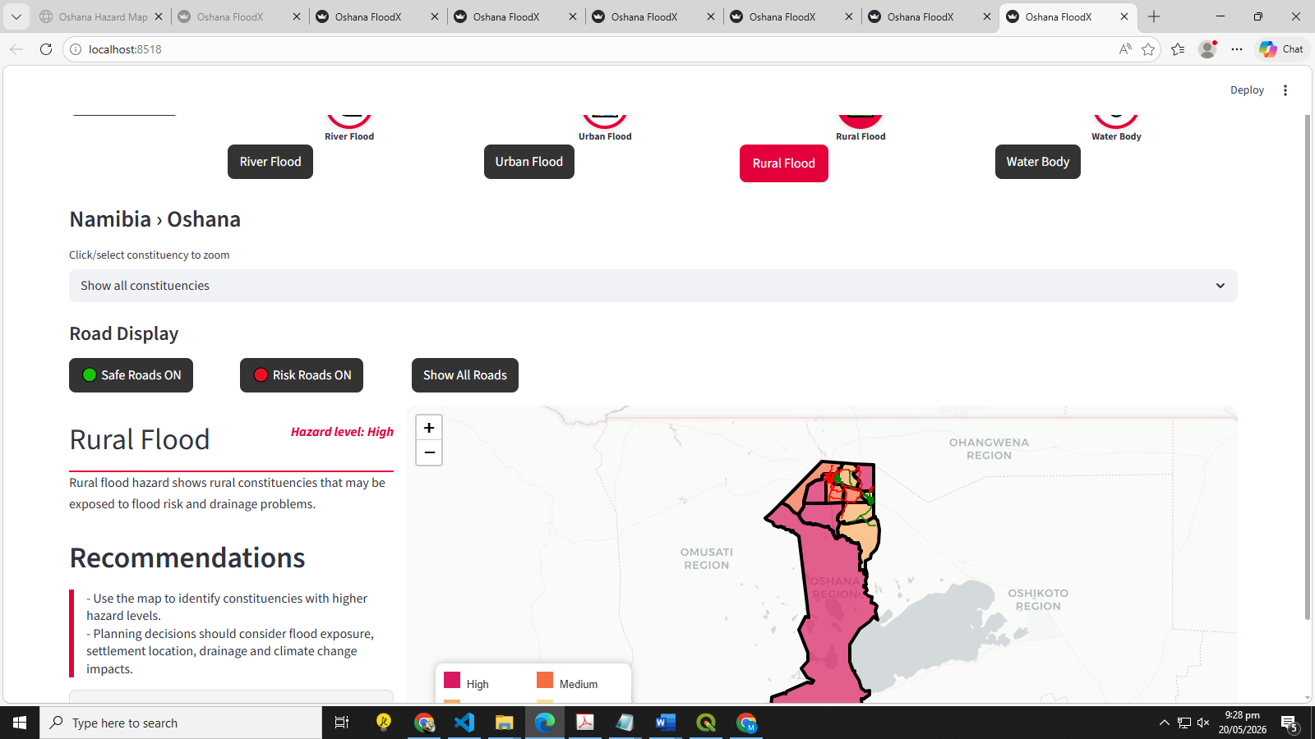
Project overview
What the application does for the user
Purpose
Displays flood hazard levels by Oshana constituency.
Allows users to switch between River, Urban, Rural and Water Body hazard views.
Classifies roads as Safe Road or Risk Road based on hazard exposure.
Supports constituency selection and click-to-zoom interaction.
Oshana FloodX | GIS Programming Project | 2

Slide 3
Main Python libraries
The app combines web interface tools with geospatial processing tools
Streamlit
GeoPandas
Builds the dashboard pages, buttons, select boxes and app state.
Reads KML/GeoDataFrames, manages CRS and spatial layers.
Pandas
Folium
Reads and cleans the roads CSV attribute table.
Creates the interactive Leaflet web map.
streamlit-folium
Shapely
Embeds the Folium map inside the Streamlit app.
Creates points, reads WKT geometry and tests intersects/contains.
Oshana FloodX | GIS Programming Project | 3

Slide 4
Data inputs and preparation
The app loads, cleans and simplifies geospatial layers before mapping
KML
CSV
CRS
Clean
Simplify
Oshana constituencies
Roads with WKT
Reproject to WGS84
Names + empty records
Faster web rendering
Key data-preparation decisions
Reliability checks
Constituencies are simplified to reduce loading time.
Roads are read from geometry_wkt and converted from EPSG:32733 to EPSG:4326.
Empty KMLs stop the app safely with an error message.
Invalid WKT rows are ignored instead of crashing the app.
Oshana FloodX | GIS Programming Project | 4

Slide 5
Application methodology
Step-by-step logic used in the system
1
Load spatial data
Read constituency KML and roads CSV.
2
Prepare geometry
Clean records, set CRS and simplify shapes.
3
Assign hazard levels
Use selected hazard type to color constituencies.
4
Classify roads
Roads intersecting High or Medium hazard areas become Risk Roads.
5
Display dashboard
Render the interactive map and update based on clicks/buttons.
Oshana FloodX | GIS Programming Project | 5

Slide 6
Hazard switching logic
Each icon changes the hazard layer shown on the map
🌊
🏙️
⛰️
💧
Session state
Map colors
st.session_state.hazard
High / Medium / Low
River
Urban
Rural
Water
When a user clicks an icon, Streamlit updates the hazard type.
The selected hazard type chooses a different list of hazard levels.
Folium redraws the constituency polygons using the new color classes.
current_levels = hazard_level_by_type.get(
st.session_state.hazard,
hazard_level_by_type["River Flood"]
)
level = current_levels[idx % len(current_levels)]
Oshana FloodX | GIS Programming Project | 6

Slide 7
Road risk classification
Road exposure is calculated using spatial intersection
Road geometry
Constituency polygon
Intersects?
Risk output
Line from CSV/WKT
Hazard class area
Spatial test
Red or green road
Risk Road rule
Safe Road rule
If a road intersects a High or Medium hazard area → Risk Road
If not exposed to High or Medium hazard areas → Safe Road
Oshana FloodX | GIS Programming Project | 7

Slide 8
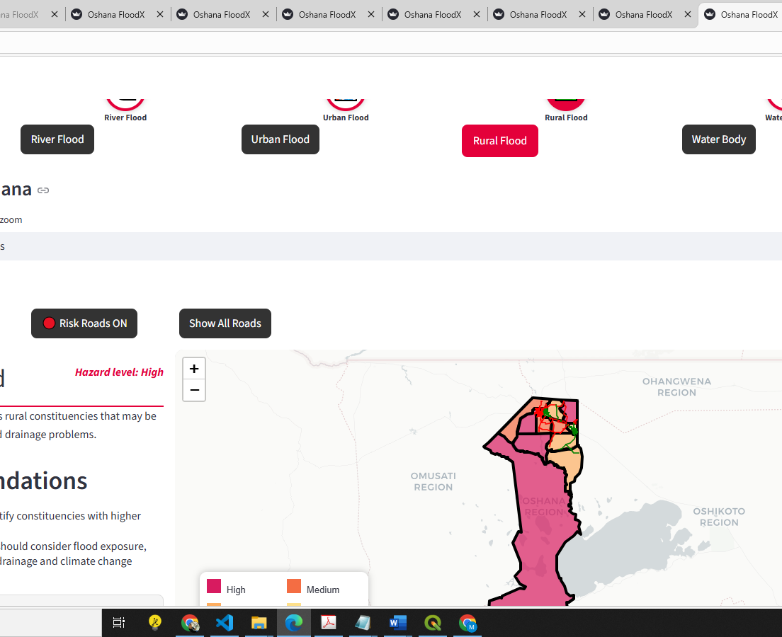
Dashboard interaction design
How users interact with the final app
User controls
Hazard icons update the active hazard layer.
Constituency dropdown zooms to a selected area.
Map click selects the clicked constituency.
Safe/Risk road buttons filter road visibility.
Legend explains hazard and road colors.
Oshana FloodX | GIS Programming Project | 8

Slide 9
Performance and crash-prevention choices
The code includes several practical safeguards
Caching
CRS handling
@st.cache_data avoids reloading files on every click.
Roads are converted from EPSG:32733 to EPSG:4326 for web mapping.
Geometry simplification
Empty geometry checks
Reduces rendering load for KML polygons and road lines.
Empty or missing geometries are removed before display.
Safe file loading
Streamlit state
try/except blocks prevent one broken file from crashing the whole app.
Session variables keep selected hazard, constituency and road filters stable.
Oshana FloodX | GIS Programming Project | 9

Slide 10
Final outputs and presentation points
What to demonstrate during assessment
Outputs produced
Demo script
Interactive Oshana hazard map.
Four hazard views linked to top icons.
Clickable and selectable constituency zoom.
Road classification: Safe Road and Risk Road.
Legend and dashboard recommendations.
Start on the home page and open the hazard map.
Click each hazard icon and show the map color changes.
Select one constituency and show zoom/filter behavior.
Toggle Safe/Risk Roads and explain the spatial intersection method.
End by explaining the libraries and methodology.
Oshana FloodX | GIS Programming Project | 10

